Slide 1
Ensemble Forecast Sensitivity to Observations (EFSO) and
Proactive Quality Control
Daisuke Hotta^{(2,1)}, Eugenia Kalnay⁽¹⁾,
Yoichiro Ota⁽²⁾, Takemasa Miyoshi^{(3,1)}
      ⁽¹⁾ University of Maryland
      ⁽²⁾ Japan Meteorological Agency
      ⁽³⁾ RIKEN, Kobe, Japan
Acknowledgements: NESDIS JPSS for support, JCSDA (Dr. Sid Boukabara) for access to
S4 supercomputer and Dr. Jung (NCEP) for advice

Slide 2
Today’s topics
EFSO (Ensemble Forecast Sensitivity to Observations) and “Proactive QC” (11 slides)
EFSR (Ensemble Forecast Sensitivity to Observation Error Covariance (R-matrix)) and Tuning of R (5 slides; preliminary work)

Slide 3
Part 1:
EFSO (Ensemble Forecast Sensitivity to Observations) and “Proactive QC”

Slide 4
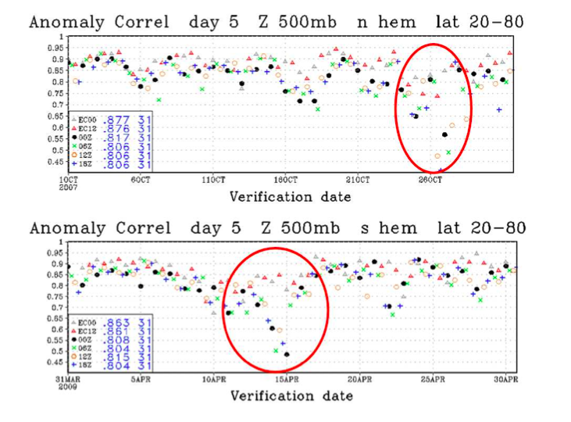
Motivation:
The NCEP “5-day skill dropout” problem
From Kumar et.al (2009)

Slide 5
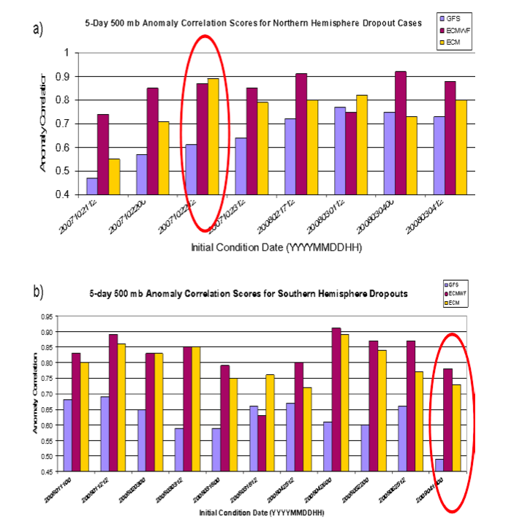

Introduction:
The NCEP “5-day skill dropout” problem
GFS-GSI (Operational)
ECMWF
GFS-GSI which assimilates “Pseudo-Obs” generated from ECMWF analysis
“Culprit” is not the model but “bad observations” (or inability of DA system to properly assimilate them)
→ How can we detect those “flawed” observations without resorting to an external system ?
From Kumar et.al (2009)

Slide 6
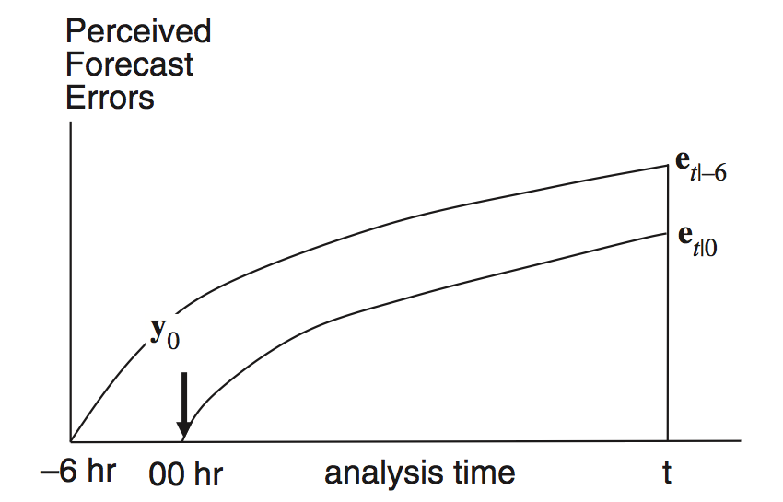

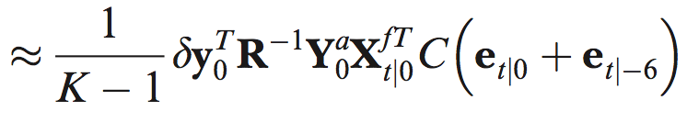
EFSO: Ensemble Forecast Sensitivity to Observations
Quantifies how much each observation improved/degraded the forecast
Economical alternative to OSE
First invented for a variational DA-system using the adjoint method by Langland and Baker (2004)
Liu and Kalnay (2008) adapted it to LETKF
Kalnay, Ota, Miyoshi and Liu (Tellus, 2012) has given an improved, simpler formulation
The new formulation is
  more accurate
  simpler and easier to implement
  applicable to any formulation of enKF
Reduction of forecast error
by the assimilation of obs.
O-B of the ens. mean
forecast spread
analysis spread in obs. space

Slide 7
“Proactive QC”
Run regular DA cycle from -06h to 00h
Run regular DA cycle from 00h to 06h
Perform 6-hour EFSO for 00h obs. to identify “flawed” obs.
If detected, repeat 00h analysis without using the detected obs.
Repeat ①-④ shifting the time

Slide 8
Key questions to be answered
Are 6 hours long enough for detecting “flawed observations”?
    When compared to errors of very short forecast, analysis errors might not be negligibly small, which makes estimation of the former more difficult.
What is the best criterion for rejection of observations?
    Rejecting too many observations might lead to forecast degradation, too few observations makes no difference. Where does the best balance reside?
Does rejection of those observations really improve analysis and forecast?

Slide 9
Experimental Set-up
System: NCEP’s operational GFS/hybrid GSI (lower-resolution version)
Resolution:
    T254L64 (deterministic)
    T126L64 (ensemble)
Analysis: hybrid GSI (3D-Var)
    EnKF part replaced by LETKF
  Assimilated Observations: same as the NCEP operation
  Period: 2012/01/10 00UTC − 2012/02/10 18UTC
  Spin-up period: 10 days from 2011/12/31 18UTC to 2012/01/09 18UTC
LETKF parameters
    Localization : cut-off length of 2800km (horizontal) and 2.0 x scale height (vertical)
    Background Covariance inflation: adaptive multiplicative “relaxation-to-prior” inflation (Zhang et.al 2004; MWR)
  EFSO parameters:
    localization scale: same as LETKF
    error norm: moist total energy norm

Slide 10
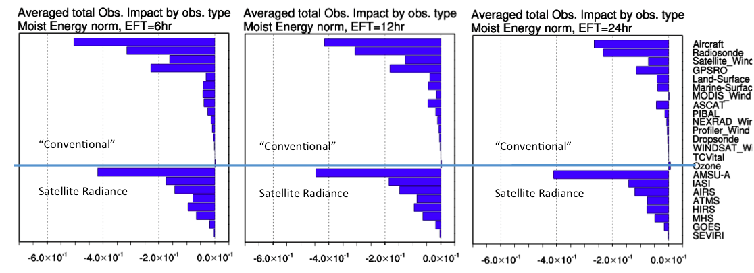
EFSO’s sensitivity to forecast lead time
(1) Time average
Average total observation impact classified by observation types
Lead-Time: 6 hrs
Lead-Time: 12 hrs
Lead-Time: 24 hrs
EFSO results are not very sensitive to the choice of evaluation lead time.

Slide 11
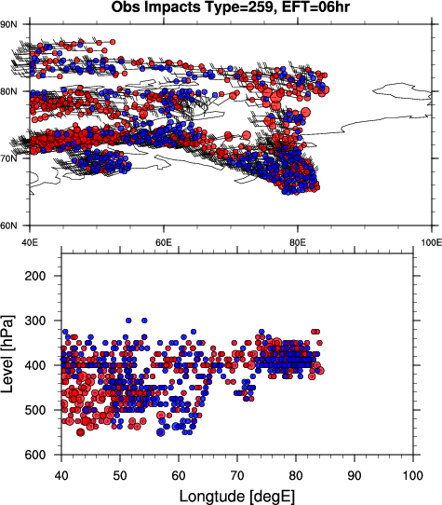
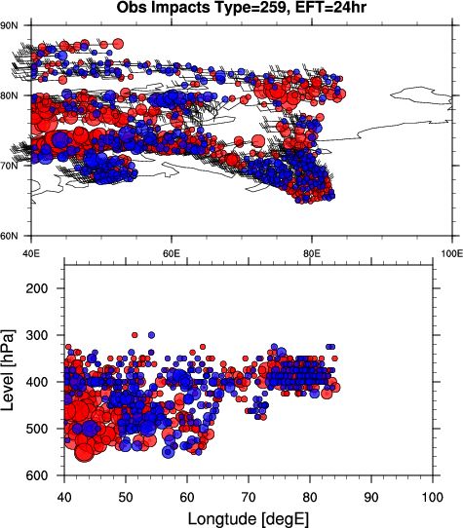
EFSO’s sensitivity to forecast lead time
(2) Individual Case
Example: MODIS wind near the North Pole on Feb 06 18UTC, 2012
Impacts of individual obs.
lead time 06h vs. 24h
Geographical distribution
Red: degradation; Blue: improvement
Lead-Time: 6 hrs
Lead-Time: 24 hrs
Again, EFSO results are not very sensitive to the choice of evaluation lead time, even for individual cases.
→ 6 hours are long enough for detection of “flawed” observations.

Slide 12
Key questions to be answered
Are 6 hours long enough for detecting “flawed observations”?
    → Yes!
What is the best criterion for rejection of observations?
    Rejecting too many observations might lead to forecast degradation, too few observations makes no difference. Where does the best balance reside?
Does rejection of those observations really improve analysis and forecast?

Slide 13
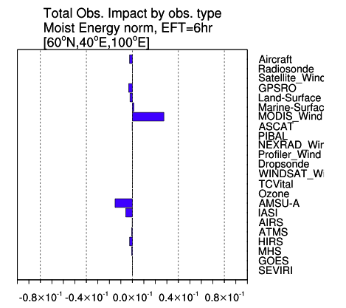
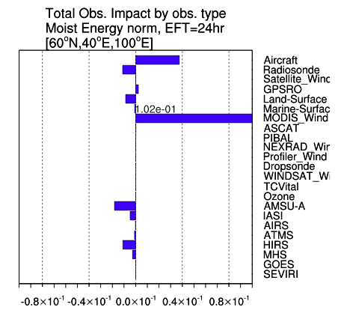
Data Denial EFSO Experiment
Example: Feb 06 18UTC, 2012, [60N-90N] x [40E-100E]
MODIS wind is estimated to have increased errors, both for 6hr- and 24hr- forecasts.
We try the following three cut-off strategies:
  RejectAllObs: Remove all observations of the detected type within the target domain, regardless of the EFSO impacts
  RejectAllNeg: Remove all observations of the detected type within the target domain that have negative impacts
  NetZero: Sort the observations of the detected type within the target domain based on the EFSO impacts, and remove observations from the one with largest negative impacts until the net impact becomes zero (neutral)
MODIS→
Improve←
→ Degrade
MODIS→
Improve←
→ Degrade

Slide 14
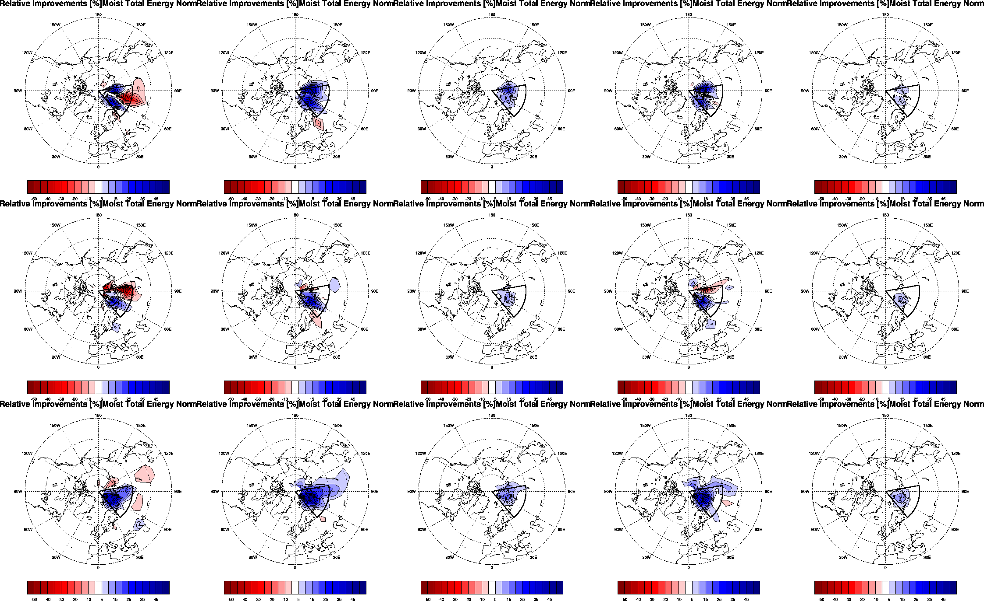
Relative improvement of forecast errors defined by
(e_{before QC} – e_{after QC} )/ e_{before QC} x 100 [%]
Red: degradation; Blue: improvement
6hr EFSO
suspect=MODIS
24hr EFSO
suspect=MODIS, Aircraft
RejectAllObs
RejectAllNeg
NetZero
RejectAllNeg
NetZero
FT=06
FT=12
FT=24

Slide 15
Key questions to be answered
Are 6 hours long enough for detecting “flawed observations”?
    → Yes!
What is the best criterion for rejection of observations?
  → Somewhere Between RejectAllNeg and NetZero (still to be explored)
Does rejection of those observations really improve analysis and forecast?
    → Yes!

Slide 16
Summary for Proactive QC
“Flawed” observations that potentially lead to forecast skill dropouts can be detected by EFSO diagnostics after only 6 hours from the analysis.
Repeating the analysis without using the detected “flawed” observations (Proactive QC) indeed does improve forecast and analysis
In operational forecasting system, having to wait 6 hours after analysis might be a bottleneck, but for reanalysis, this should not be a problem.
  Having the flawed observations plus metadata will help algorithm developers.
  Could be used for the “final” (delayed) analysis
  → Can be a powerful tool for improving reanalysis

Slide 17
Part 2:
EFSR (Ensemble Forecast Sensitivity to Observation Error Covariance (R-matrix)) and Tuning of R

Slide 18
Motivation
Data Assimilation (DA) combines information from background and observations with an “optimal weight”.
The “optimal weight” is determined based on the background- and observation- error covariances B and R, which are prescribed external parameters for DA systems.
For a long-term reanalysis, the quality of the background and observations cannot be assumed to be constant over time.
→ We need a tuning technique for B and R, which can be particularly important for reanalysis.

Slide 19
EFSR Formulation
Daescu and Langland (2013, QJRMS)
proposed an adjoint-based formulation of forecast sensitivity to B and R matrix.
For R-sensitivity, we can easily formulate its ensemble equivalent using EFSO by Kalnay et.al (2012) :
Limitation: EFSR diagnostics only indicates whether we should increase or decrease R. No indication is available as to how much we should change.

Slide 20
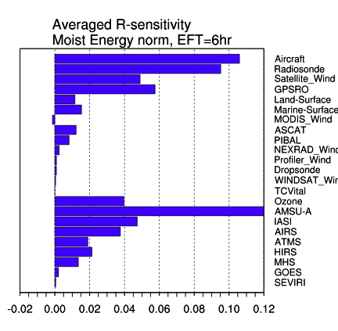
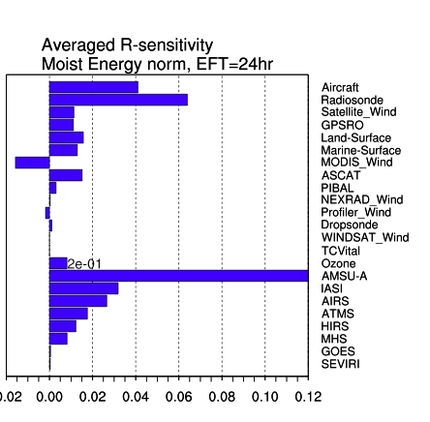
Result from GFS / GSI-LETKF hybrid
Aircraft →
Radiosonde →
MODIS wind →
AMSU-A →
Positive value: error increases as σ_{o}² increases → should decrease σ_{o}²
Aircraft, Radiosonde and AMSU-A: large positive sensitivity
MODIS wind : negative sensitivity
→ Tuning experiment:
  Aircraft, Radiosonde and AMSU-A: scale σ_{o}² by 0.9
  MODIS wind: scale σ_{o}² by 1.1

Slide 21
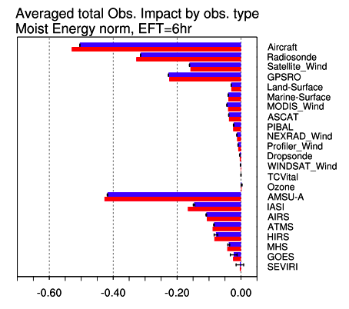
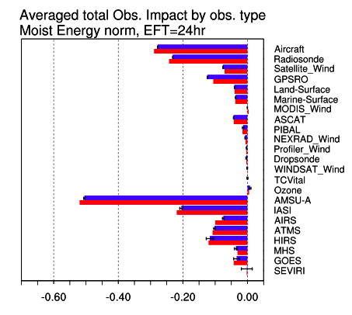
Tuning Experiment: Result
EFSO before/after tuning of R
Aircraft →
Radiosonde →
MODIS wind →
AMUS-A →
(IASI) →
Aircraft, Radiosonde and AMSU-A: significant improvement of EFSO-impact
MODIS wind : insignificant difference in EFSO
  MODIS had “flawed” obs. along with “helpful” obs. The “flawed” obs. might have resulted in incorrect estimation of EFSR.
IASI: Significant improvement in EFSO although its error covariance is untouched !

Slide 22
Summary for EFSR
EFSR gives information on whether we should increase/decrease prescribed observation error covariance R.
Tuning of R based on this diagnostics improves observational impact on forecast.
We verified this on a real (quasi-operational) system!

