Slide 1
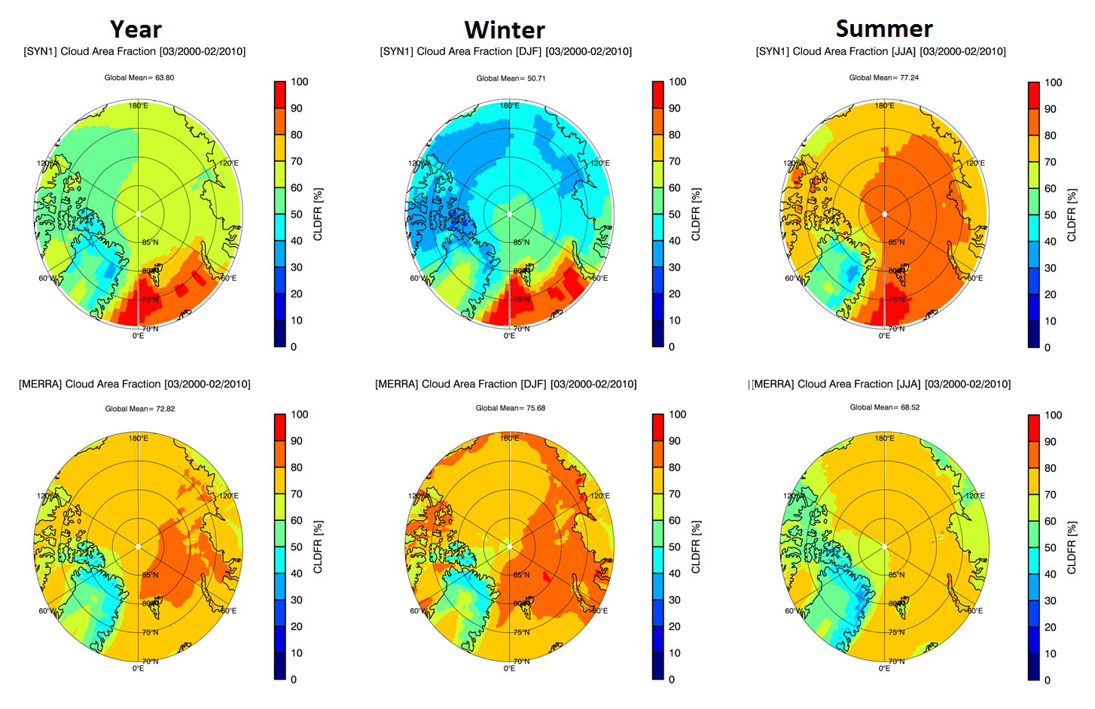
Quantifying the uncertainties of reanalyzed Arctic cloud-radiation properties using satellite data (Dong)
MODIS
MERRA
MERRA annual mean CF is 9% higher than MODIS observed one (72.8% vs. 63.8%), significantly higher during winter (75.7% vs. 50.7%), and lower during summer (68.5% vs. 77.2%). But MODIS CF is underestimated during winter.

Slide 2
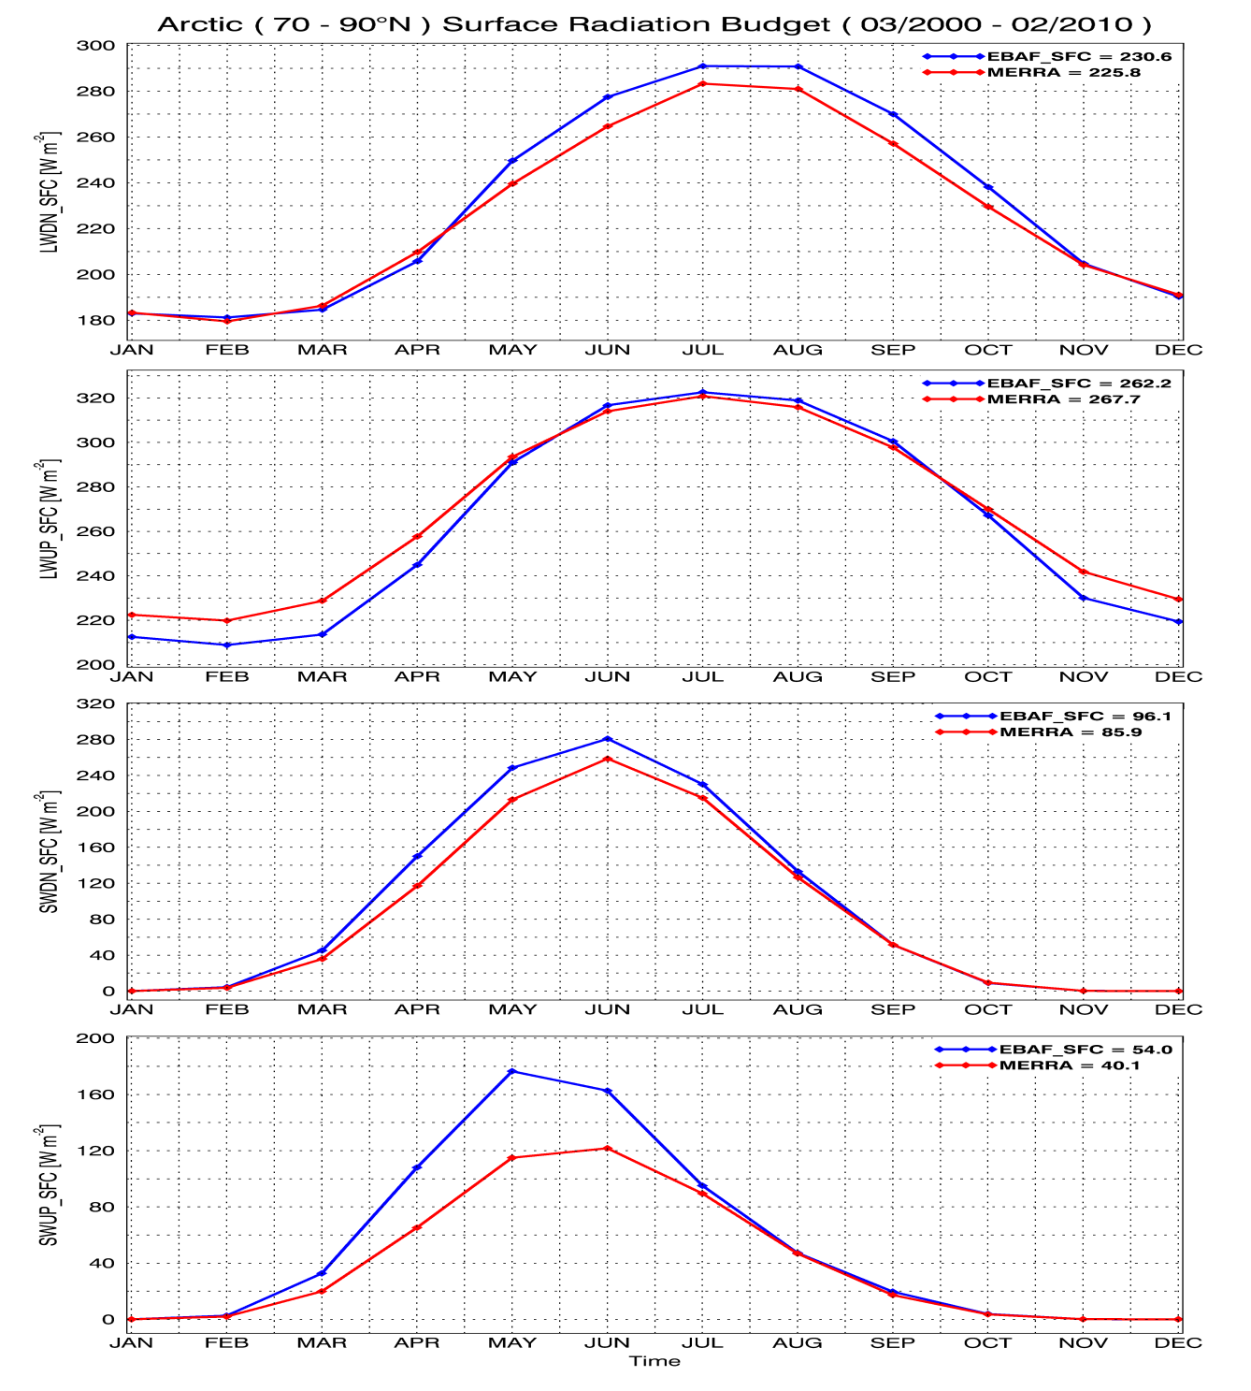
Quantifying the uncertainties of reanalyzed Arctic cloud-radiation properties using satellite data (Dong)
Monthly mean surface
downwelling and upwelling LW and SW flux comparisons between CERES EBAF and MERRA over Arctic region during 2000-2010.
The differences in SWdown and LW fluxes are much less than their SWup comparison because MERRA snow/
ice albedo was fixed at 0.6, while the observed ones can be up to 0.8-0.9. (Dong et al. 2013, Clim Dyn)

