Slide 1




A Hybrid Ocean Assimilation System at NCEP
Prof. Stephen G. Penny
Dept. of Atmospheric and Oceanic Science
University of Maryland, College Park
Visiting Scientist, National Centers for Environmental Prediction (NCEP/NOAA)
06/25/2014

Slide 2
Results with NCEP’s Global Ocean Data Assimilation System (Hybrid-GODAS)
This work is funded by NOAA’s Modeling, Analysis, Predictions and Projections (MAPP) program as part of the “Research to Advance Climate Reanalysis”.
Intent:
  Upgrade NCEP’s operational global ocean data assimilation system (GODAS) from 3D-Var to an ensemble-based system.
  Advance ocean assimilation component of the next generation Climate Forecasting System (CFS) (i.e. coupled atmos/ocean/ice/land)
Notes:
Integrate with the new Climate Forecast System (CFSv3) being developed at NOAA to benefit the next-generation climate reanalysis

Slide 3
Experiment 2: OSSE
Duration:
8 Years (Jan. 1991- Dec. 1998)
Model:
GFDL MOM4p1, 1/2º-1/4º, 40-vertical level
Observations:
Synthetic Temperature and Salinity profiles (XBT/CTD historical locations) with realistic magnitude observation errors (representativeness + instrument errors)
Surface forcing:
28-member 20th Century Reanalysis (20CRv2: Compo, Whitaker, et al. 2011),
re-centered at NCEP R2 (members 1-28 selected from 56 after re-centering)
Inflation:
none
Horizontal Localization:
Latitude dependent: 720km at Eq. down to 200km at poles
Vertical Localization:
none (=> more accurate, computationally faster, & facilitates use of satellite data)
Initialization:
6-year spinup from Jan 1st 1985 CFSR ocean state (same for all 56 members), forced by re-centered 56-member 20CRv2

Slide 4
EnKF and 3DVar for Hybrid:
EnKF is the Local Ensemble Transform Kalman Filter (LETKF) of Hunt et al. (2007), modified for the ocean by Penny (2011)
Operational 3DVar-GODAS (Behringer)
Modifications to operational system:
    Only using obs in the analysis cycle window
    Analysis increment applied at analysis time AND Incremental Analysis Updates (IAU) (both cases run)
    Not using synthetic salinity observations
    Relaxing surface to OI SST (as done by operational system and applied in nature run)
Nature run uses 56-member mean surface forcing (R2) for slight model bias vs. 28-member ensemble subset

Slide 5
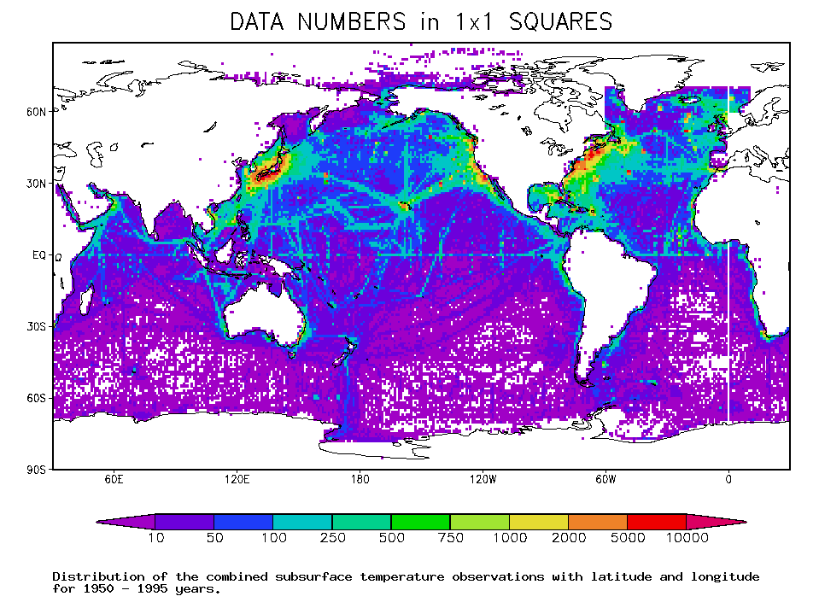
(Carton et al. 2000)

Slide 6
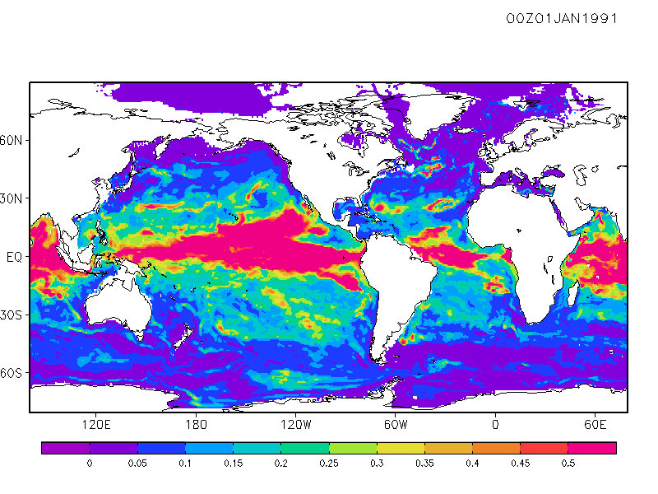

Temperature ens. spread, 100 m

Slide 7
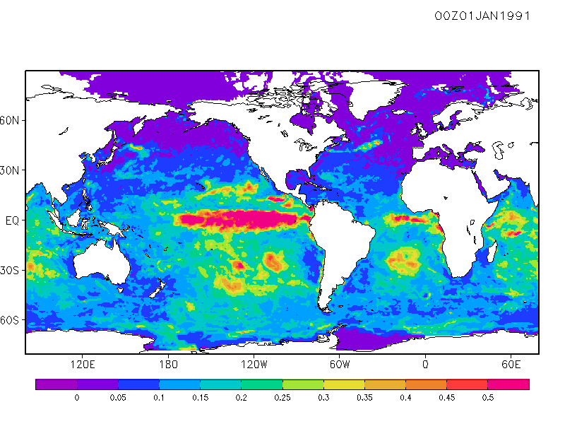

SST ens. spread

Slide 8
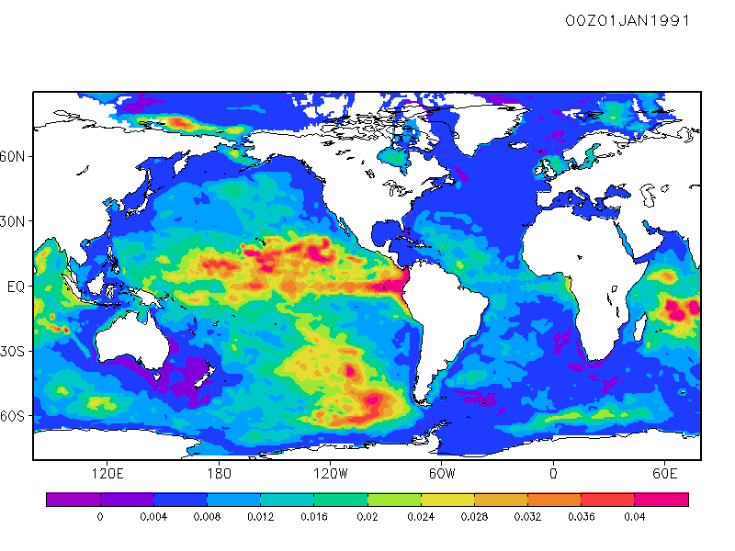

SSH ens. spread

Slide 9
North Pacific RMSE
ºC
3DVar-GODAS
m
SST
SSH
Hybrid-GODAS
ºC
psu
Temp (0-700m)
Salinity(0-700m)

Slide 10
North Pacific RMSE
psu
3DVar-GODAS
SSS
Hybrid-GODAS
m/s
m/s
U(0-700m)
V(0-700m)

Slide 11
North Atlantic RMSE
ºC
m
SST
SSH
ºC
psu
Temp (0-700m)
Salinity(0-700m)

Slide 12
Tropical Pacific RMS Errors
ºC
m
SST
SSH
ºC
psu
Temp (0-700m)
Salinity(0-700m)

Slide 13
Tropical Atlantic RMS Errors
ºC
m
SST
SSH
ºC
psu
Temp (0-700m)
Salinity(0-700m)

Slide 14
Indian Ocean RMS Errors
ºC
m
SST
SSH
ºC
psu
Temp (0-700m)
Salinity(0-700m)

Slide 15
South Pacific RMSE
ºC
m
SST
SSH
ºC
psu
Temp (0-700m)
Salinity(0-700m)

Slide 16
South Atlantic RMSE
ºC
m
SST
SSH
ºC
psu
Temp (0-700m)
Salinity(0-700m)

Slide 17
Conclusions
Experiments with Hybrid-GODAS using synthetic observation data show the Hybrid consistently outperforms the operational 3DVar.
In well-observed regions, the Hybrid outperforms the Control case (3DVar with perfect Initial Conditions and Forcing)
The Hybrid shows considerable improvement during the strong 97-98 ENSO period.
Next steps:
  Inclusion of satellite data: altimetry (later: gravity, SST, SSS)
  Seasonal forecast experiments with CFS to validate Hybrid vs. 3DVar initial conditions
  1-month concurrent run with operational system for validation prior to operational implementation

Slide 18
Thank You
Steve.Penny@noaa.gov

Slide 19
LETKF
The Local Ensemble Transform Kalman Filter of Hunt et al. (2007)
  Defining terms:
analysis ensemble mean
background (b.g.) ensemble mean
analysis ens.
b.g. perturbations
b.g. error covariance
observation error covariance
b.g. error covariance in ens. subspace
observation operator
k := ensemble dimension
l := observation dimension
m := model dimension
innovation

Slide 20
LETKF
The Local Ensemble Transform Kalman Filter of Hunt et al. (2007)
  To reduce computational burden, the analysis is computed in the k-dimensional subspace formed by the k ensemble members.
  To reduce the required sample size of ensemble members, localization is applied.
“Observation Localization”

Slide 21
Combined Kalman Gain
The general linear gain matrix K is defined as:
The traditional hybrids define a linearly combined error covariance matrix. Suppose instead we form a combination of their respective gain matrices:
Notes:
I do not claim this is optimal (or that it is even possible to find an optimal K with no knowledge of the accuracy of Pb or B).
This provides a minimum rank to K, which is important since Kp will reduce in rank with k and l.

Slide 22
Hybrid-LETKF
Choose the coefficients:
β₁ = 1
β₂ = α
β₃ = -α
where α is a constant scaling parameter so that,
This allows us to form the following algorithm:
Penny, 2013: The Hybrid Local Ensemble Transform Kalman Filter. Mon. Wea. Rev., doi: http://dx.doi.org/10.1175/MWR-D-13-00131.1.
Notes:
I do not claim this is optimal (or that it is even possible to find an optimal K with no knowledge of the accuracy of Pb or B).
This provides a minimum rank to K, which is important since Kp will reduce in rank with k and l.

Slide 23
Hybrid/Mean-LETKF Algorithm
Standard-LETKF
Analysis is performed locally at each grid point, using any specified radius of localization
Use 3D-Var minimization to search larger dimension subspace around the LETKF analysis
3D-Var
Since B is an overestimate of the analysis error, backtrack toward the LETKF analysis solution

Slide 24
Hybrid/Mean-LETKF Algorithm
Standard-LETKF
Analysis is performed locally at each grid point, using any specified radius of localization
This is essentially the only coding required, which can be applied directly to restart files with no modification of existing operational code.
Use 3D-Var minimization to search larger dimension subspace around the LETKF analysis
3D-Var
I.e. Since B is an overestimate of the analysis error, backtrack toward the LETKF analysis solution

Slide 25
Experiment 1: Real Data
Duration:
14 Months (Dec. 2010 - Feb. 2012)
Model:
GFDL MOM4p1, 1/2º-1/4º, 40-vertical level
Observations:
Temperature and Salinity profiles (Argo)
Surface forcing:
20-member NCEP Global Ensemble Forecast System (GEFS)
Inflation:
none
Horizontal Localization:
Latitude dependent: 720km at Eq. down to 200km at poles
Vertical Localization:
none (=> more accurate, computationally faster, & facilitates the assimilation of satellite data)
Initialization:
Center is the GODAS operational estimate. Scaled perturbations were applied from randomly selected historical fields for ensemble

Slide 26
EnKF and 3DVar for Hybrid:
EnKF is the Local Ensemble Transform Kalman Filter (LETKF) of Hunt et al. (2007), modified for the ocean by Penny (2011)
Operational 3DVar-GODAS (Behringer)
Modifications to operational system:
    Only using obs in the analysis cycle window
    Analysis increment applied at analysis time, i.e. no Incremental Analysis Updates (IAU)
    Not using synthetic salinity observations
    Not relaxing surface to OI SST

Slide 27
Before Implementing the Hybrid
Recall:
LETKF-GODAS (2012)
3DVar-GODAS
1st month of experiment starting 12/02/2010 with real data,
assimilation cycle every 5 days, 20 members

Slide 28
Global Temperature and Salinity Observed minus 5-dy Forecast (O-F) RMSD
Using the Hybrid
α = 1.0
3DVar-GODAS
Temperature
Salinity
Hybrid-GODAS

Slide 29
Pacific T & S (O-F)
3DVar-GODAS
α = 1.0
North (20-60ºN)
Hybrid-GODAS
Temperature
Salinity
Tropical (20ºS-20ºN)
South (20-60ºS)

Slide 30
Atlantic T & S (O-F)
3DVar-GODAS
α = 1
North (20-60ºN)
Hybrid-GODAS
Temperature
Salinity
Tropical (20ºS-20ºN)
South (20-60ºS)

Slide 31
T & S (O-F)
α = 1
3DVar-GODAS
Arctic (60-90ºN)
Note: not assimilated by operational 3DVar-GODAS
Hybrid-GODAS
Temperature
Salinity
Indian (60ºS-20ºN)
Southern Ocean (60-90ºS)

Slide 32
Possible Weaknesses
Ensemble spread is too small
  Ensemble size too small
  Surface forcing spread too small (esp. horizontal wind stress)
Validation using 5-dy forecast (O-F) RSD may be influenced by temporal correlations on daily to weekly timescales
Initial Ensemble spread not realistic or initial states not well-balanced
Experiment period too short

