Slide 1


Proposal Title:
Diagnosing and quantifying uncertainties of
the reanalyzed clouds, precipitation and
radiation budgets over the Arctic and SGP
using combined surface-satellite observations
PI: Xiquan Dong, Uni. of North Dakota
Co-Is: Baike Xi and Aaron Kennedy
Three Graduate Students:
Emily Qiu, first year’s Ph.D student
Erica Dolinar, second year’s MS student
Ron Stenz, second year’s MS student
Both Erica and Ron will work on this
project for their Ph.D degree next fall

Slide 2
Objectives
Objective 1: Quantifying the uncertainties of reanalyzed Arctic cloud-radiation properties using satellite-surface data
Objective 2: Investigating the reanalyzed hydrological cycle at SGP

Slide 3
Anticipated Results
We will use an innovative diagnostic method to
quantify the uncertainties of reanalyzed cloud-radiation-precipitation,
compare the five reanalyzed results with observations, find their similarities and differences, and
investigate how these differences relate to large-scale dynamic patterns and variables using the Self Organizing Maps (SOM) method.

Slide 4
Reanalyses and Datasets
Reanalyses: (i) CFSv3, (ii) 20CR, (iii) MERRA,
(iv) ERA-I, and (v) JRA-25.
Datasets:
a) Satellite observations:
➔CERES EBAF: TOA and surface radiation fluxes
➔CERES-MODIS: Cloud properties: CF, LWP/IWP, re.
➔CloudSat/CALIPSO (CC): CF, LWP/IWP, re.
➔TRMM and GPCP precipitation products over SGP
b) Surface observations
➔Cloud-Precipitation Products at SGP: UND hybrid radar/GOES cloud-precipitation product, Oklahoma Mesonet, and NEXRAD Q2.
➔DOE ARM NSA and SGP cloud and radiation data
➔BSRN and other surface observations over Arctic

Slide 5
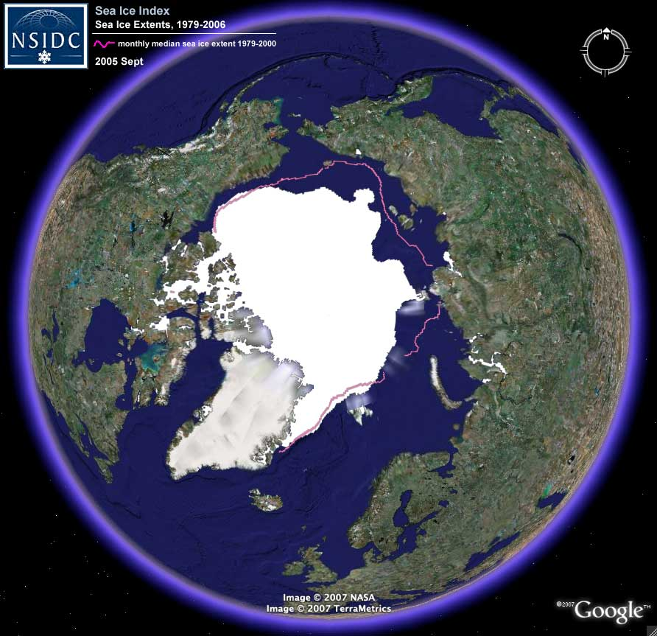
ARM and BSRN Surface Sites
BSRN Sites:
Event | Time
Alert (ALE) | 09/2004-08/2013
Barrow (BAR) | 01/1992-02/2010
Eureka (EUR) | 11/2007- 12/2011
Greenland Summit (GRS) | No data available yet
Tikisi (TIK) | 06/2010- 09/2013
Ny-Ålesund (NYA) | 08/1992- 02/2012
Atqasuk
BAR
Oliktok
TIK
EUR
ALE
GRS
NYA
ARM Sites:
Event | Time
Barrow (BAR) | 05/1998-04/2011
Atqasuk | 06/2000-01/2010
Oliktok | 09/2013-12/2013

Slide 6
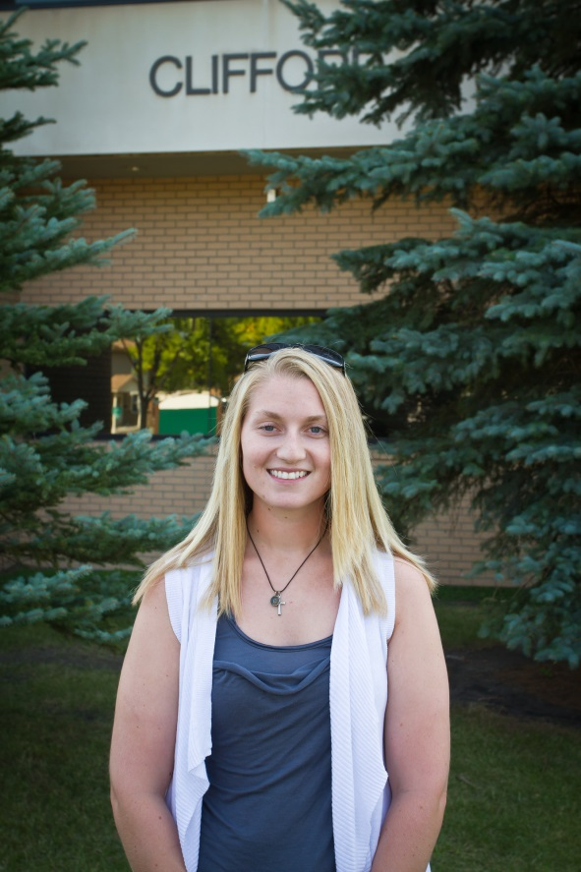

Objective 1: Quantifying the uncertainties of reanalyzed Arctic cloud-radiation properties
There are two tasks for this Objective
Task 1: : Compare the reanalyzed cloud fractions and TOA/
surface radiation budgets over arctic region using NASA CERES Ed4 results during the period 2000-2011, and CloudSat/CALIPSO (CC) during 2006-2010.
Task 2: Investigate the reanalyzed Cloud and surface radiation fluxes at ARM and BSRN surface sites.
Task 1 will be performed by Ms. Erica Dolinar. She is currently
evaluating CMIP5 CF and radiation budgets using CERES-MODIS and CC.
(Dolinar et al. 2013, Clim Dyn)
Task 2 will be performed by Ms. Emily Qiu. She is currently working on validating CERES-MODIS cloud retrievals using ARM NSA
observations over Arctic region.

Slide 7
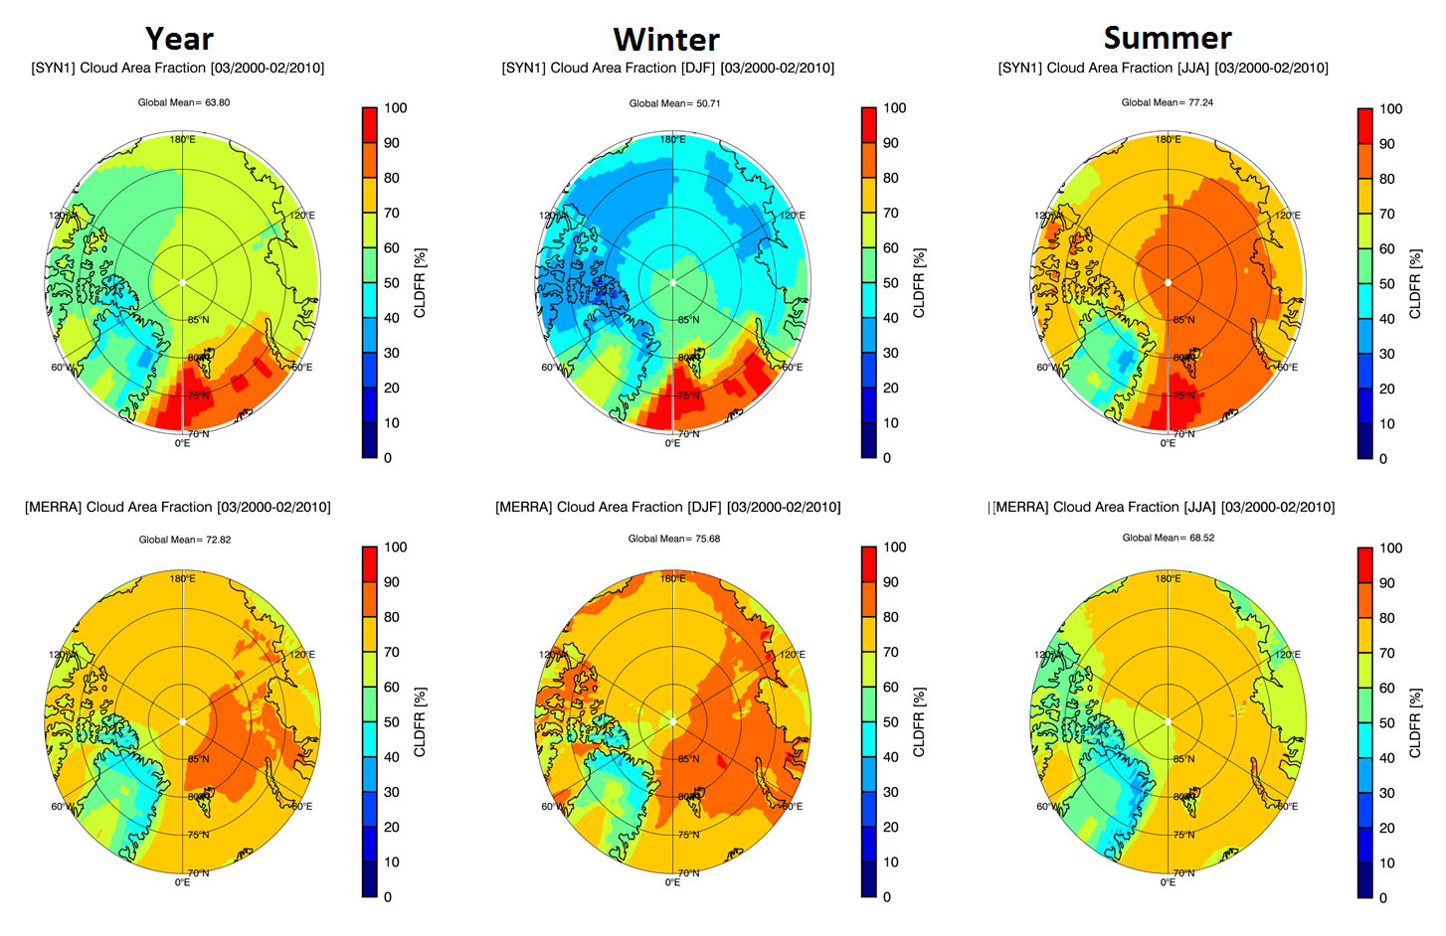
Task 1: : Examples with Satellites
MODIS
MERRA
MERRA annual mean CF is 9% higher than CERES-MODIS observed one (72.8% vs. 63.8%), significantly higher during winter (75.7% vs. 50.7%), and lower during summer (68.5% vs. 77.2%). However, MODIS is not perfect.

Slide 8
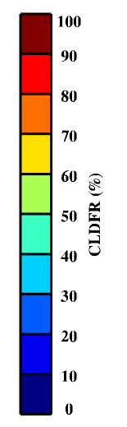
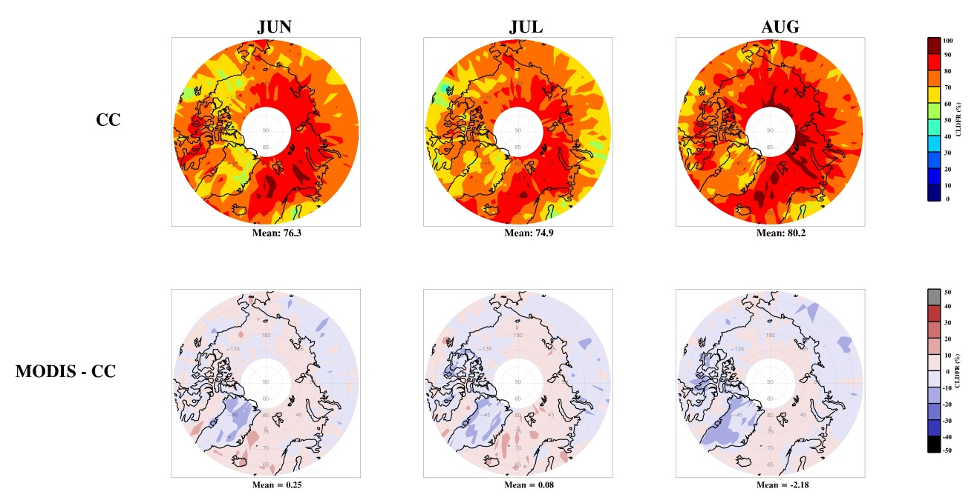
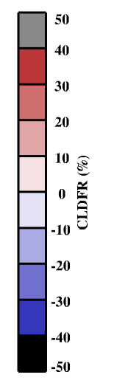
Cloud Fraction Comparison between MODIS and CC
Summer
Mean = 76.3%
Mean = 74.9%
Mean = 80.2%
Mean = 0.25%
Mean = 0.08%
Mean = -2.18%
During the summer months, CERES-MODIS derived total CFs agree with CloudSat/CALIPSO (CC) very well, in general, remain within 10% of active CC measurements
(Giannecchini, MS thesis, 2012)

Slide 9
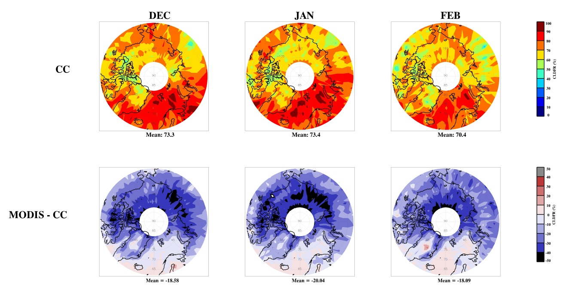
Cloud Fraction Comparison between MODIS and CC
Winter
Mean = 73.3%
Mean = 73.4%
Mean = 70.4%
Mean = -18.6%
Mean = -20.0%
Mean = -18.1%
CERES-MODIS results agree well with CC across the Greenland and Barents Seas, but over central Arctic region, CERES-MODIS underestimates CFs about 30-40% due to Polar night.

Slide 10
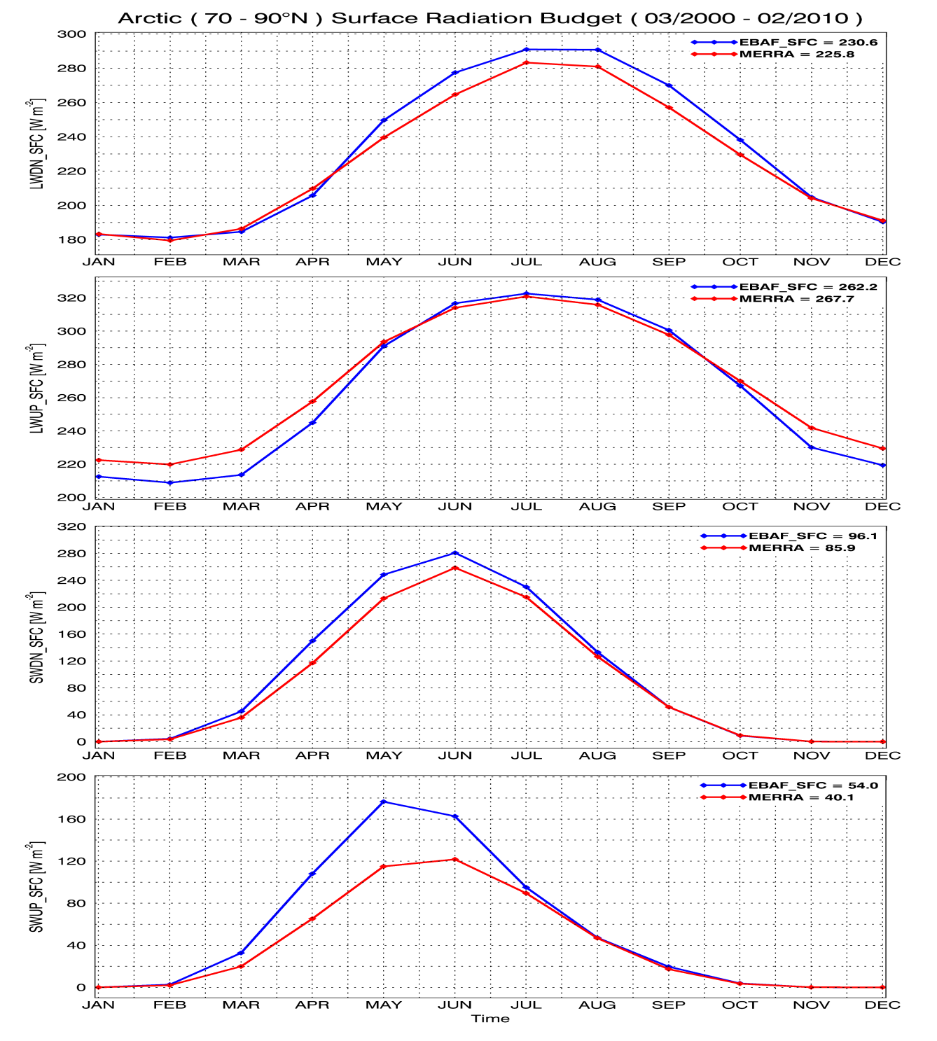
Arctic surface radiation budget
Monthly mean surface
downwelling and upwelling LW and SW flux comparisons between CERES EBAF and MERRA over Arctic region during 2000-2010.
The differences in SWdown and LW fluxes are much less than their SWup comparison because MERRA snow/
ice albedo was fixed at 0.6, while the observed ones can be up to 0.8-0.9. (Dong et al. 2013, Clim Dyn)

Slide 11
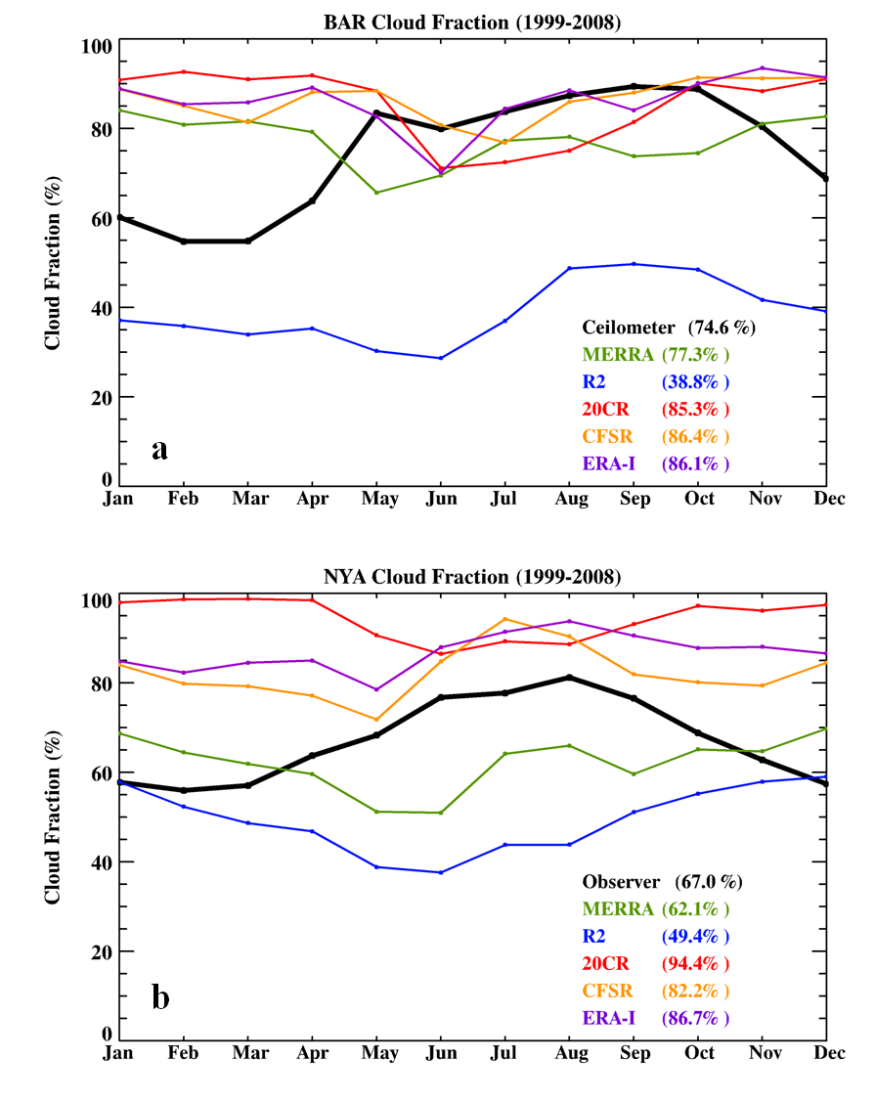
Task 2: : Examples with surface
Monthly mean CF from the ARM NSA ceilometer increases from March to May, remains high from May to October, and then decreases from November until the following March. Four of five reanalyses (MERRA, 20CR, CFSR, and ERA-I) have minimal seasonal variations in their reanalyzed CF. They are similar in magnitude to the observed CF from May to October, but have large positive biases (+15% → +40 %) from November to April.
R2 stands out with large negative biases (-35.8%).
(Zib et al. 2012, J Clim)
ARM NSA site

Slide 12
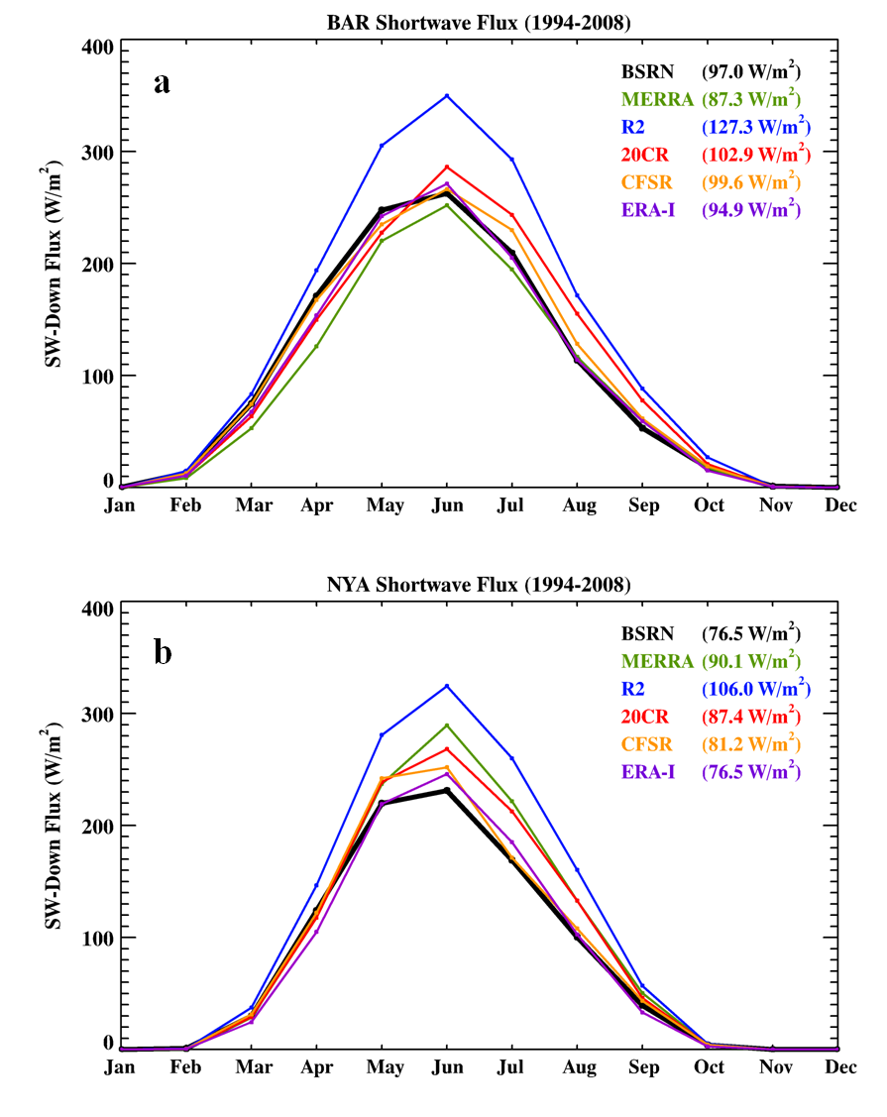
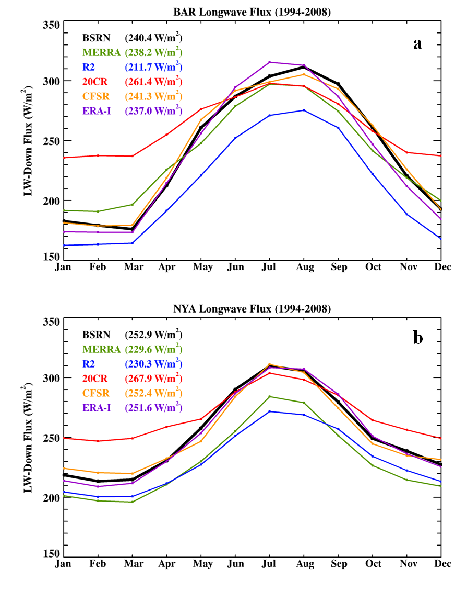
Task 2: : Examples with surface
With large negative bias in CF, R2 SW-down is much higher and LW_down is much lower than ARM observations.
Other four reanalyzed SW_down and LW_down fluxes agree well with ARM observations except for LW_down winter 20CR.
(Zib et al. 2012, J Clim.)
Summary:
Compared to satellite and surface data, there are large temporal and spatial variations in reanalyses. It is necessary to quantify their biases and uncertainties.
ARM NSA site

Slide 13
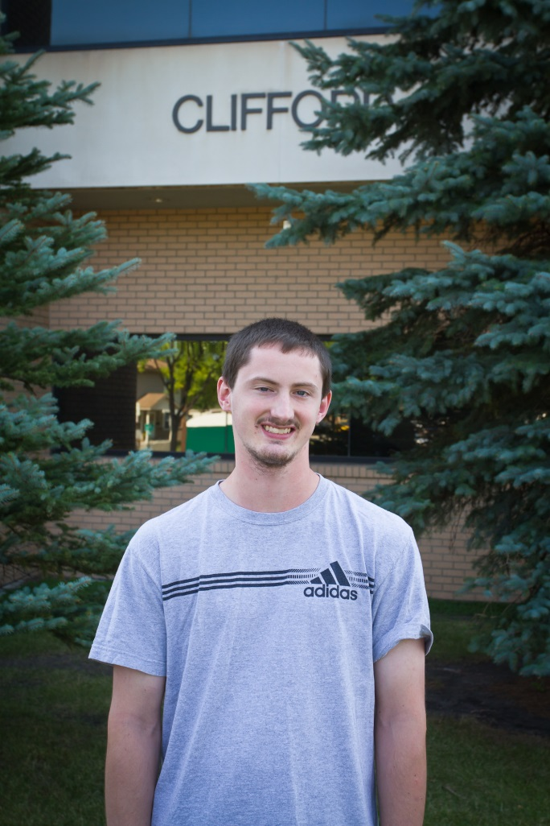
Objective 2: Investigating the reanalyzed hydrological cycle at SGP
We will compare monthly mean cloud fractions and total precipitations from five selected reanalyses with different observational platforms, such as ARM, Oklahoma mesonet, NEXRAD Q2, GPCP, TRMM, and UND hybrid radar/GOES product over the SGP region during the period 1997-2013.
It is challenge to evaluate the reanalyzed lifetime and diurnal cycles of Deep convective systems, and their associated precipitation rate and areal coverage from each reanalysis.
This objective will be performed by Mr. Ron Stenz. He is currently
improving GOES-R precipitation retrievals using UND hybrid radar/GOES product, OK mesonet and NEXRAD Q2 product.
(Stenz et al. 2013, J. Hydrometeo)

Slide 14
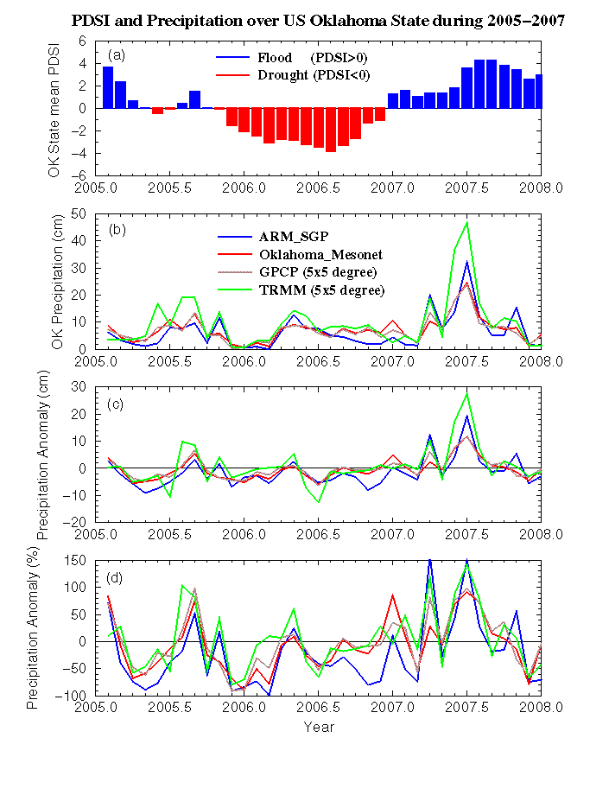
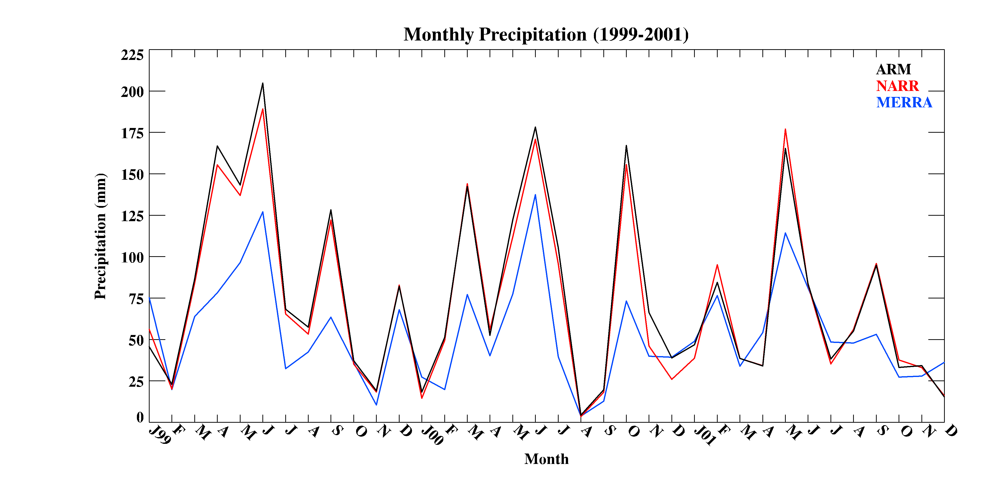
Precipitation comparisons are straighforward
Kennedy et al 2011, J. Clim
Kennedy et al. 2011, J. Clim
Dong et al 2011, JGR

Slide 15
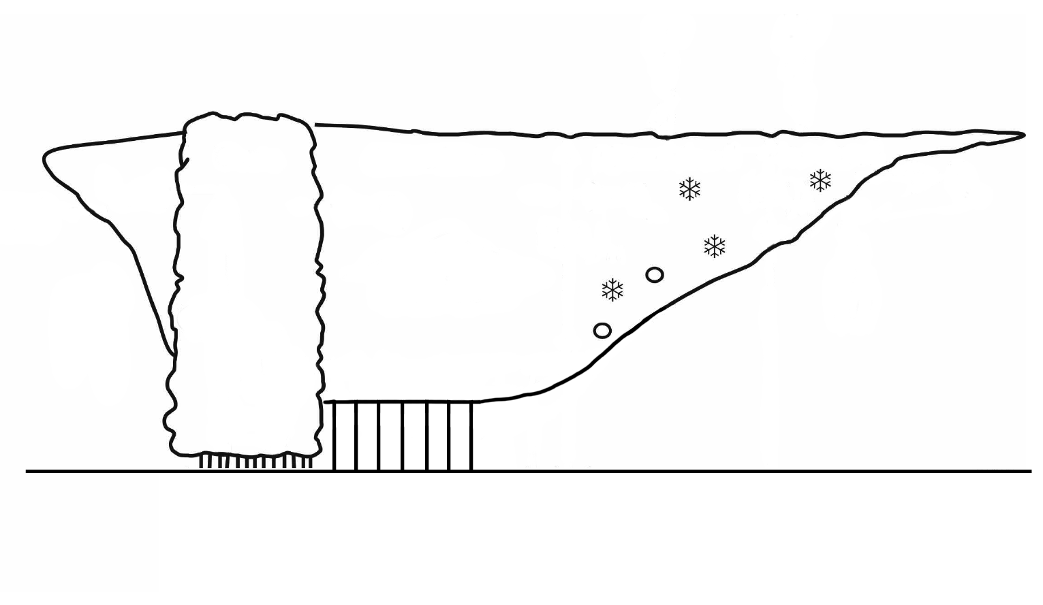


Cold Cloud Shield (GOES)
NEXRAD
GOES
Thick Anvil
Convective
Stratiform
Deep Cloud
Thick Anvil
Thin Anvil
E_{ce}
C_{T}
E_{se}
E_{se}
E_{ce}
C_{cu}
C_{su}
Mid-Level
E_{cd}
Low-Level
E_{sd}
Total Anvil
Precipitation
Total Anvil
Feng et al. (2011) JGR

Slide 16
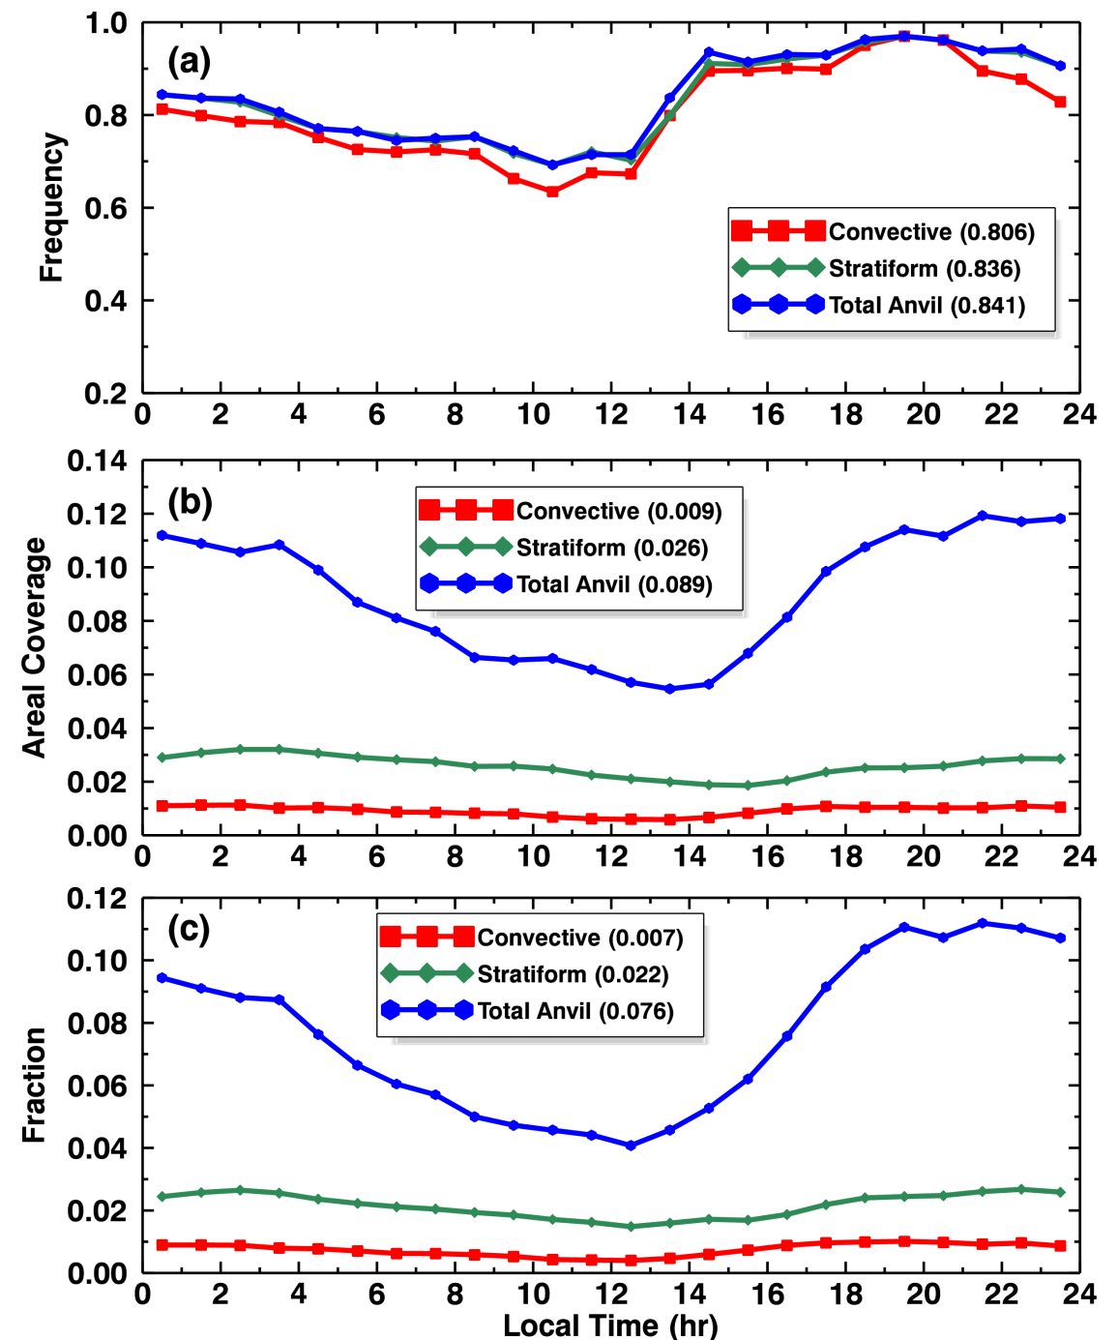
Diurnal Cycle of DCS Cloud Fraction
Local Noon
Time period:
May-Aug, 2010-2011,
~ 4000 DCSs , hourly data
Domain: SGP Oklahoma
Color lines: CC, SR, AC
Freq: peak right after sunset for CC/SR/AC
Area: AC dominates area cover. CC peaks at late afternoon, SR/AC peak between evening and midnight
Cloud Fraction CF
= Freq. × Area Coverage
Peak of SR/AC CFs consistent with nocturnal MCS over SGP region
Frequency
Area
CF
CF
Feng et al. 2011
Notes:
Introduce each color, will be consistent for this section

Slide 17
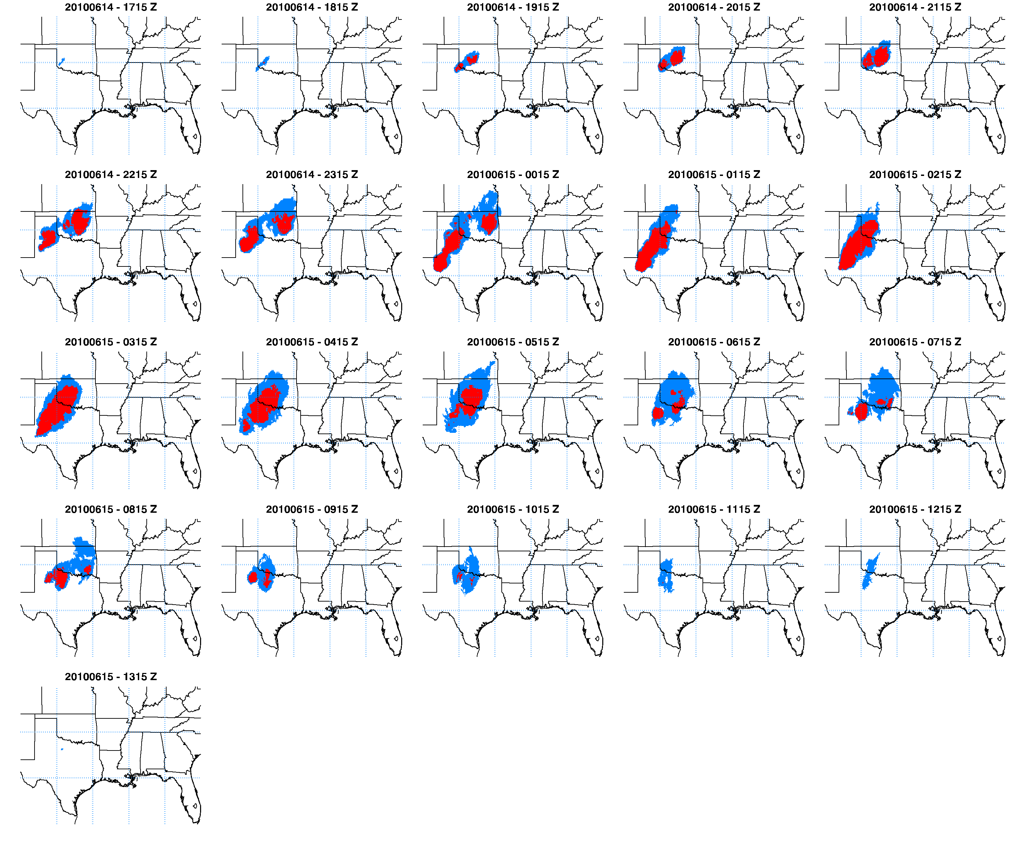
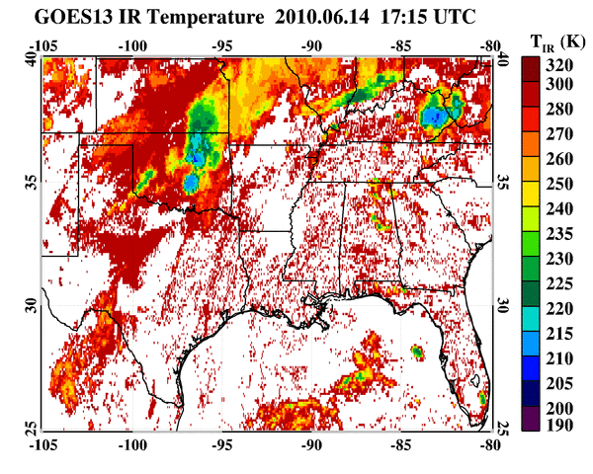
Example of one tracked system using GOES IR temp
(last 15 hrs)
Formation
Mature
Dissipation
Red: cold core (T_{IR} < 215 K)
Blue: cold cloud (T_{IR} < 235 K)
The formation-dissipation processes of a DCS
Feng et al. 2012
Notes:
Two cold cores developed and split at 8-hr after detection
Mature stage show large areas of depressed T_{IR} and expanding cold cloud area

Slide 18
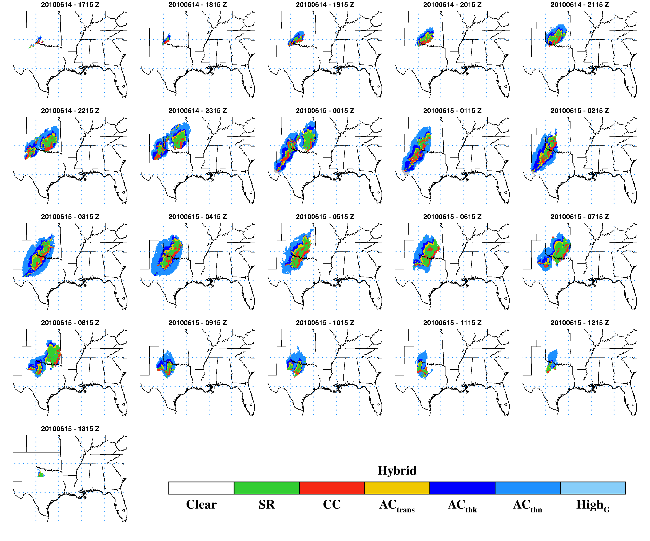
Linked tracking results with Hybrid Classification
Precipitation
Anvil Clouds
Red: cold core (T_{IR} < 215 K)
Blue: cold cloud (T_{IR} < 235 K)
Derive statistics for each system using information from hybrid classification
Notes:
Matching/Expanding process only change system size, number of systems and life cycles remain intact

Slide 19
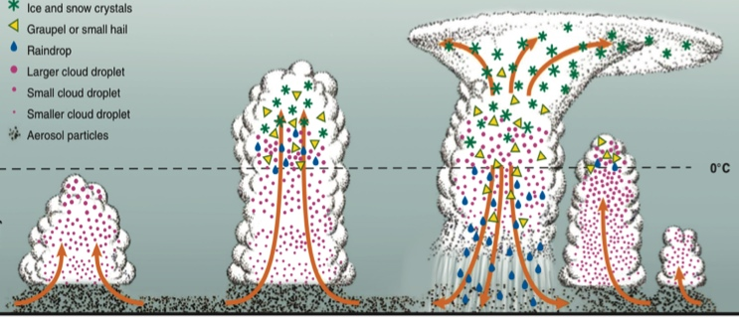
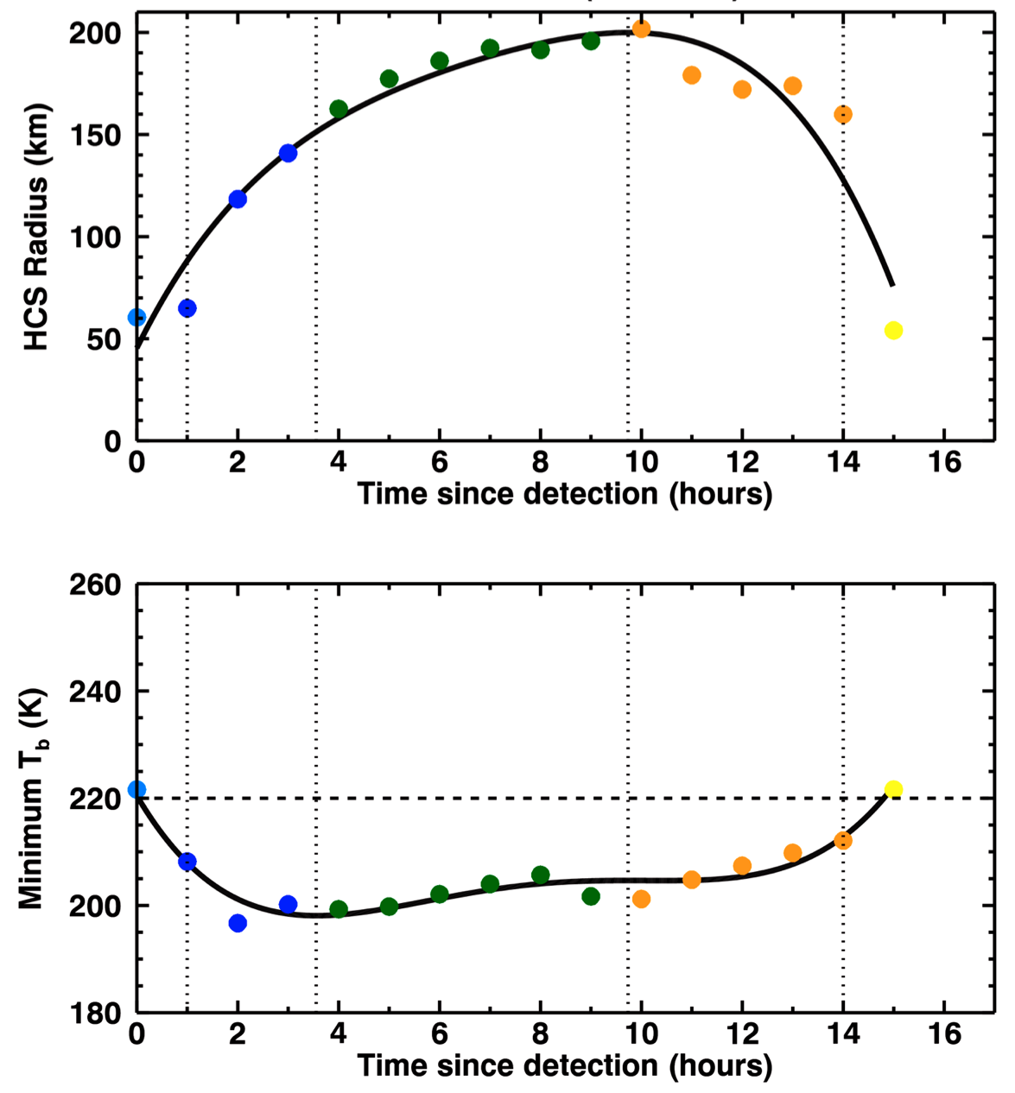
Define Life Cycle Stages
Reason: composite systems with different lifetimes
Based on tendency of system size and T_{IR}
Developing (1, 2)
  Before reaching min T_{IR}
  Warm developing (T_{IR} > 220K)
  Cold developing (T_{IR} < 220K)
Mature (3)
  Min T_{IR} < time < Max Radius
Dissipating (4, 5)
  Cold dissipating
  Warm dissipating
Group all systems based on defined stages
System Equivalent Radius
Developing Mature Dissipating
1 2 3 4 5
System Min T_{IR}

Slide 20
Work Plan and responsible personnel
2013-2014: Attend NOAA MAPP CRTF Monthly Telecom, and seek collaboration with other team members.
2014-2015
(1) Collect and process all observational and reanalysis datasets➔ those will be used in this study (whole team).
(2) Compare Arctic cloud-radiation results between reanalyses and satellite and surface data (Dolinar, Qiu, Dong, Xi), and develop Arctic SOM (Kennedy)
(3) Compare cloud-precipitation over the ARM SGP region between reanalyses and satellite-surface products (Ron, Dong)
(4) Present the results to scientific meetings, such as AMS, AGU, EGU, and NOAA MAPP and reanalysis related meetings, and submit two papers to refereed journals (whole team).
2015-2016
(5) Find the similarities and differences in Arctic cloud-radiation between reanalyses and datasets, and link these results with large-scale dynamic patterns and variable through SOM technique (whole team).
(6) Evaluate the reanalyzed life and diurnal cycles of Deep convective systems, and their associated precipitation rate and areal coverage from each reanalysis (Ron, Dong)
(7) Present research results to scientific meetings, and submit three papers to refereed journals (whole team).
(8) Hiring web developer to post our results on our webpage (http://faculty.atmos.und.edu/dong/) (Computer assistant, Xi).

Slide 21
Thanks for your attention!
Questions?

Slide 22
Backup Slides

Slide 23
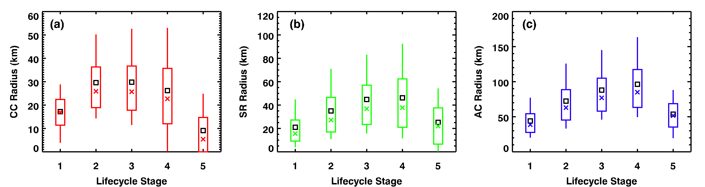
Composite by Life Cycle
Conv Core (CC)
Strat Rain (SR)
Anvil Cloud (AC)
Size
Time period: May-Aug, 2010-2011 (hourly data)
Total number of tracked systems: 3995
CC expands quickly in developing stage, reach maximum between cold developing/mature stage
SR/AC size have similar tendency: gradually grow and reach maxima at cold dissipating stage
CC area: 9%, SR area: 18%, AC area:73%
Notes:
Explains box whisker plot, box: 25/75 percentile, whisker: 90%, square: mean, cross: median

Slide 24
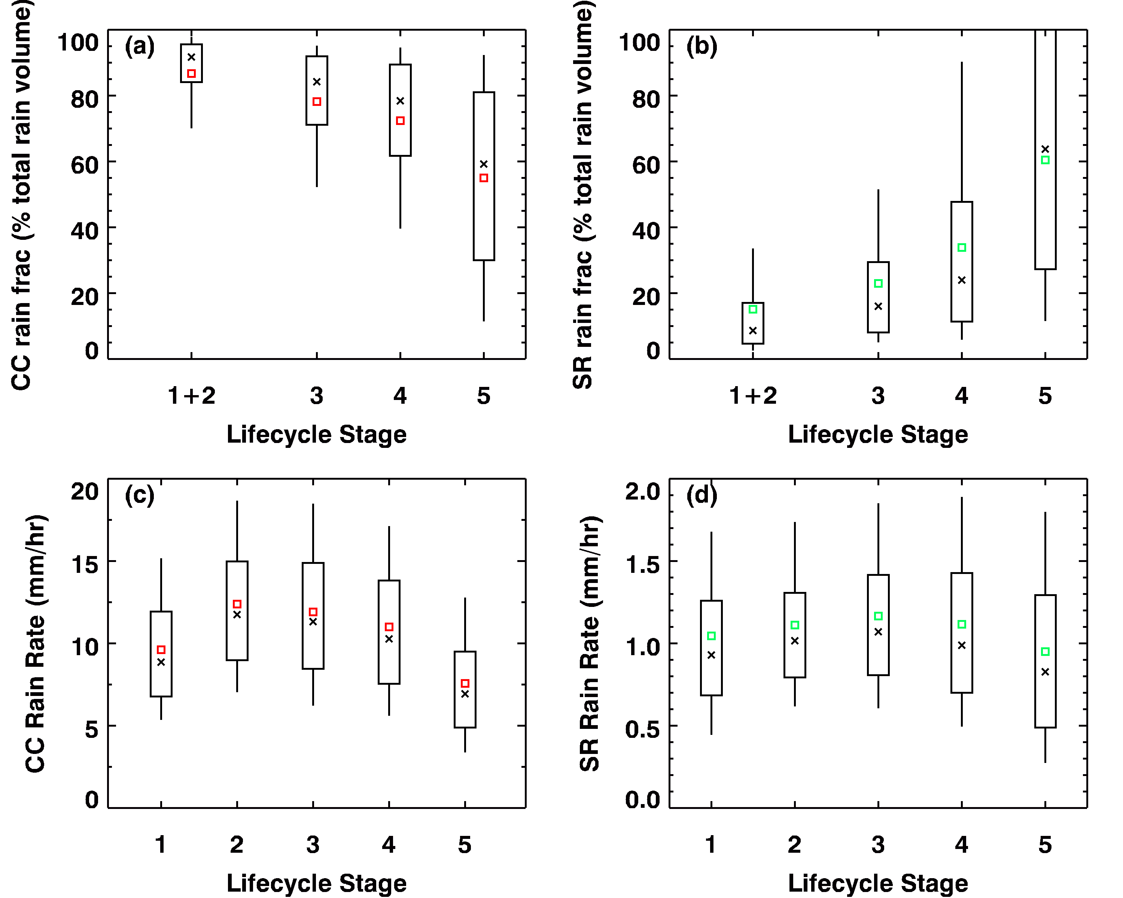
Precipitation Evolution
Precipitation comes almost exclusively from convective rain in developing and mature stage
Stratiform rain gradually becomes more important as system dissipates
CC/PR rain rate evolution similar to sizes
PR_{CC} is 10× PR_{SR}
Volume Rain Fraction (%)
SR
CC
Rain Rate (mm/hr)

Slide 25
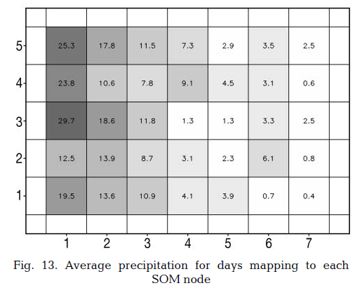
Self Organizing Map (SOM)
L
After creating the feature map, the user can then classify individual samples
H
5x7 SOM for January SLP – Hewitson and Crane (2002)
SOM is a competitive neutral network. It classifies atmospheric states (P, WS, RH) and links them with cloud and precipitation occurrences which will help us to determine if reanalyzed biases come from model dynamics.

