Slide 1
ERA-CLIM results
ERA-CLIM2 plans
Copernicus Climate Change Service
Dick Dee
NOAA CRTF
26 Feb 2014

Slide 2
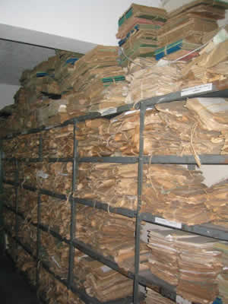
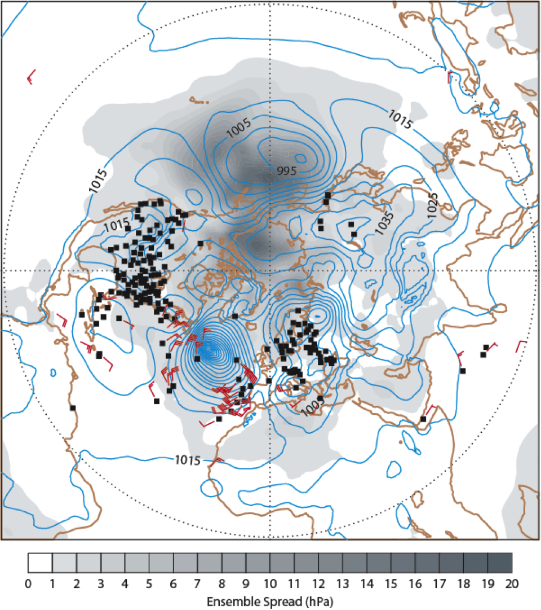
The ERA-CLIM project
ERA-CLIM: EU collaborative research project, 2011-2013, 9 global partners
Goal: Preparing input observations, model data, and data assimilation systems for a global atmospheric reanalysis of the 20th century
Main components:
Data rescue efforts (in-situ upper-air and satellite observations)
Incremental development of new reanalysis products
Use of reanalysis feedback to improve the data record
Access to reanalysis data and observation quality information

Slide 3
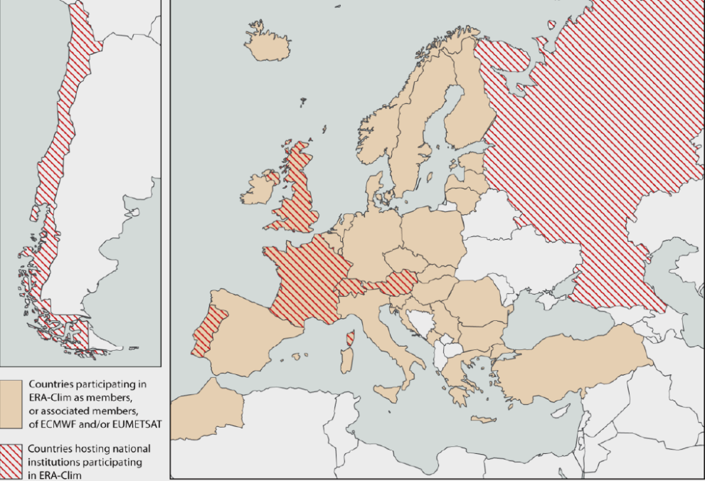
The ERA-CLIM project
ERA-CLIM: European Reanalysis of Global Climate Observations
3-year collaborative research project, Jan 2011- Dec 2013
Funded by EU research FP7, Environment theme
Total cost €4.9M; EC contribution €3.5M
9 partners, 59 person-years, 50 deliverables
Partners:
Met Office
Météo-France
EUMETSAT
University of Vienna
Univeristy of Bern
University of Lisbon
RIHMI-WDC (Russia)
Universidad del Pacífico (Chile)
ECMWF

Slide 4
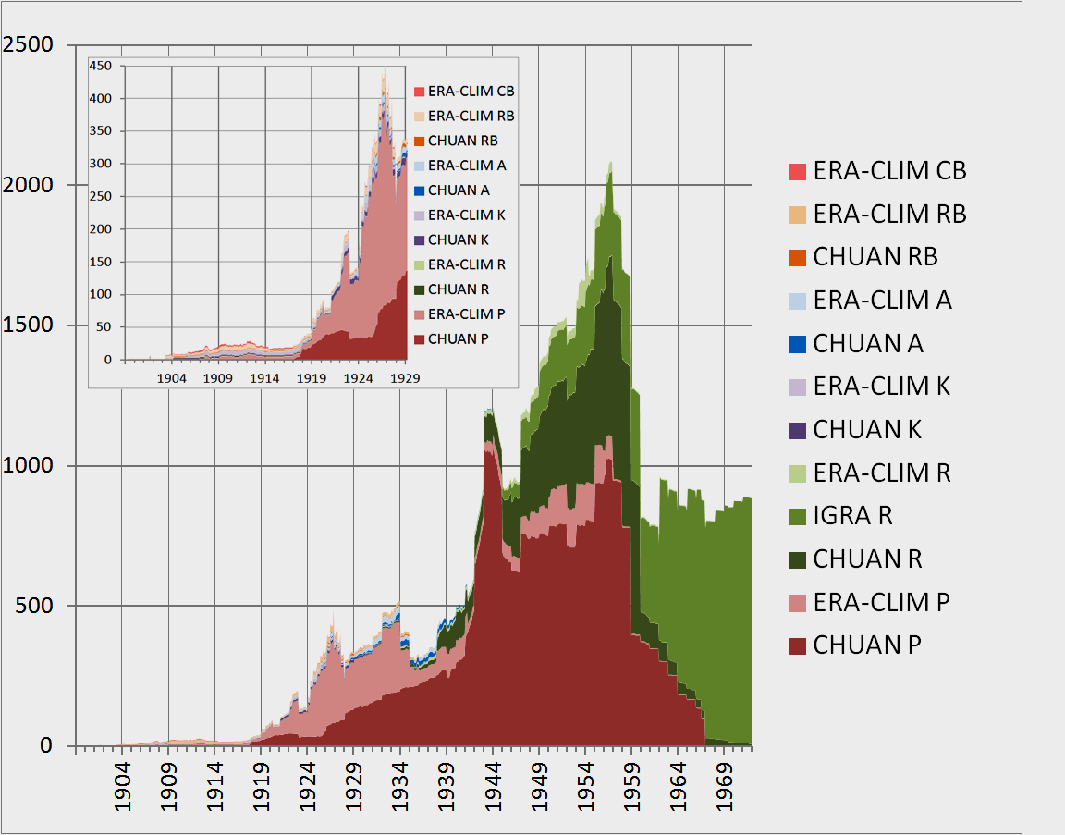
Data rescue, upper-air data
Uni Bern, Météo-France, Uni Lisbon, RIHMI, UPAC
6 ascent types
wind, temperature,
humidity, dew-point depression
height, pressure levels
Quality control:
Range checks
Consistency checks
Local time versus UTC
Feedback info from
ERA-CLIM 20C reanalysis
Inventoried ERA-CLIM upper-air records
CB: captive balloon
RB: registering balloon
P: pilot balloon
A: aircraft
K: kite
R: radiosonde

Slide 5
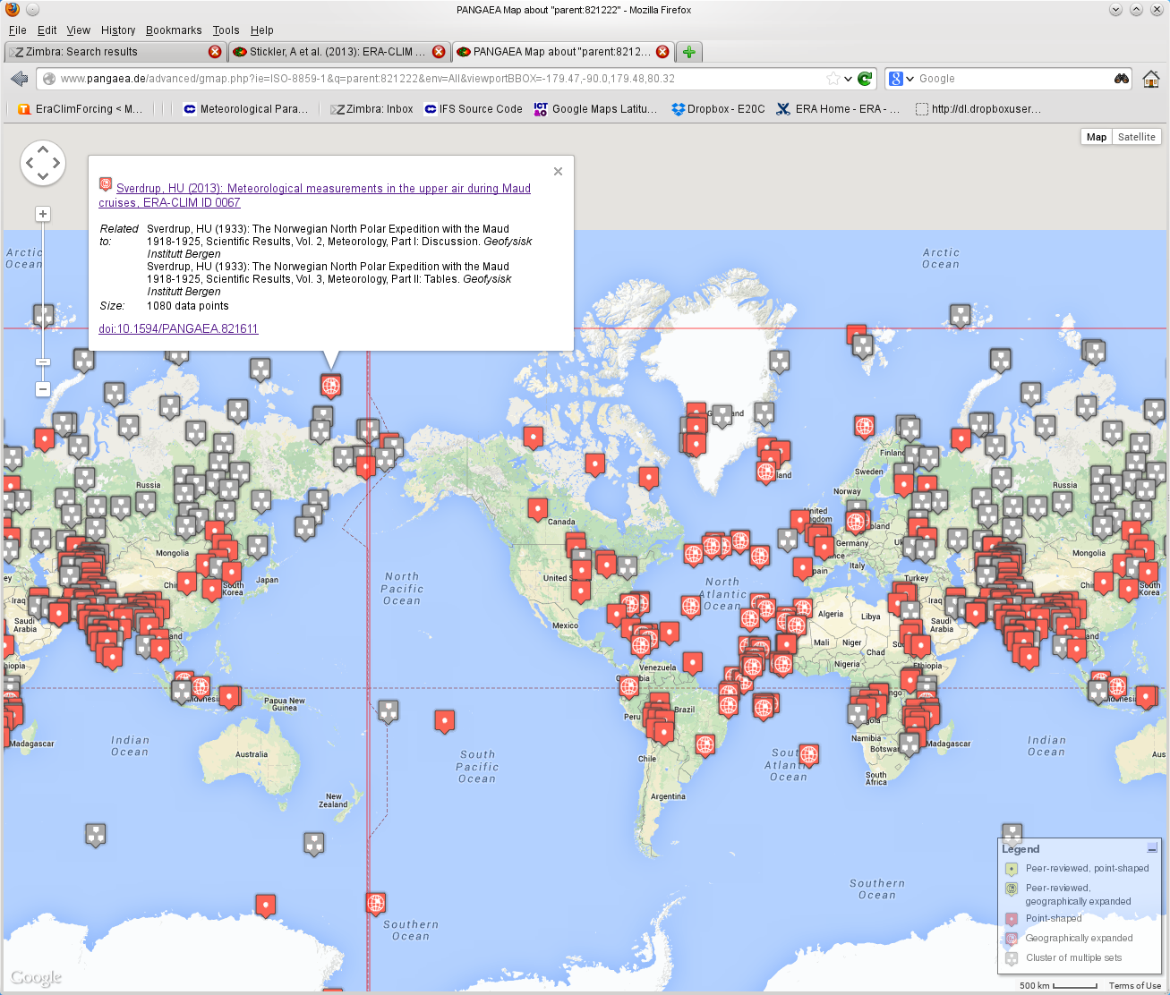
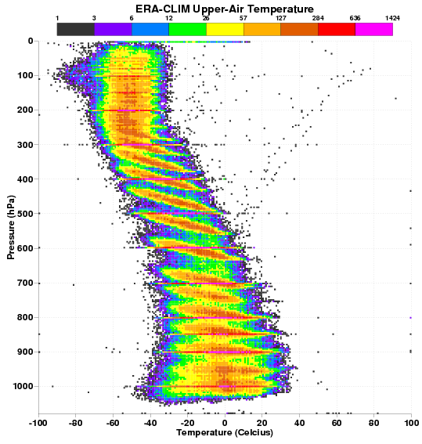
Data rescue, upper-air data
Data will be merged in the next version of CHUAN
Is available via http://doi.pangaea.de/10.1594/PANGAEA.821222
Is being used in a pilot reanalysis at ECMWF and will be placed in the OFA
Temperature recorded on pressure levels
Digitized upper-air data, as available via Pangaea

Slide 6
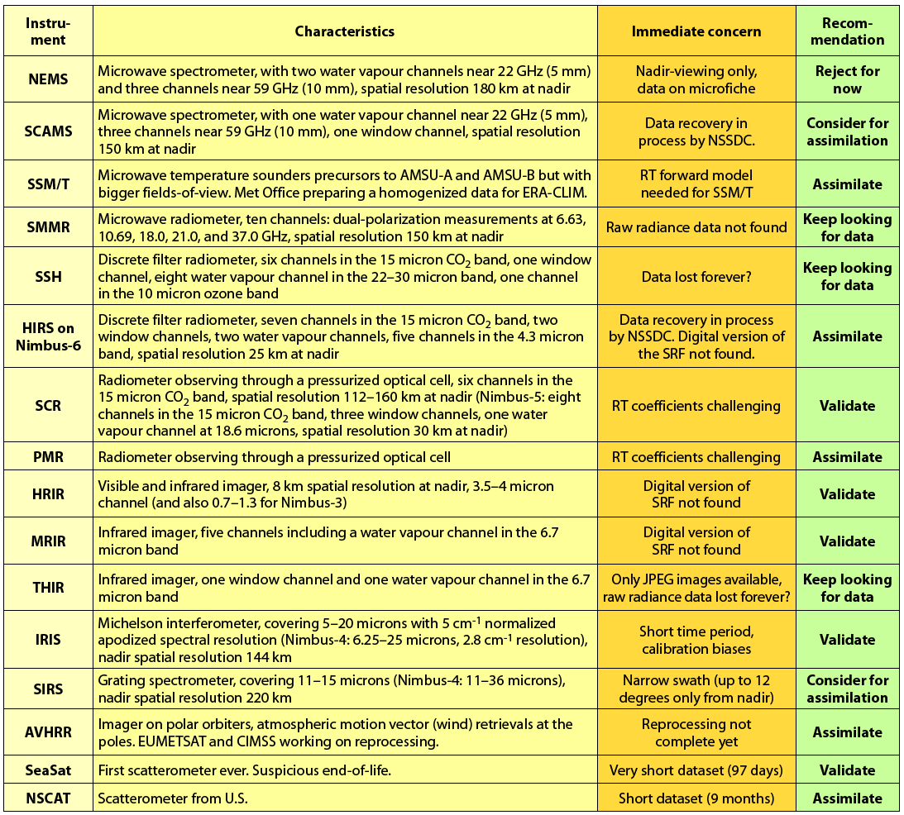

Survey historical satellite data for potential usage (assimilation) in reanalysis
Met Office, ECMWF
Covering 190 satellite datasets:
23 legacy datasets to be used
38 legacy datasets to be used with
improved observation operators
88 reprocessed datasets to be used
8 reprocessed datasets to be monitored,
6 early satellite datasets to be tested for usage
before seeking reprocessing/recalibration,
27 early satellite datasets to be tested for monitoring
before seeking reprocessing/recalibration.
Regarding observation operators:
RTTOV coefficients have been updated for a number of old satellite sensors (MetOffice).
Selection of old instruments with significant
potential to improve the reanalysis record

Slide 7
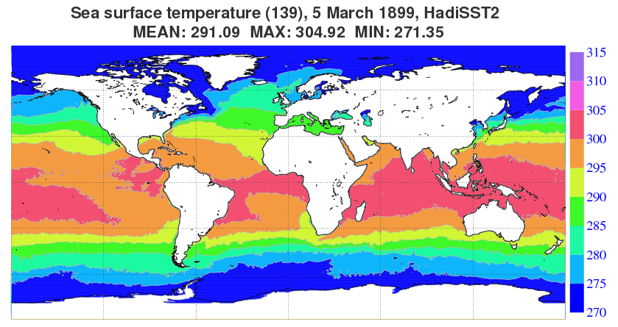
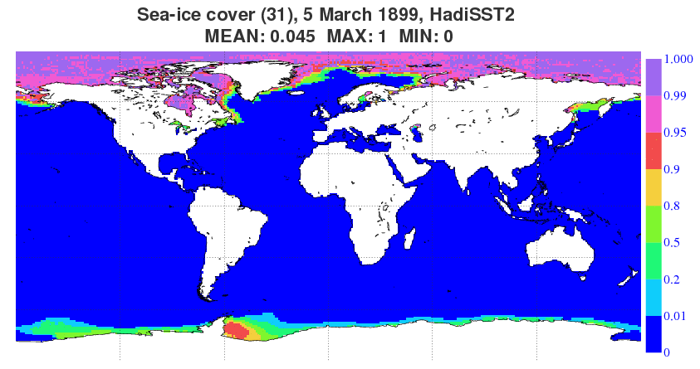
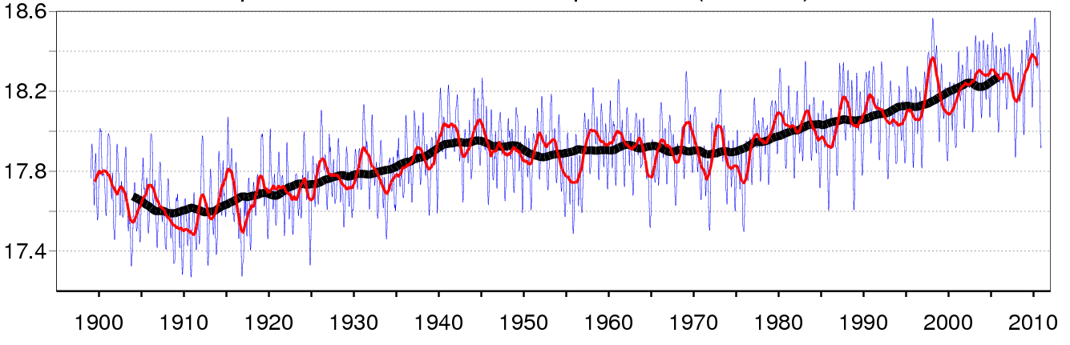
Sea-surface temperature and sea-ice cover: HadISST2
Produced by the Hadley Centre (follow-up of HadISST1),
Rayner et al. 2013, Kennedy et. al. 2013, Titcher and Rayner 2013
1899-2010, 0.25-degree gridded daily fields
two releases.
Data: in situ ICOADS, Met Office database, AVHRR pathfinder (1985-2007), ATSR2 and AATSR (1995-2011)
Ensemble: 10 equally likely realizations
Used in all ERA-CLIM
pilot reanalyses
Monthly, Yearly, Decadal moving average

Slide 8
ERA-CLIM pilot reanalyses
ECMWF, dedicated WP
IFS: Atmosphere and ocean-wave component
All: T159 (~125km), 91 levels in the vertical (up to 1 Pa)
Except: ERA-20C/Land: T799 (~25km)
Period:
All: 1899 – 2010
Except: ERA-PreSAT: 1939-1949
All pilot runs use:
HadISST2 SST and sea ice fraction,
CMIP5 long-term forcing for total solar irradiance,
ozone, greenhouse gases, aerosols. (synergy with EC-EARTH)

Slide 9
2
Planned reanalysis productions | 2012 | 2013 | 2014 | 2015 | 2016 | 2017
ERA-Interim ERA-Interim/Land
ERA-20CM ERA-20C ERA-20C/Land
ERA-SAT ERA-SAT/Land
CERA-20C CERA-20C/Carbon
CERA-SAT CERA-SAT/Land
Extended climate reanalysis
ERA-Interim replacement
Coupled with ocean

Slide 10
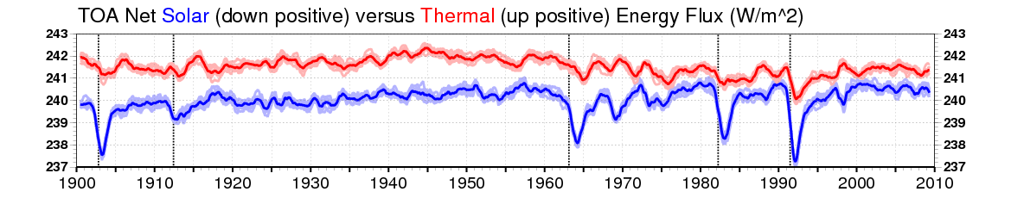
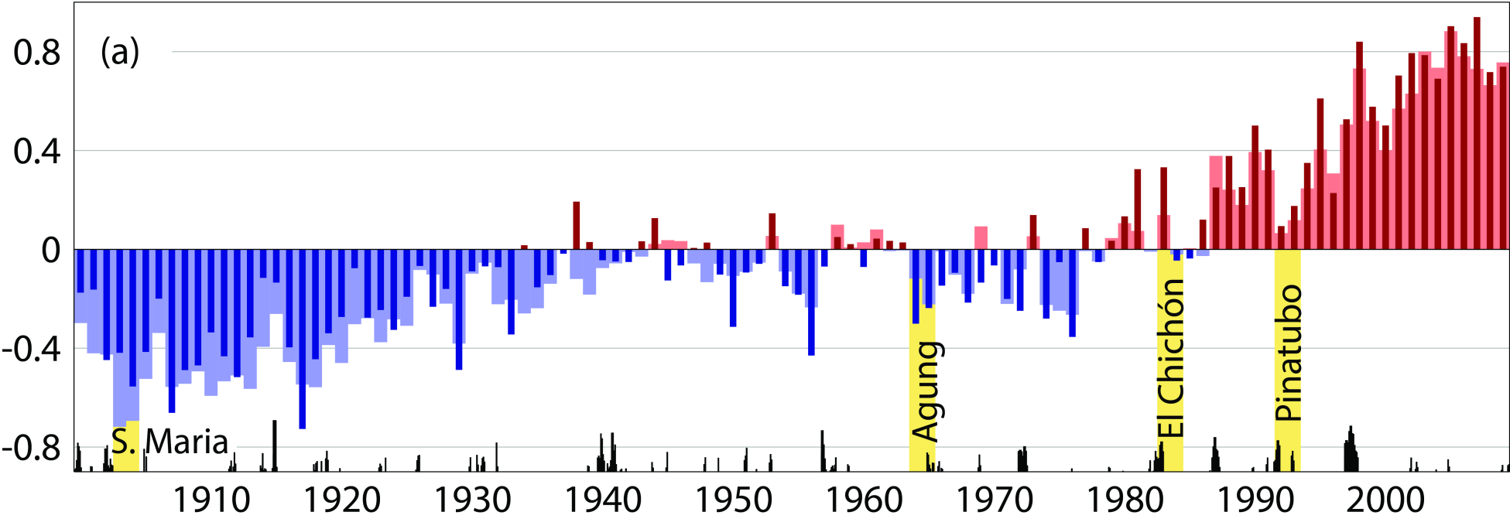
ERA-20CM
+ HadISST2
Although there are certainly model biases:
ERA-20CM gives good reference of low-frequency variability
Well suited to project global warming and major events onto other geophysical quantities not directly provided in the forcing data
CRUTEM4 data (Jones et al., 2012)
ERA-20CM
Hersbach, Peubey et. al. 2013, ERA report series (16)

Slide 11
ERA-20C
Inspired on the NOAA/CIRES 20CR reanalysis
Usage of synoptic pressure and wind from ICOADS and ISPD (~1.5 Billion obs)
Variational bias correction based on break-point analysis from
20CR feedback information
Ensemble Data assimilation of 10 members
  Self-updating background error covariances
  Problems with stratospheric increments, quality control, VarBC
Deterministic re-run
  Use background info from the ensemble, VarBC before analysis
  Most ‘climate quality’ issues resolved; but best synoptic analyses?
Poli et. al. 2013, ERA report series (14)

Slide 12
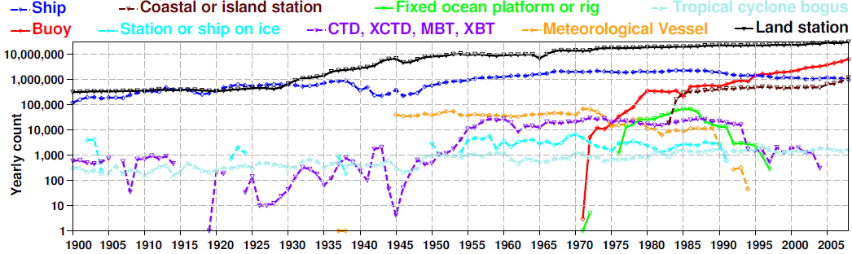
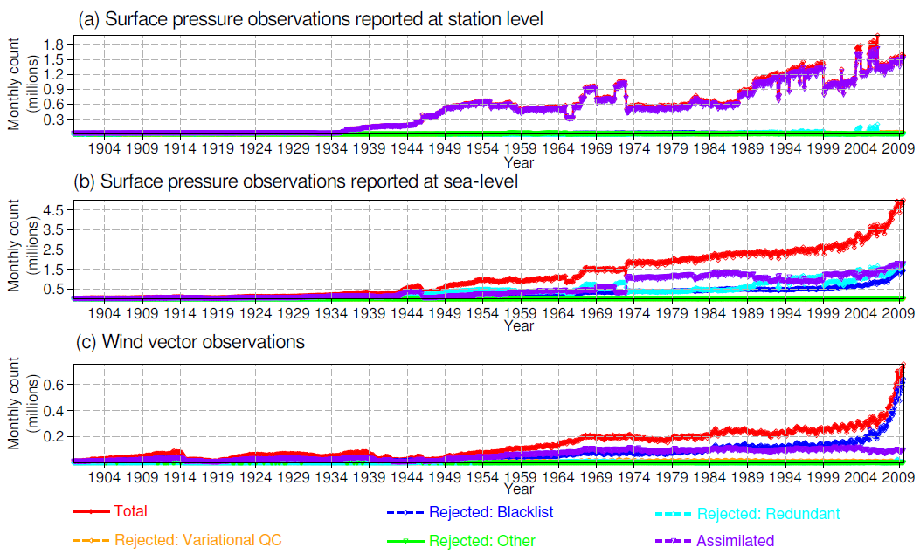
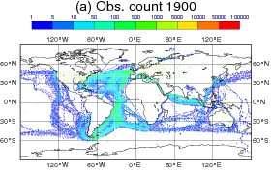
Assimilation of surface pressure and maritime wind from ICOADS (2.5.1) and ISPD (3.2.6)

Slide 13
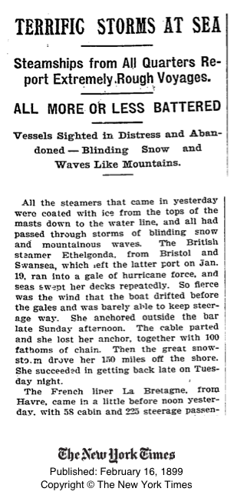
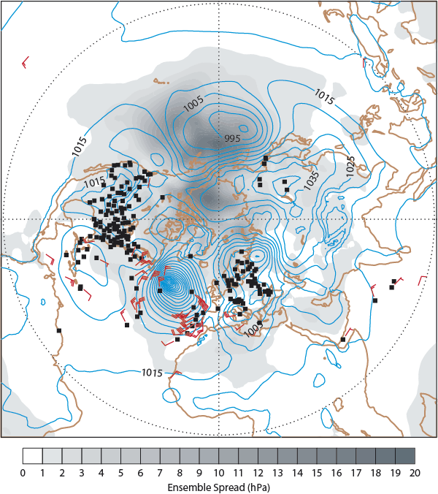
ERA-20C: Assimilating surface observations
3 February 1899

Slide 14
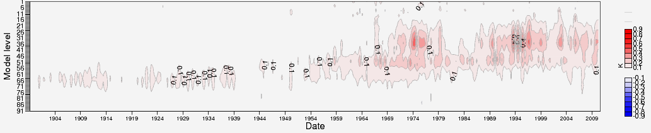
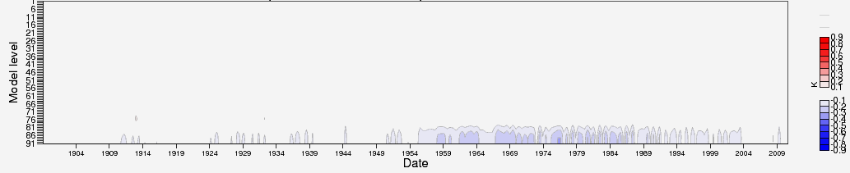
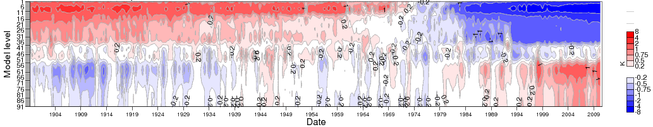
Analysis temperature increments
E20C ensemble
E20C deterministic
Temperature trend
E20C deterministic

Slide 15
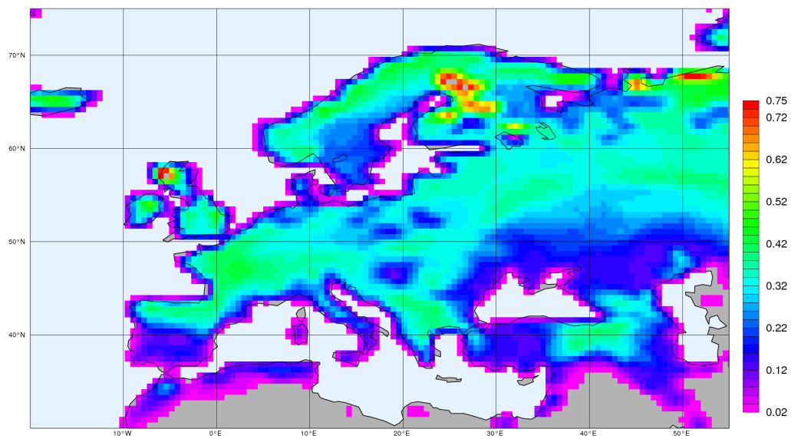
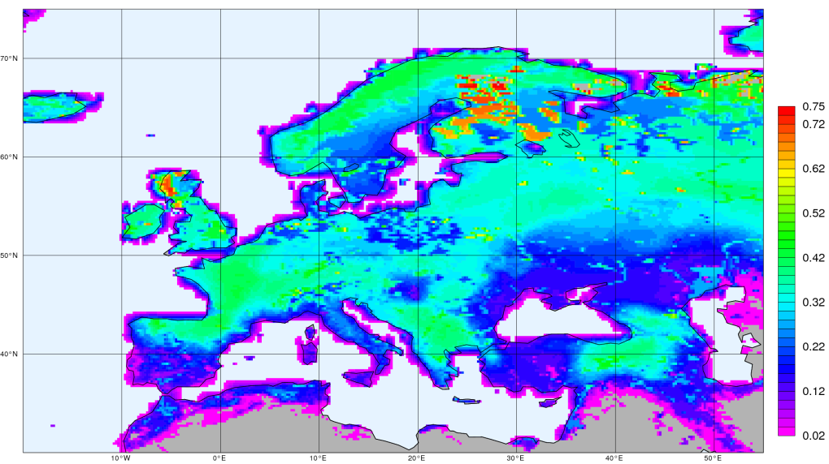
ERA-20C/Land
Down-scaling the ERA-20C reanalysis at the surface to 25km (T799)
T. Komori
ERA-20C
Method as used in ERA-Interim/Land
Balsamo et. al. 2012, ERA Report Series (13)
To be completed by end of March 2014
Soil moisture
ERA-20C/Land

Slide 16
ERA Pre-SAT:
Usage of early upper-air data
Deterministic reanalysis from 1939 - 1949
demonstration run
In addition to surface data, use all available upper-air data:
  CHUAN, NCAR holdings, ERA-CLIM data
To be completed the by end of March 2014

Slide 17
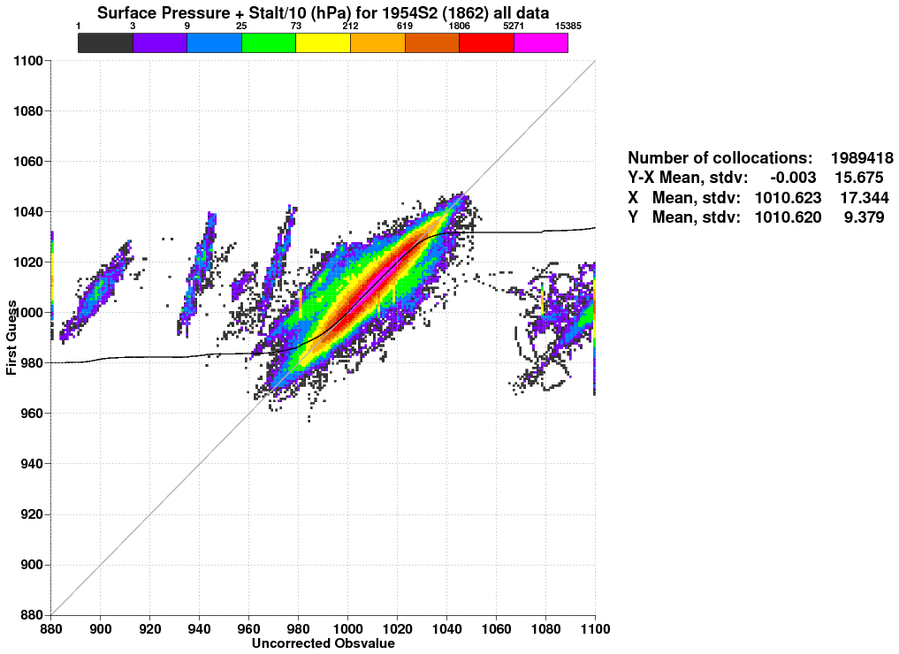
Feedback: Quality control ERA-20C all data
Stuck sensors
Unit conversion problems, erroneous meta data?

Slide 18
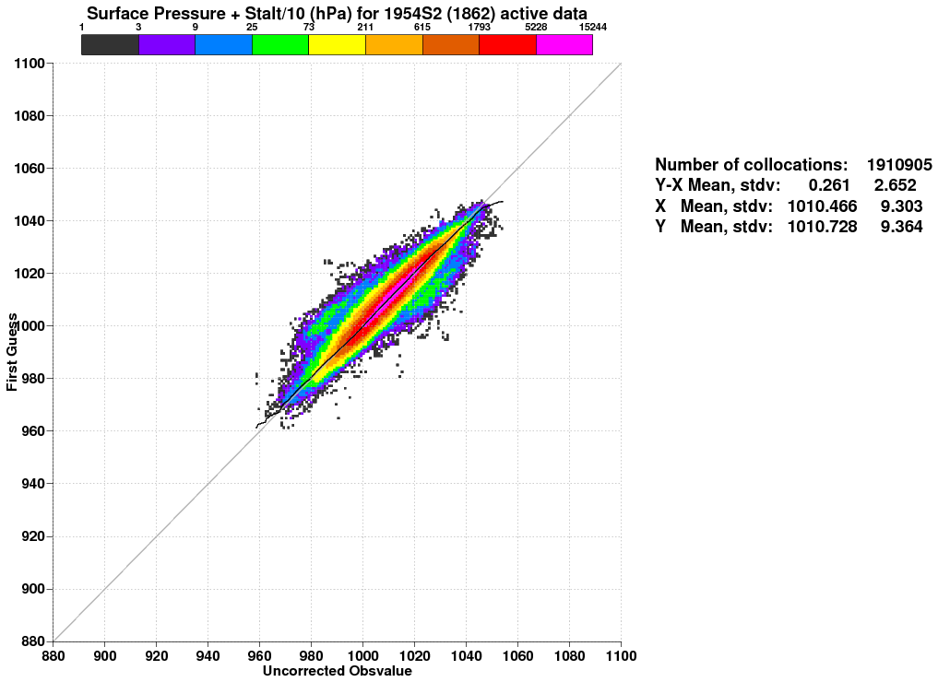
Feedback: Quality control ERA-20C after screening

Slide 19
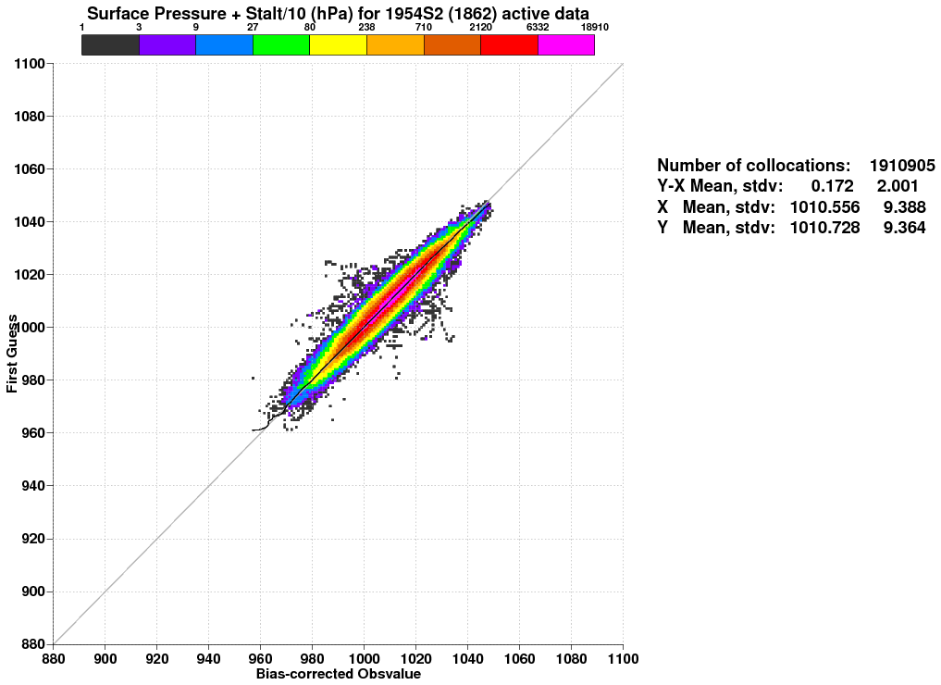
Feedback: Quality control ERA-20C Bias Correction

Slide 20
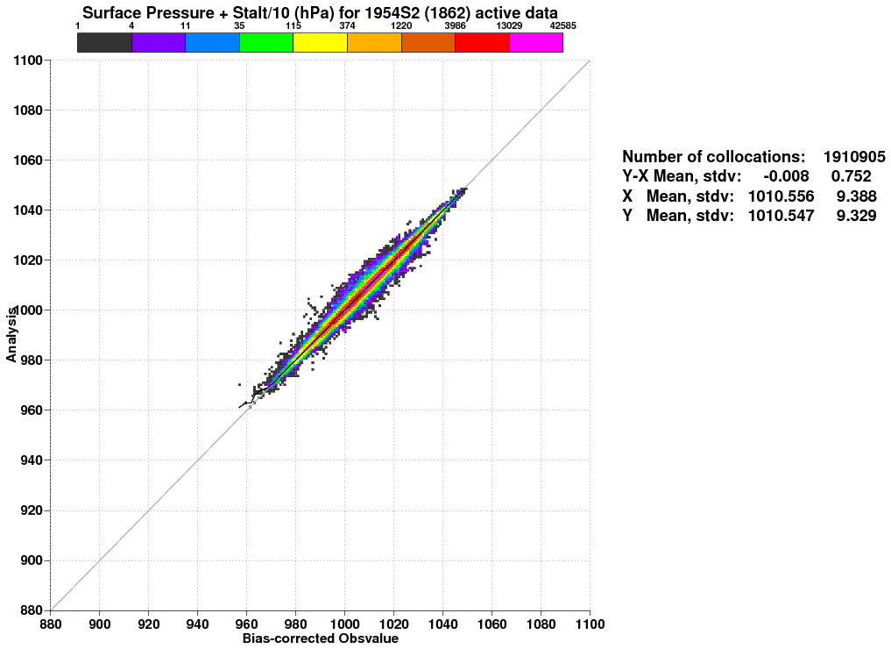
Feedback: Quality control ERA-20C after assimilation

Slide 21
ERA-CLIM products
20th-century atmospheric reanalysis (1900-2010) 125km global resolution, 91 vertical levels
ERA-20CM ERA-20C ERA-20CL | Atmospheric model integration | IFS Cy38r2 + CMIP5 data HadISST v2.1
 | Assimilation of surface observations | ICOADS v2.5.1 ISPD v3.2.6 (incl. ERA-CLIM)
 | High-resolution land surface parameters (25km global)
Final ERA-20C/M/L products will be available by mid 2014

Slide 22
ERA-CLIM2 kick-off meeting
24/25 Feb 2014
ECMWF

Slide 23
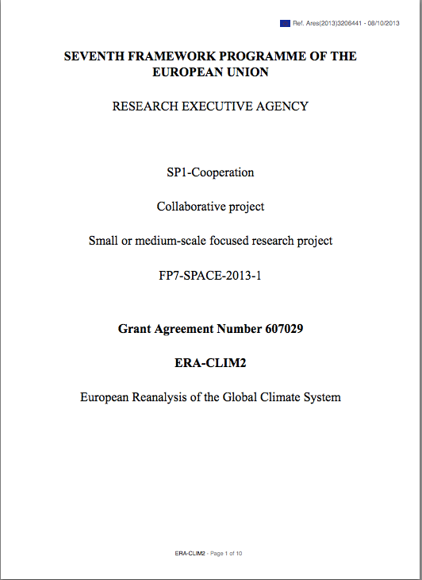
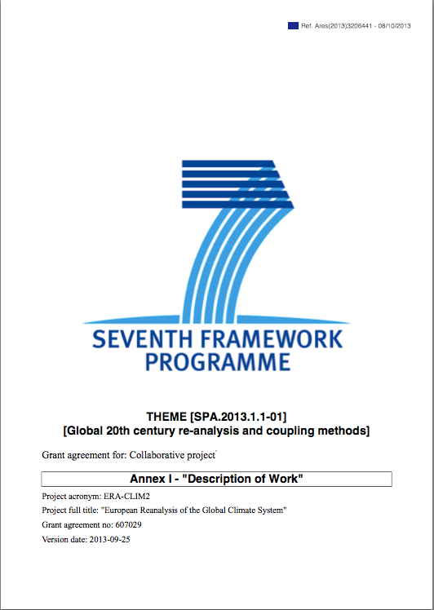
ERA-CLIM2: Project overview

Slide 24
ERA-CLIM2 Objectives
• Production of an ensemble of 20th-century reanalyses at moderate spatial resolution, using a coupled atmosphere-ocean model, which will provide a consistent data set for atmosphere, land, ocean, cryosphere, including, for the first time, the carbon cycle across these domains;
• Production of a new state-of-the-art global reanalysis of the satellite era at improved spatial resolution, which will provide a climate monitoring capability with near-real time data updates;
• Further improvement of earth-system reanalysis capability by implementing a coherent research and development program in coupled data assimilation targeted for climate reanalysis;
• Continued improvement of observational data sets needed for reanalysis, in-situ as well as satellite-based, with a focus on temporal consistency and reduction of uncertainties in estimates of essential climate variables;
• Development of tools and resources for users to help assess uncertainties in reanalysis products.

Slide 25
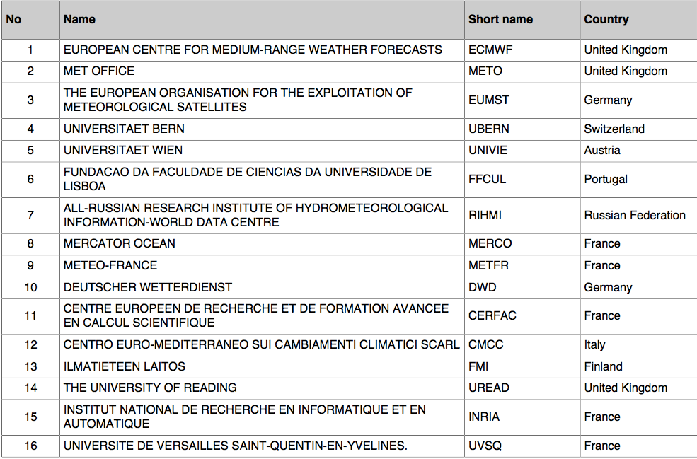
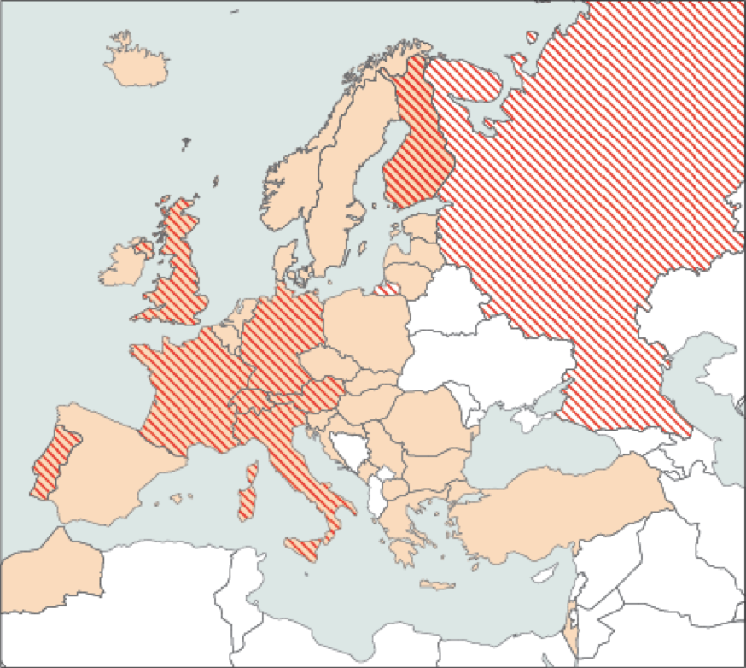
ERA-CLIM2 Resources
2 International organizations
4 National Meteorological Services
5 Academic institutions
5 National research centres
Human resources: 88 person-years
Monetary value: 15.9 M€ (7 M€ EU)

Slide 26
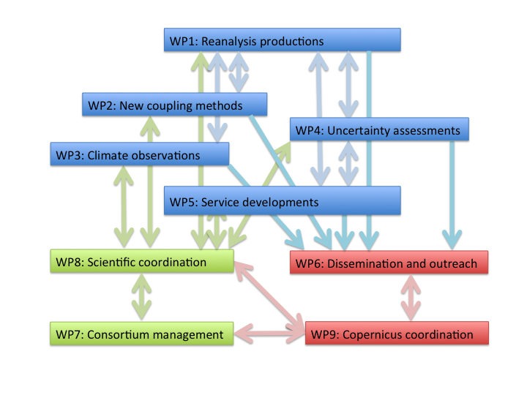
ERA-CLIM2 Work Packages

Slide 27
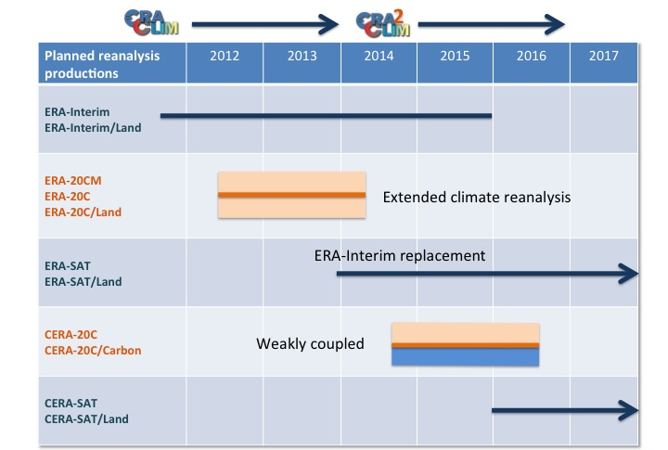
WP1: Global 20th-century reanalysis (132 pm)
T1.1 - Production of an extended climate reanalysis (52 pm)
T1.2 - Production of a reanalysis of the satellite era (68 pm)
ECMWF (84 pm)
UVSQ (34 pm)
MERCO (12 pm)

Slide 28
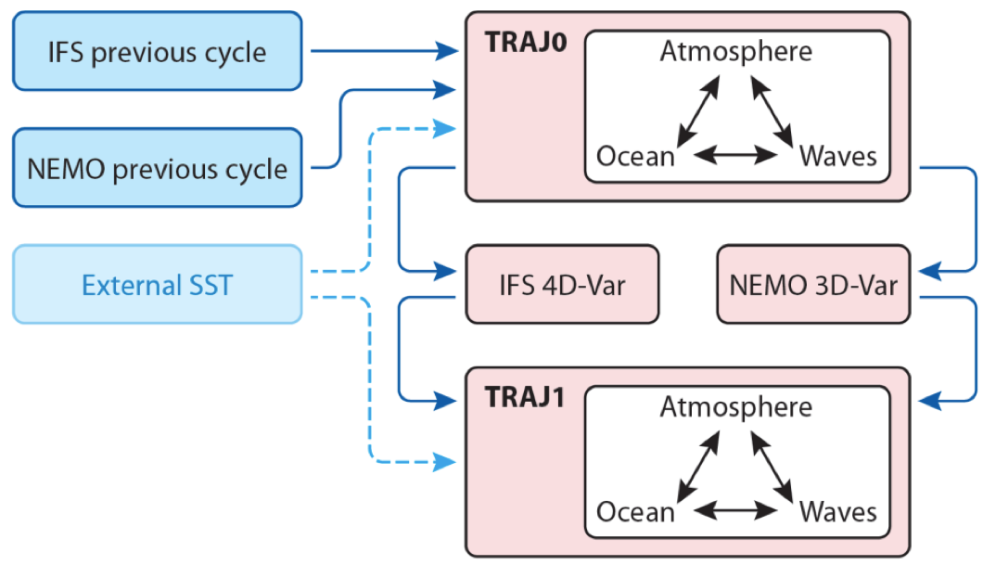
WP2: Future coupling methods (251 pm)
T2.1 - Coordination and integration (24 pm)
T2.2 - Assimilation techniques for improved use of surface observations (36 pm)
T2.3 - Development of the ocean analysis component (46 pm)
T2.4 - Development of the carbon component (39 pm)
T2.5 - Research towards fully coupled data assimilation (72 pm)
METO (64 pm)
UREAD (36 pm)
MERCO (31 pm)
CERFAC (24 pm)
CMCC (24 pm)
INRIA (24 pm
ECMWF (24 pm)
UVSQ (21 pm)

Slide 29
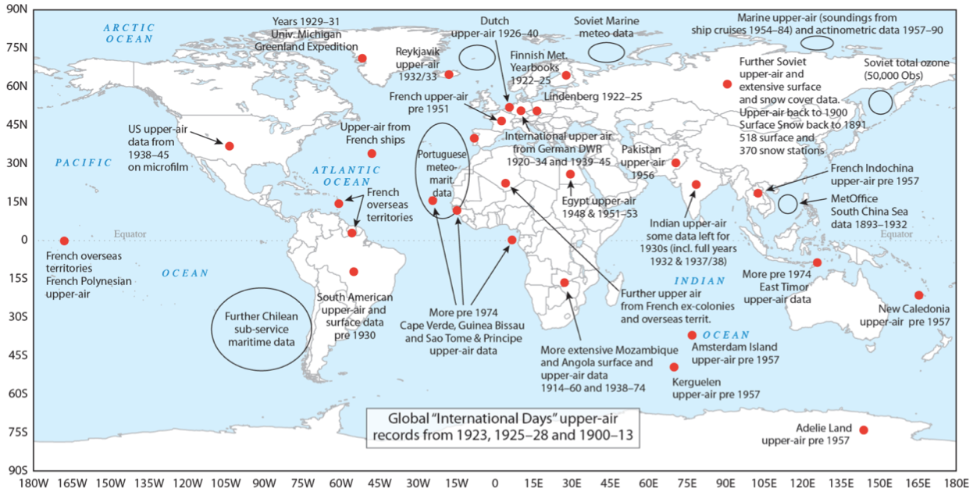
WP3: Earth system observations (463 pm)
T3.1 – Data rescue for in-situ observations, quality control and metadata (315 pm)
T3.2 – Satellite data rescue, reprocessing and inter-calibration (53 pm)
T3.3 – Boundary constraints and external forcing (73 pm)
UBERN (50 pm)
FFCUL (112 pm)
RIHMI (110 pm)
METO (72 pm)
METFR (55 pm)
EUMST (37 pm)
FMI (27 pm)

Slide 30
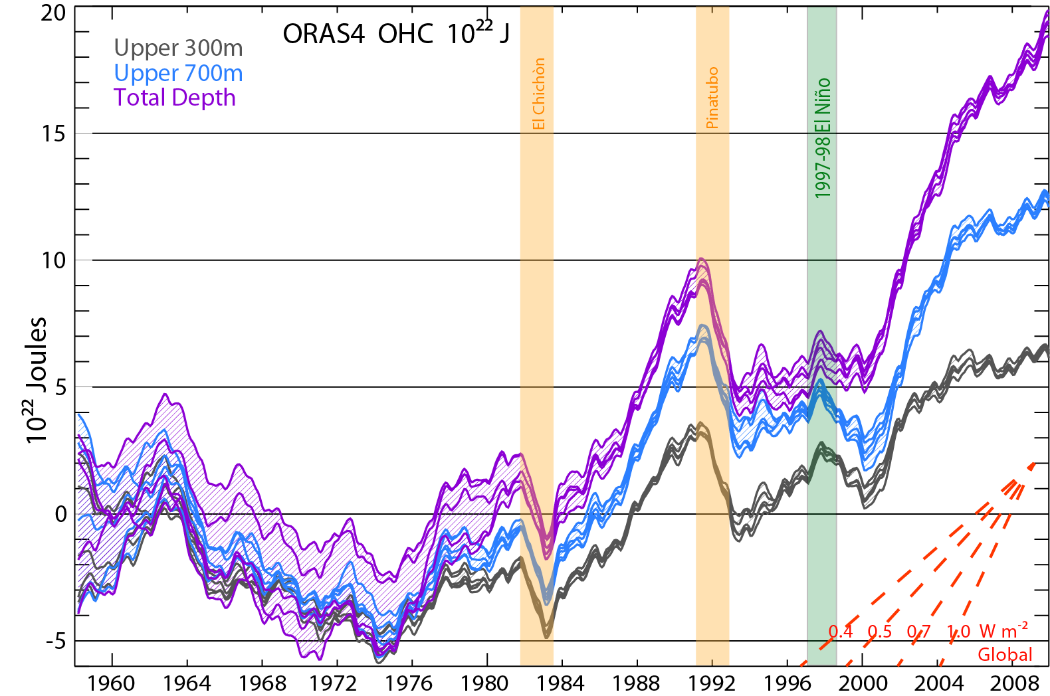
WP4: Quantifying uncertainties (145 pm)
T4.1 - Quality control, bias adjustment and homogenization of input observations (45 pm)
T4.2 - Diagnostics and uncertainty assessments of reanalysis output (81 pm)
UNIVIE (39 pm)
DWD (30 pm)
ECMWF (24 pm)
FFCUL (22 pm)
UBERN (10 pm)
UVSQ (10 pm)
RIHMI (8 pm)
Balmaseda et al. 2013

Slide 31
WP5: Service developments (24 pm)
T5.1 – Data services and visualization tools (12 pm)
T5.2 – Data services requirements (12 pm)
ECMWF (24 pm)
D5.1: NetCDF support in MARS
D5.2: Data server for CERA reanalyses
WP6: Dissemination and outreach (16 pm)
T6.1 – Science-to-science (3 pm)
T6.2 – Science-to-policy (3 pm)
T6.3 – Science-to-society (3 pm)
ECMWF (9 pm)
METO (2 pm)
UBERN (2 pm)
UNIVIE (2 pm)
EUMST (1 pm)
D6.3: Workshop on Observations for Earth System Reanalysis (2015)
D6.6: Workshop on Coupled Data Assimilation for Earth System Reanalysis (2016)

Slide 32
Copernicus Climate Change Workshop
17/18 Feb 2014
ECMWF

Slide 33
Copernicus = EU’s Earth Observation Programme (formerly GMES)
Copernicus is implementing several “Operational Services”
A Climate Change Service will be implemented starting 2014/2015
It will be implemented through a delegation agreement
ECMWF has* expressed interest in operating the CCS
The core of the CCS will be a “Climate Data Store” with global/regional climate information based on observations and models
Global reanalysis will be an essential element of the CCS
Last week’s workshop: consulting the European met services and other providers to discuss vision, capabilities etc
Some key recommendations:
  Support for data rescue
  Open and transparent access to data

