Slide 1
2013 MAPP Project (2yrs):
Exploration of advanced ocean data assimilation schemes at NCEP
PIs: Jim Carton & Eugenia Kalnay (UMD), David Behringer & Hendrik Tolman (NOAA/NCEP)
These results are produced by Steve Penny (UMD/NOAA)
Progress Report & Plans
Grant Objective: explore the relative merits of different assimilation schemes: 3DVar, LETKF, and a hybrid filter in the context of NCEP’s GODAS ocean analysis
This Presentation: a 5mo long comparison of 3DVar GODAS and a HYBRID GODAS (DEC, 2010 – APR, 2011)

Slide 2
3DVar GODAS as configured for this comparison
Grid: Global tripolar grid, 1/4-1/2 deg x 40Lev res
Physics: MOM4P1, KPP boundary layer mixing scheme, GM isopycnal tracer mixing, Smagorinsky velocity mixing, free surface, sea ice.
Forcing: Wind stress, heat flux, E-P from GEFS, SSS relaxed to Levitus monthly climatology with a 10day relaxation.
Assimilation: 3D VAR minimizes:
Temperature and salinity error covariances vary geographically and temporally.
Assimilation data:
    Temperature profile data (XBTs, Argo, moorings),
    Salinity profile data (ARGO)

Slide 3
HYBRID-GODAS
3DVar-GODAS cost function
Replaced with:
where
comes from LETKF. Then:
α: empirical weighting constant
Bonus: The two existing data assimilation systems can be used with almost no modification

Slide 4
Comparison Experiment:
3DVar-GODAS vs Hybrid-GODAS
Time Period: 12/2/2010 – 4/5/2011 (~ 5 months) La Nina conditions peak in January (very high SOI), fade by May.
Ocean model: same as 3DVar GODAS
Initial conditions: from a 10-year operational GODAS analysis using NCEP R2 surface forcing. Perturbations introduced to create initial ensemble.
Analysis Cycle: 5dy cycle, 5dy observation window
Time filtering: none
Observations: profile T, S (typically 1500/5dy)
Forcing: GEFS winds, heating, freshwater
Hybrid ensemble: 20-member ensemble with α = 1.0. No inflation in the ocean interior.
We’ll focus on statistics of temperature observation minus forecast differences
Notes:
Steve, can you elaborate on “updated initial conditions”? What were the initial conditions for this experiment?

Slide 5
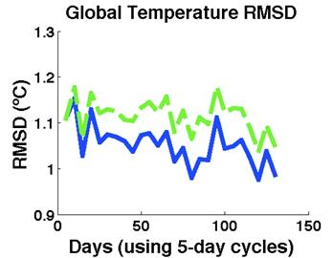
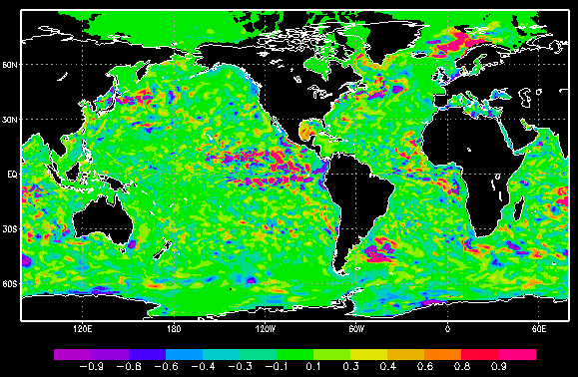
Results:
RMS obs. minus forecast temp differences
RMS T O-F All data
No high lat data in 3DVar-GODAS
3DVar GODAS
T_{hybrid} minus T_{3DVar} at 50m after 5mo
HYBRID
Notes:
Steve, What are the typical number of profiles entering the 5dy cycles? I assume the variability for the Arctic has to do with fewer profiles? Do you have a sense of whether the differences in RMSD are the result of different mean states or variability? Try plotting histograms of O-F. is this mom4? Is the resolution correct? What oceanographic phenomena occurred between 12/2/2010 – 4/5/2011 (in other words, what’s the signal?)
Other notes: global RMSD seems to suggest that you are sampling the globe. Better is something like all basin, all depth.

Slide 6
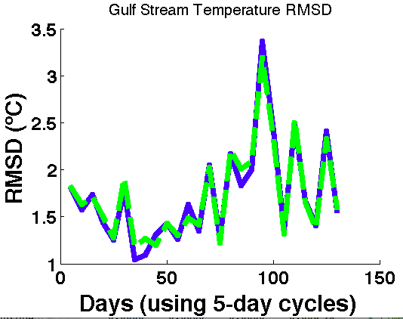
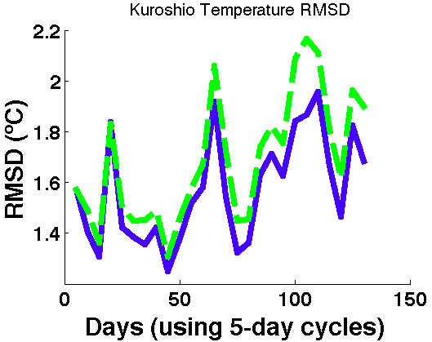
RMSD in boundary currents

Slide 7
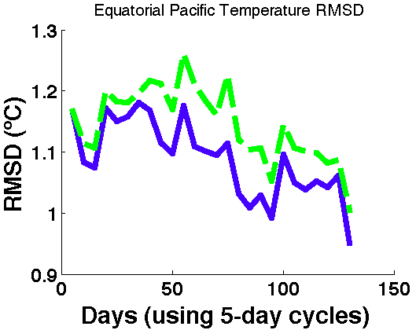
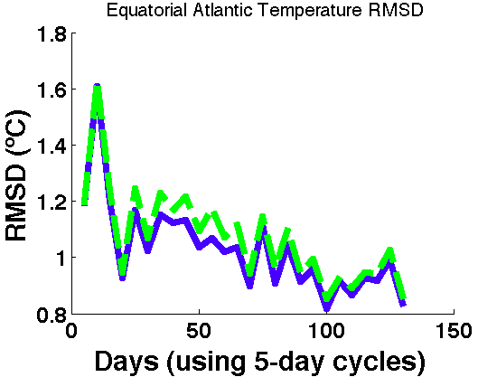
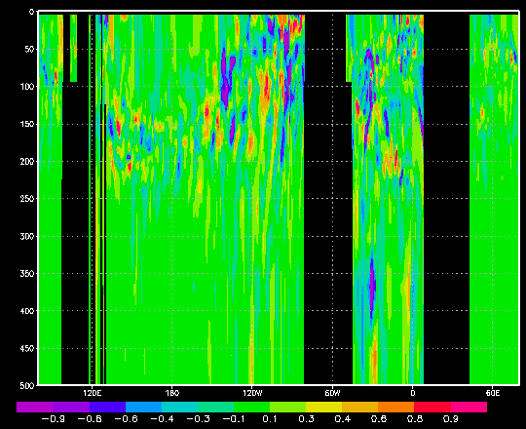
RMSD in tropics (±20°)
T_{hybrid} minus T_{3DVar} at 50m after 5mo
Notes:
Steve, Is this indian ocean picture equatorial as well? What are the latitude limits for data inclusion? Why do errors decline in the Atlantic?

Slide 8
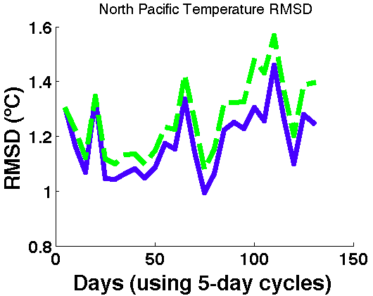
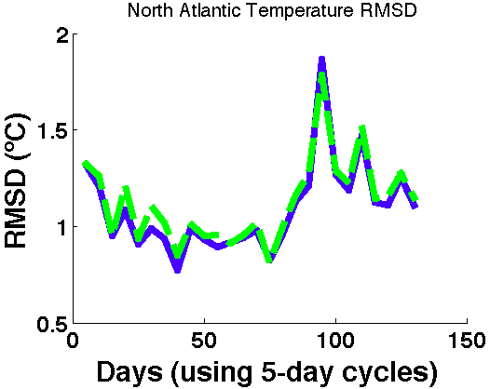
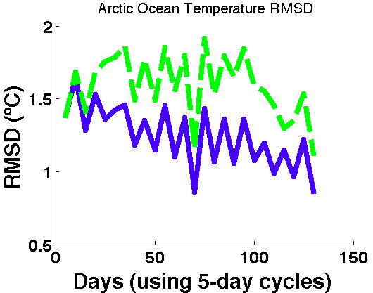
RMSD in different basins
No assimilation in GODAS in Arctic
Notes:
Steve, what was happening in the North Pacific that gave a spike in RMSD around day 100? Is this indian ocean picture equatorial as well? What are the latitude limits? Why do errors decline in the Atlantic?

Slide 9
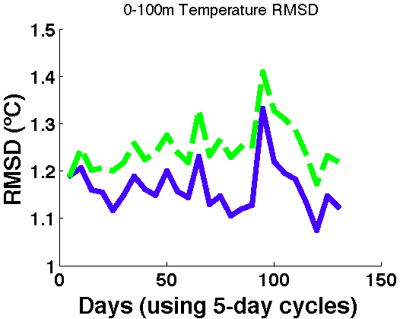
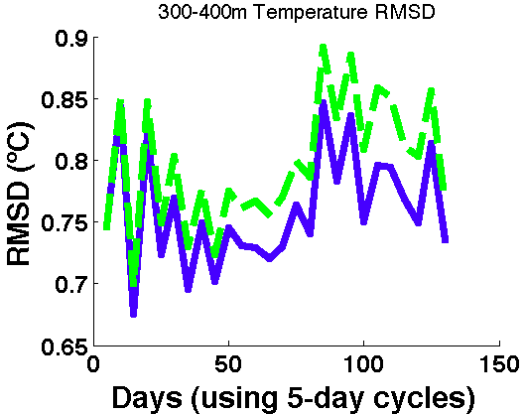
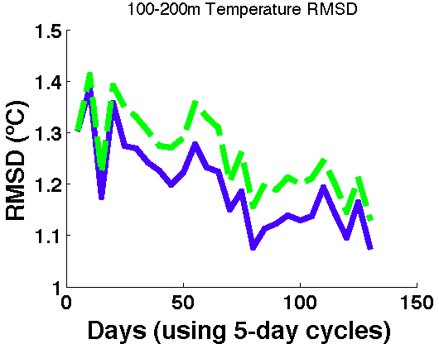
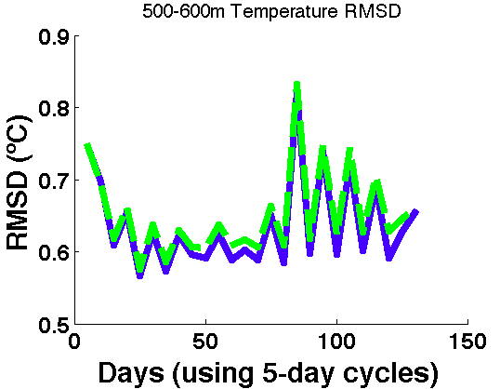
RMSD with depth
Notes:
Why is so much of the improvement in the upper 100m? Again, I wonder if its because of a bias in 3DVar

Slide 10
Where we are now
LETKF software has been rewritten to be compatible with GODAS framework
New hybrid has been developed (see: Penny, 2013) to allow a seamless connection to 3DVar-GODAS.
First results seem promising. A second, more extensive comparison experiment is being planned

Slide 11
What’s next
Complete a more extensive comparison experiment (5yrs)
Explore choices for localization, α
  Introduce new observation types (SSH, SSS, Mass?)
Introduce SST/mixed layer assimilation
Upgrade to MOM5 ocean model
Continue development of hybrid filter
As time permits we may try to implement one or more of these filters in the RTOFS eddy-resolving model

