Slide 1
Diagnosing and quantifying uncertainties of
the reanalyzed clouds, precipitation and
radiation budgets over the Arctic and SGP
using combined surface-satellite observations
PI: Xiquan Dong, Uni. of North Dakota/Arizona
Two Objectives:
Quantifying the uncertainties of reanalyzed Arctic cloud-radiation properties using satellite-surface data
Investigating the reanalyzed hydrological cycle
over the CONUS

Slide 2
Objective 1: Quantifying the uncertainties of reanalyzed Arctic cloud and radiation properties using satellite-surface observations
By Yiyi Huang, a 2nd year’s MS student
A paper entitled “Quantifying the Uncertainties of Climatological Mean State of Reanalyzed Arctic Cloud and Radiation Properties using Satellite-surface Observations” was submitted to Clim. Dynamics (under reviewing) by Huang et al.
Summary:
1) All 5 reanalyses (MERRA2, CFSR, ERA-I, 20CRv2C, JRA-55) can simulate similar distribution of observed cloud fractions over Arctic region during summer, with best in MERRA2 and worst in JRA-55.
2) All 5 reanalyses had wrong representation of surface types over northern and eastern Greenland during summer time.
3) Reanalyses can capture the relationship between SW fluxes and CF over open Ocean, but have difficulties over Sea ice, particular at TOA.

Slide 3
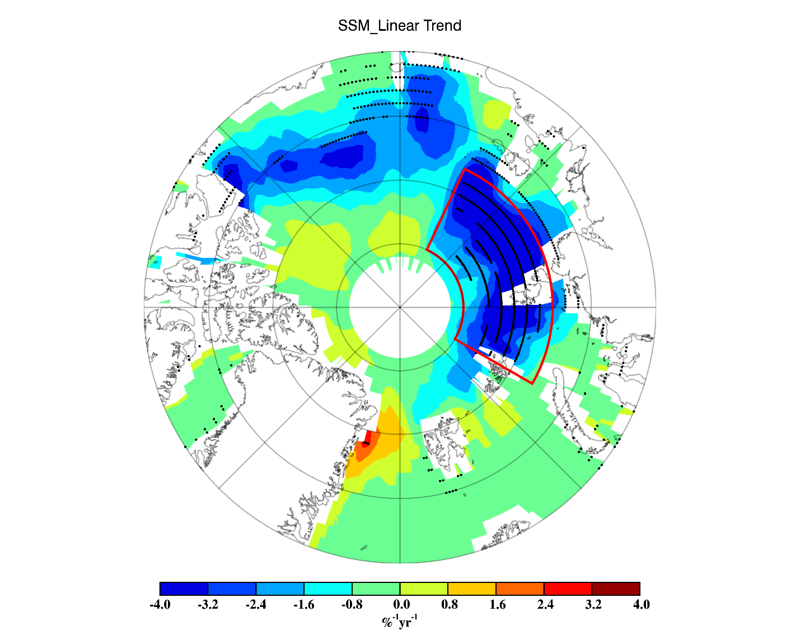
Yiyi is working on her second this summer entitled “
A prediction of 2016 September sea-ice extent minimum over the Arctic using springtime clouds and radiation properties”.
It will be submitted to GRL next week.
➔We developed a new method to estimate September SIE through 16-year (2000-2015) trends of September SIE and springtime (March-June) clouds & radiation properties from satellite retrievals, and predict a range of minimal September SIE in 2016.
➔Applying this new method to calculate September 2007 SIE, the calculations and satellite observations agree very well.
➔This prediction method provides an innovative insight to develop an empirical statistical forecast model by utilizing springtime clouds and radiation observations .
Spatial distribution of 16-year (2000-2015) linear trends of sea ice concentration over the Arctic (70°-90°N). The area of focus (AOF) is outlined in red.

Slide 4
Objective 2: Investigating the reanalyzed
hydrological cycle over the CONUS
By Wenjun Cui, Will receive her MS this summer
Cui, W., X. Dong, B. Xi, and R. Stenz, 2016: Comparison of the
GPCP 1DD precipitation product and NEXRAD Q2 precipitation
estimates over the CONUS. J. Hydrometeology, 17, 1837-1853.

Slide 5
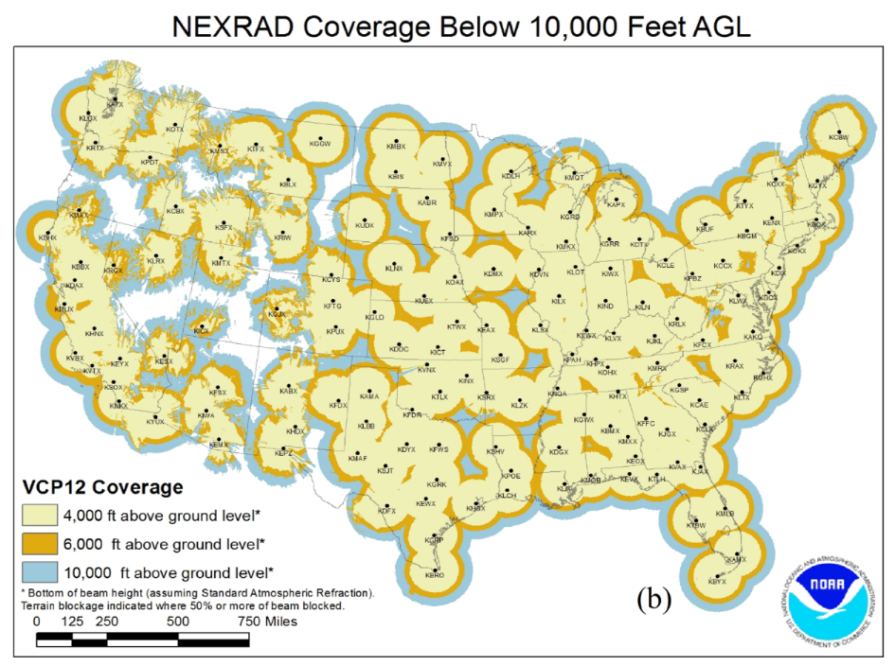
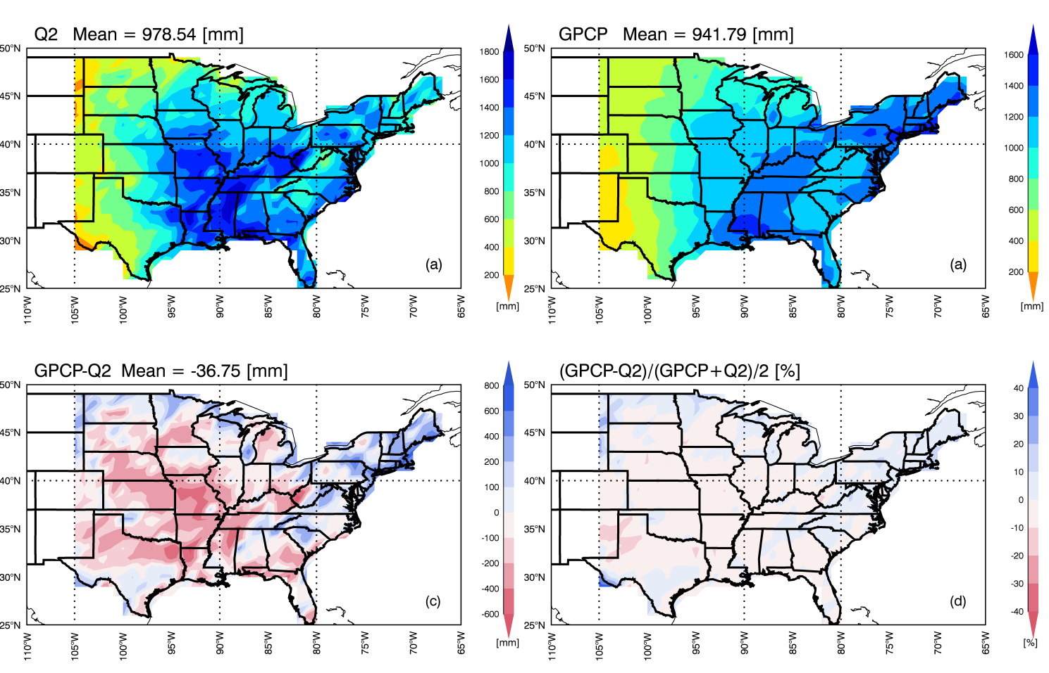
Spatial distribution for annual average precipitation
➔Both Q2 and GPCP estimates increase from west to east.
➔Although their annual means are close, large regional diff.
➔Some of Q2 estimates largely depend on radar coverage.
Appalachian Mountains
21
Notes:
Although the difference between their yearly precipitation estimates is only 36.75 mm (3.8%) over the CONUS, there are large regional differences between two datasets. Q2 estimates are much larger than GPCP estimates over the central US, up to 600 mm larger in some areas, while in northern and northeastern regions Q2 estimates are less than GPCP estimates as illustrated in Fig. 10c.

Slide 6
Wenjun is also working on her second this summer entitled
“Evaluation of reanalyzed precipitation variability and trends using the GPCP product over the CONUS”. It will be submitted to J. Hydrometeo. Next Month.
However, large regional differences exist. Reanalyses generally overestimate precipitation over the western US and underestimate over the eastern/ northeastern US.
Reanalyses can generally capture the variability of GPCP precipitation distribution over the US during the period 1980-2013.

Slide 7
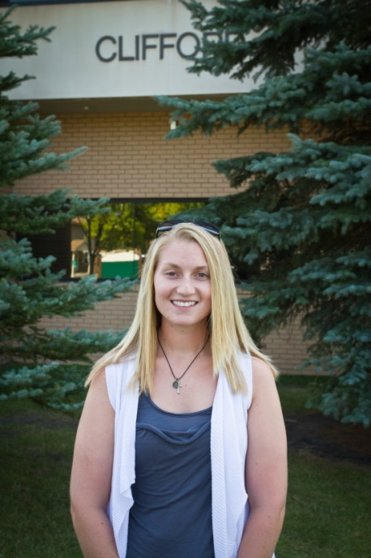
Erica Dolianr, a 2nd year’s Ph.D student,
Now she is doing summer intern at NASA
Langley Research Center this summer
Our study is beyond the two proposed objectives.
Dolinar, Erica, Xiquan Dong and Baike Xi (2016). Evaluation and intercomparison of clouds, precipitation, and radiation budgets in recent reanalyses using satellite-surface observations. Clim Dyn. (2016) 46,; 2123-2144.
She is working on her third paper this summer entitled “ A Radiation Closure Study of Clear-sky Radiative Fluxes with Inputs from Observed and MERRA-2 Atmospheric Profiles. Will be submitted to JGR.
With no-cost extension, we will continuously work on this project until next summer

