Slide 1
IARPC Reanalysis White Paper and
Overview of a new Global Weather Reanalysis for NCEP GEFS system
Tom Hamill
NOAA / ESRL / Physical Sciences Division
(303) 497-3060 tom.hamill@noaa.gov

Slide 2
Part 1: Arctic reanalysis white paper
(sponsored by IARPC, Inter-agency Arctic Research Policy Committee). Draft here; need IARPC login. authors: Richard Cullather, Tom Hamill, David Bromwich, Xingren Wu, Patrick Taylor

Slide 3
Why a white paper on Arctic reanalysis?
Inform program managers, suggesting where targeted investments needed.
  Creation of white paper initiated by program managers wanting this.
Describe how Arctic researchers can get their data plugged into future reanalyses.
Describe strengths and weaknesses of current reanalyses.
Document (draft) is here, and we welcome your comments.

Slide 4
Arctic white paper organization
Executive summary.
Introduction, including background on reanalysis, DA, uses of reanalyses with emphasis on Arctic.
Reanalyses and observations: what specific data goes into current reanalyses.
Assessments of current reanalyses.
Future developments.
Recommendations.

Slide 5
Recommendation 1: Fund the next generation of reanalyses focused on the entire Arctic.
Make all relevant Arctic data amenable to reanalysis use
Develop improved physical parameterizations in the underlying forecast model
Develop of advanced data assimilation methods for the atmosphere, sea ice, land surface, and Greenland Ice Sheet
Make computational capacity improvements that will permit extremely high atmospheric horizontal resolution (i.e., well into in the non-hydrostatic domain, 5 km or less) to capture the topographic forcing and spatial gradients with fidelity.

Slide 6
Recommendation 2: Fund development of cloud prediction at spatial resolutions used by reanalyses and for mixed phase, liquid water, and ice clouds, as well as the prediction of aerosols and their impacts on cloud formation.
Dedicated field campaigns (surface based and airborne) should be conducted to collect tailored observations characterizing the full annual cycle especially targeting cloud condensation and cloud ice nuclei. Cloud prediction is one of the greatest impediments for much improved Arctic atmospheric modeling (process to Earth System models) and the production of reliable Arctic reanalyses.

Slide 7
Recommendation 3: Promotion of joint observation-modeling-reanalysis-forecasting activities.
Interaction between observers and modelers is important for understanding observational uncertainty and improving the model representation of physical processes. One activity that is in the advanced planning stage is the Year of Polar Prediction (YOPP), 2017-2019. Following the Year of Tropical Convection (YOTC), a computer archive of all analyses, reanalyses, forecasts and observations during YOPP should be supported along with research using the archive to isolate model errors in the Arctic.

Slide 8
Recommendation 4: daily rawinsonde observations for the central Arctic Ocean.
With international coordination, action is needed to expand the sparse in situ station observing network. Also, there is an additional need for long-term (all-season) surface energy budget (radiative plus turbulent fluxes) monitoring for the evaluation of reanalyses in the sub-Arctic boreal zone region.

Slide 9
Recommendation 5: Fund studies to assess key in- situ Arctic observing system components.
Observation characterization and quality control for automatic weather station and buoy observations would be useful for reanalyses. In particular, buoy data is recognized as a critical observing system for the Arctic, and it is vital that these observations be used correctly in reanalyses.

Slide 10
Recommendation 6: Establish a mechanism to identify new and past observations suitable for new Arctic reanalyses.
A workshop should be conducted with the goals of 1) identifying the availability, quality, and potential use of accumulated in situ observations from field studies and other means that are not presently being assimilated, 2) identifying mechanisms for which future such observations would be incorporated, either through repository, GTS, or other means, and 3) assessment of the potential use of other types of novel Arctic observations including MISR cloud track winds, GPS integrated precipitable water, and GRACE-derived land soil moisture. This action should seek the participation of groups such as the WCRP Data Advisory Council.

Slide 11
Recommendation 7: Facilitate research for improving atmospheric remote sensing techniques over ice and snow.
A particular focus for the Arctic is on the assimilation of satellite sounder data over sea ice covered by low-level stratus cloud. Research should center on improving methods for retrieving the maximum usable meteorological information for these locations.

Slide 12
Recommendation 8: Promote and facilitate Arctic reanalysis intercomparison and evaluation.
To facilitate inter-comparison in important new ways, reanalysis centers should provide vertically-integrated atmospheric transports and convergence of mass, moisture, and energy. Intercomparison and evaluation activities including the Ana4MIPS program with the Earth System Grid project, and the Climate Data Guide at NCAR should continue to be developed.

Slide 13
Recommendation 9: Convene workshop to gather recommendations on what improvements to analysis and forecast systems are most necessary to improve surface analyses, with follow up by funding agencies
A large percentage of reanalysis users are concerned with surface conditions (temperature, precipitation, winds, ice state, and so forth)
Surface states in reanalyses are often biased.
Recommendations may include general topics such as:
  (a) What model and assimilation developments in the research community are ready for advanced testing and use in next-generation reanalyses?
  (b) Where are there major gaps in our knowledge of Arctic surface and near surface processes?
  (c) What targeted investments are thus most necessary to remedy gaps in knowledge and develop improved parameterizations to remedy forecast bias?
  (d) Are new observation platforms necessary, and if so, what are the most key observations?

Slide 14
Recommendation 10: Provide basic R&D funding to promote the development of strongly coupled data assimilation methodologies.
"Strongly coupled" reanalyses are clearly desirable for the Arctic, so as to better exploit the sparse observations.
Observations from the ocean or ice or land can affect the atmospheric state estimate, and atmospheric observations can change the ocean, ice, and land state.
Potentially leads to improved consistency in the analyses of state components and the ability to leverage more observational data to improve the estimates of the atmospheric state.
At the frontier of assimilation and modeling research. If the forecast interactions are mis-modeled between state components, the influence of observations from one state component on another will be mis-estimated.
Hence, strong coupling will provide a very useful diagnostic of the quality of physics at interfaces and will help determine which physical parameterizations are in greatest need of improvement.

Slide 15
Recommendation 11: Education and outreach to Arctic communities should be supported to provide compelling visualizations of the changing Arctic based on reanalyses.
The great power and promise of reanalyses is only realized when a wide and diverse community including stakeholders is able to make appropriate use of these data.

Slide 16
Part 2: A global, modern-era reanalysis for the NCEP GEFS

Slide 17
Basic information on upcoming reanalysis
Goal: Produce ~ 20-year (maybe more…) reanalysis and reforecast for upcoming NCEP GEFS v12, and set up durable infrastructure for similar future reanalyses/reforecasts.
PI: Tom Hamill (ESRL/PSD)
co-I: Hendrik Tolman (NCEP/EMC)
Technical leads include: Jeff Whitaker (PSD), Arun Kumar (CPC)
Funding to: PSD, EMC, CPC (from NGGPS and OAR/CPO)
Start of funding: 1 April 2016 (OAR/CPO); earlier start for NGGPS.
  3 years, pending suitable performance.

Slide 18
Overall plan
Explore issues related to best (feasible) way to do a multi-decadal atmosphere-only reanalysis, dedicated to GEFS reforecast initialization, fitting within operational constraints.
  Dealing with technical issues
  Development of observation database and diagnostics.
  Produce low-resolution “scout runs” to test.
Produce the reanalysis.
Produce the reforecast.
Subsequent to this project, use GEFS reforecasts for post-processing.
Establish a durable, re-usable reanalysis infrastructure.

Slide 19
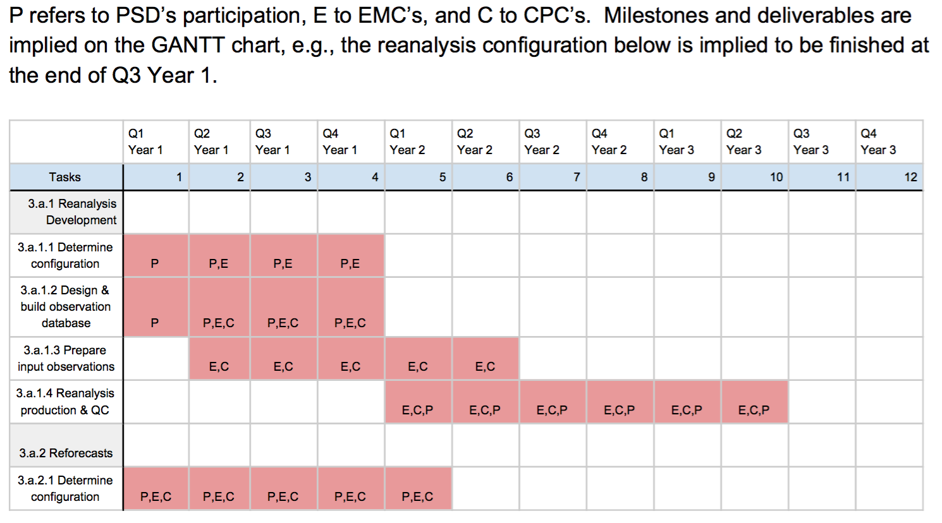
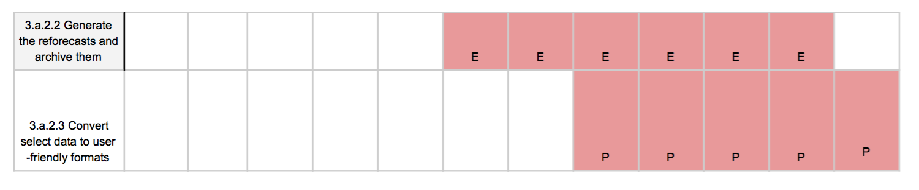
GANTT-type chart with organizational responsibilities

Slide 20
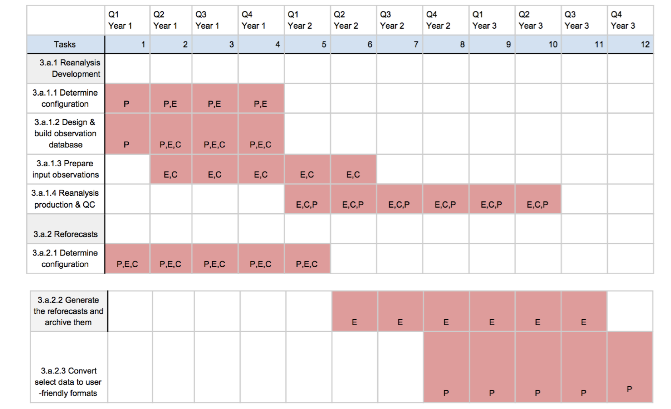
Reanalysis sub-task: determining the configuration.
Consistency vs. computational expense.
Breaking reanalysis into streams.
Observation network non-stationarity.
Changes in BUFR data since last CFSR.
Some practical challenges.

Slide 21
Tradeoff: consistency with operations vs. computational expense
Operational system: T1534 control, T574 80-member ensemble, 4D-En-Var assimilation methodology
A multi-decadal reanalysis at this resolution would likely fill up the WCOSS developmental system, swamp the disk and tape storage systems.
A computationally preferable alternative: T574 both for control and ensemble
  might be necessary to back off further, e.g. T574 control, T382 ensemble.
Experience has shown (e.g., GFS resolution change circa 2012 in DA system) that systematic errors of background forecast are resolution dependent. Question is whether reanalyses with lower-resolution version “close” enough to operational analyses.
Hence, we will perform:
  More explicit timing tests on T1534/T574, T574/T574, T574/T382.
  Comparisons of parallel runs at different resolutions to determine if systematic errors change significantly.
Will make recommendation on configuration based on these results.

Slide 22
Technical issue: breaking reanalysis into streams
Experience with CFSR was that breaking production into streams introduced discontinuities, especially in near-surface fields.
  Attributable to soil moisture difference between reanalysis at end of one stream, reanalysis at beginning of another.
  In CFSR, soil initialized with GLDAS, with spinup.
Experiment: Test overlapping streams at much reduced resolution (T254) with GLDAS initialization from offline run; see if this reduces or eliminates discontinuity.

Slide 23
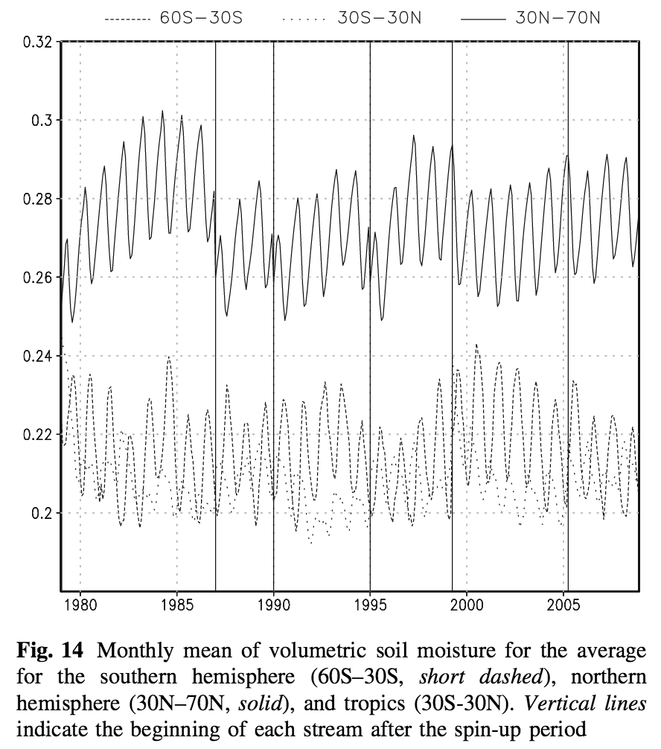
Soil moisture in CFSR, and streams
Each stream was started with ….
Notice discontinuities in especially N. Hem.
soil moistures. Since soil moisture largely
controls Bowen ratio (partitioning between
surface sensible and latent heat) this strongly
affects surface temperatures in reanalyses.
from http://www.cpc.ncep.noaa.gov/products/people/yxue/pub/28.pdf

Slide 24
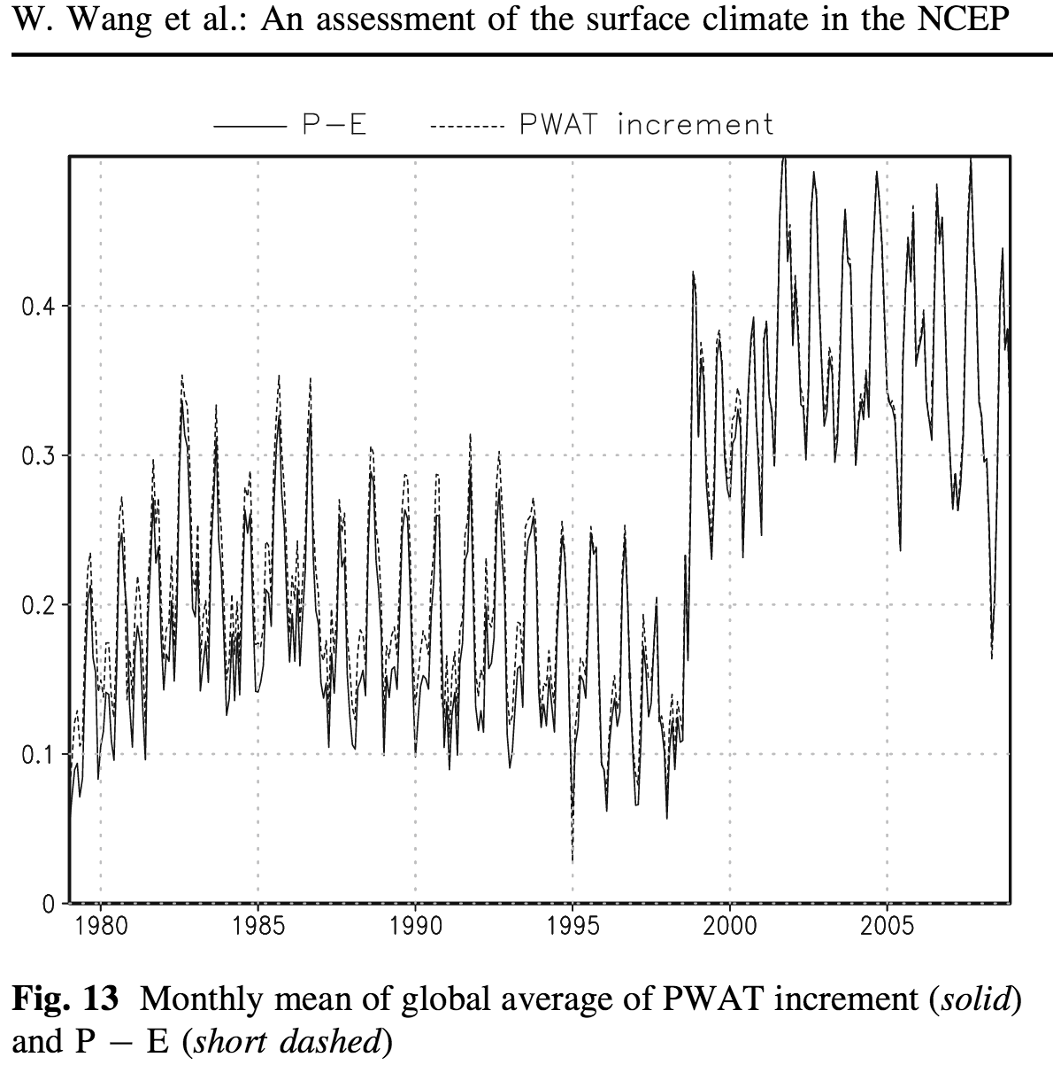
Technical issue: changing of observation network over time.
Change from TOVS to ATOVS
circa 1999, with more data
and of better quality.
QuikScat sea-surface winds
start in 2001, introducing another
smaller discontinuity.
We welcome ideas for how to deal with
this; aside from better background forecasts
(that are unbiased) this is very challenging.
from http://www.cpc.ncep.noaa.gov/products/people/yxue/pub/28.pdf

Slide 25
Practical challenge
The (talented) woman we hired to do much of the exploration of scientific and technical issues is still waiting for her security clearance for WCOSS, 6+ months after initiating paperwork.
  We’re pairing her up with another person who does have WCOSS clearance, but of course less productivity that way.

Slide 26
Task: build and design “observation database”
Issues:
Challenging to get new observations into BUFR.
Somewhat old infrastructure for examining forecast minus observation time series and other diagnostics.
Observations that weren’t assimilated are not in GSI “diag” files, and not able to be examined in current infrastructure.
Goal: an interim observation database capability,
with a more modern, integrated capibility saved
for the GSI code refactor (“JEDAI” – Tom Auligne).

Slide 27
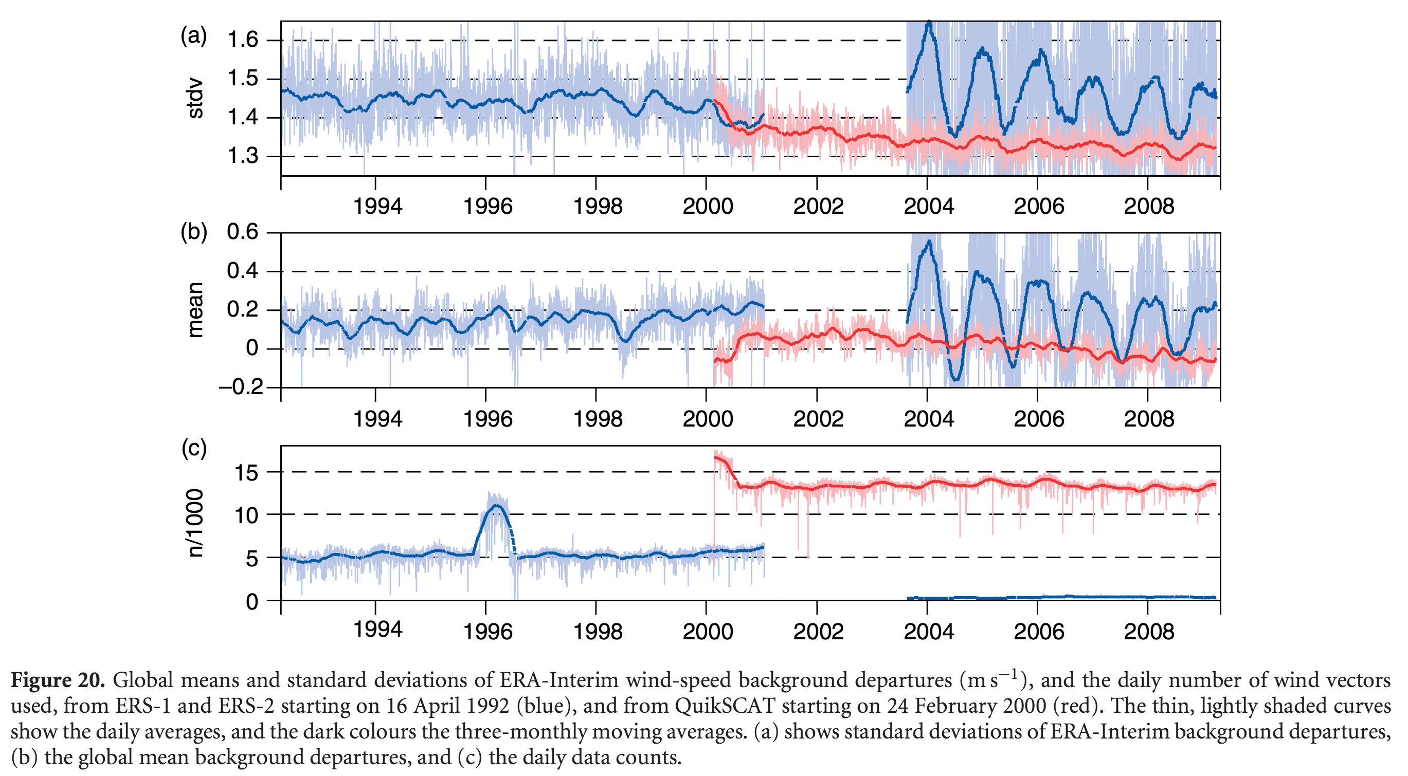
Fit of short-term forecasts to observations can be revealing of DA system characteristics.
background departures
standard deviation
background departure
mean
number of observations
from Dee et al. 2011, http://onlinelibrary.wiley.com/doi/10.1002/qj.828/pdf

Slide 28
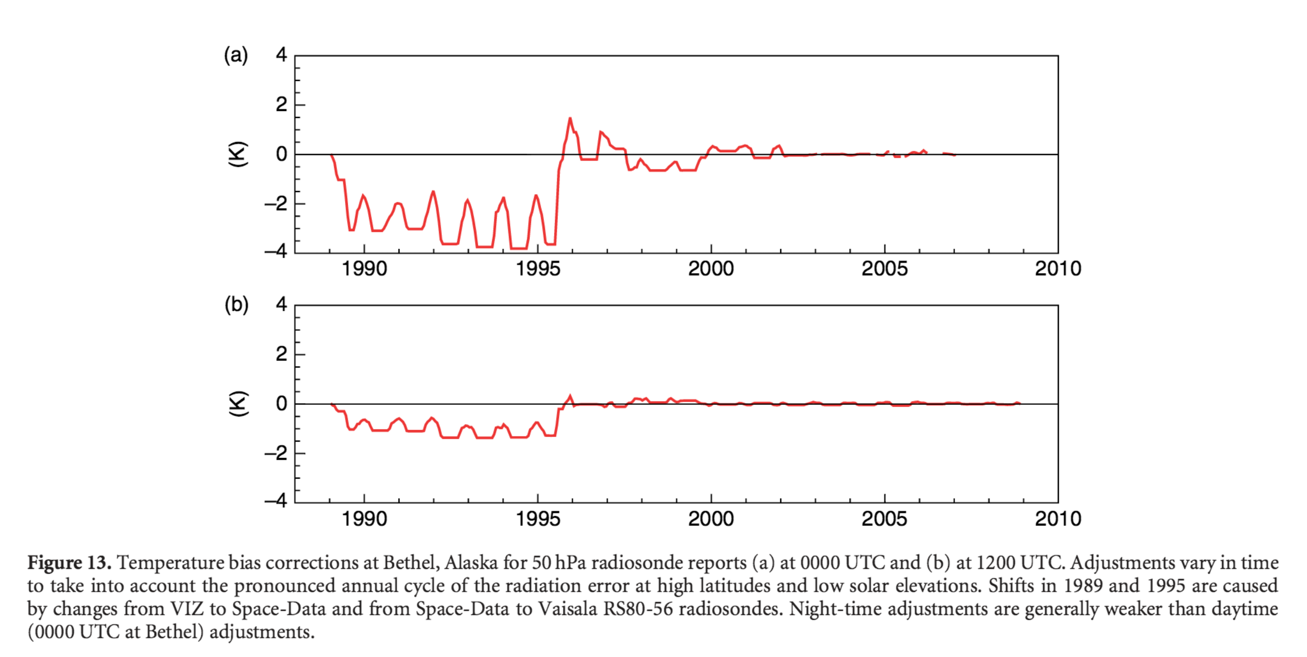
Fit of other quantities (here bias corrections) can be revealing also.
biases of
raobs changed
when the
particular
raob instrument
was changed.
from Dee et al. 2011, http://onlinelibrary.wiley.com/doi/10.1002/qj.828/pdf

Slide 29
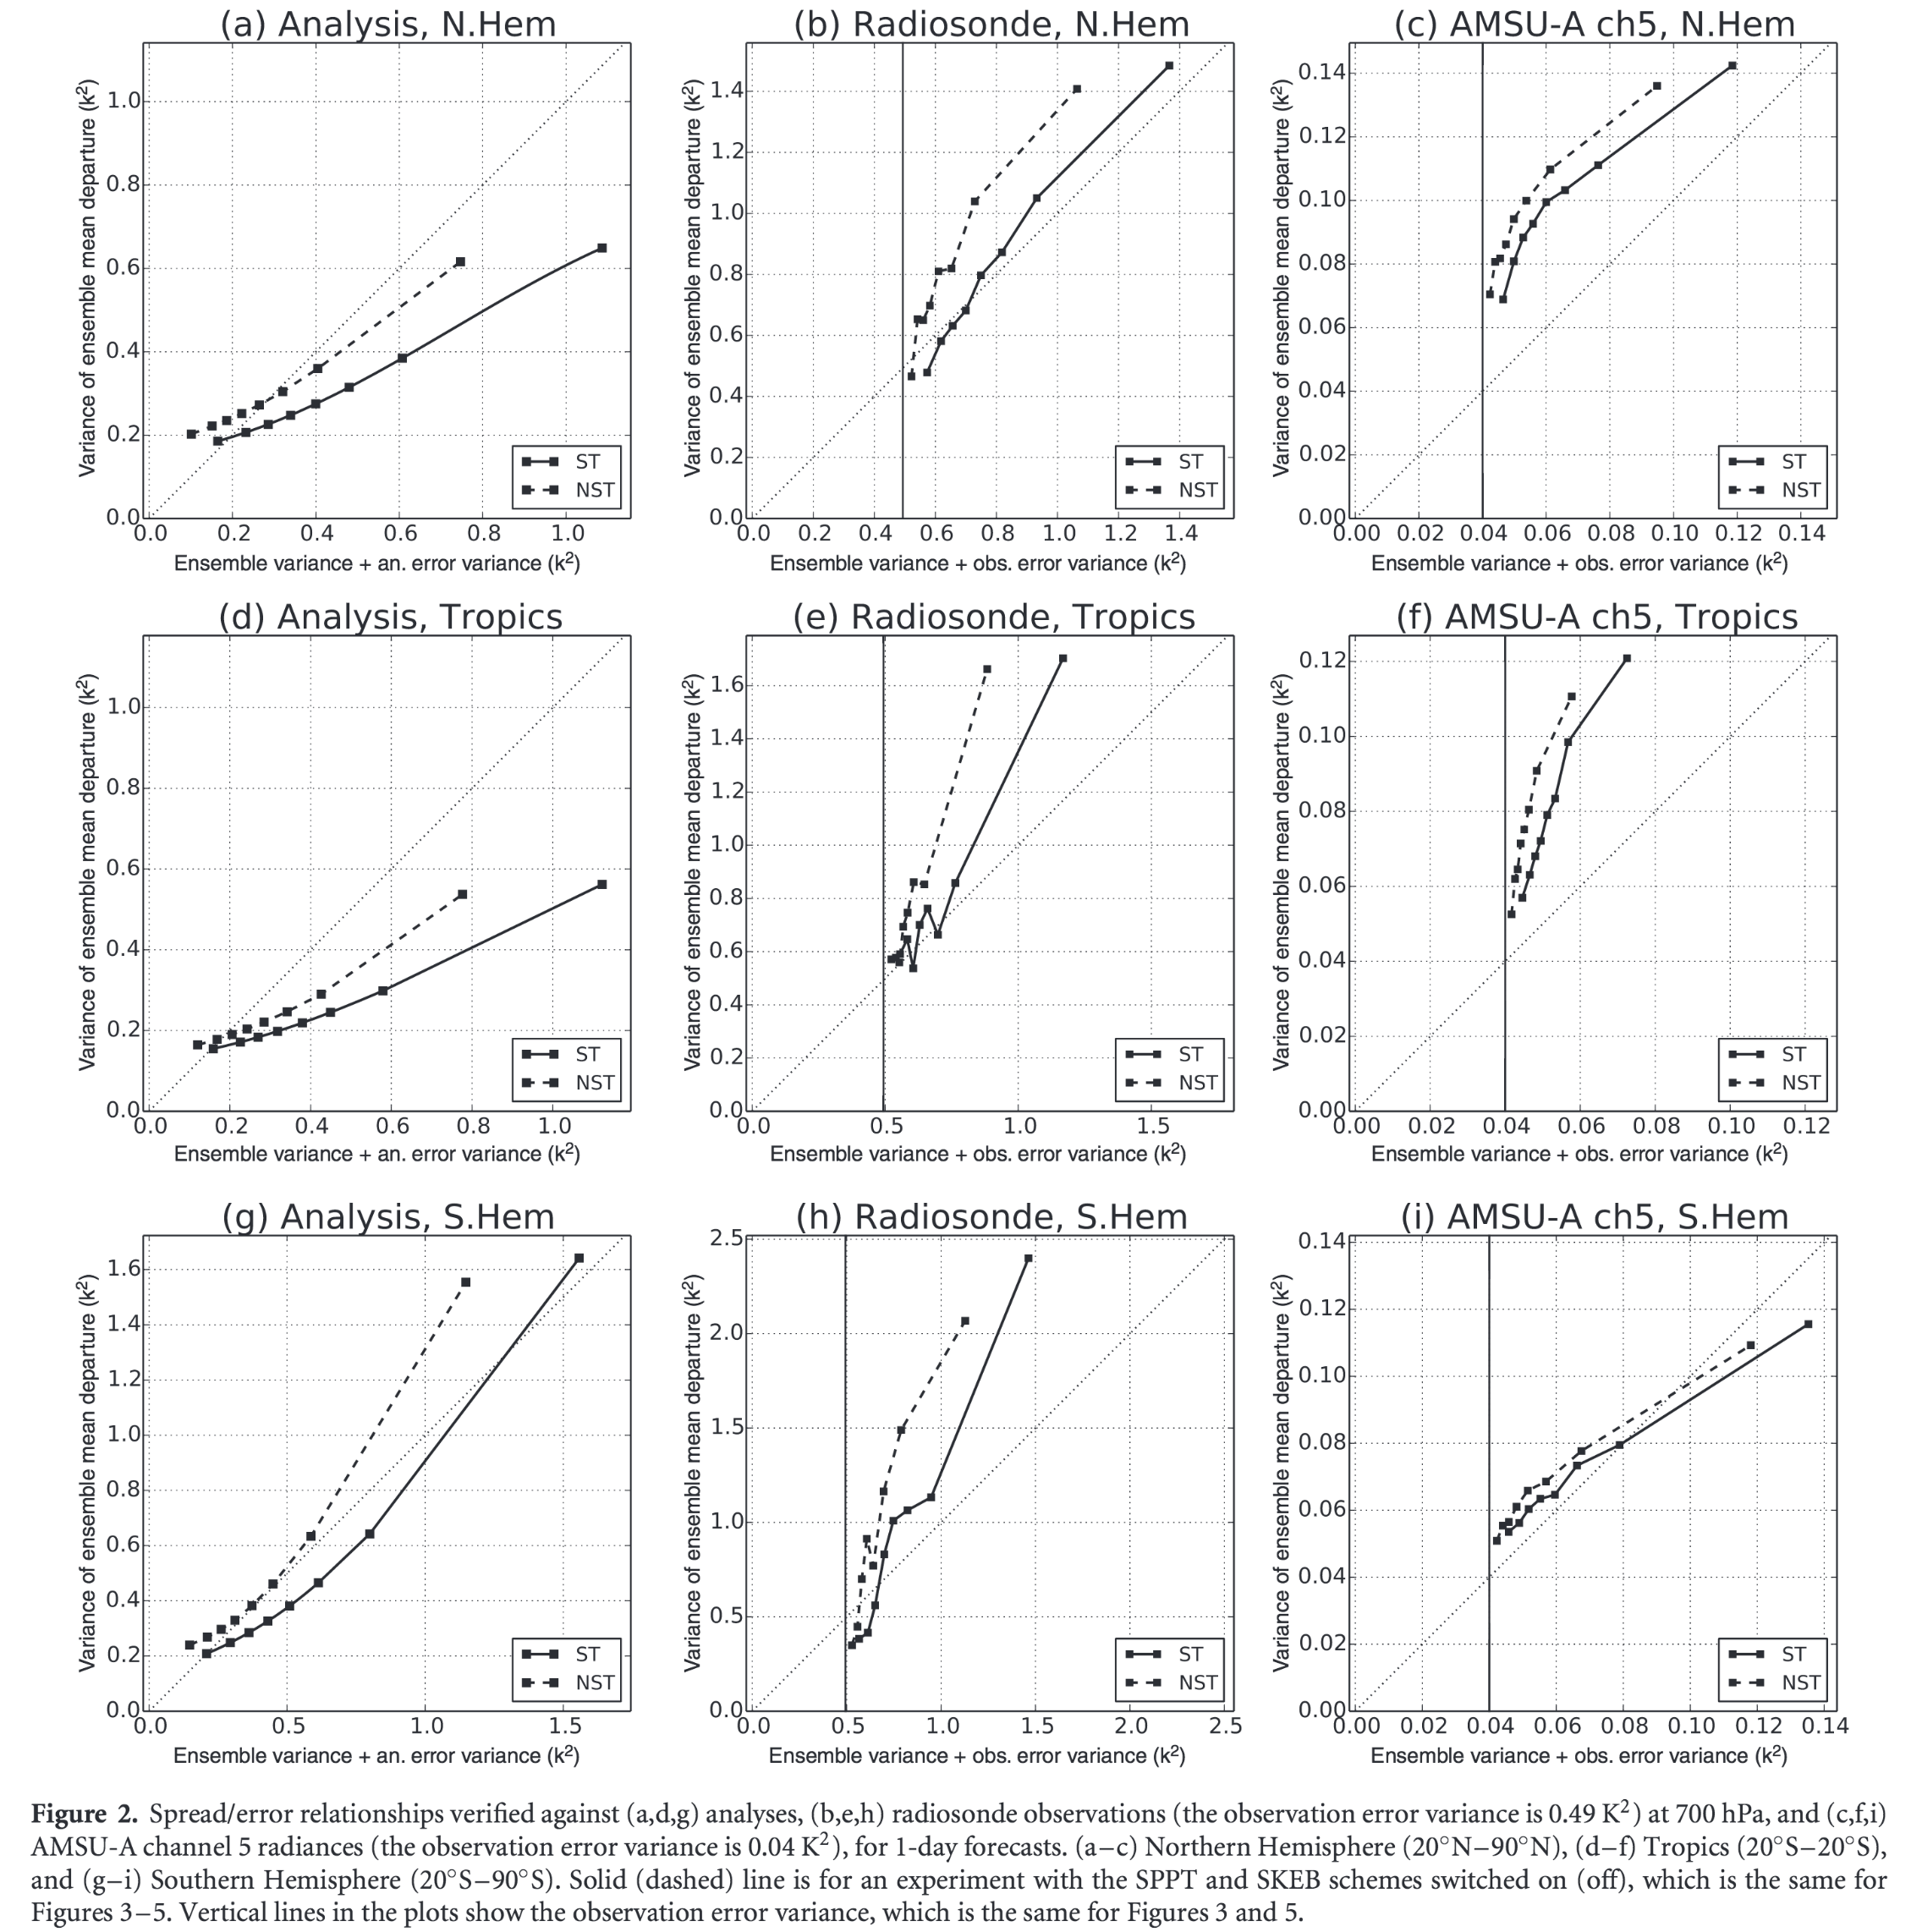
Fit of observations to longer-lead forecasts can also be revealing.
With stochastic physics and verification against analysis, ECMWF ensemble appears to be underspread (left-most
column).
Verifying against raobs or AMSU-A channel 5, one has the impression that the ensemble is still under-spread.
Yamaguchi et al. 2016, http://onlinelibrary.wiley.com/doi/10.1002/qj.2675/abstract

Slide 30
Our intent: an observation database (ODB) capability for the GSI. In these file(s) would be:
Observations (all, including those not assimilated).
Metadata (time stamp, QC flags, lat, lon, observation error assigned).
O minus F (including spread if ensemble DA used).
O minus A.
Bias-correction information.
Usage flags.

Slide 31
Longer-term vision for how this might work in JEDAI (GSI code refactor)
GTS
(and other sources)
Observation Processing
• read obs (bufr, HDF, netCDF, ascii)
• set R
• basic QC
Observer
• read background forecast(s)
• data thinning/channel selection
• interpolation
• forward operator
• background check QC
• Compute O-F, O-A
Observation Database Manager
Relational Database (like ODB), and/or hierarchical dataset (HDF5, netCDF)
(replaces BUFR tanks and
dump files)
O, R, metadata
O minus F, O minus A, QC,…
Solver
(hybrid EnVar, EnKF)

Slide 32
Patching the GSI to provide ODB capability while we await the GSI refactor.
Can be done in the short term for next GEFS reanalysis/reforecast without changing NCEP operational workflow.
Enables easier access to observations and ‘assimilation feedback’ information for monitoring, diagnosis, research.
Amounts to pre/post processing input BUFR, output GSI diagnostic files.

Slide 33
BUFR (prepbufr, radiance bufr, satwnd bufr, gpsro bufr…)
GSI
data assimilation
system
analyses
GSI diagnostic files (containing obs ingested by GSI, departures, QC, bias correction info)
(the current system)

Slide 34
BUFR (prepbufr, radiance bufr, satwnd bufr, gpsro bufr…)
GSI
data assimilation
system
analyses
python utilities:
bufr2nc (outputs BUFR as netCDF file)
merge_gsidiag_bufr2nc (matches records in GSI diagnostic file with original BUFR, adds depatures, ens. spread in ob space, QC, other DA info)
new_obs_2nc (various codes tailored to particular research data sets)
GSI diagnostic files (containing obs ingested by GSI, departures, QC, bias correction info)
OpenDAP
data server, access to research community
Observation
database
nc2prepbufr
(convert back to GSI compatible BUFR)
Other observation sources (field experiments, research instruments, etc.)
with proposed modifications

Slide 35
Reanalysis task 3: prepare input observations
If all else fails, could use CFSR BUFR data
But hope to use reprocessed AMVs, other data sources not in CFSR, leveraging ODB.
In actuality, this task done early in preparation for ”scout runs.”

Slide 36
Reanalysis task 4: produce the reanalysis
What could possibly go wrong?

Slide 37
Conclusions
We welcome feedback on Arctic reanalysis white paper.
We welcome feedback on plans for modern-era reanalysis.
  with limits; please don’t suggest “do fully coupled” or “do 40 years”

