Slide 1
Diagnosing and quantifying uncertainties of
the reanalyzed clouds, precipitation and
radiation budgets over the Arctic and SGP
using combined surface-satellite observations
PI: Xiquan Dong, Uni. of North Dakota
Three Graduate Students:
Erica Dolinar, second year’s Ph.D student
Yiyi Huang, second year’s MS student
Wenjun Cui, second year’s MS student

Slide 2
Two Objectives in Proposal
Objective 1: Quantifying the uncertainties of reanalyzed Arctic cloud-radiation properties using satellite-surface data
Objective 2: Investigating the reanalyzed hydrological cycle at SGP

Slide 3
1) Evaluation of MERRA-2 atmospheric temperature, water vapor, and ozone profiles over three climate regimes (nearly submitted to JGR) by Erica Dolinar
Three Topics
2) Quantifying the uncertainties of reanalyzed Arctic cloud and radiation properties using satellite-surface observations (submitted to Clim Dyn) by Yiyi Huang
3) Comparison of the GPCP 1DD Precipitation Product and NEXRAD Q2 Precipitation Estimates over the CONUS (accepted by J. Hydrometeo) by Wenjun Cui

Slide 4
1) Evaluation of MERRA2
What: Evaluating clear-sky MERRA2 temp., water vapor, and ozone profiles
Where: Three ARM sites (SGP, NSA, TWPC3)
When: 08/2004 – 12/2010
Why: MERRA profiles have been used by NASA CERES team to calculate radiative fluxes. With newly released MERRA2, it is better to estimate its uncertainties.

Slide 5
Generating hybrid atmospheric profiles from DOE ARM and NASA satellite observations
Atmospheric Temperature and water vapor profiles
➔From surface to 100 hPa: DOE ARM Merged sounding
➔Above 100 hPa: NASA Microwave Limb Sounder (MLS)
Atmospheric Ozone Profile
From surface to 260 hPa: NASA Atmospheric Infrared Sounder (AIRS)
Above 260 hPa: NASA MLS
Clear-sky cases selected at three ARM sites
Notes:
Stratospheric ozone from MLS is retrieved at a frequency of 240 GHz
The acceptable range of the MLS retrieved temperature is 261 – 0.001 hPa with a bias of ~1 K
Biases in the AIRS retrieved ozone are estimated to be less than 5% in the troposphere and stratosphere
For consistency, the temperature and water vapor profiles are interpolated to the ozone levels, as the resolution (standard pressure levels) of the AIRS level-3 product is much more coarse than that of the ARM merged sounding.

Slide 6
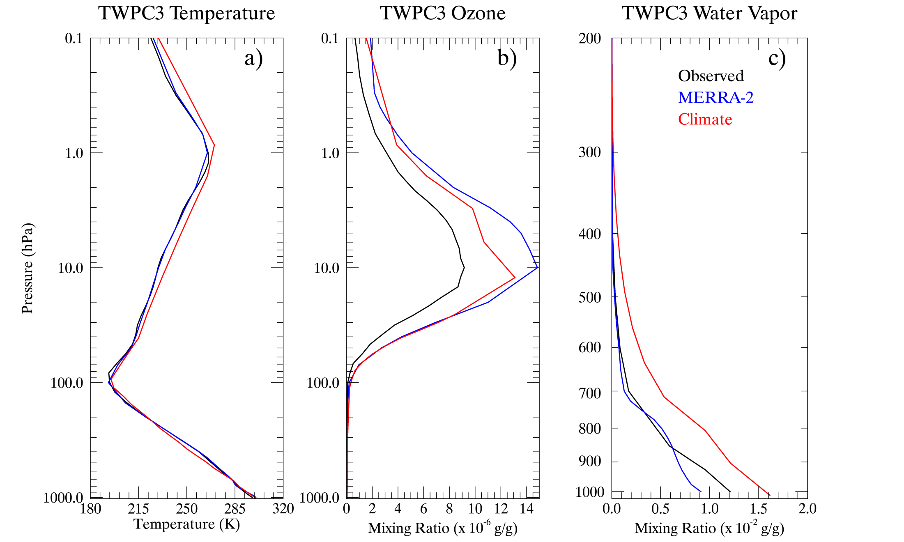
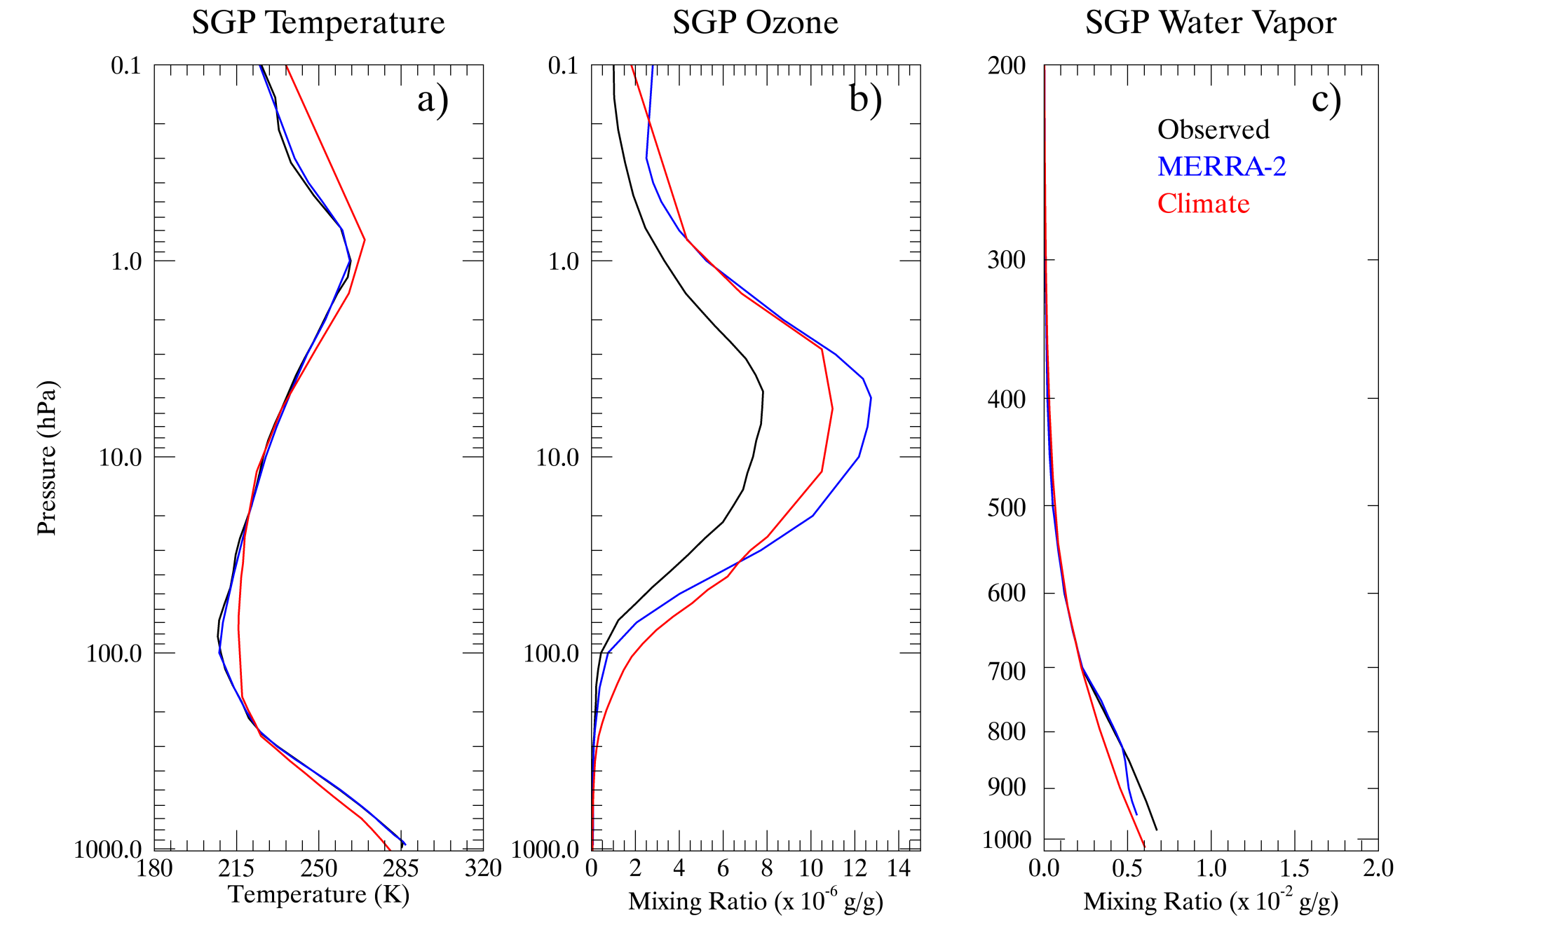
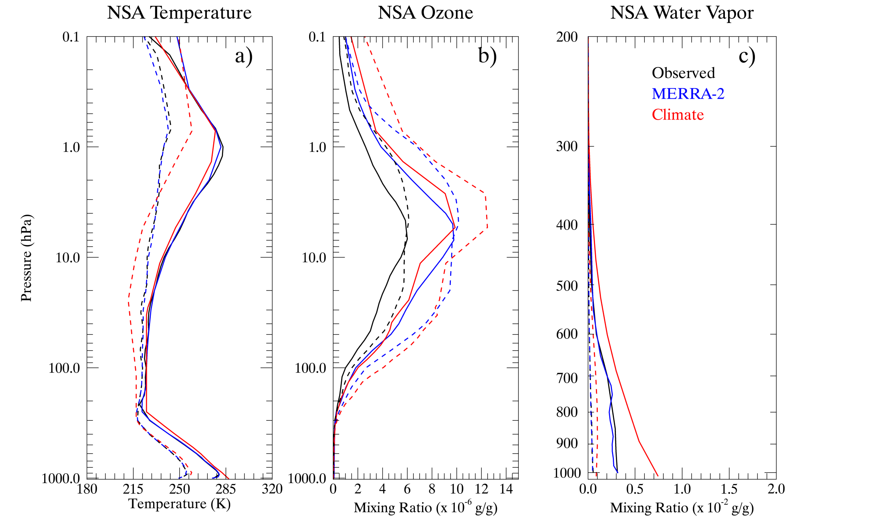
Atmospheric Profiles
Solid: Snow-free
Dashed: Snow
words
Temperature is relatively well replicated in MERRA-2
MERRA-2 stratospheric ozone is much larger than the observed one
Boundary layer water vapor is drier in MERRA-2 than ARM merged sounding
Notes:
Even the characteristic low-level temperature inversion of the Arctic is captured in the reanalysis.

Slide 7
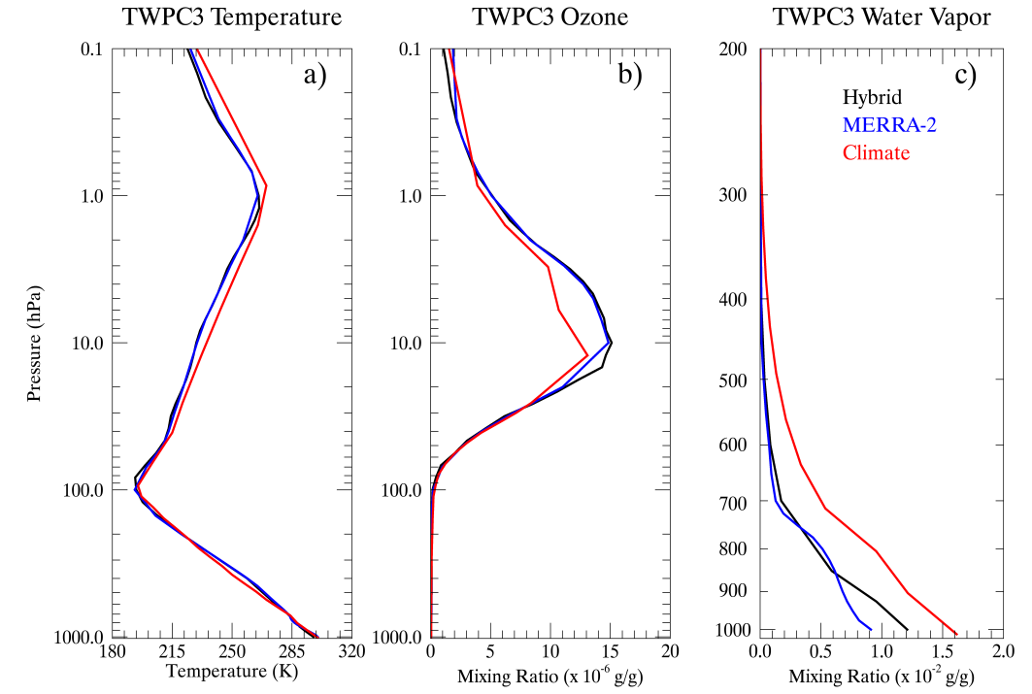
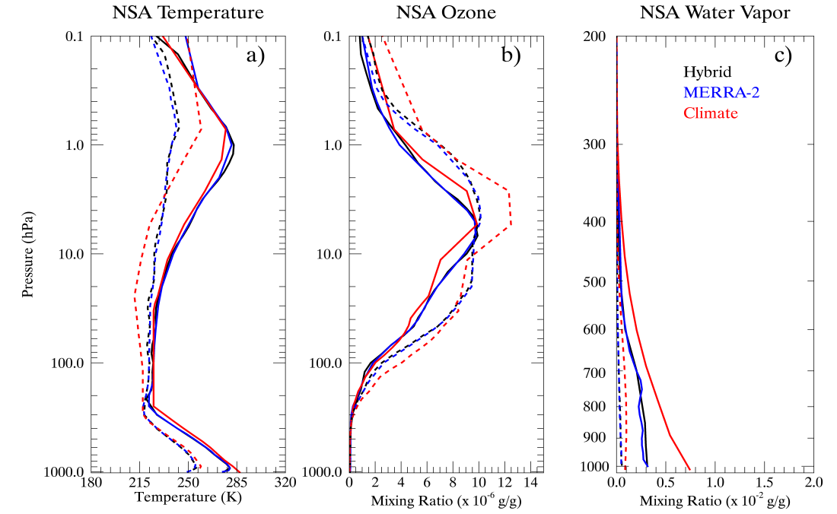
Corrected MLS Ozone profiles
After timing a conversion factor of 1.65 for old one (for unit conversion), the corrected MLS observed ozone mixing ratios are nearly identical to the MERRA-2 assimilated ones. Thank Mike Bosilovich for pointing out this calculation error.

Slide 8
Part II:
Quantifying the uncertainties of reanalyzed Arctic cloud and radiation properties using satellite-surface observations

Slide 9
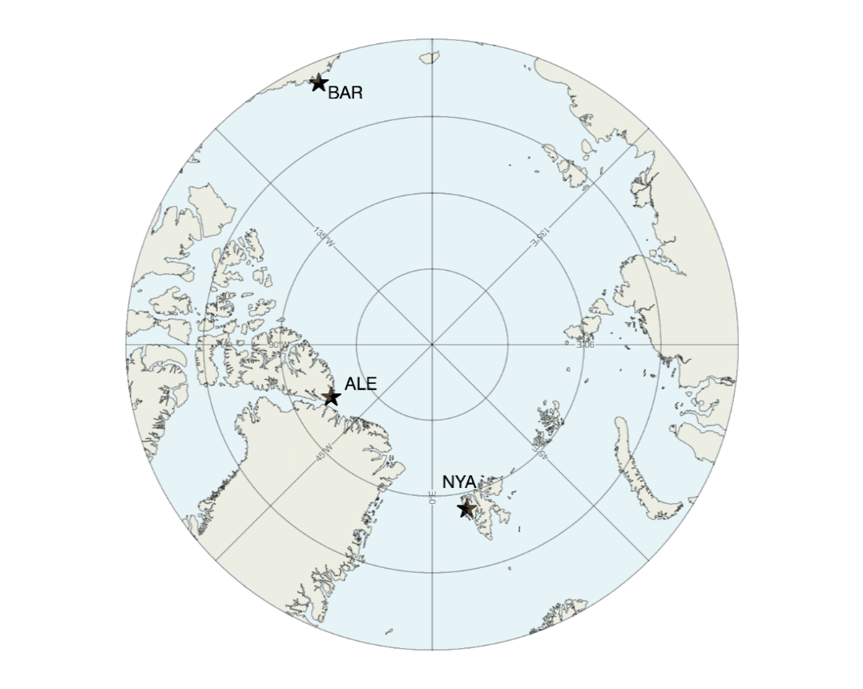
Time frame: 03/2000-02/2012 (Monthly data)
Area of interest: Arctic (70°-90°N)
Satellite observations
NASA CERES-MODIS SYN1deg Ed3A (cloud fraction)
CERES EBAF-TOA and -Surface Ed2.8 (TOA and surface radiation fluxes)
Global reanalyses
JMA Japanese 55-year Reanalysis (JRA-55)
NOAA-CIRES Twentieth Century Reanalysis Version 2c (20CRv2c)
NCEP Climate Forecast System Reanalysis (CFSR)
ECMWF ERA-Interim (ERA-Interim)
NASA Modern-Era Retrospective-Analysis for Research and Applications Version 2 (MERRA-2)
12 years of gridded monthly mean data from satellite and reanalyses are interpolated and re-gridded to the same spatial resolution (2° × 2°) during the comparisons

Slide 10
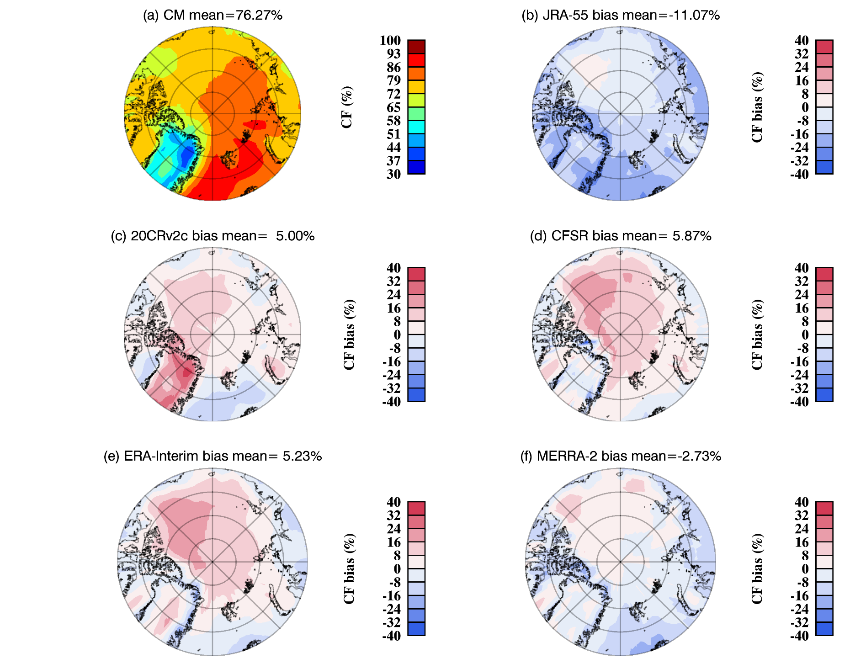
Cloud Fraction (CF) in summer (JJA)
76.3%
Reanalysis | Bias (%) | RMSD (%)
JRA-55 | -11.1 | 12.40
20CRv2c | 5.0 | 10.06
CFSR | 5.9 | 11.36
ERA-I | 5.2 | 11.56
MERRA-2 | -2.7 | 7.05
JRA-55, negative bias across over entire Arctic
20CRv2c, CFSR and ERA-I: positive bias over Arctic ocean
MERRA2: good job
Notes:
The largest CFs (>90%) occur in the Atlantic side of the Arctic Ocean where the North Atlantic cyclone track frequently advects warm and abundant moisture over there. In contrast, the CFs over Greenland and Ellesmere Island are minimal (<60%) because these regions are dominated by a more stable boundary layer and anti-cyclonic weather systems

Slide 11
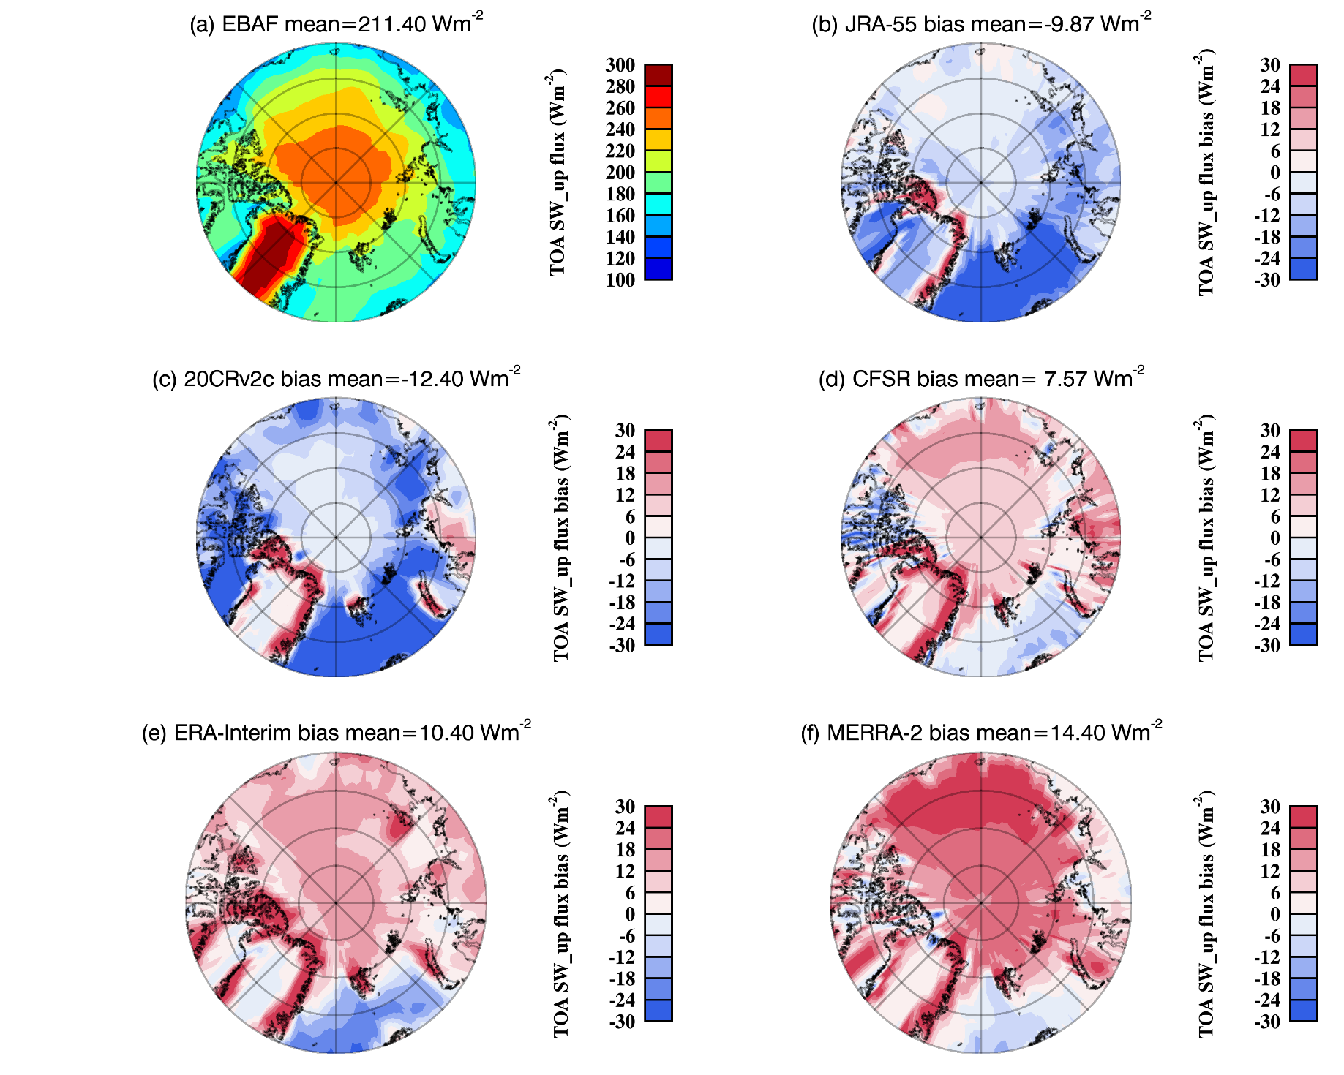
Reflected SW flux at Top Of Atmosphere (TOA) in JJA
211.4 Wm⁻²
Reanalysis | Bias (W/m²) | RMSD (W/m²)
JRA-55 | -9.9 | 23.4
20CRv2c | -12.4 | 24.7
CFSR | 7.6 | 19.7
ERA-I | 10.4 | 21.2
MERRA-2 | 14.4 | 20.4
All five reanalyses show positive biases along the northern and eastern coasts of Greenland

Slide 12
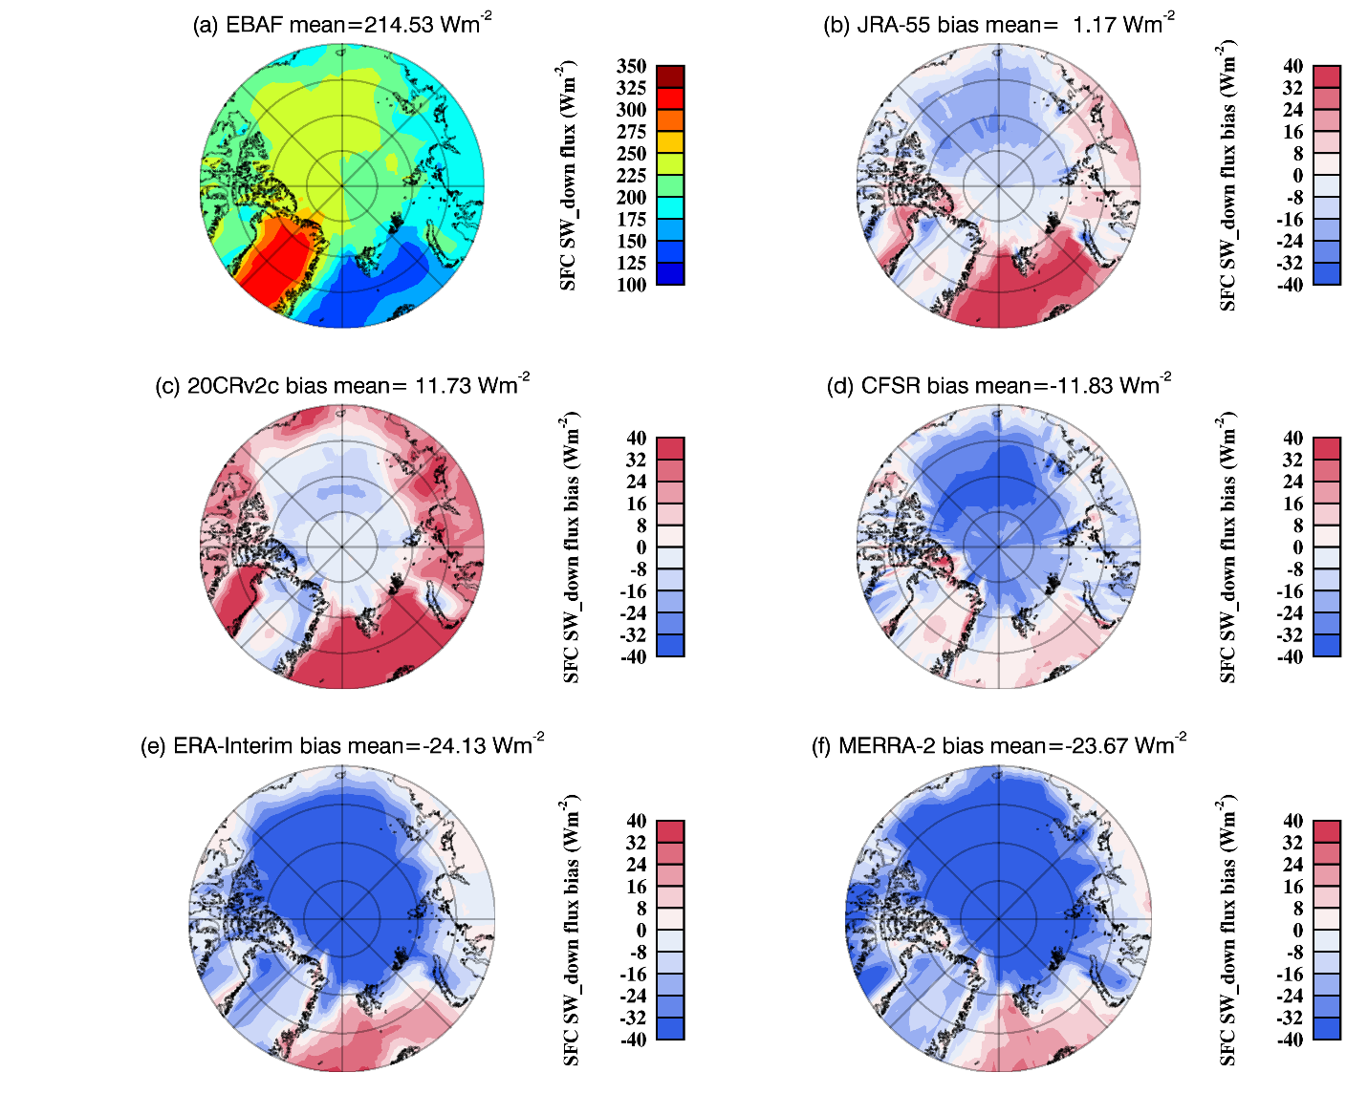
SW_down flux at the surface in summer
214.5 Wm⁻²
Reanalysis | Bias (W/m²) | RMSD (W/m²)
JRA-55 | 1.2 | 18.99
20CRv2c | 11.7 | 22.93
CFSR | -11.8 | 24.12
ERA-I | -24.1 | 45.58
MERRA-2 | -23.7 | 35.41
All have positive biases over Atlantic Ocean, but negative biases over Arctic Ocean

Slide 13
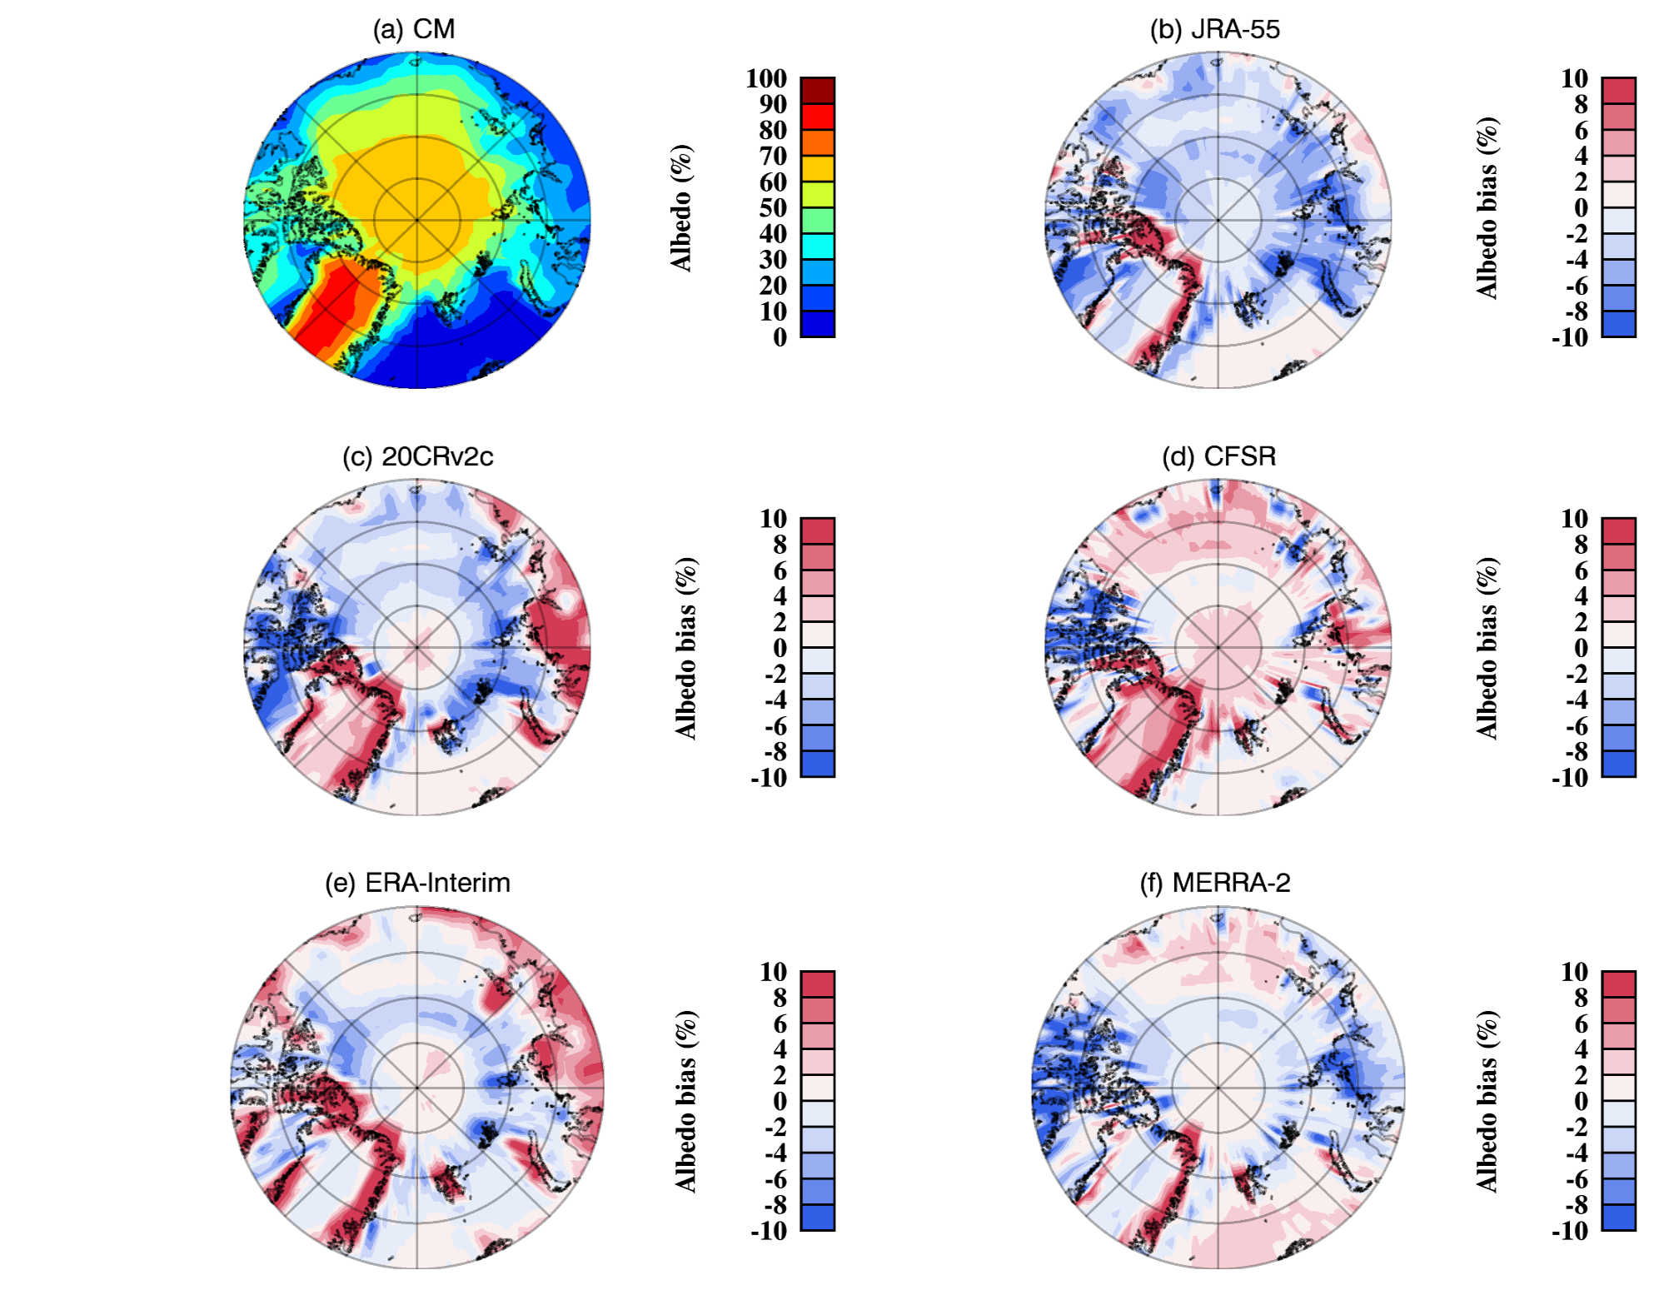
Surface SW albedo in summer
Along northern and eastern coasts of Greenland:
➔Positive biases in surface albedo, as well as in Surface and TOA SW_up fluxes
Conclusion:
In all reanalyses, they have wrong representation of surface types over coastal Greenland

Slide 14
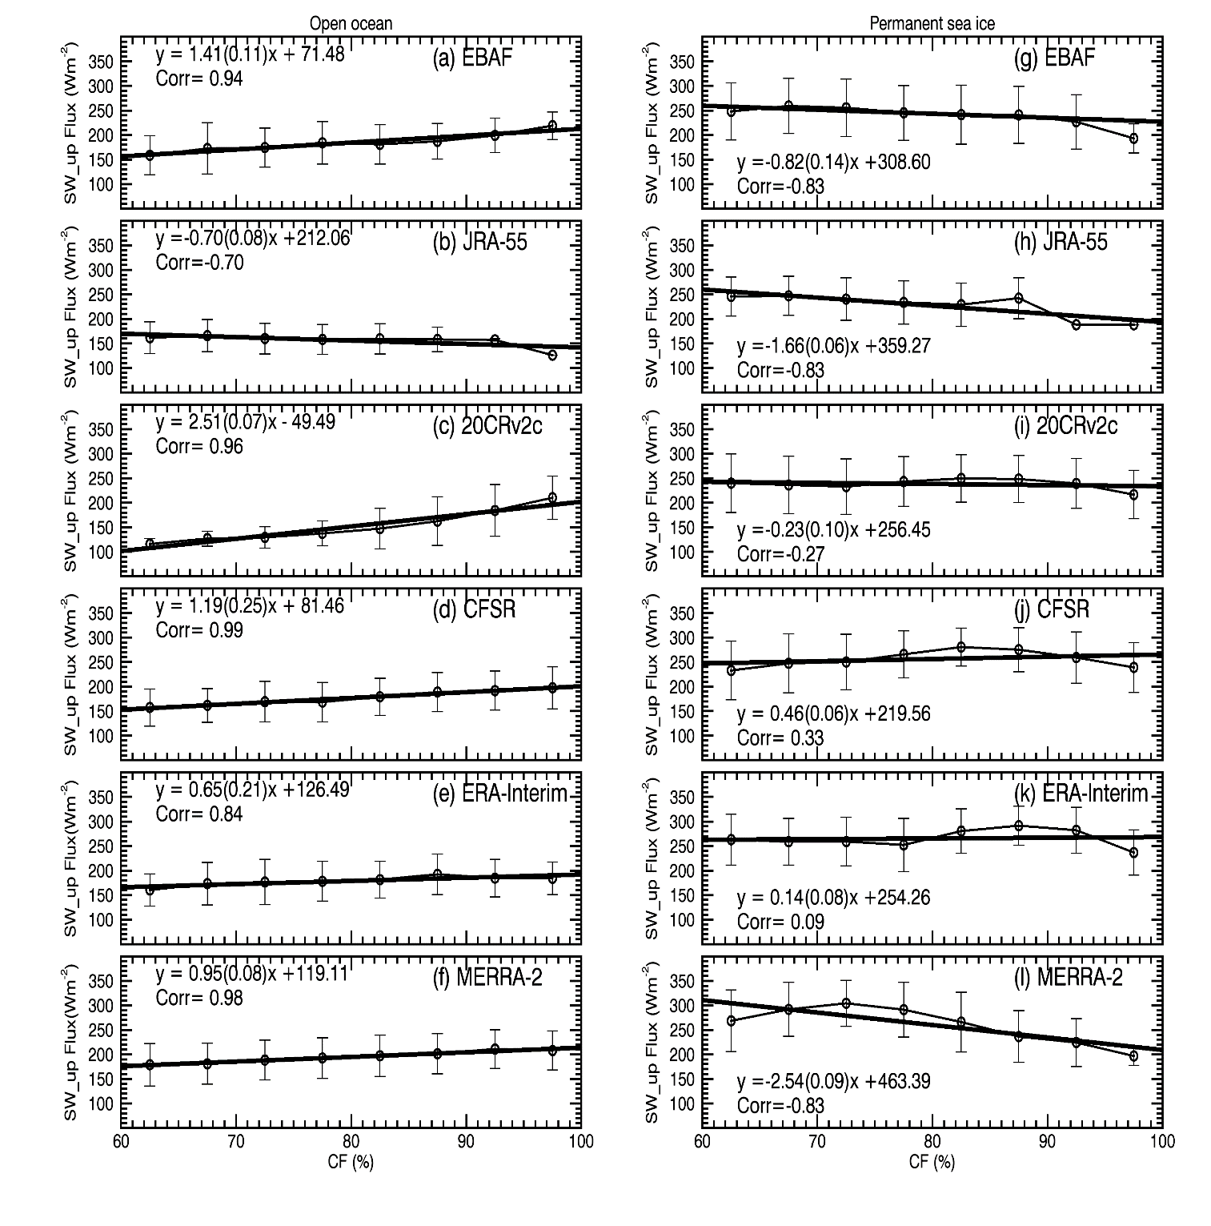
TOA SW_up flux vs. CF over Open Ocean and Sea ice (JJA)
Open ocean
Sea ice
From CERES data, TOA SW_up flux increases with increasing CF over open ocean, but slightly decreases over sea ice.
Sea ice:80°-90°N, 0 °-360°
Open ocean:70°-80°N, 0°-45°E
Notes:
The values in JRA-55 for CFs > 90% are not reliable due to lack of samples
For open ocean, all reanalyses have very high correlations between the binned SW_down fluxes and CFs, while the differences in various reanalyses are larger in permanent sea ice.

Slide 15
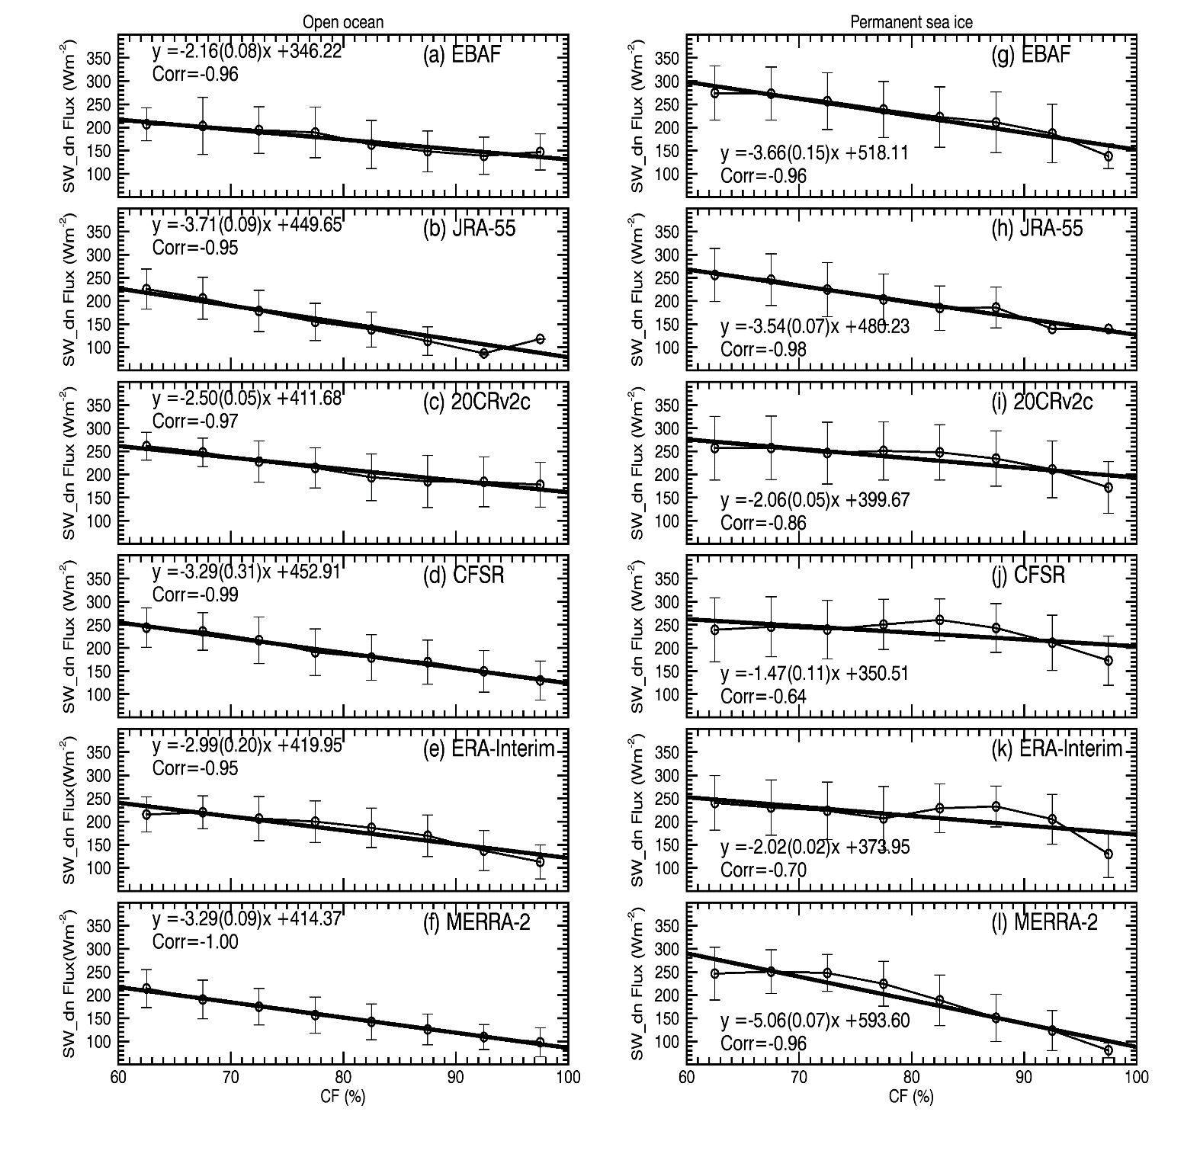
Surface SW_down flux vs. CF over Open Ocean and Sea ice (JJA)
Open ocean
Sea ice
➔SW_down fluxes decrease with increasing CFs over both open ocean and sea ice (high albedo, multiple reflections)
➔Most of reanalyzed results capture these decreasing trends.
Sea ice:80°-90°N, 0 °-360°
Open ocean:70°-80°N, 0°-45°E

Slide 16
Taking home message
All 5 reanalyses can simulate similar distribution of observed cloud fractions over Arctic region during summer, with best in MERRA2 and worst in JRA-55
All 5 reanalyses had wrong representation of surface types over northern and eastern Greenland during summer time.
Reanalyses can capture the relationship between SW fluxes and CF over open Ocean, but have difficulties over Sea ice, particular at TOA.

Slide 17
Part III:
Comparison of the GPCP 1DD Precipitation Product and NEXRAD Q2 Precipitation Estimates over the CONUS

Slide 18
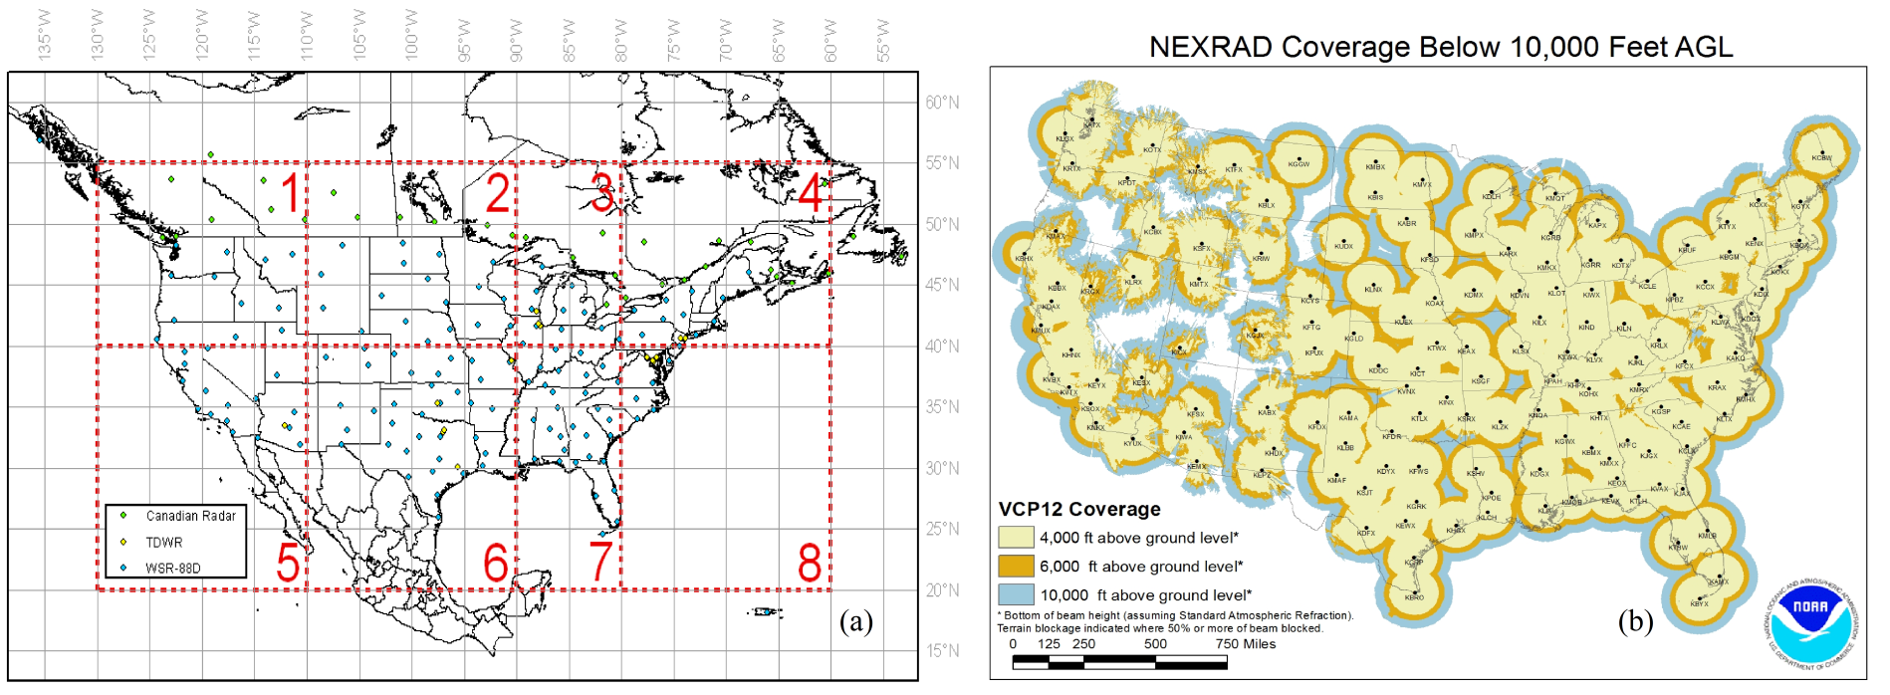
Datasets
Satellite-based GPCP 1DD (Version 1.2): Global coverage,
1 °× 1°, Daily
Radar-based NMQ Q2 (radar only): Cover CONUS,
1 km × 1km, 5-min
Study Period: 2010-2012
Study Region: CONUS except for Mountain regions
17

Slide 19
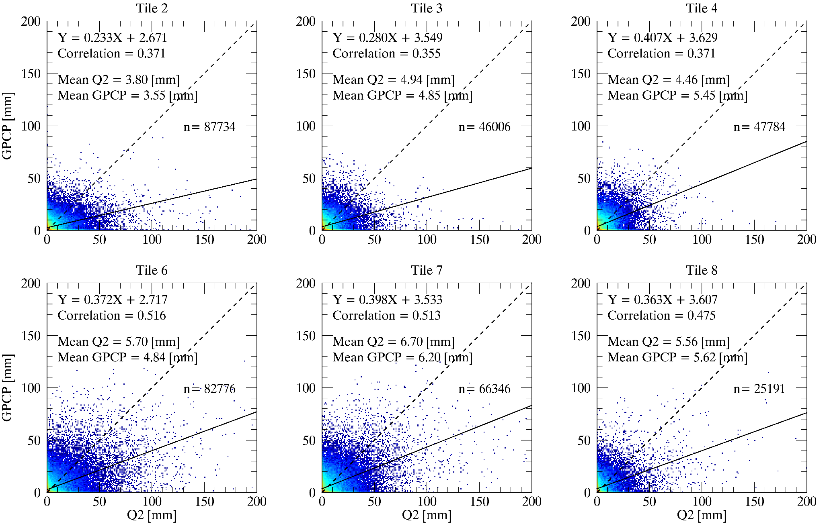
GPCP vs. NEXRAD Q2 daily precipitation estimates
-6.6% 4.5% 22.2%
➔Precipitation in southern tiles (6-8) > northern tiles (2-4)
➔GPAP is comparable to Q2 in Tiles 2, 3, 7 and 8.
GPCP > Q2 in Tile 4, GPCP < Q2 in Tile 6 during 2010-2012.
-17.8% - 7.5% 1.1%
18
RDP (relative difference percentage) = (GPCP-Q2)/Q2 × 100%

Slide 20
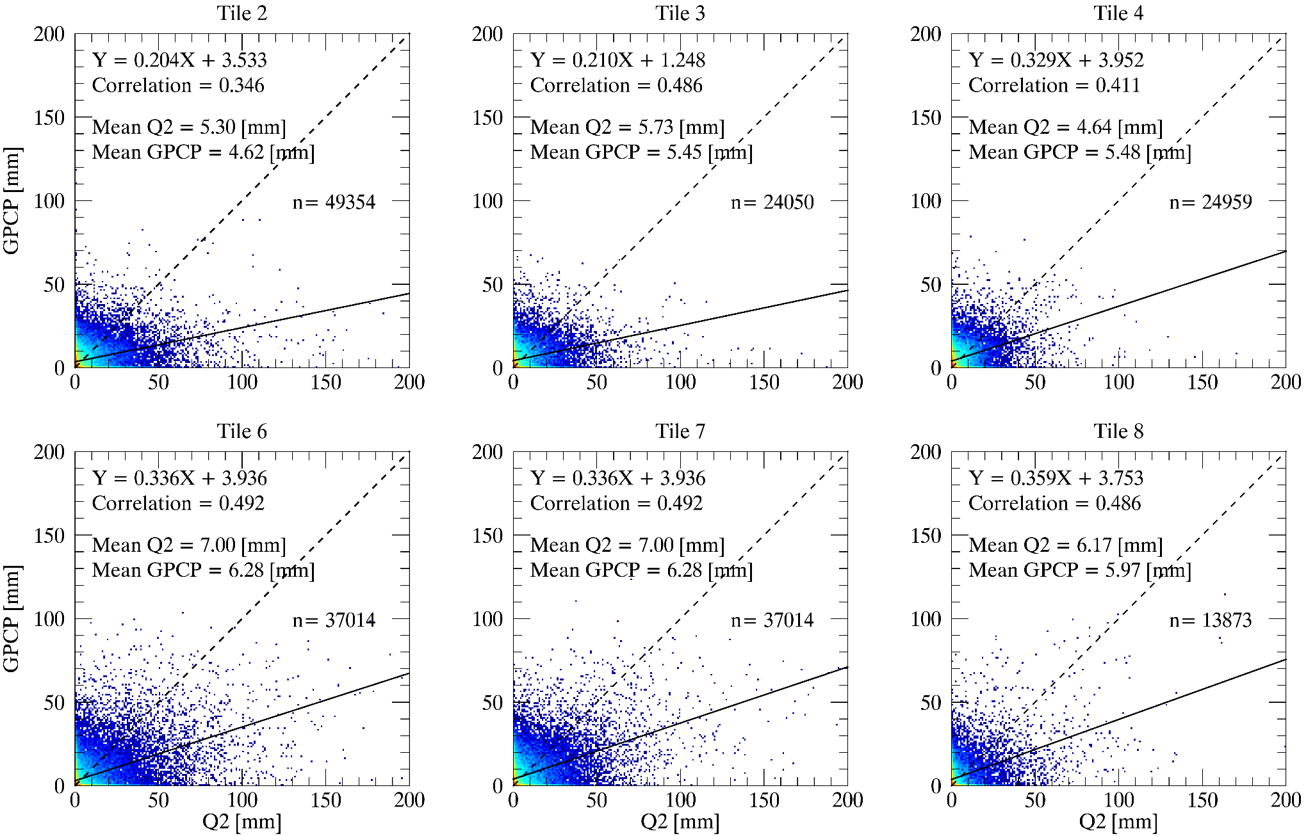
Warm season (Apr – Sept) daily estimates
-12.8% - 4.9% 18.1%
➔Both Q2 and GPCP > their annual counterparts
Q2 > GPCP in Tiles 2 and 6 due to (a) overestimated precipitation in Q2 for heavy rain events, (b) GPCP may not detect small-scale precipitation events.
➔In tile 4, Q2 < GPCP because Q2 may misclassify rainfall from MCSs to
stratiform rain.
-21.3% -10.3% -3.2%
19

Slide 21
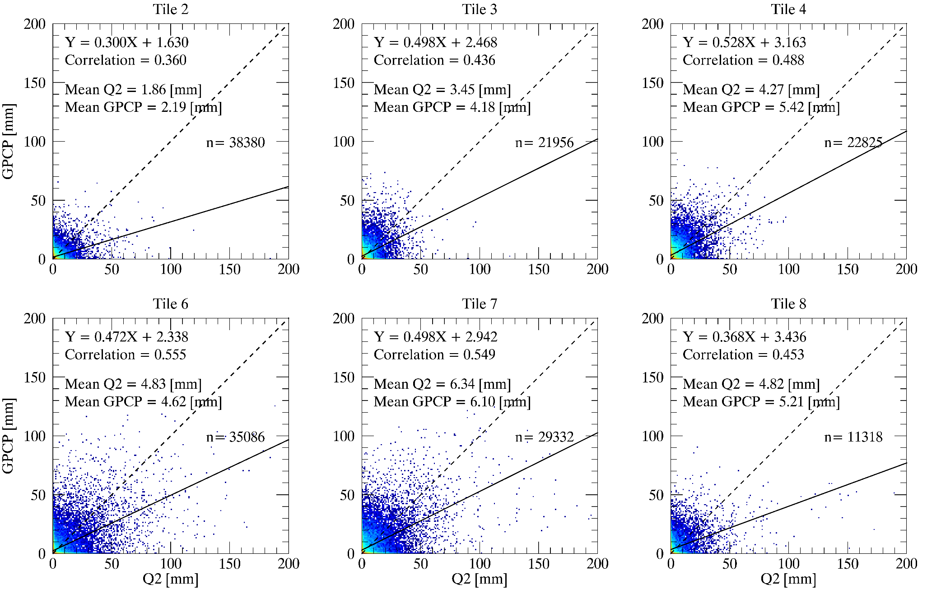
Cold Season (Oct – Mar) daily estimates
15.1% 21.2% 26.9%
➔Both Q2 and GPCP estimates much less than warm season
counterparts, particular in northern tiles.
➔Q2 < GPCP in northern tiles, likely due to snow Z-R
relationship and radar overshooting problem.
Convective: Z=300R1.4
Stratiform: Z=200R1.6
Warm rain: Z=230R1.5
Snow at surface: Z=75R2.0
-4.3% -3.8% 8.1%
20
Notes:
Z-R relationship

Slide 22
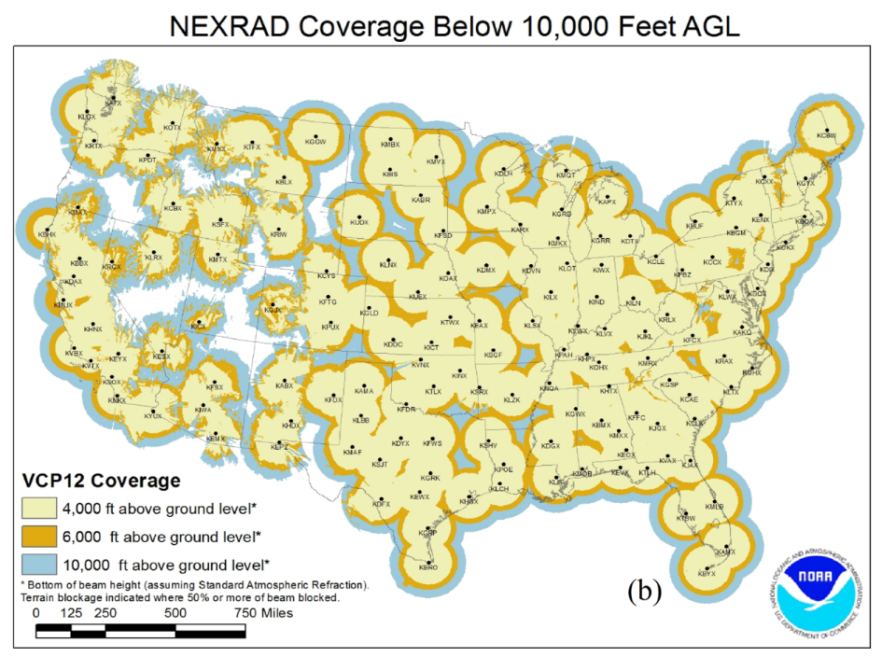
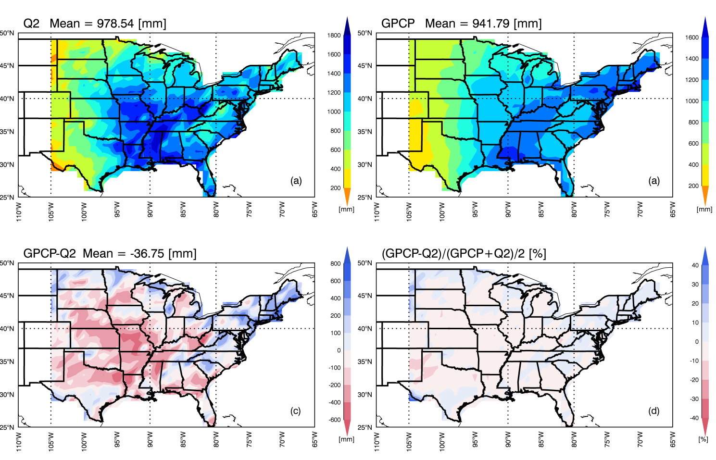
Spatial distribution for annual average precipitation
➔Both Q2 and GPCP estimates increase from west to east.
➔Although their annual means are close, large regional diff.
➔Some of Q2 estimates largely depend on radar coverage.
Appalachian Mountains
21
Notes:
Although the difference between their yearly precipitation estimates is only 36.75 mm (3.8%) over the CONUS, there are large regional differences between two datasets. Q2 estimates are much larger than GPCP estimates over the central US, up to 600 mm larger in some areas, while in northern and northeastern regions Q2 estimates are less than GPCP estimates as illustrated in Fig. 10c.

Slide 23
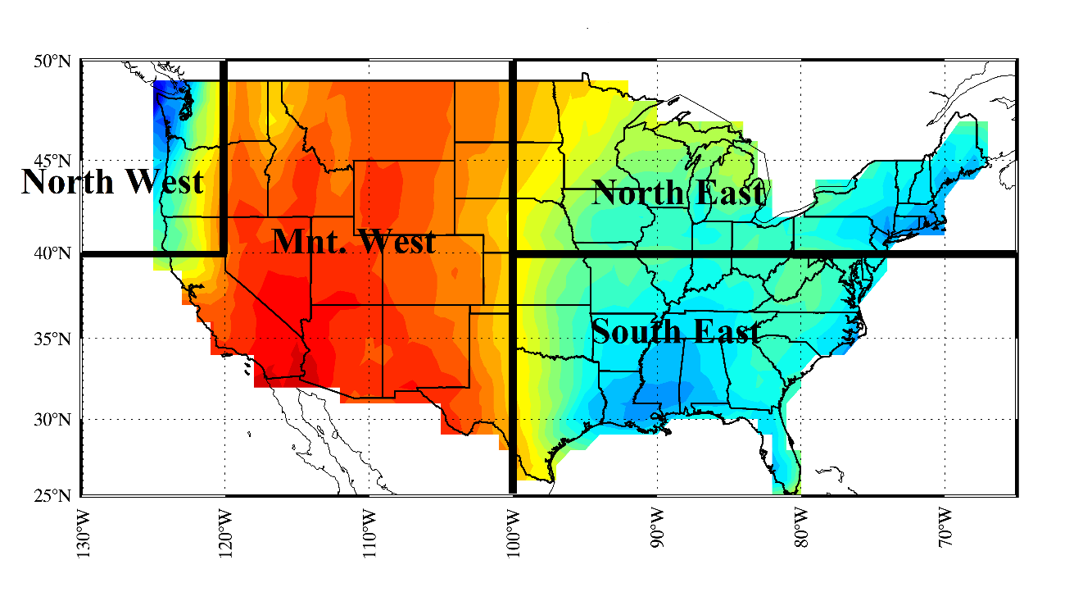
Future work: Evaluation of reanalyzed Precipitation over CONUS
Datasets
➔Satellite data:
GPCP 1DD, 1°× 1°
➔Reanalysis data:
MERRA-2, 0.625°× 0.5°
JRA-55, 0.562°× 0.562°
20CR, 2°× 2°
CFSR, 0.5°× 0.5°
ERA-Interim, 0.703°× 0.702°
NCEP/NCAR, 2°× 2°
Study Region
1°× 1°
Study Period
1997~2011
20CR and CFSR are not available after 2012
22

Slide 24
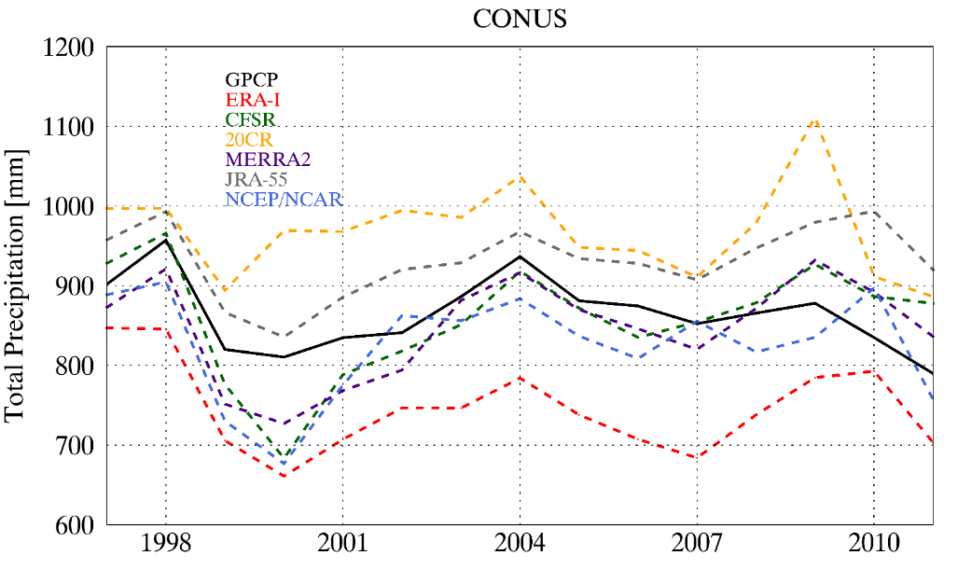
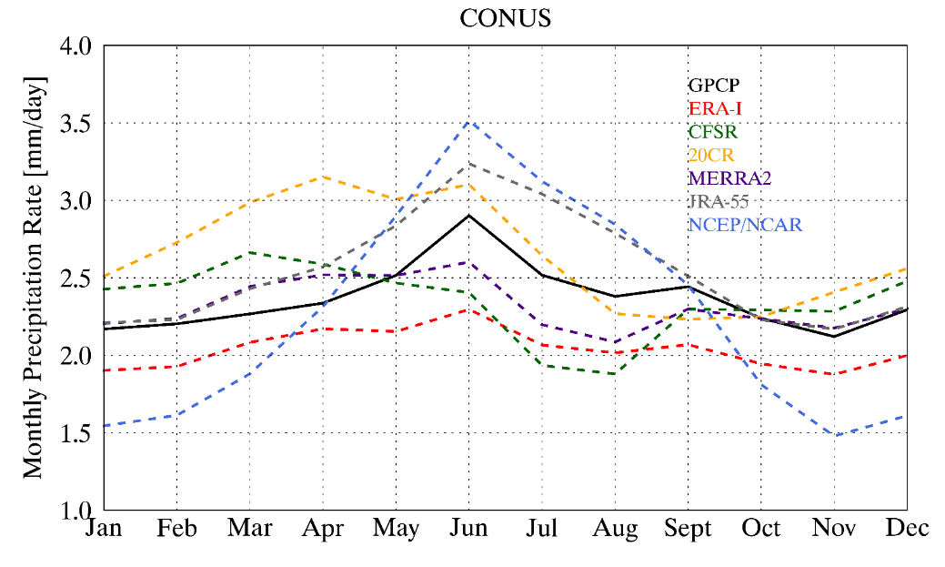
Yearly accumulated and monthly mean Precipitation
 | GPCP | CFSR | JRA-55 | MERRA2 | 20CR | ERA-I | NCEP/NCAR
Yearly [mm] | 868.24 | 857.30 | 930.94 | 846.65 | 968.90 | 746.04 | 825.62
Diff |  | -10.94 | 62.7 | -21.59 | 100.66 | -122.2 | -42.62
Monthly [mm/day] | 2.37 | 2.34 | 2.54 | 2.32 | 2.65 | 2.04 | 2.26
Diff |  | -0.03 | 0.17 | -0.05 | 0.28 | -0.33 | -0.11
23
Notes:
CFSR and MERRA2 showed similar patterns as GPCP. 20CR and JRA-55 overpredicted while ERA-Int underpredicted through the entire study period.
NCEP/NCAR underpredicted cold season precip and overpredicted warm season precip. ERA-Int and MERRA2 have less seasonal variation than GPCP.

Slide 25
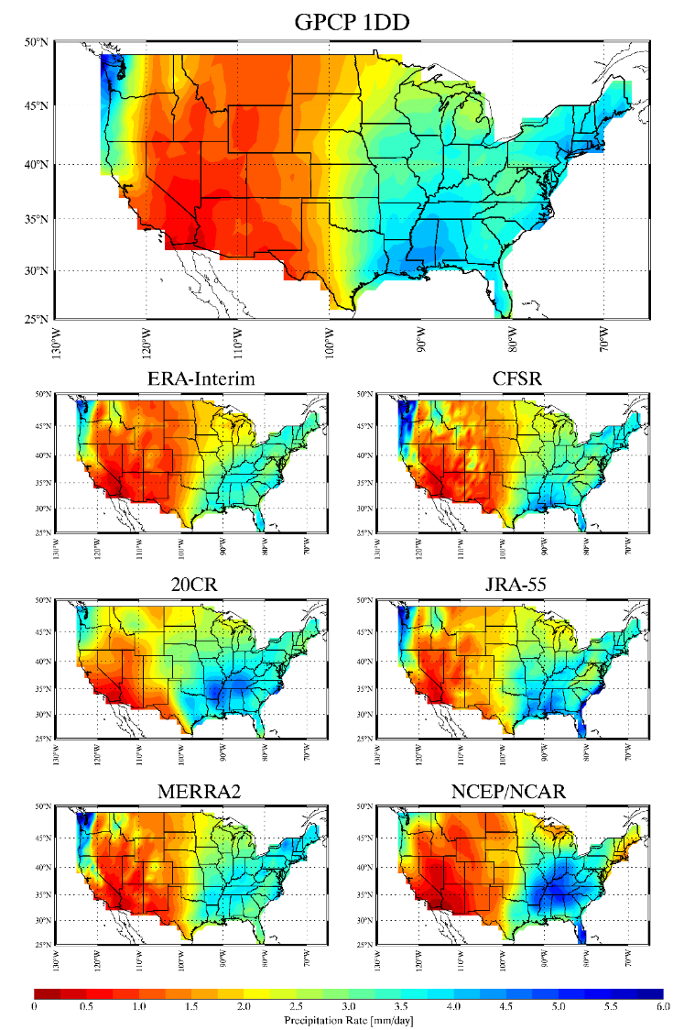
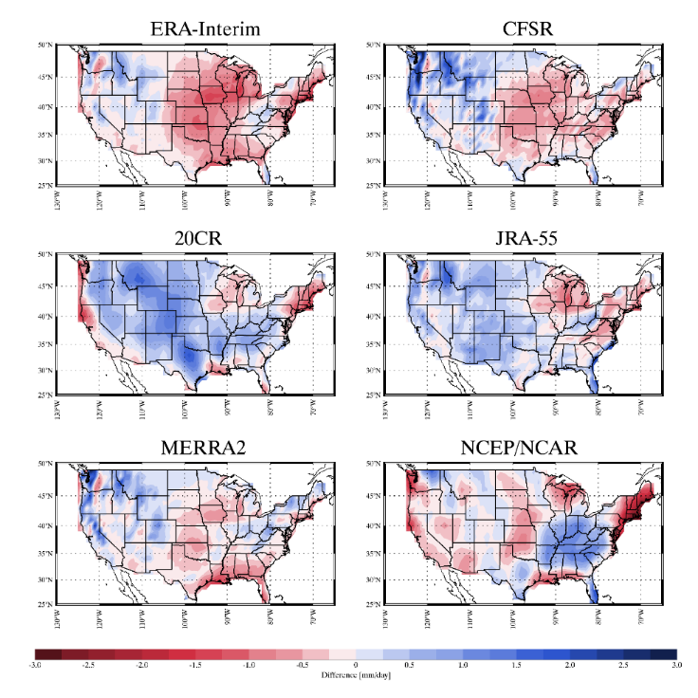
Spatial distributions for monthly means
Although their general patterns (dry in west and wet in east) are similar, there are large differences in some regions.
24
Notes:
Underpredict over Great Lakes regions.
Reanalysis data predicted more precipitation over Mtn.W region (satellite-based GPCP may underestimate over complex terrains).

Slide 26
Thanks for your attention!

Slide 27
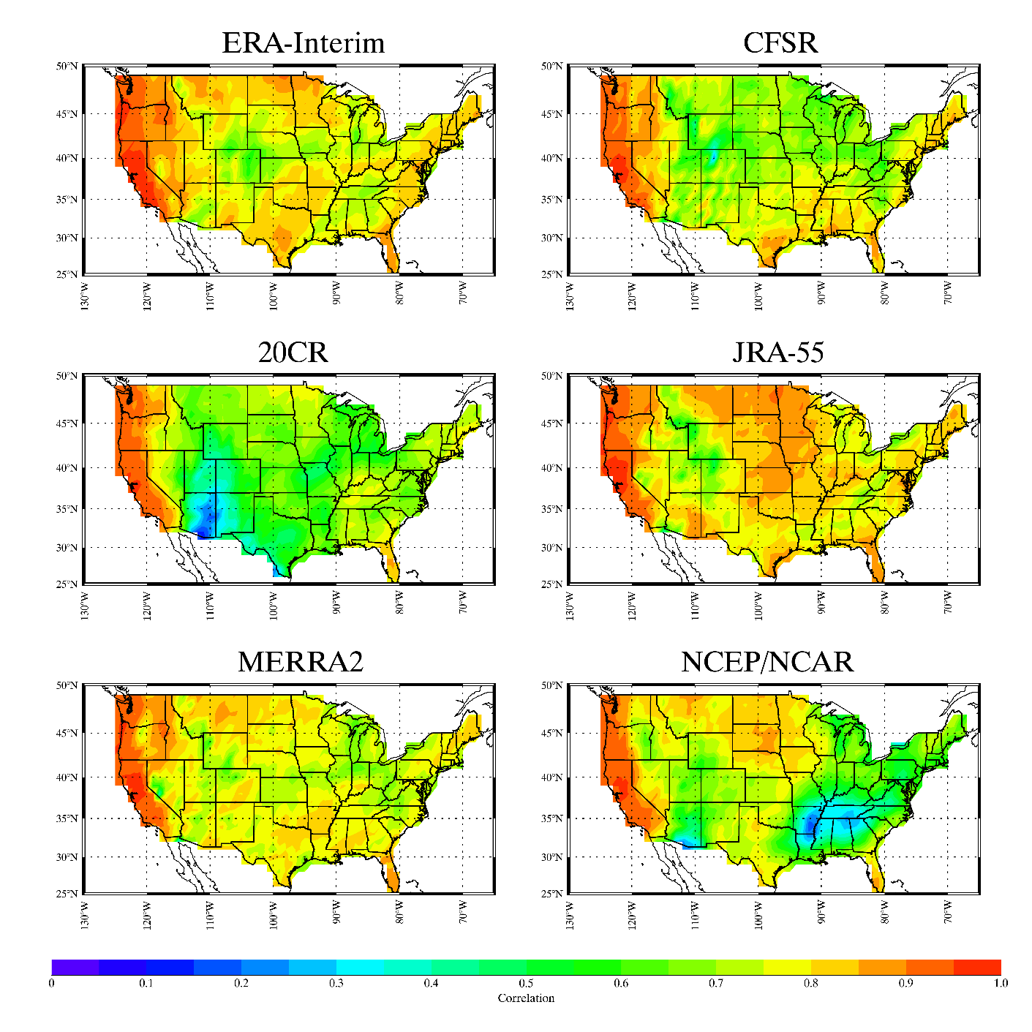
Spatial distributions of correlation coefficients
Reanalysis data are well correlated with GPCP, most of CONUS have cc higher than 0.6.
Cc are between 0.9~1 over the West Coast region for all reanalyzes.
20CR showed low (0.1~0.3) cc over Arizona meanwhile NCEP/NCAR showed low cc over southeastern regions.
9

Slide 28
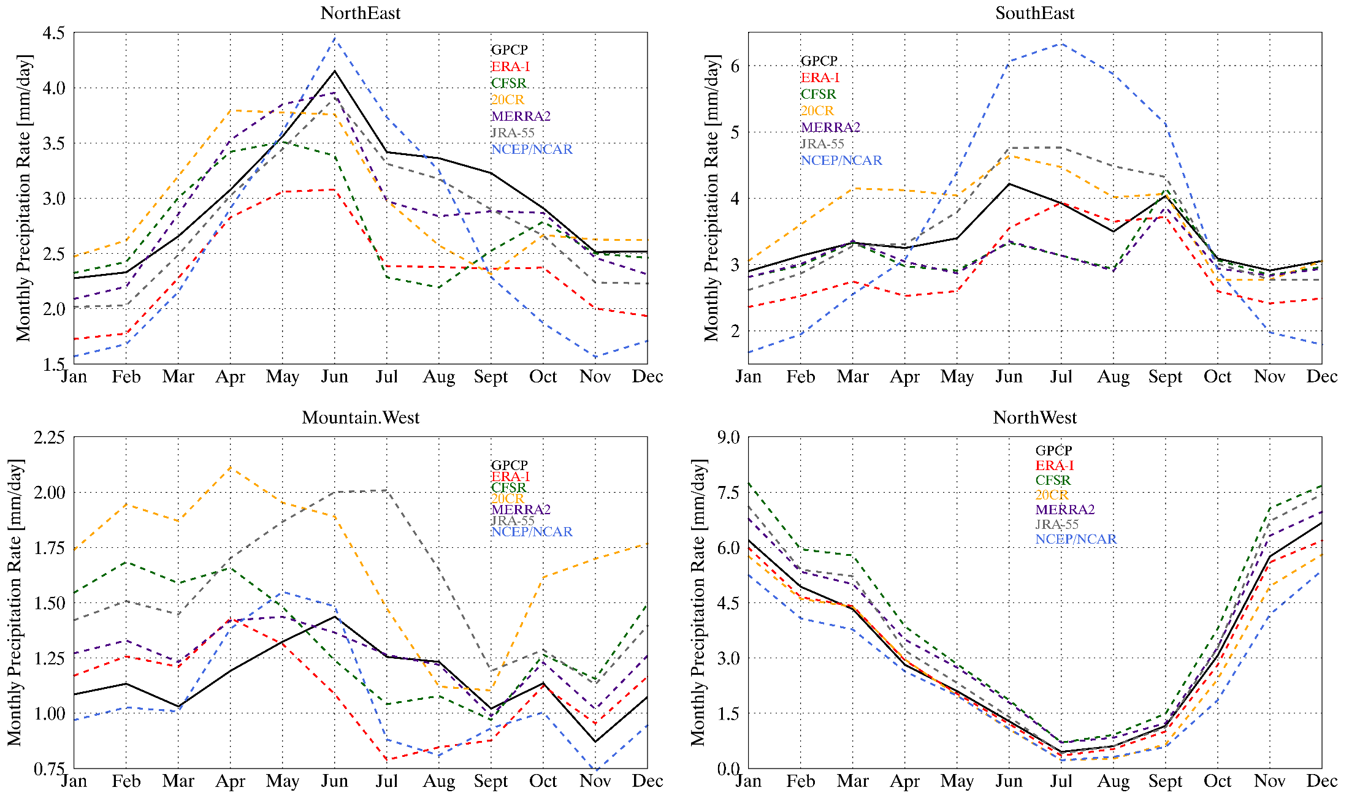
Monthly means for different regions
10

Slide 29
Mean, std, bias, and r for different regions
 | GPCP 1DD | ERA-Interim | CFSR | 20CR | JRA-55 | MERRA2 | NCEP/NCAR
COUNS | 2.37±1.97 | 2.05±1.78 | 2.35±2.10 | 2.66±2.01 | 2.55±2.10 | 2.32±2.06 | 2.62±2.27
 |  | -13.66% | -0.73% | 12.19% | 7.67% | -2.01% | -4.55%
 |  | 0.852 | 0.804 | 0.738 | 0.851 | 0.827 | 0.726
NE | 3.00±1.64 | 2.35±1.40 | 2.73±1.54 | 2.95±1.49 | 2.79±1.53 | 2.90±1.78 | 2.56±1.80
 |  | -21.72% | -8.83% | -1.66% | 7.14% | -3.29% | -14.51%
 |  | 0.779 | 0.725 | 0.657 | 0.818 | 0.763 | 0.642
SE | 3.39±2.05 | 2.93±1.92 | 3.12±2.29 | 3.73±2.19 | 3.56±2.28 | 3.09±2.19 | 3.64±2.79
 |  | -13.81% | -8.10% | 9.87% | 4.95% | -9.02% | 7.33%
 |  | 0.796 | 0.784 | 0.658 | 0.796 | 0.777 | 0.578
Mnt.W | 1.15±1.06 | 1.11±1.07 | 1.36±1.39 | 1.70±1.52 | 1.56±1.41 | 1.26±1.25 | 1.07±1.19
 |  | -4.01% | 17.50% | 47.19% | 34.93% | 9.01% | -7.61%
 |  | 0.783 | 0.705 | 0.632 | 0.813 | 0.766 | 0.741
NW | 3.28±3.13 | 3.14±3.01 | 4.14±3.81 | 2.93±2.79 | 3.69±3.66 | 3.71±3.45 | 2.61±2.56
 |  | -4.19% | 26.21% | -10.84% | 12.37% | 13.08% | -20.40%
 |  | 0.919 | 0.858 | 0.888 | 0.922 | 0.849 | 0.898
11

Slide 30
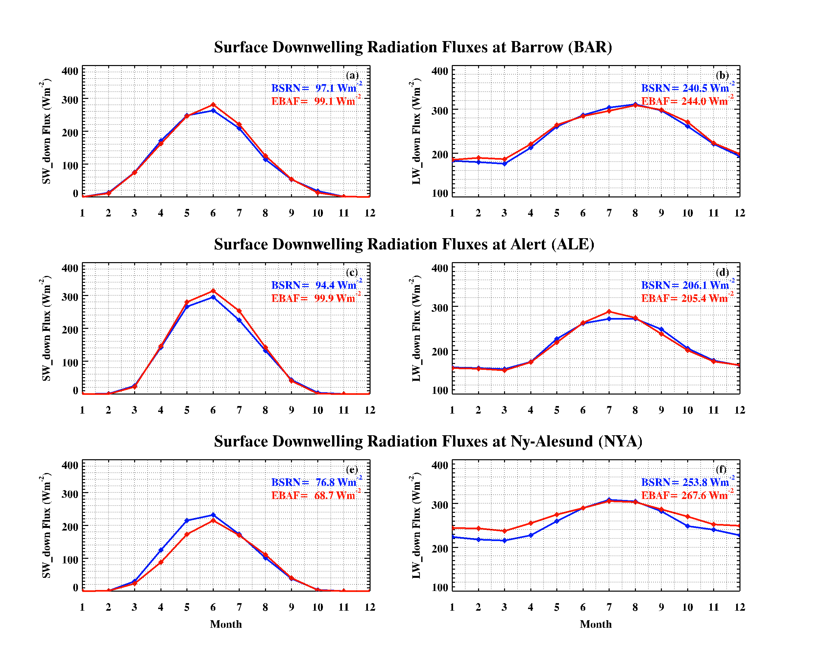
Validation of satellite retrievals by Baseline Surface Radiation Network (BSRN) surface observations at three selected Arctic sites
There is +10 W/m² bias in satellite derived SW_down flux compared to BSRN during summer

