Slide 1
Quantifying the uncertainties of reanalyzed Arctic cloud-radiation properties using satellite-surface Observations
Yiyi Huang
Xiquan Dong, Baike Xi, Erica Dolinar, and Ryan Stanfield
University of North Dakota

Slide 2
Outline
Datasets and Methodology
Comparison between satellite-derived and ground-based observations
Results I: Cloud fraction (CF)
Results II: Top-of-Atmosphere (TOA) radiation fluxes and cloud radiative effects (CREs)
Results III: Surface radiation fluxes
Summary

Slide 3
Datasets
Time frame: 2000/03-2012/02
Area of interest: Arctic (70°-90°N)
Satellite observations: CERES-MODIS cloud fraction, CERES-EBAF edition 3 for radiation fluxes at Top of Atmosphere (TOA) and surface
Reanalyses
 | JRA55 | 20CR V2c | CFSR | ERA-Interim | MERRA
Horizontal Resolution | Global Gaussian Grid (288×145) 1.25°×1.25° | Global Gaussian Grid (180×91) 2°×2° | Global Gaussian Grid (1153×576) 0.31°×0.31° | Global Gaussian Grid (480×241) 0.75°×0.75° | Global Gaussian Grid (540×361) 0.66°×0.5°
Vertical Resolution | 60 levels (to 0.1 hPa) | 24 levels | 64 levels (to 0.26 hPa) | 60 levels (to 0.1 hPa) | 72 levels (to 0.01 hPa)
Temporal Resolution | 3 hour time average | 3 hour time average | 1 hour time average | 6 hour time average | 1 hour time average

Slide 4
Methodology
Using monthly means of cloud and radiation parameters
Both Satellite observations and reanalyses are averaged into the same grid box (2ºx2º) during comparison.
In order to provide more reliable satellite derived surface Radiation products over entire Arctic region, the ground-based observations from BSRN surface sites have been collected to validate the NASA CERES surface radiation products (In progress).

Slide 5
Comparison between satellite-derived and surface observations
Variable | CERES-EBAF (70°-90°N) | Dong et al. 2013ª (70°-90°N) | BAR(71.32°N,156.6°W) CERES/ARM^{b} | NYA(78.93°N,11.93°E) EBAF/BSRN^{c}
CFs (%) | 63.2 |  | 64.8/78(Radar); 75(Ceilo) | 66.5/67.0
LW↑_{all} (Wm⁻²) | 262.8 | 262.2 | 262.0/271.3
LW↓_{all} (Wm⁻²) | 232.2 | 230.6 | 245.9/240.0 | 243.8/252.9
SW↑_{all} (Wm⁻²) | 53.9 | 54 | 48.7/48.6
SW↓_{all} (Wm⁻²) | 95.9 | 96.1 | 104.0/96.9 | 88.5/76.5
LW↑_{clr} (Wm⁻²) | 264.9 |  | 277.1/265.2
LW↓_{clr} (Wm⁻²) | 192.7 |  | 204.8/203.2
SW↑_{clr} (Wm⁻²) | 65.9 |  | 58.9/65.3
SW↓_{clr} (Wm⁻²) | 127.9 |  | 139.5/139.8
CRF_{lw} (Wm⁻²) | 41.6 |  | 56.2/30.7
CRF_{sw} (Wm⁻²) | -20.0 |  | -25.3/-26.2
CRF_{net} (Wm⁻²) | 21.6 |  | 30.9/4.5
In Progress
BSRN Sites:
Alert (ALE,82.49°N,62.42°W):2001/11-2012/10
Tikisi (TIK,71.59°N, 128.92°E):2001/05-2012/04
ªData from Dong et al. (2013): surface radiation fluxes from CERES-EBAF satellite data from 2000/03 to 2010/02
^{b}Data from Dong et al. (2010): surface radiation fluxes from the ARM NSA and NOAA BRW sites in North Slope of Alaska, from 1998/06 to 2008/05
^{c}Data from Zib et al. (2012) :surface radiation fluxes from the BSRN at Barrow(BAR) and Ny-Alesund (NYA) surface stations, from 1994 to 2008

Slide 6
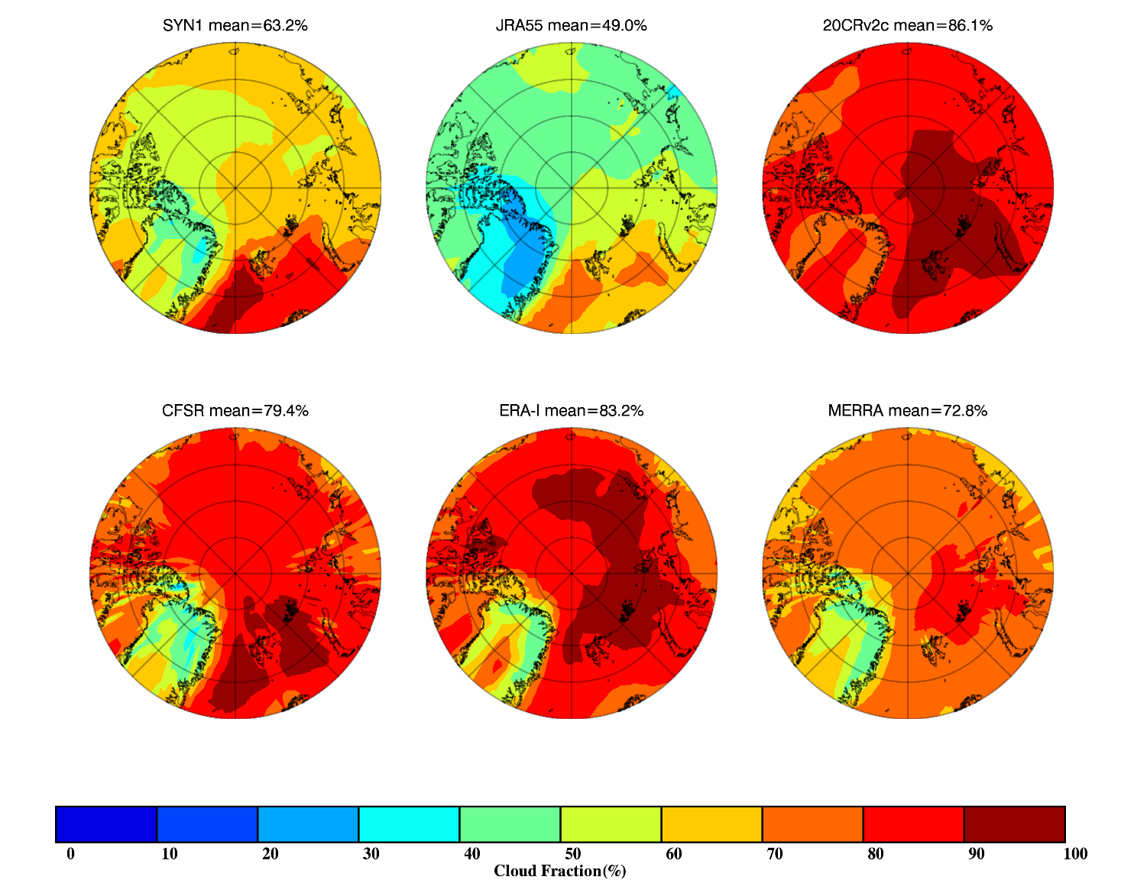
Results I: Cloud Fraction
CERES-MODIS
JRA55
20CR V2c
CFSR
ERA-I
MERRA
Compared to NASA CERES derived CFs, only JRA55 can capture its seasonal variation but with large negative bias, while other four reanalyses overestimated CFs, particular during cold months.
CF uncertainty from passive satellite remote sensing is also large without solar radiation.

Slide 7
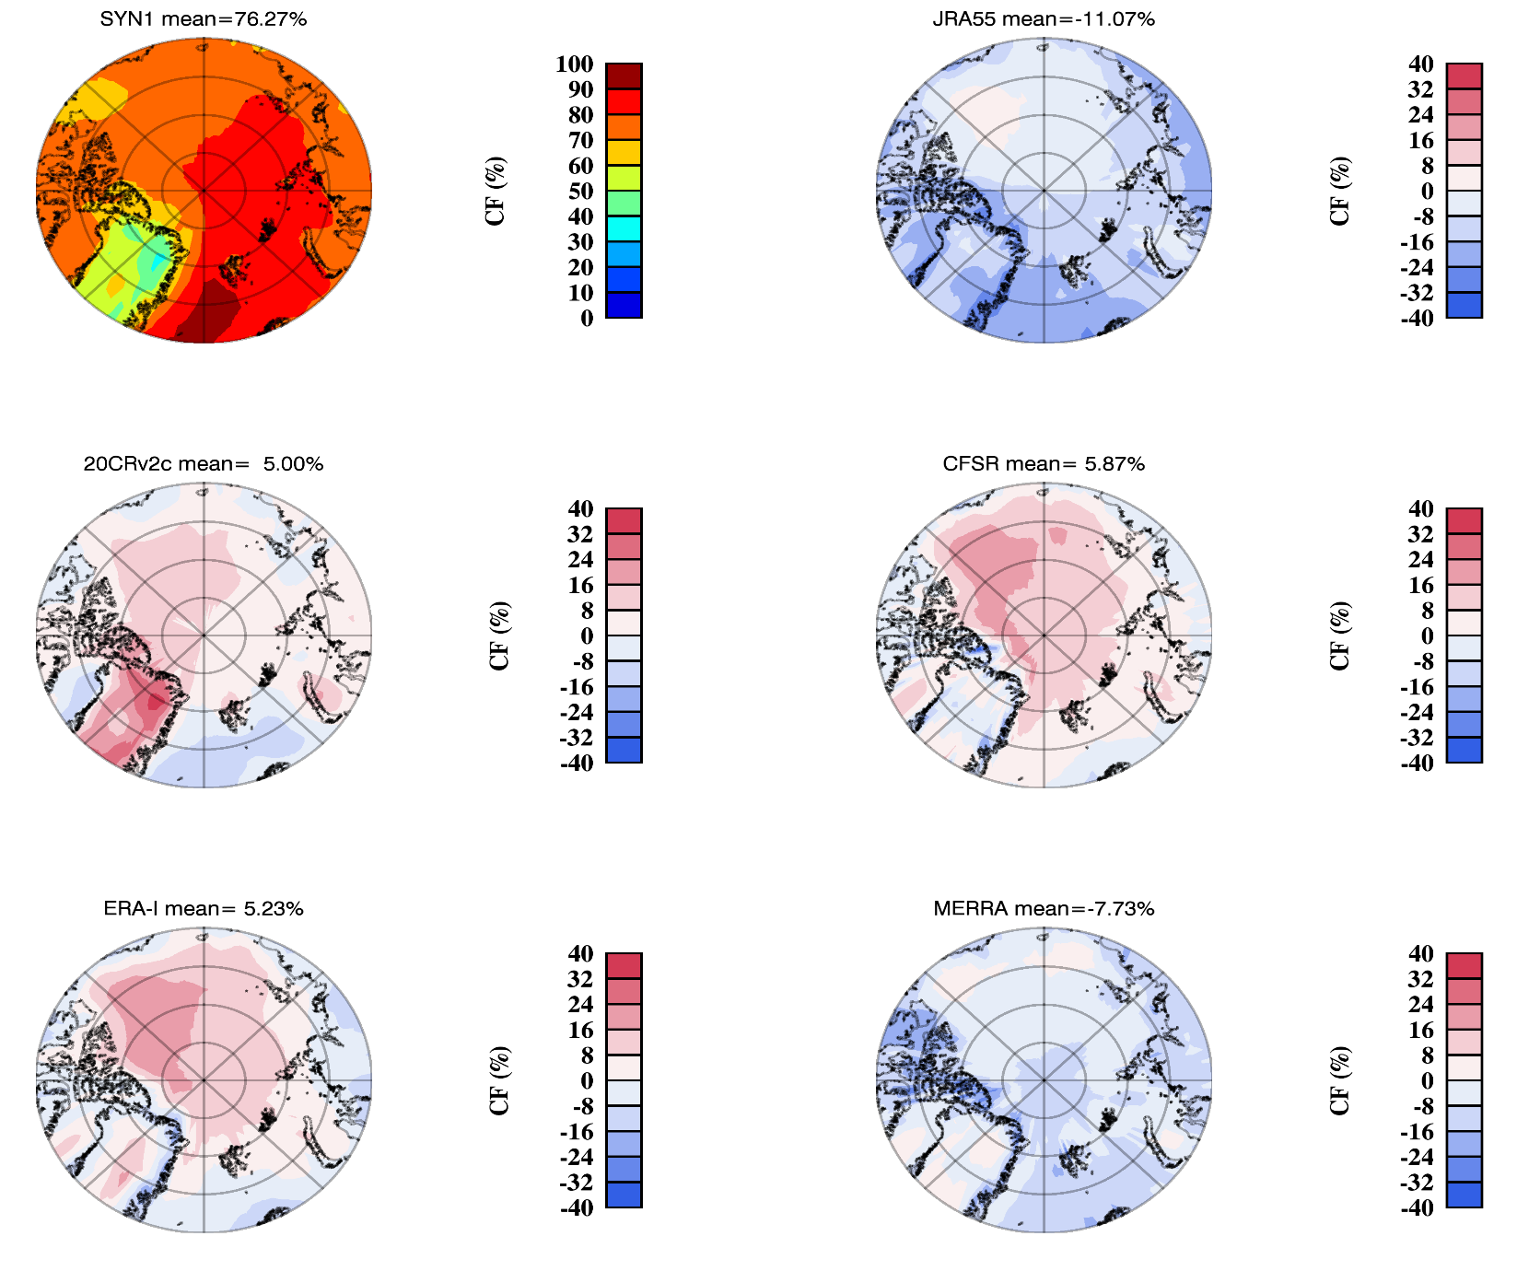
Results I: Warm season (JJA) CFs
CERES-MODIS (CF)
JRA55 - CF
For CERES-MODIS, the minimum CFs are located in Greenland, while the CFs in the ocean are very uniform
JRA55 has the largest negative biases against observations
There are relatively higher positive biases in the Arctic ocean in 20CR V2c, CFSR and ERA-I
20CR V2c - CF
CFSR - CF
ERA-I - CF
MERRA - CF

Slide 8
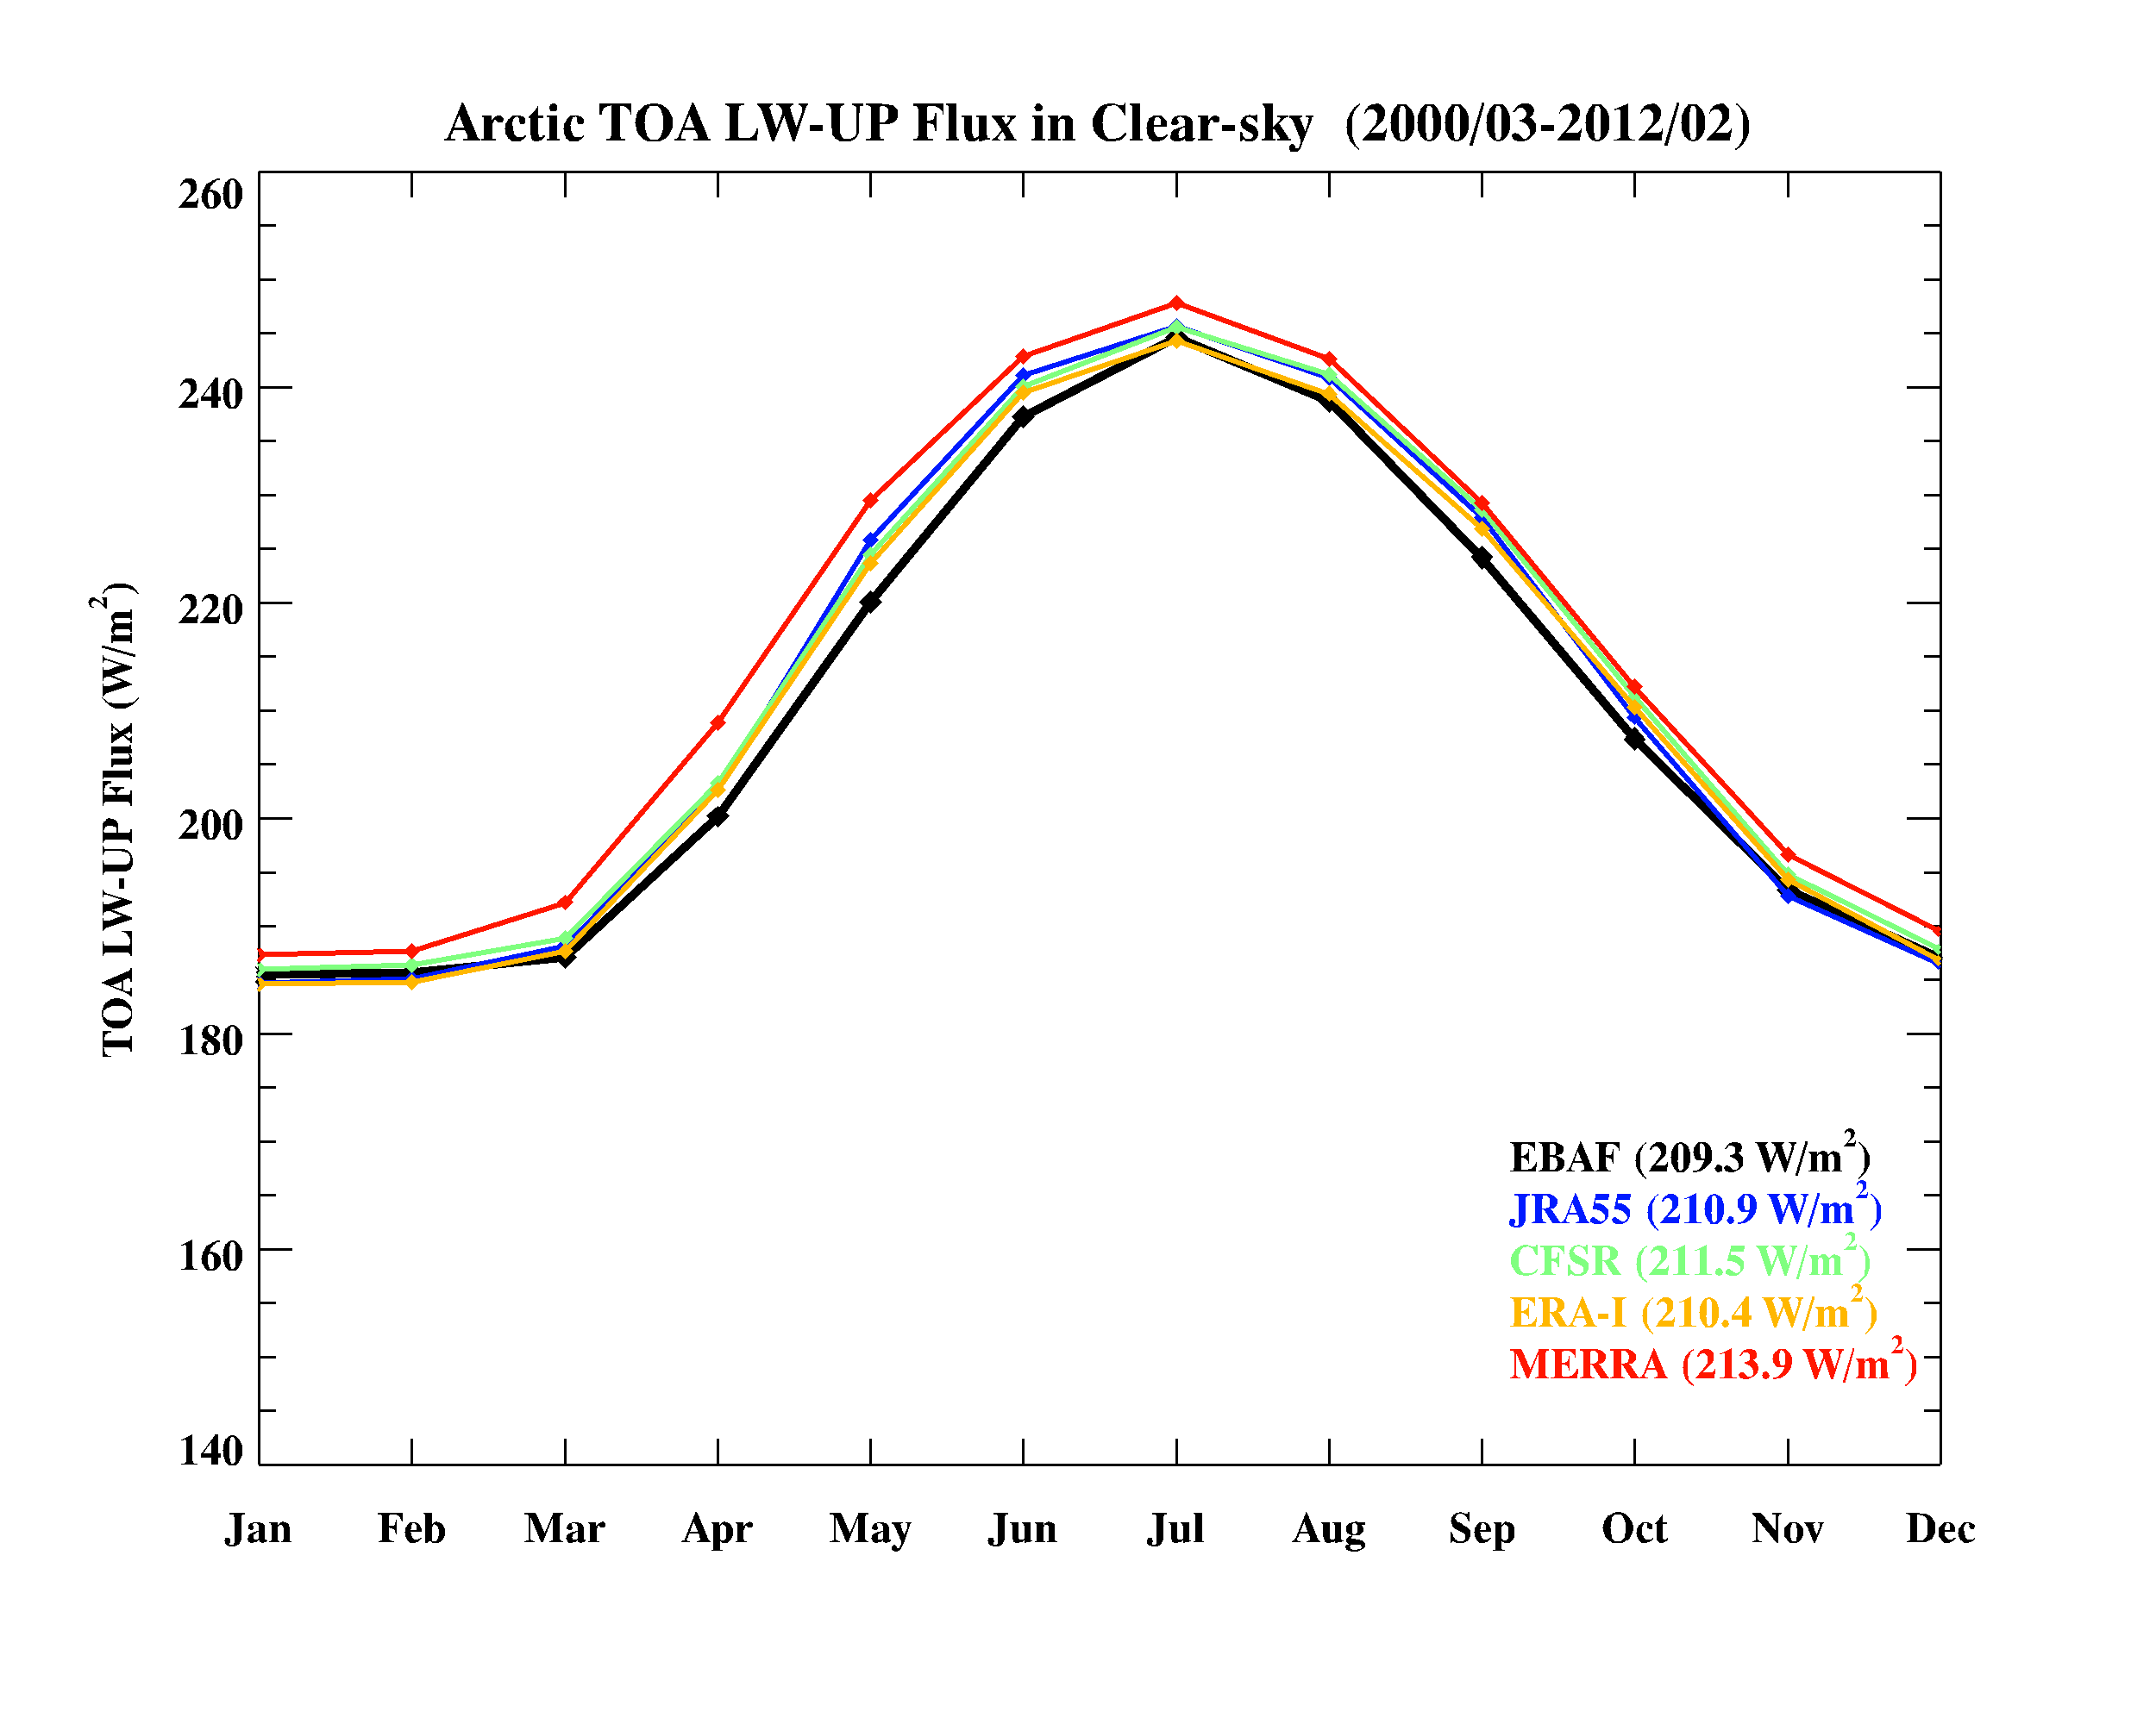
Results II: TOA LWup radiation fluxes
All-sky
Clear-sky
The TOA LWup flux increases from January to July and decreases to following winter
Clear-sky TOA LWup flux is 12 W/m² higher than all-sky one from CERES observations
All reanalyses can well represent the trend of LWup fluxes for both in all-sky and clear-sky
JRA55 is higher, but 20CR is lower, than CERES observations.

Slide 9
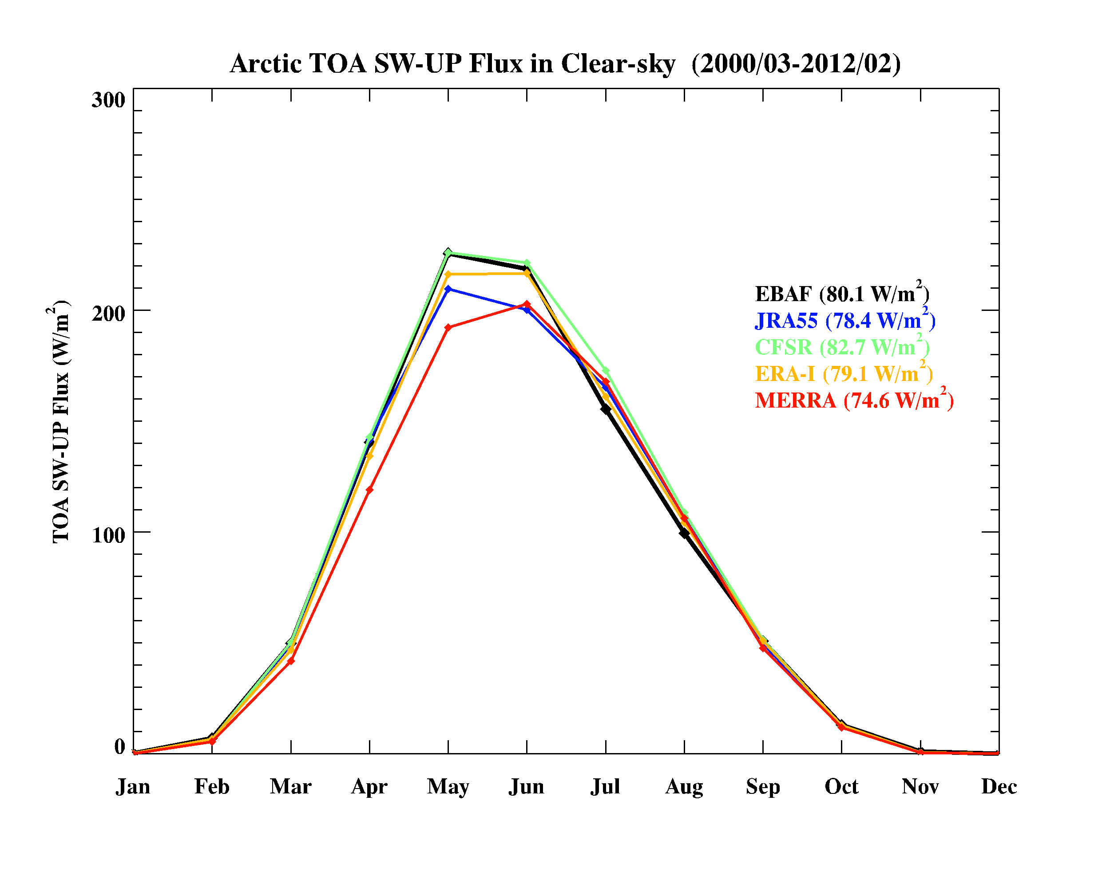
Results II: TOA SWup radiation fluxes
All-sky
Clear-sky
All-sky TOA SWup flux peaks in June, while clear-sky one peaks in May due to high Solar radiation and large snow-ice coverage. All-sky TOA SWup flux is ~20 W/m² higher than clear-sky one.
Although the annual mean differences between observations and reanalyses are within a few Wm⁻², there are large biases during warm months.

Slide 10
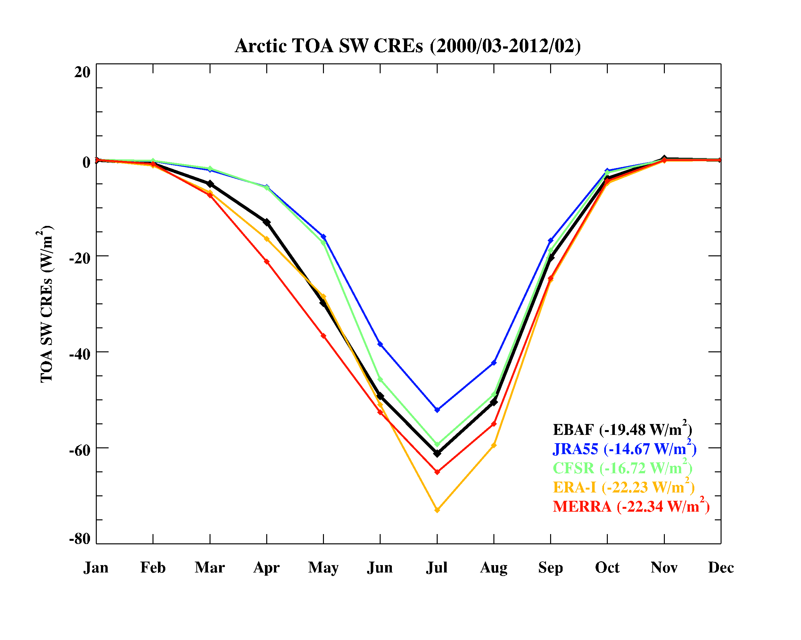
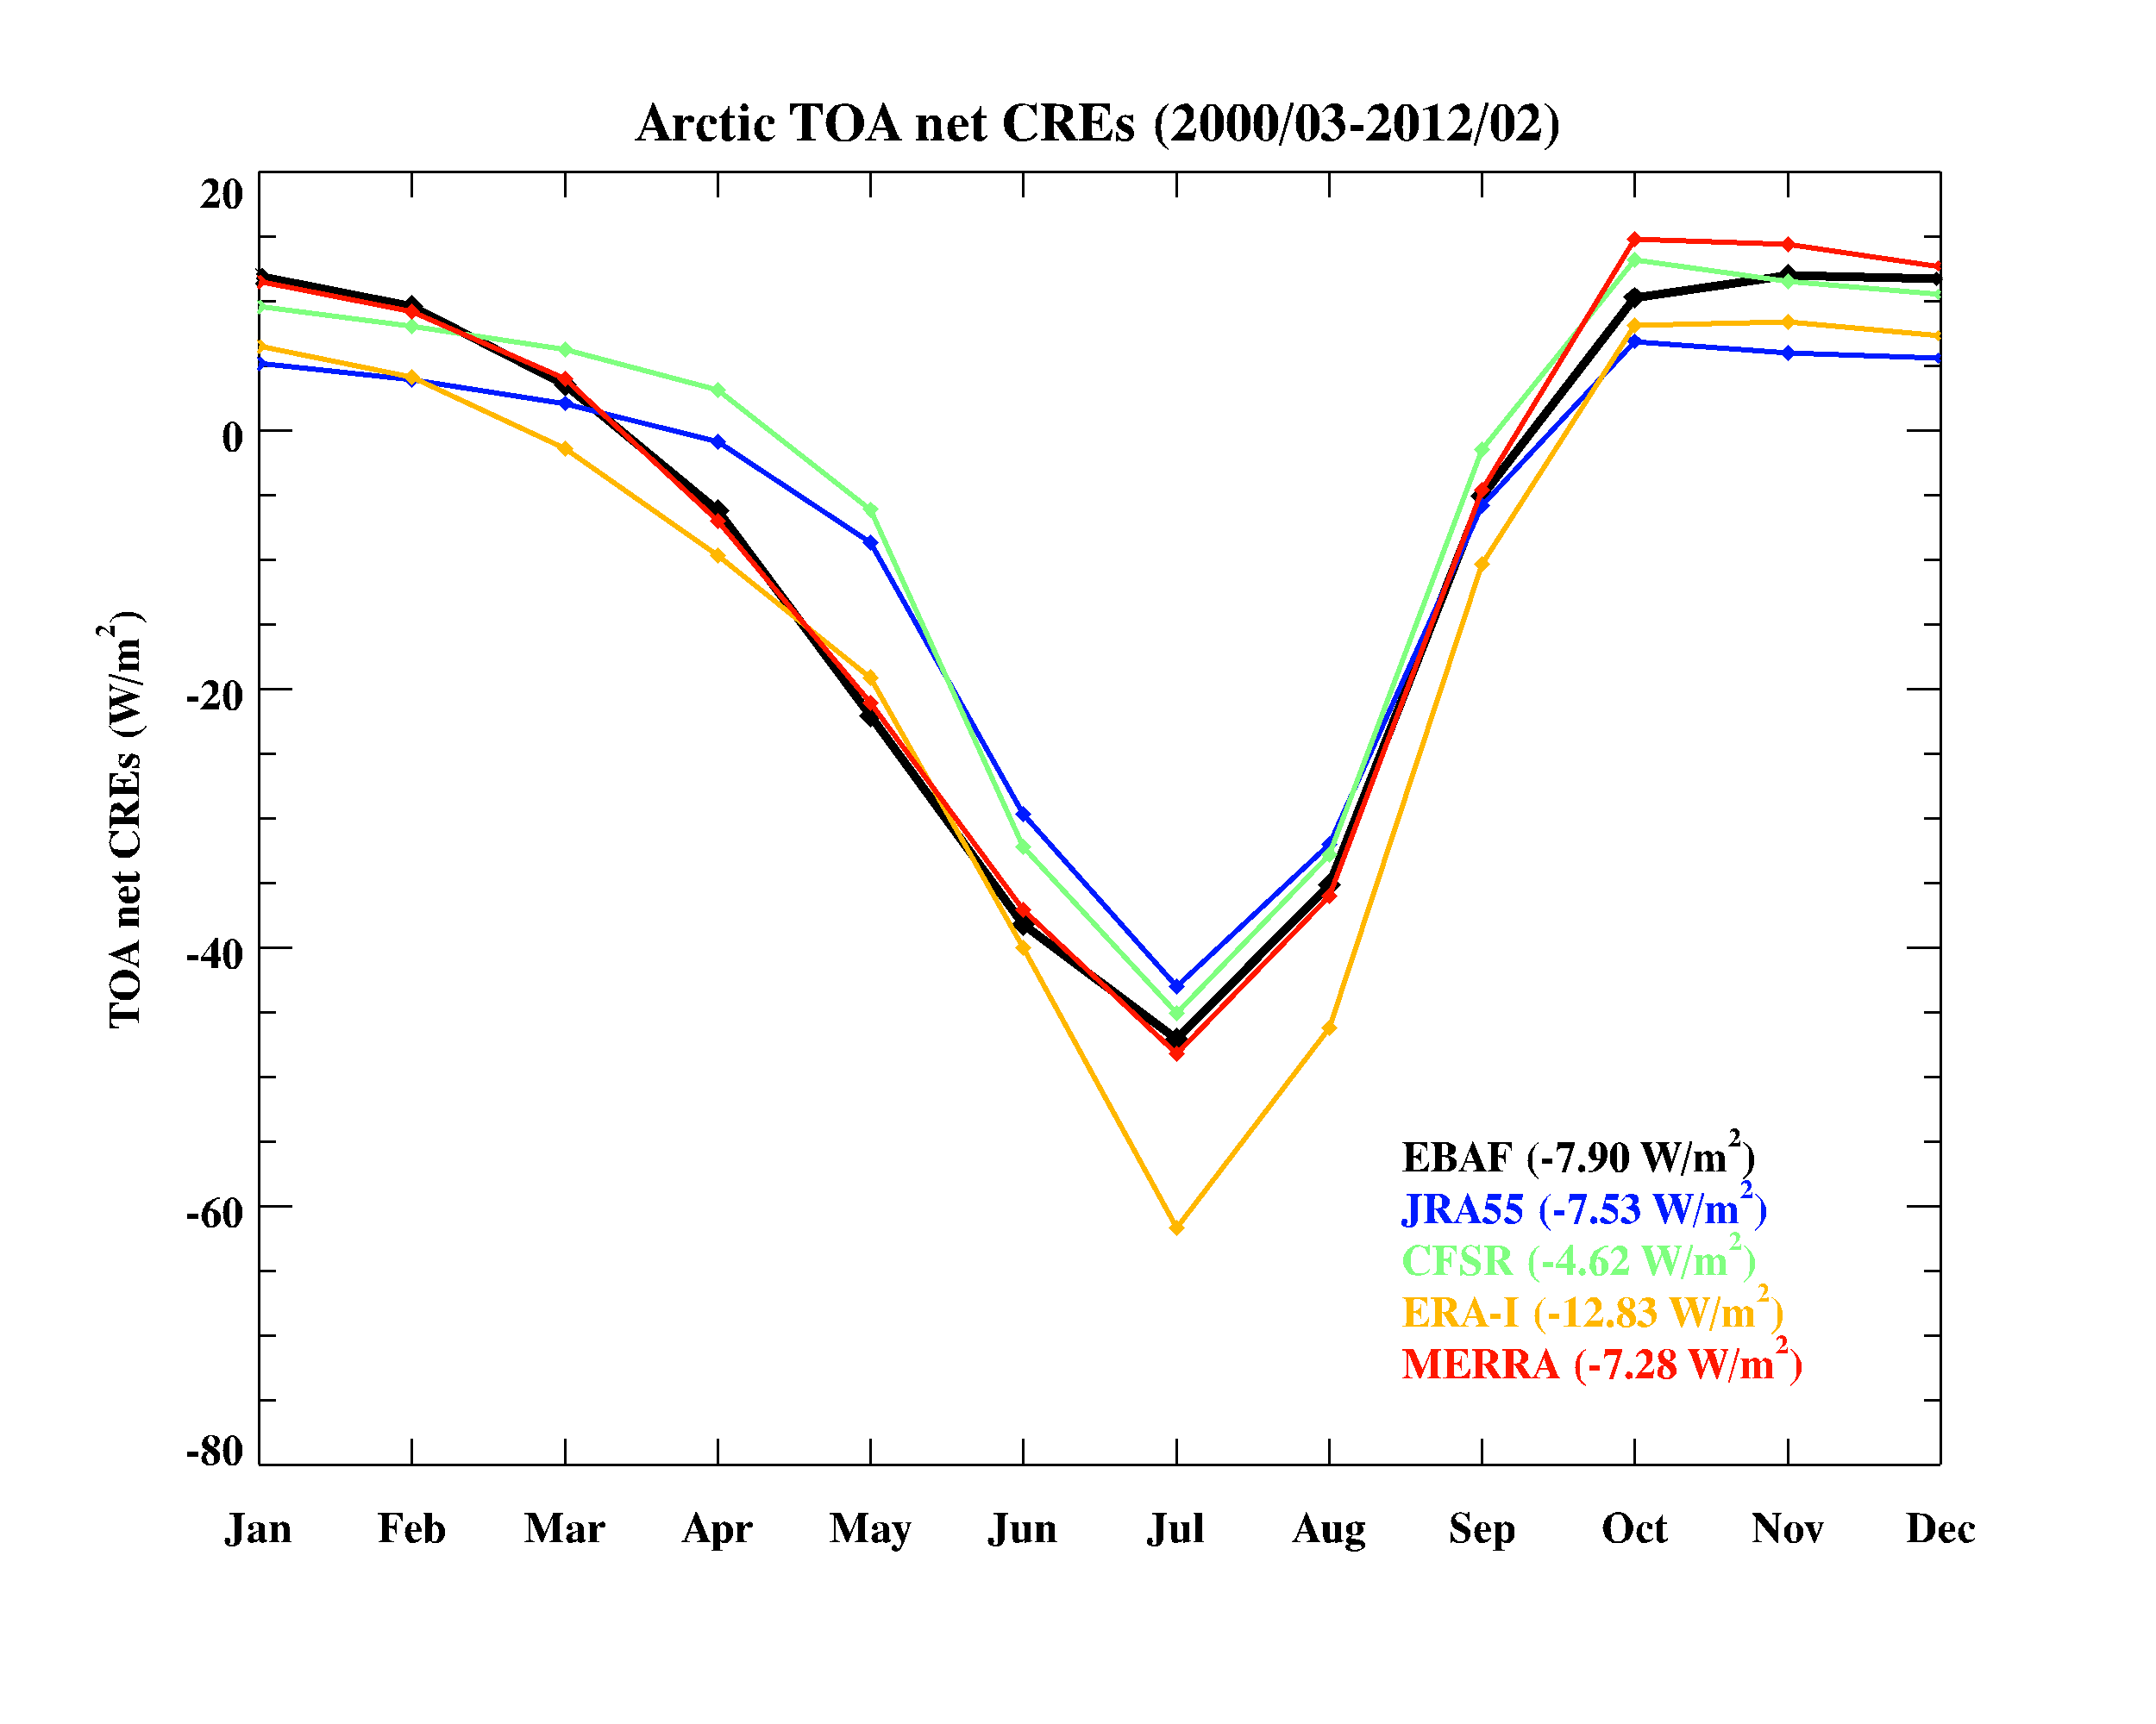
Results II:TOA CREs
LW CRE
LW CREs are positive, indicating warming effect.
Reanalyzed LW CREs follow the seasonal variation with
a 4 Wm⁻² bias in MERRA and a
–4 Wm⁻² bias in JRA55.
TOA SW: cooling effect
(peak in July)
Net CREs are dominated by LW warming effect during winter, and by SW cooling effect during summer.
Good agreement in NET CREs are due to compensating effects of LW and SW CREs.
SW CRE
NET=LW+SW

Slide 11
Results II: Warm season (JJA) TOA net CREs
Lower CF
CERES EBAF
Strongest warming effect in Greenland associated with low CF
Strongest cooling effect in North Atlantic Ocean with higher CF
Reanalyses
JRA55 and CFSR are positively biased over the Arctic Ocean, however ERA-I is negatively biased in this area
Positive net CRE from JRA55 and negative ERA-I are relatively consistent with the CF results (Low CF in JRA55 and high CF in ERA-I)
Higher CF

Slide 12
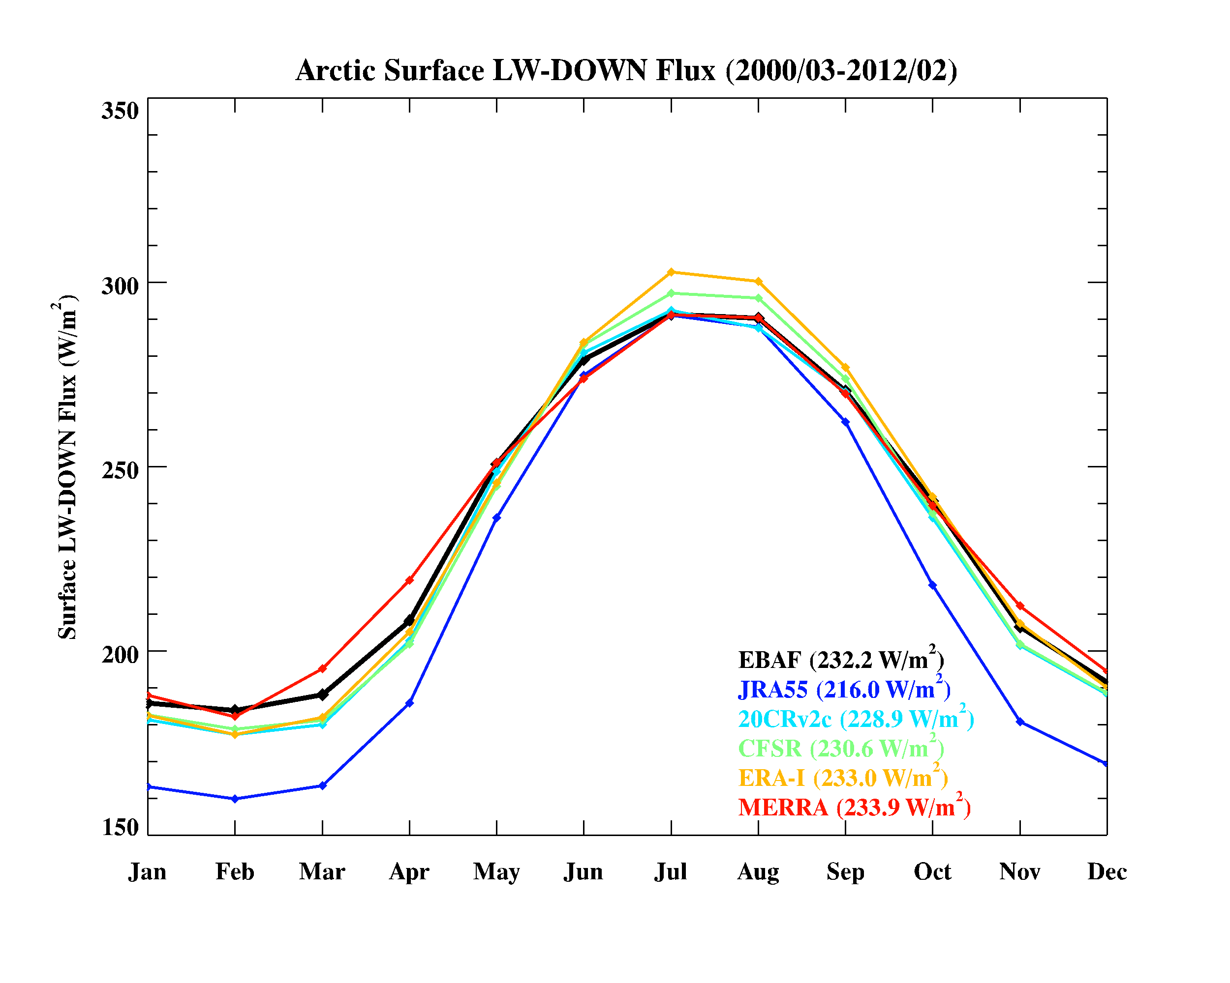
Results III: Surface LW radiation fluxes
LW up
LW down
Reanalyzed LW_up fluxes agree perfectly with CERES EBAF results from April to October, but constantly higher from Nov. to March.
The annual mean differences in LW_down flux are 4 Wm⁻², except for JRA55 has a -16 Wm⁻² negative bias.

Slide 13
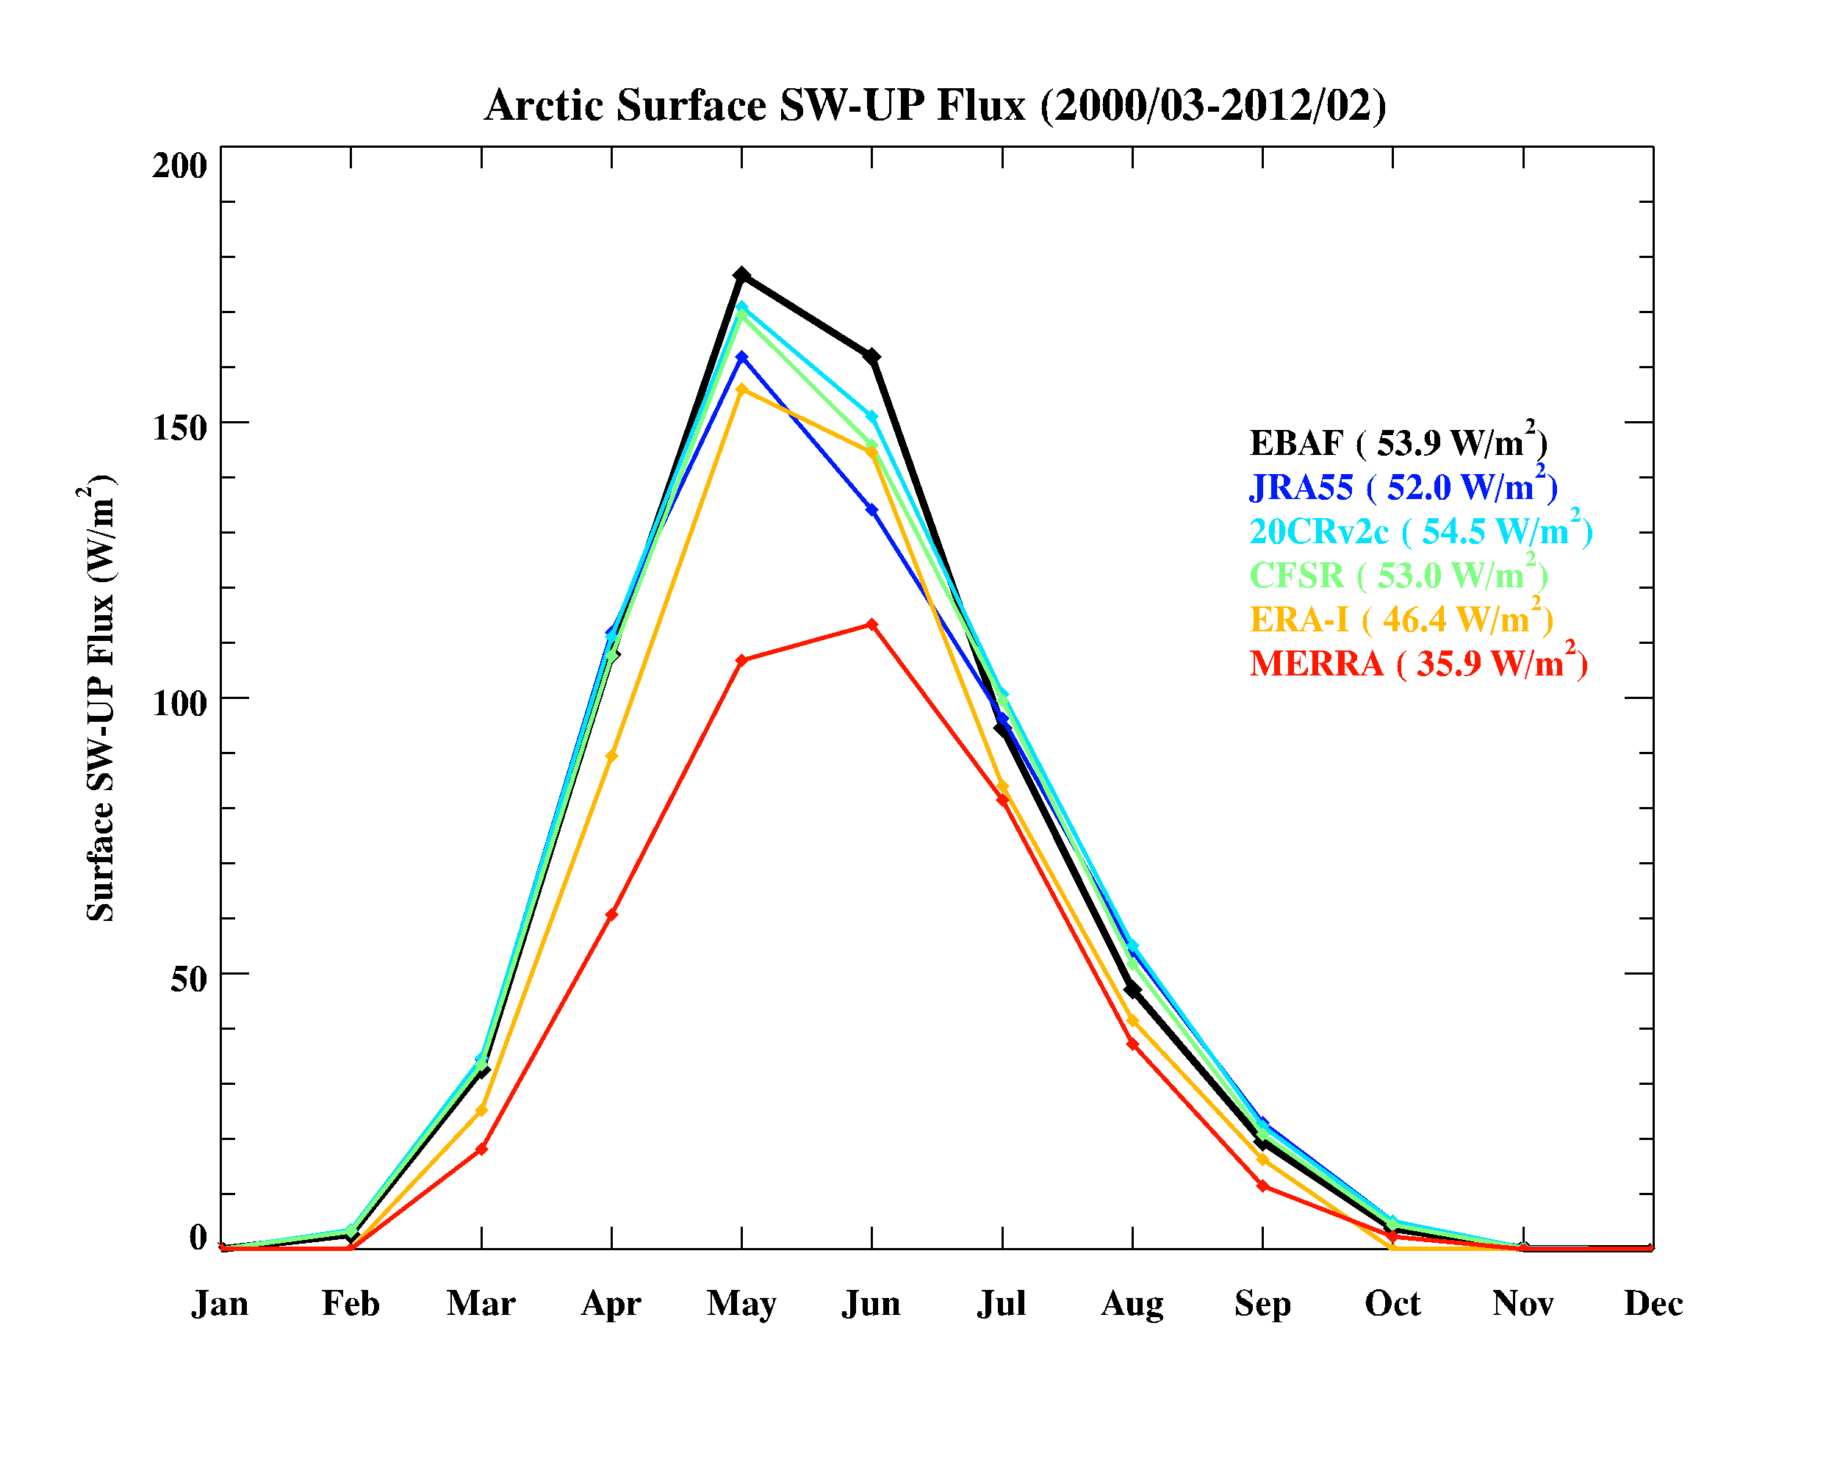
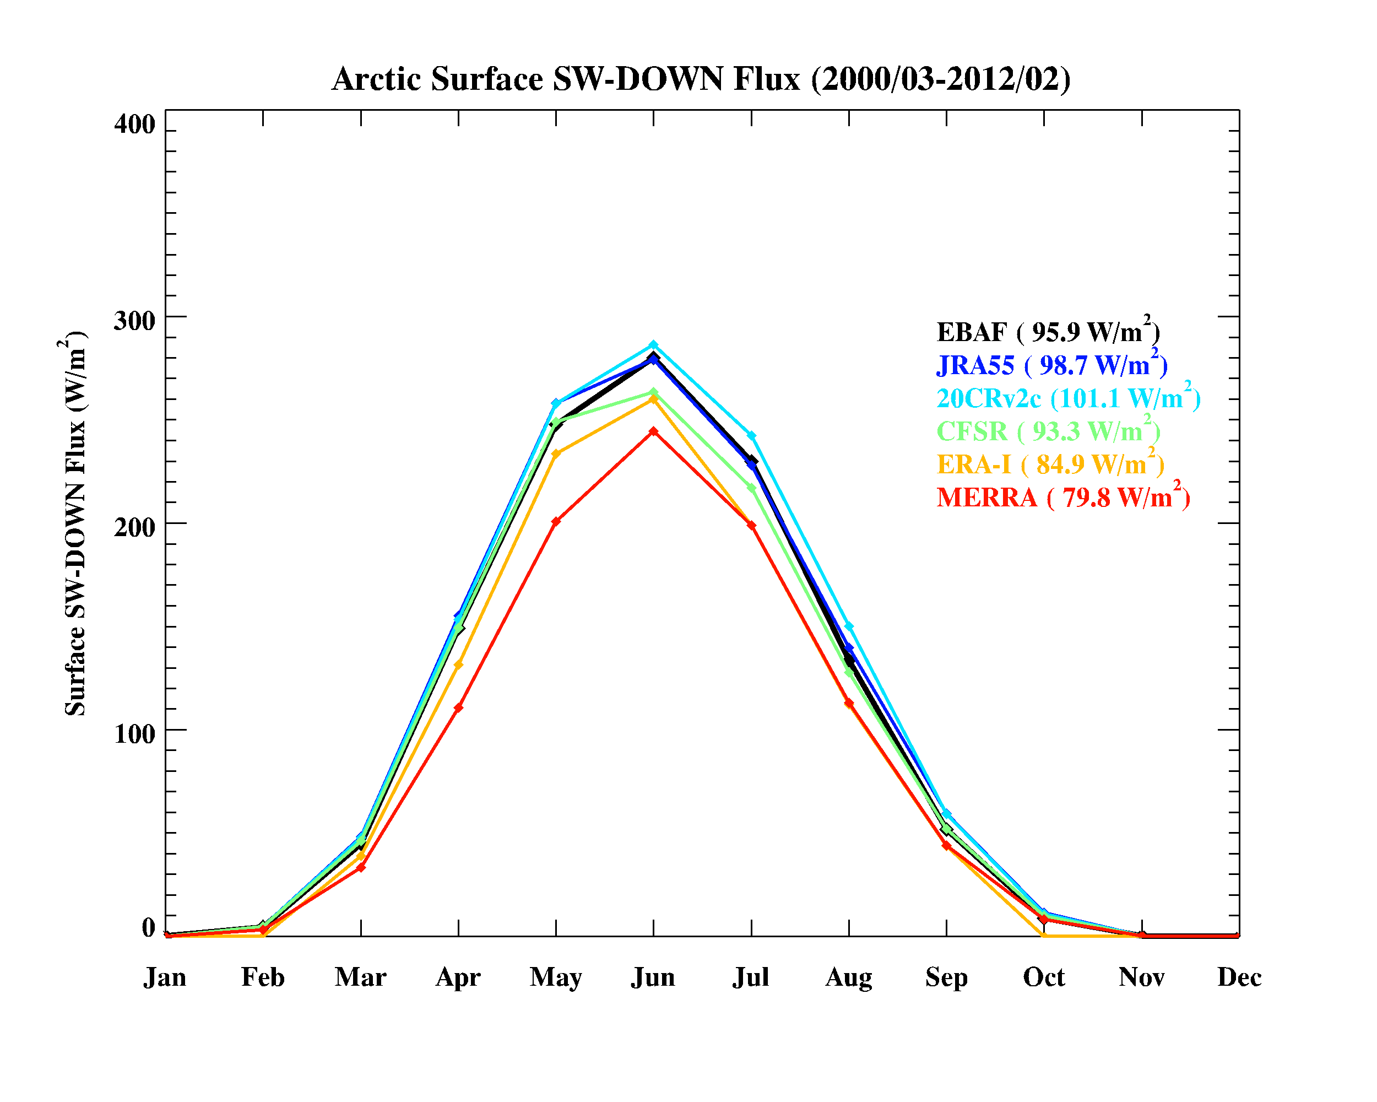
Results III: Surface SW radiation fluxes
SW up
SW down
MERRA reanalyzed SW_down and SW_up fluxes are much lower than CERES EBAF
Other reanalyses represent the seasonal variation well with relatively large differences during summer months.

Slide 14
Results III: Warm season (JJA) Surface SWdown flux
CERES EBAF
Maximum SWdown flux is over Greenland where CF is low
Minimum value is over North Atlantic Ocean and is associated with higher CF
Reanalyses
CFSR, ERA-I and MERRA are largely negative biased in the Arctic Ocean
CFSR and ERA-I reanalyzed SW_down fluxes are consistent with their CF results

Slide 15
Summary
Except JRA55, the other four reanalyses have difficulties in representing the seasonal variation of Arctic cloud fraction, especially during the cold season (overestimation)
Almost all the reanalyses can well capture the seasonal cycle of radiation fluxes, both at the TOA and surface
TOA net CREs are dominated by LW warming effect during winter months, and by SW cooling effect from April to September
In general, most of the reanalyzed CF and radiation results are not physically consistent with each other, such as higher CF should result in higher TOA SW up and lower surface SW down flux etc.

