Slide 1
Evaluation of Tropical Pacific Observing Systems Using NCEP and GFDL Ocean Data Assimilation Systems
Y. Xue¹, C. Wen¹, X. Yang² , D. Behringer¹, A. Kumar¹,
G. Vecchi², A. Rosati², R. Gudgel²
¹ NCEP/NOAA, USA
² GFDL/NOAA, USA
Climate Reanalysis Task Force Telecon, Jan 28, 2015

Slide 2
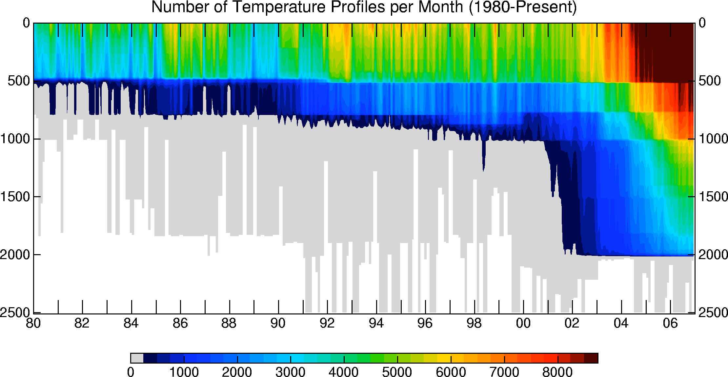
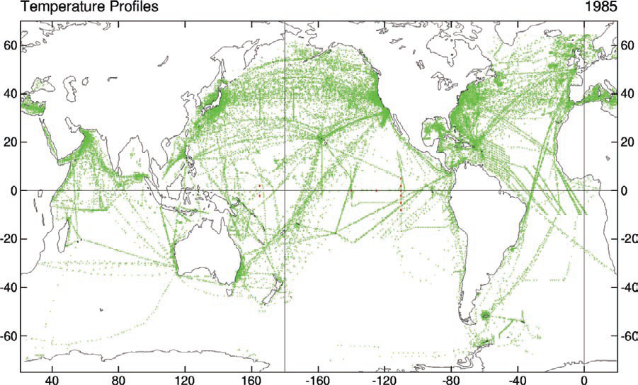
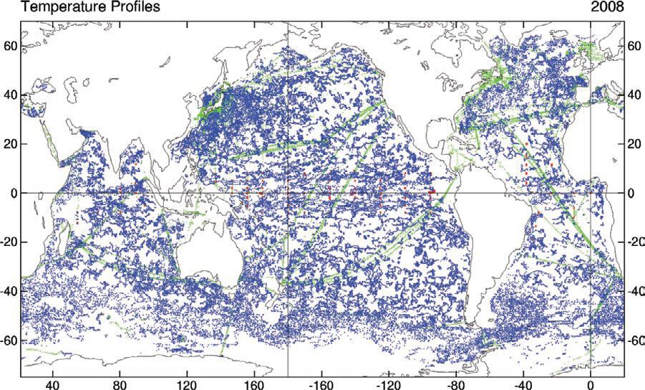
Ocean Observations
from Saha et al. (2010)
XBT
TAO
(after 1985)
Altimetry
(after 1993)
Argo
(after 2001)
XBT
TAO
Argo
Notes:
Pre-altimetry period (1980-1992): XBT profiles provide a poor coverage of the tropical and southern oceans. XBT corrections are needed.
Altimetry period (1993-2002): Temperature signal needs to be extracted from SSH, and TAO data are also available for improving the tropical Pacific analysis
Argo period (2003-2009): Argo profiles provide a good coverage of the global ocean, and should improve the tropical and southern ocean analysis.

Slide 3
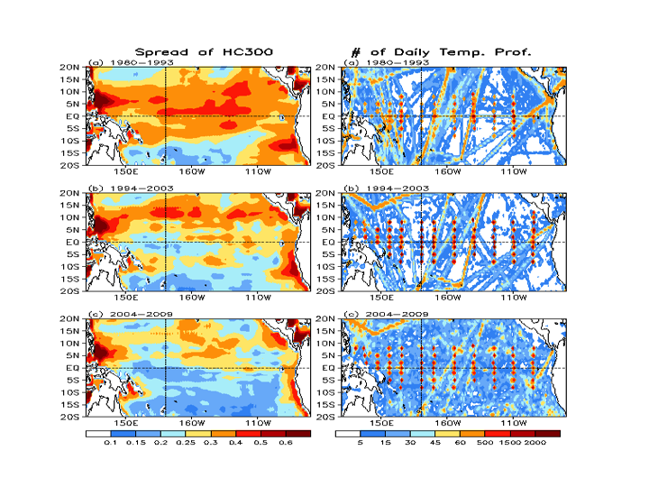
Multiple ORA Heat Content Intercomparison
Xue et al. 2011, J Clim
Ensemble Spread
Data Count
TAO & XBT
(1980-1993)
Altimetry & TAO & XBT
(1994-2003)
Argo & Altimetry & TAO & XBT
(2004-2009)

Slide 4
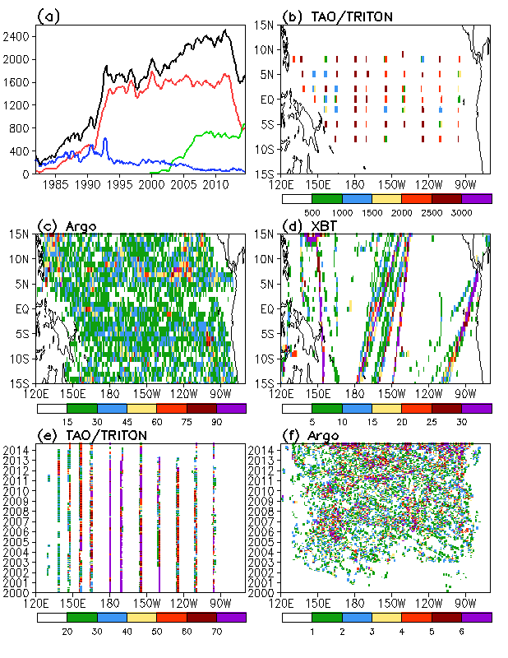
Tropical Pacific Observing Systems
Daily temperature profiles per month
Black: All data
Red: TAO/TRITON
Blue: XBT
Green: Argo
2004-2011
8S-8N
2004-2011
2004-2011
3S-3N

Slide 5
Coordinated Observing System Experiments
At NCEP and GFDL (2004-2011)
 | CTL | ALL | noMoor | noArgo
In situ data included | no profiles OISST | all profiles OISST | all except moorings OISST | all except Argo OISST
XBT | × | √ | √ | √
TAO | × | √ | × | √
Argo | × | √ | √ | ×
What are the mean biases and RMSE (monthly anomalies) in the control simulations when no in situ observations are assimilated?
How well are mean biases and RMSE constrained by assimilation of all in situ observations?
What are influences of withholding mooring or Argo data on mean biases and RMSE?

Slide 6
NCEP’s Global Ocean Data Assimilation System
MOM4p1, 0.5º resolution, 1/4º in 10ºS-10ºN, 40 levels
Daily fluxes from NCEP Reanalysis 2
3D-VAR, Univariate in temperature and salinity (Behringer 2007)
Horizonal covariance with scale elongated in zonal direction, vertical covariance as function of local vertical temperature gradient
Temperature profiles and OISST assimilated
Synthetic salinity derived with climatology T/S relationship and temperature profiles from XBT and moorings, observed salinity from Argo assimilated
Altimetry SSH not assimilated
Temperature (salinity) at 5m is relaxed to daily OISST (WOA salinity climatology) with 10 (30) day relaxation time scales.

Slide 7
GFDL’s Ensemble Coupled Data Assimilation
CM2.1 coupled climate model
MOM4 with 1º resolution, 1/3º near equator, 50 levels
Ensemble Kalman filter with 12-ensemble members
Atmosphere is constrained by NCEP reanalyses (3D air temperature, u, v assimilated)
Temperature profiles and OISST assimilated
Pseudo salinity derived with vertical coupled T-S EOFs and temperature profiles from XBT and moorings and altimetry SSH, observed salinity from Argo assimilated
Altimetry SSH not assimilated
Ensemble mean is analyzed

Slide 8
Evaluation of OSEs
Evaluation data
TAO temperature and current
Altimetry SSH from AVISO
Surface current from OSCAR
EN4 temperature and salinity analysis (objective analysis based on in situ data only) is used as reference but not the “truth”
Evaluation Methods
Mean and annual cycle
Standard deviation (STD)
Root-mean-square error (RMSE) and anomaly correlation coefficient (ACC)
Integrated RMSE in upper 300m

Slide 9
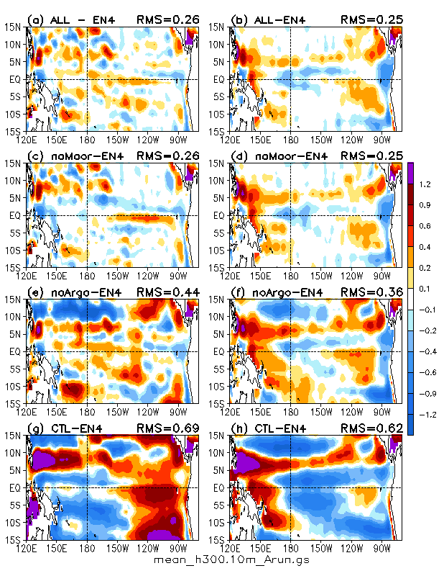
Mean Biases in Upper 300m Heat Content

Slide 10
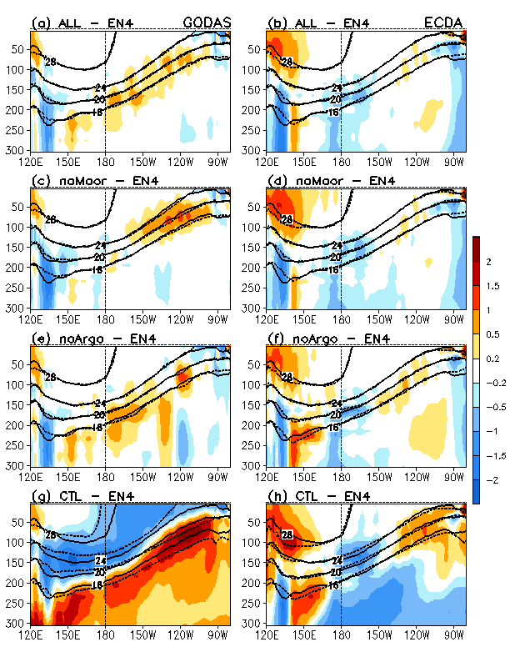
Mean Biases in Temperature Averaged in 2S-2N

Slide 11
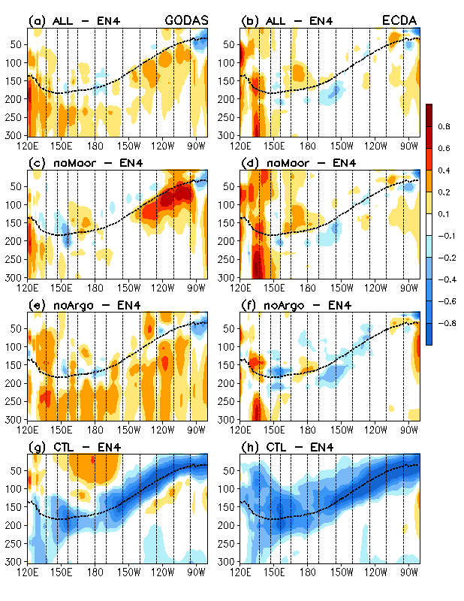
STD Biases of Temperature Averaged in 2S-2N

Slide 12
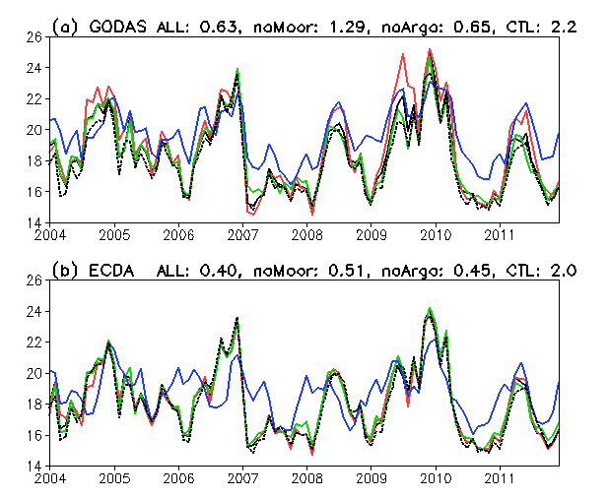
Temperature Averaged in 130W-100W, 2S-2N at z=75m
TAO (dotted line)
ALL
noMoor
noArgo
CTL

Slide 13
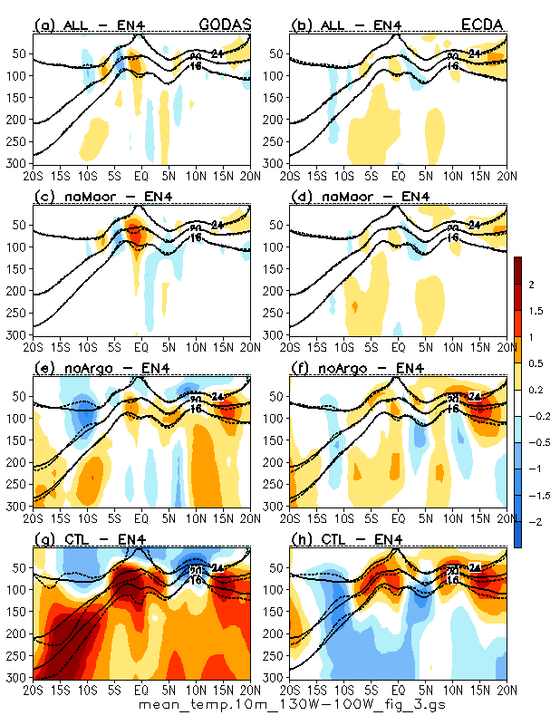
Mean Biases of Temperature Averaged in 130W-100W

Slide 14
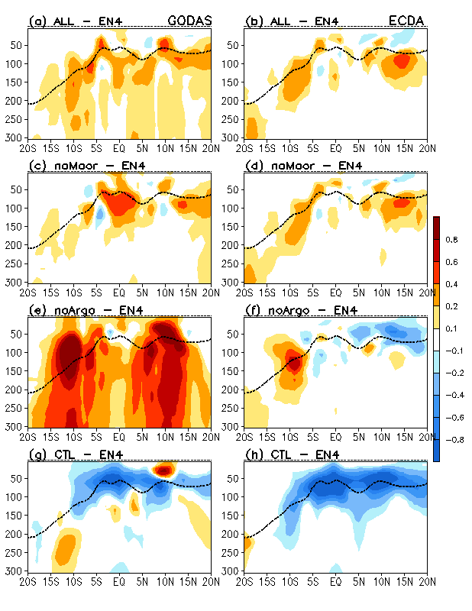
STD Biases of Temperature Averaged in 130W-100W

Slide 15
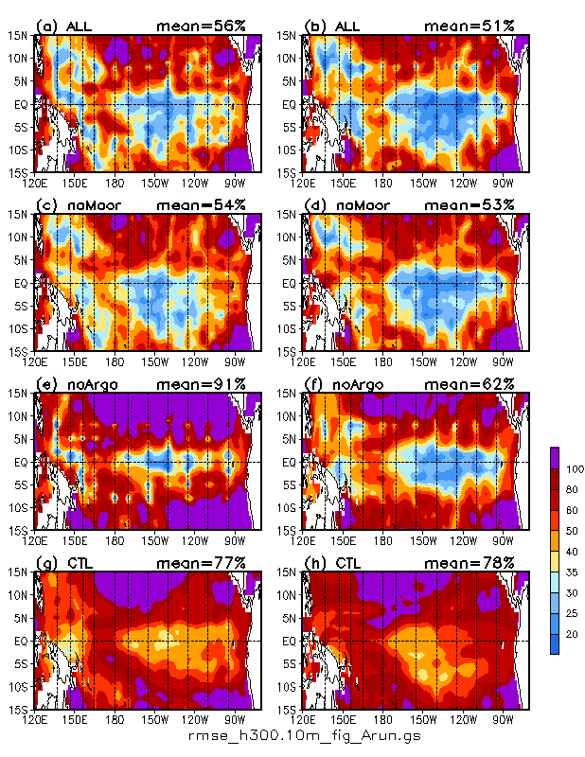
RMSE/STD of Upper 300m Heat Content Anomaly

Slide 16
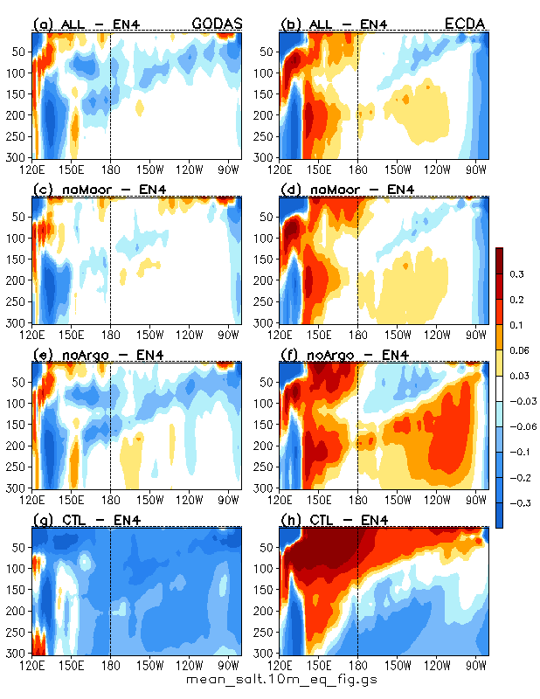
Mean Biases of Salinity Averaged in 2S-2N

Slide 17
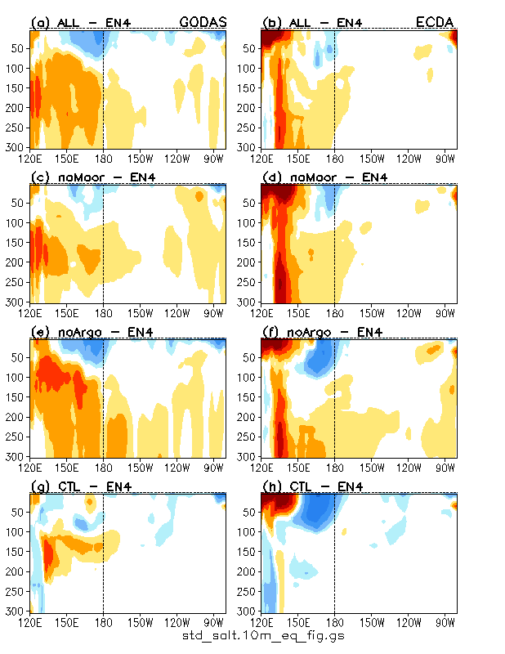
STD Biases of Salinity Averaged in 2S-2N

Slide 18
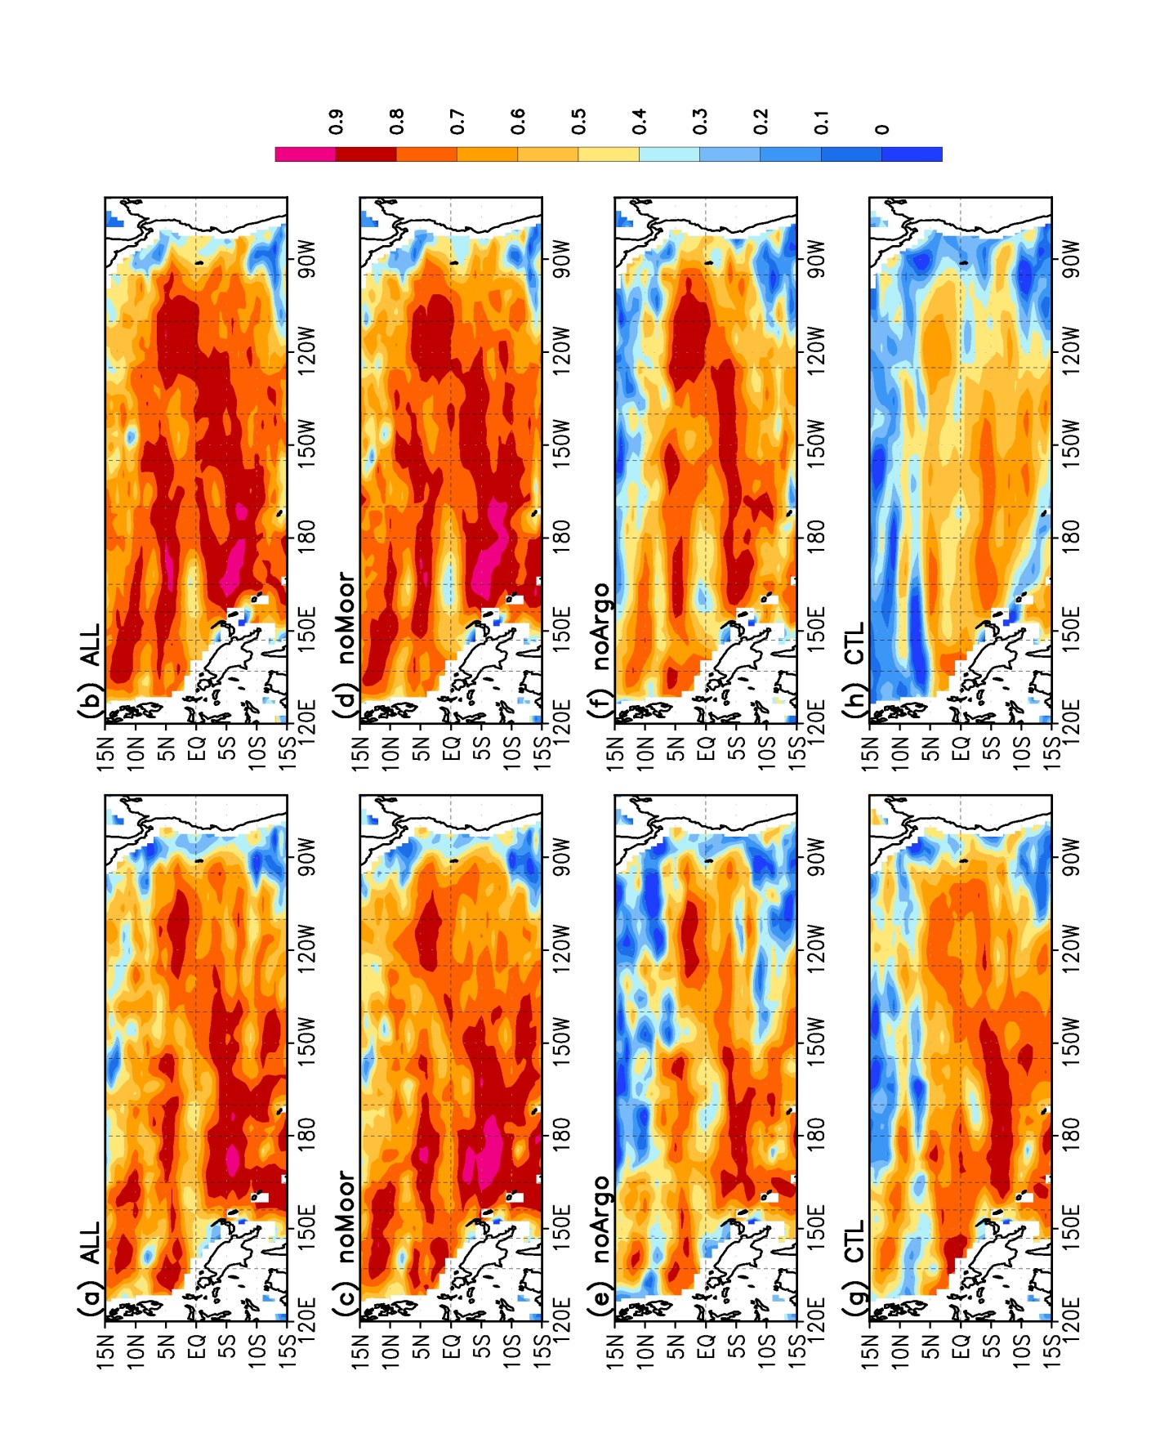
Anomaly Correlation of Surface Zonal Current with OSCAR

Slide 19
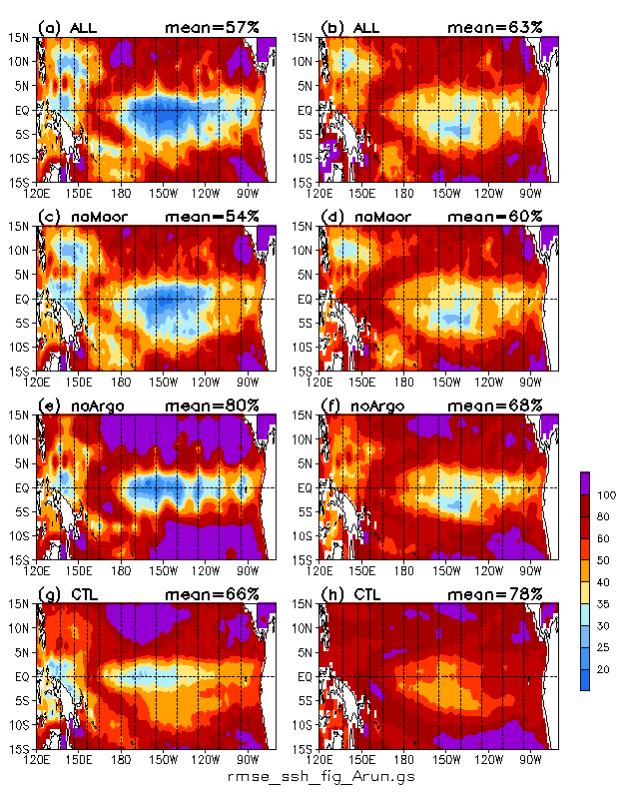
RMSE/STD of SSH

Slide 20
Summary
Coordinated Observing System Experiments (OSEs) were conducted using NCEP’s GODAS and GFDL’s ECDA during 2004-2011.
OSE simulations were evaluated with observations (TAO temperature, TAO currents, altimetry SSH) and analyzed data (EN4 temperature and salinity analysis, OSCAR surface current analysis)
Without assimilation of in situ data, both GODAS and ECDA had large mean biases, STD biases and RMSE.
Assimilation of in situ data significantly reduced mean biases, STD biases and RMSE in all variables except zonal current at equator.
For constraining temperature analysis, the mooring data is more critical than the Argo data in the equatorial Pacific, but the Argo data is more important in off-equatorial regions.
For constraining salinity, sea surface height and surface current analysis, the influence of Argo data is more critical.
Impacts of observations on ocean analysis are sensitive to configuration of data assimilation schemes, indicating that a multi-model approach is needed to assess the value of tropical Pacific observing systems.

Slide 21
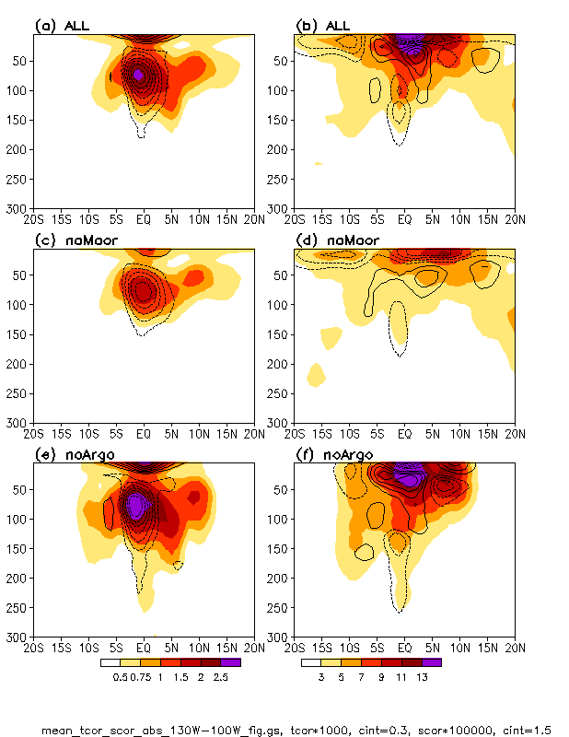

Slide 22
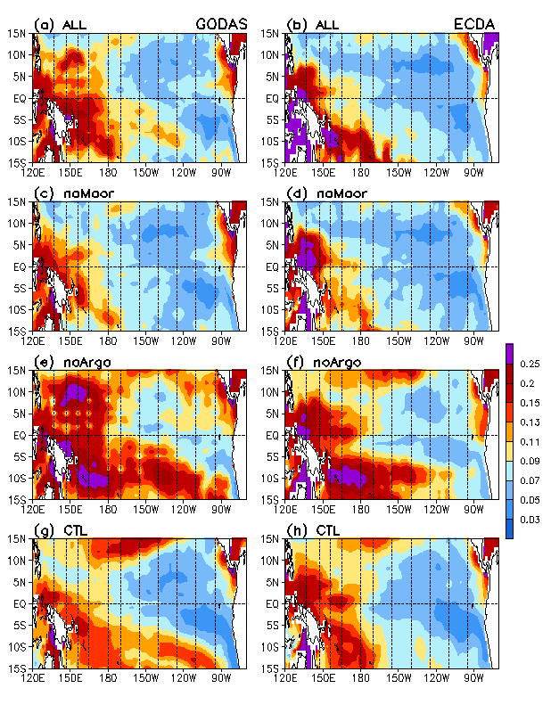

Slide 23
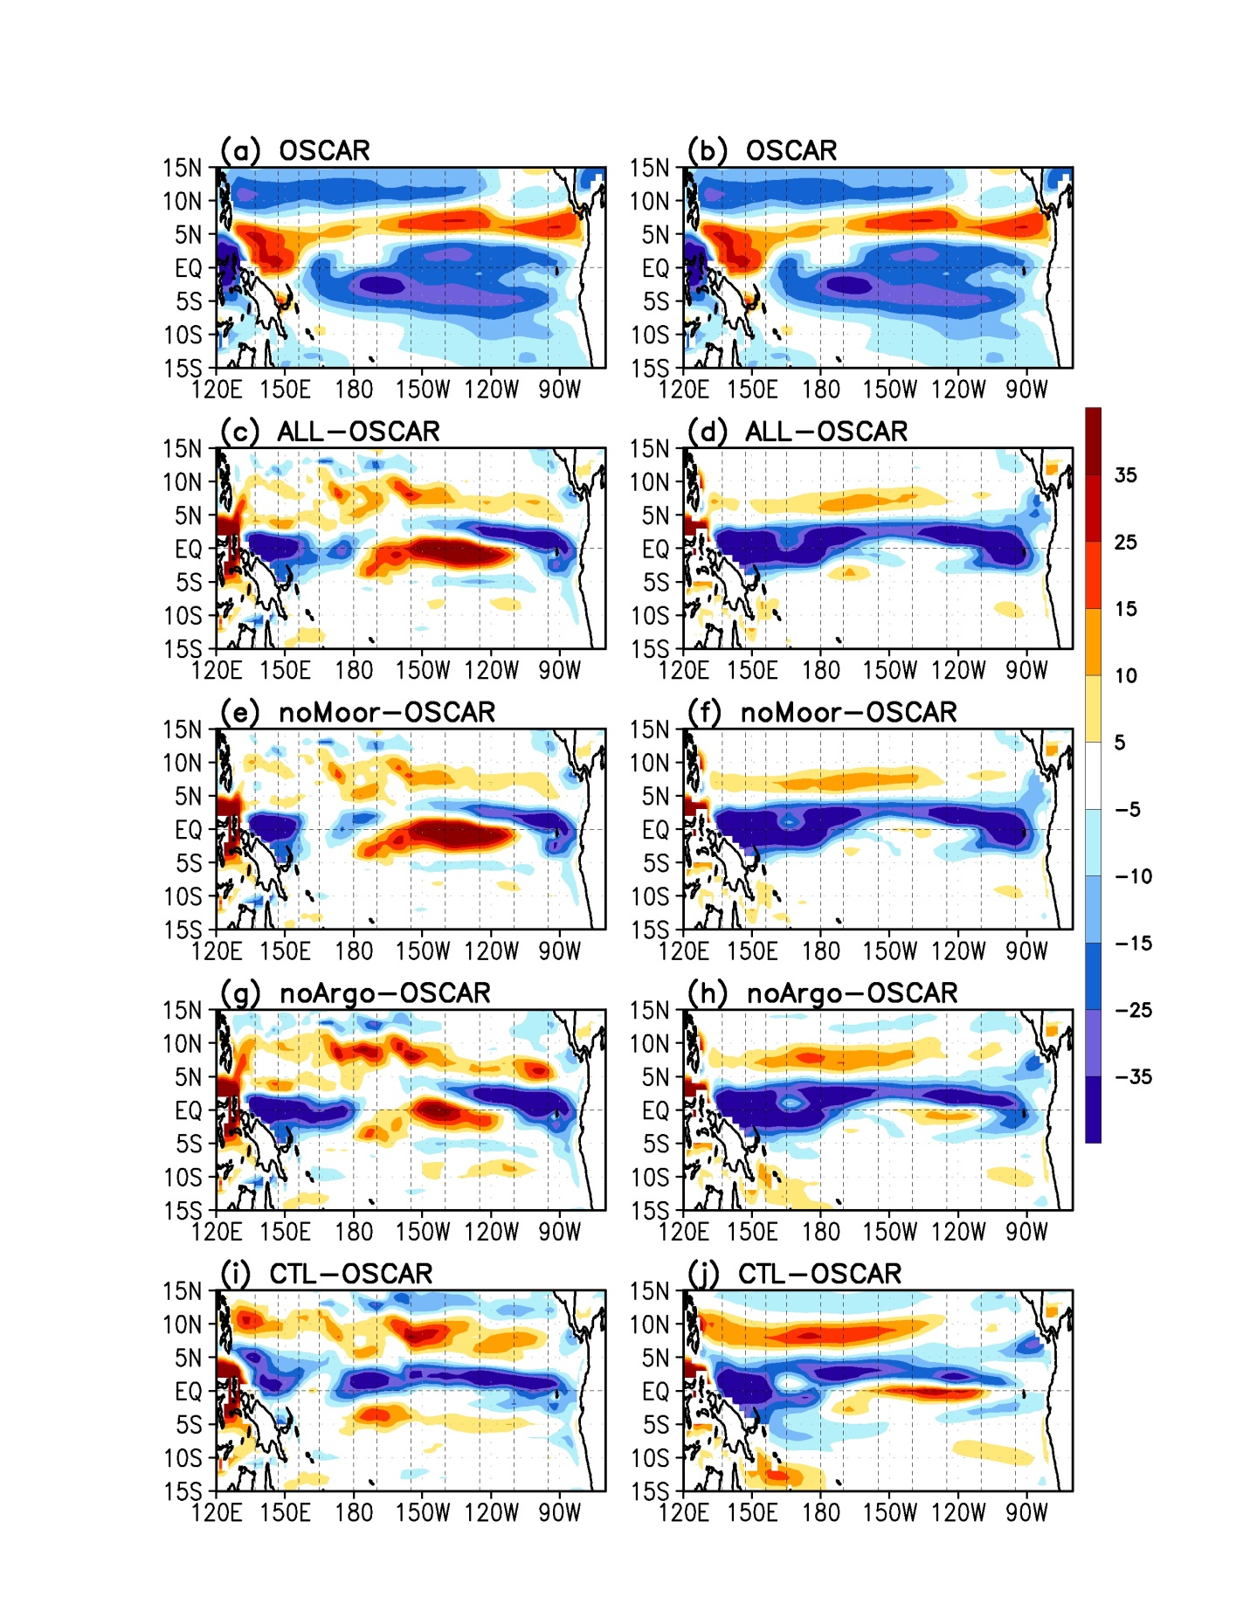

Slide 24
