Slide 1
Reanalyzed Clouds, Precipitation, TOA and Surface Radiation Budgets: A Global Satellite Comparison and a Regional Study at Two ARM Locations
Erica Dolinar, Xiquan Dong, and Baike Xi
University of North Dakota
Department of Atmospheric Science
10 December 2014

Slide 2
Introduction/Motivation
Predicting the interactions between clouds, radiation, and precipitation on the global and regional scales has been an ongoing task for many years
Models and parameterizations help to better resolve these interactions
Satellites and ground-based observations can help with model evaluation

Slide 3
Tasks
1. Global (60 °N/S) distributions: reanalyses and observations
Cloud Fraction, Precipitation Rates (PR), and TOA Cloud Radiative Forcings (CRFs)
2. Define vertical velocity regimes (from reanalyses)
Upwelling/convective: wide variety of convective-type clouds
Downwelling/subsidence: MBL stratocumulus clouds
Biases
PR analysis
3. Regional Studies (2 ARM sites: Azores and Nauru)
CF and surface downward radiation fluxes

Slide 4
Reanalyses
20CR (Compo et al. 2011)
CFSR (Saha et al. 2006)
Era-Interim (Dee et al. 2011)
JRA-25 (Onogi et al. 2007)
MERRA (Rienecker et al. 2011)
*Only available reanalysis data are shown

Slide 5
Observational Data
Satellite
Cloud Fraction (CF): CERES MODIS Ed3A
Precipitation Rate: TRMM 3B43 version 7
TOA and surface Radiation: CERES EBAF-TOA and –Surface Ed2.8
Ground-based observations
Cloud Fraction: ARM Cloud radar-lidar
SW and LW fluxes: ARM PSP and PIR

Slide 6
Task 1 Global Distributions

Slide 7
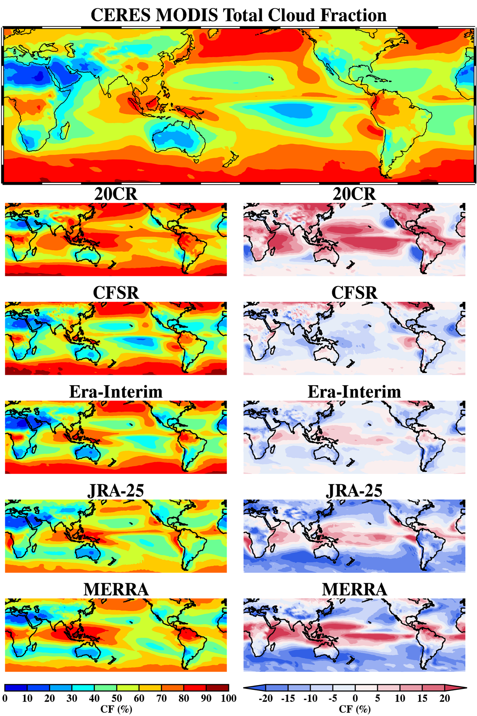
Cloud Fraction (CF)
Overall distribution is well simulated
Some larger biases in the equatorial Pacific, Indian Ocean, and where MBL stratocumuli form and reside
Reanalyses under predict the global (60 N/S) CF (except 20CR)
20CR | CFSR | Era-Interim | JRA-25 | MERRA | CERES MODIS
67.1 | 57.9 | 57.7 | 53.8 | 57.1 | 60.0

Slide 8
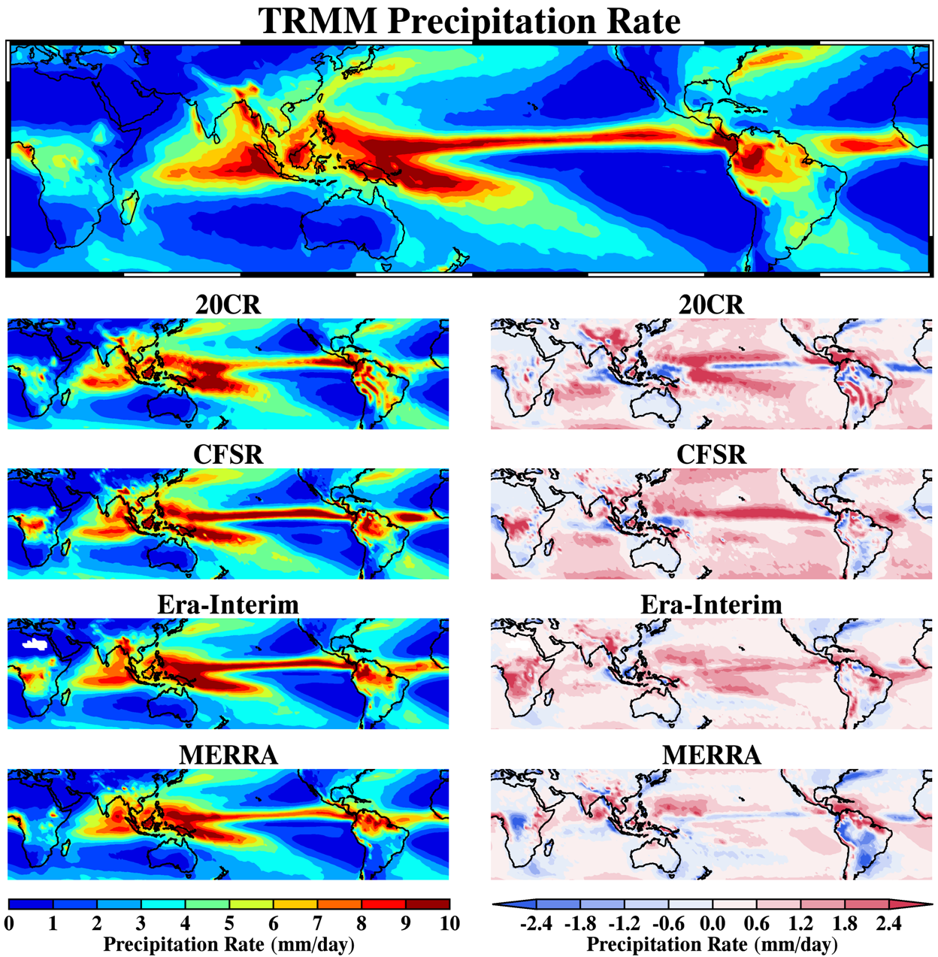
Precipitation Rate (PR)
PR is over predicted in the tropics and extra-tropics, especially over oceans
Well developed ITCZ in the reanalyses
Errors in strength and placement are evident
Issues in areas of complex terrain (i.e. Tibetan Plateau and South America) and Africa
20CR | CFSR | Era-Interim | JRA-25 | MERRA | TRMM
3.3 | 3.5 | 3.3 | --- | 3.0 | 2.9

Slide 9
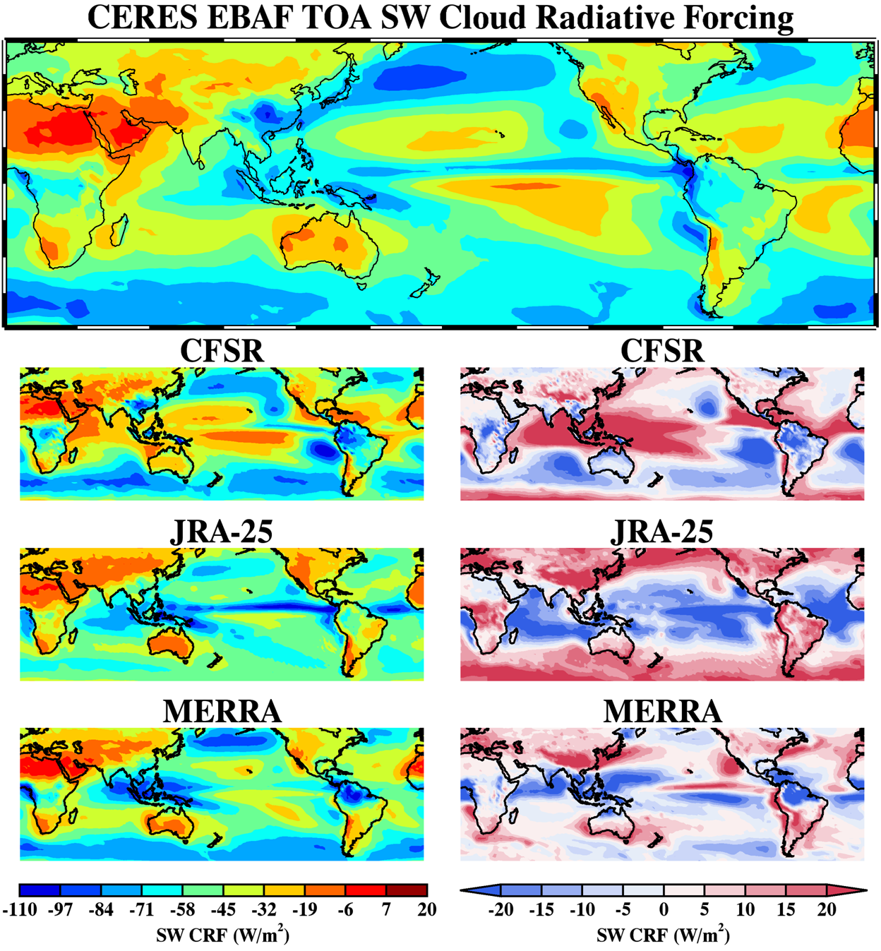
TOA SW CRF
Strongest SW cooling in Southern Ocean, Northern Pacific, and ITCZ
Weakest SW cooling in Northern Africa, Middle East, and Australia (where CF is minimal)
Weaker SW cooling in reanalyses*
Large biases in the topics and where MBL clouds form
20CR | CFSR | Era-Interim | JRA-25 | MERRA | CERES EBAF
---- | −46.7 | ---- | −48.2 | −50.1 | −50.2
*Positive bias: weaker cooling, smaller negative number

Slide 10
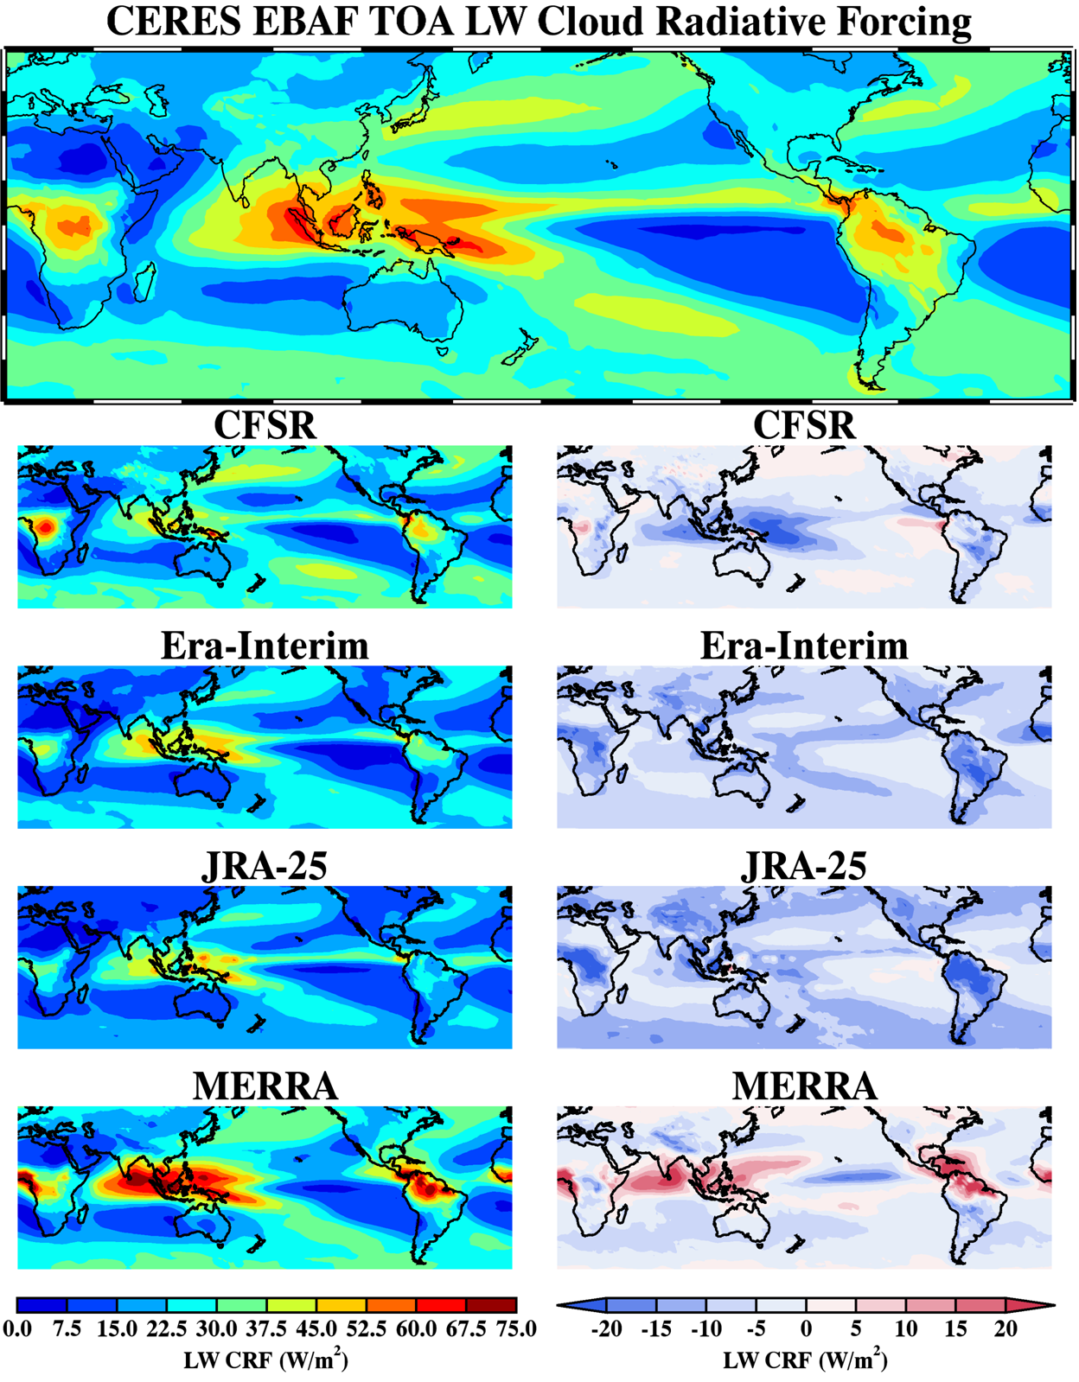
TOA LW CRF
Strongest LW warming in tropics (especially East Indies) and along mid-latitude storm tracks
Weakest LW warming in subsidence zones and where clouds are infrequent
LW CRF is under predicted by the reanalyses (especially in the Pacific, Africa, and South America)
Evidence of stronger warning in MERRA
20CR | CFSR | Era-Interim | JRA-25 | MERRA | CERES EBAF
---- | 23.6 | 19.4 | 18.5 | 26.8 | 27.6

Slide 11
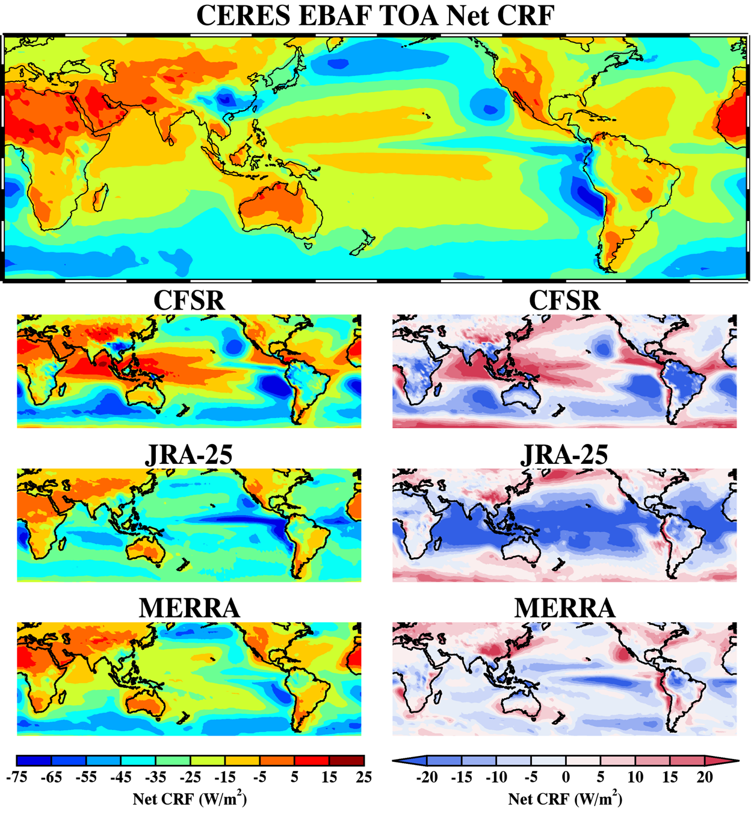
TOA Net CRF
Global Net cooling due to clouds
Reanalyses predict this net cooling to be stronger than observed by CERES EBAF
A result of a relatively weak LW warming
Large discrepancies in the tropics and mid-latitudes where MBL clouds frequently occur
20CR | CFSR | Era-Interim | JRA-25 | MERRA | CERES EBAF
---- | −23.1 | ---- | −29.7 | −23.3 | −22.6
*Positive bias: weaker cooling, smaller negative number

Slide 12
Summary of Task 1
The globally (60 °N/S) averaged reanalysis and observation results during the period of this study (03/2000 – 02/2012). PRs are from (45 °N/S).
 | 20CR | CFSR | Era-Interim | JRA-25 | MERRA | Observations
CF | 67.1 | 57.9 | 57.7 | 53.8 | 57.1 | 60.0
PR | 3.3 | 3.5 | 3.3 | −−− | 3.0 | 2.9
RSR_{all-sky} | 92.5 | 96.6 | −−− | 95.9 | 98.6 | 98.4
RSR_{clear-sky} | −−− | 49.9 | −−− | 47.7 | 48.5 | 48.2
OLR_{all-sky} | 243.9 | 251.2 | 253.3 | 262.9 | 250.3 | 247.2
OLR_{clear-sky} | −−− | 274.8 | 272.7 | 281.4 | 277.1 | 274.8
SW CRF | −−− | −46.7 | −−− | −48.2 | −50.1 | −50.2
LW CRF | −−− | 23.6 | 19.4 | 18.5 | 26.8 | 27.6
Net CRF | −−− | −23.1 | −−− | −29.7 | −23.3 | −22.6
Units: CF (%), PR (mm/day), TOA Radiation (W/m²)
*Radiation budgets are from TOA
RSR = Reflected Shortwave Radiation
OLR = Outgoing Longwave Radiation
SW CRF = S_{o}(R_{clear-sky} − R_{all-sky})
LW CRF = (OLR_{clear-sky} − OLR_{all-sky})
Net CRF = SW CRF + LW CRF

Slide 13
Task 2 Vertical Velocity Regimes

Slide 14
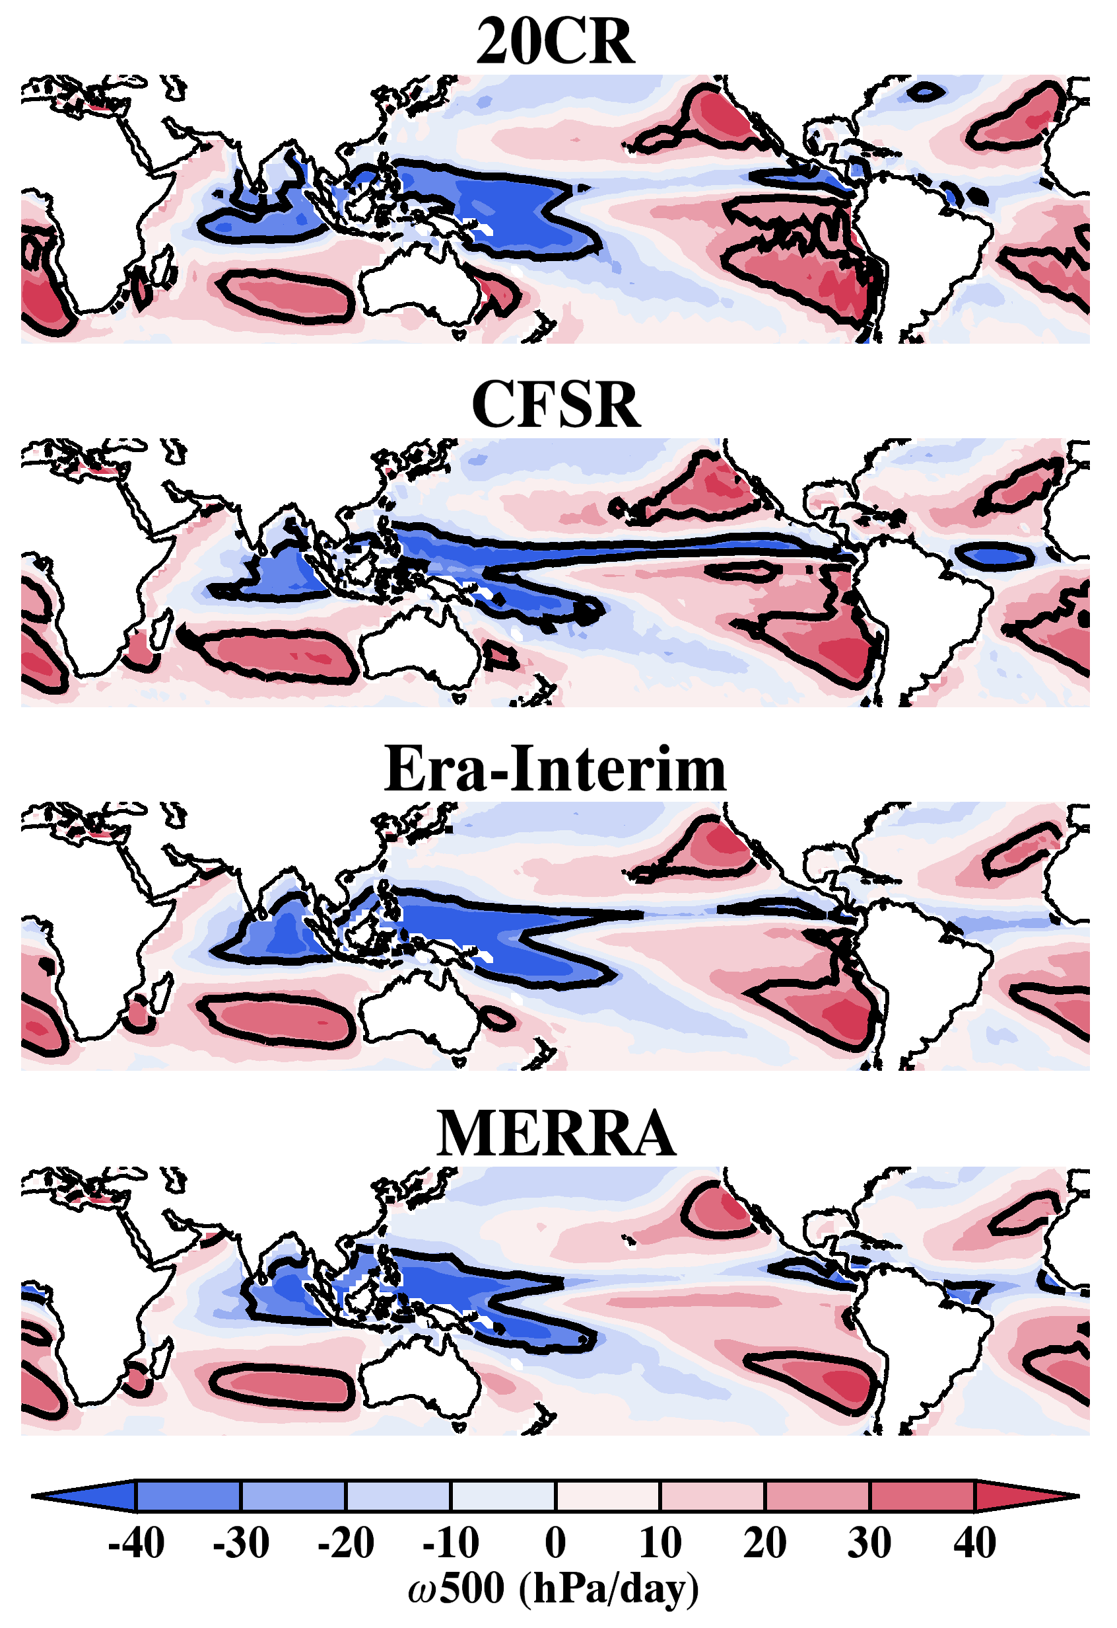
Vertical Velocity Regimes
Determined by thresholds in the reanalyzed vertical velocities at 500 hPa (ω500)
> 25 hPa; Downwelling
< -25 hPa; Upwelling
Some differences in the definition of the regimes by each reanalysis (i.e. larger downwelling zones in 20CR and the extent of upwelling zone across Pacific in CFSR)
Cloud parameterizations are inherently considered
Stratiform
Convective

Slide 15
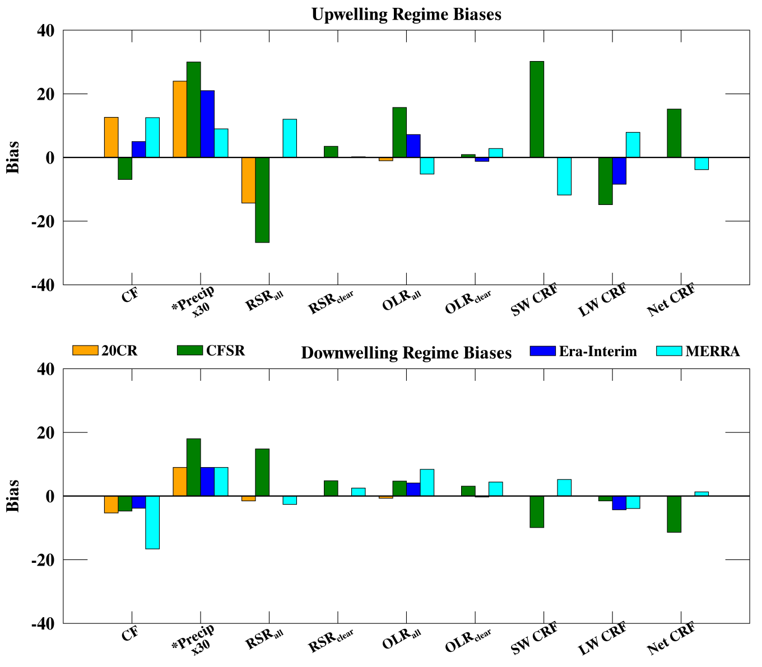
Regime Biases
Upwelling
Biases are generally larger in the upwelling regime
CF is typically over (under) predicted in the upwelling (downwelling) regime
PRs are over predicted in both regimes
Radiation budgets follow the cloud/radiation interaction theories well (i.e. more clouds, larger net CRF cooling)
Downwelling

Slide 16
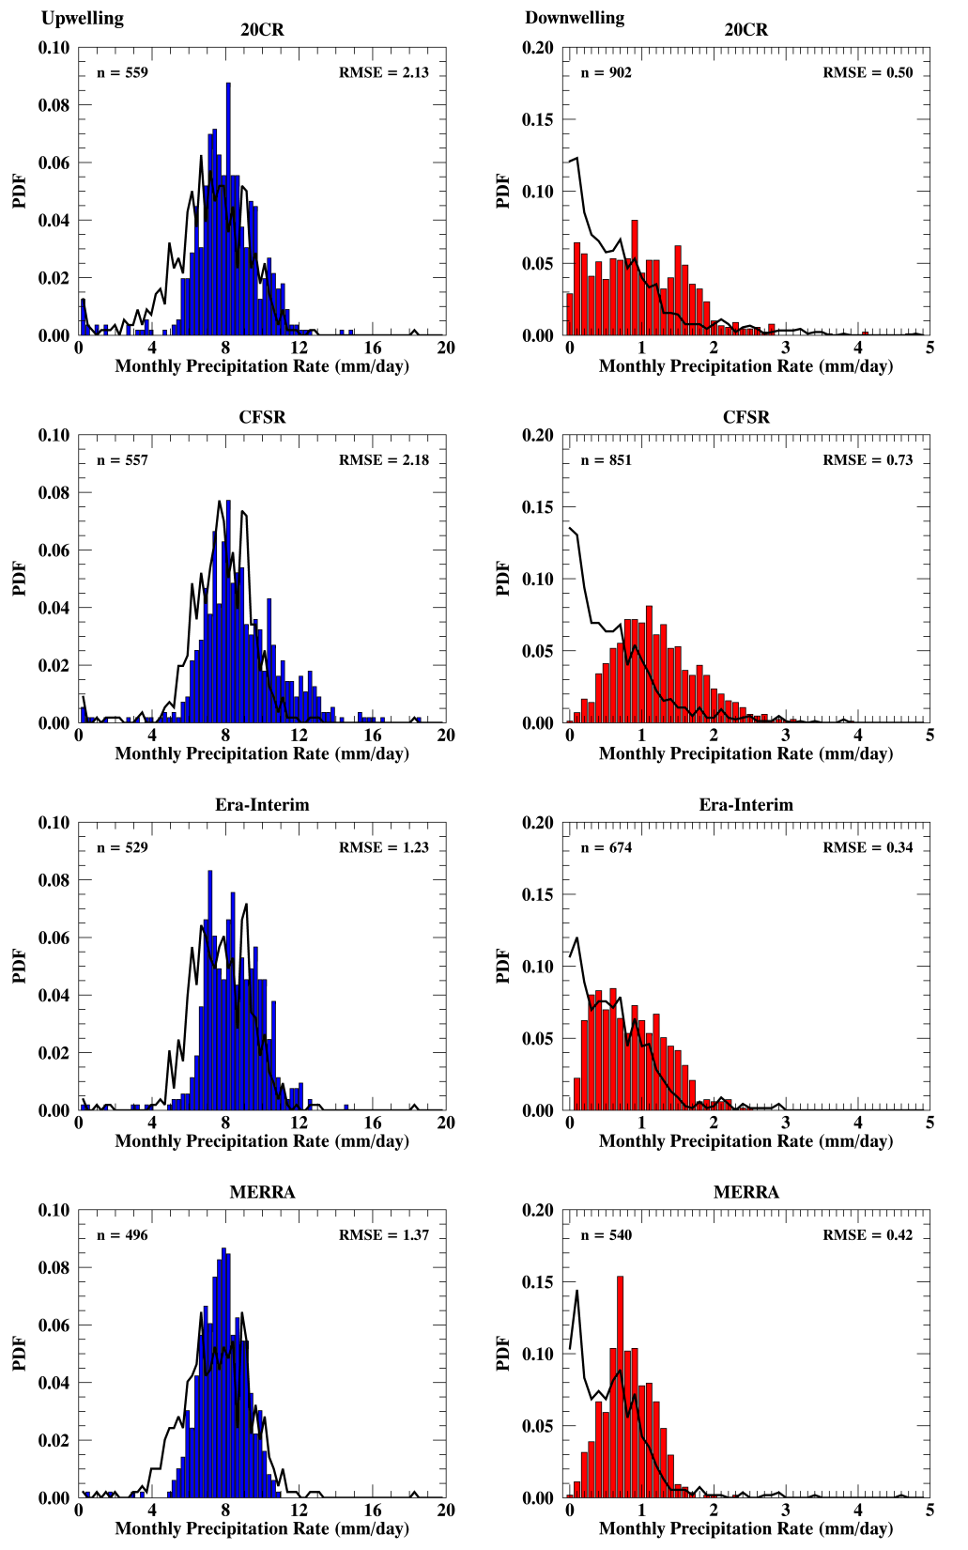
PR Analysis
*TRMM results in black line
Upwelling
Downwelling
PRs are over predicted in both regimes
Some weaker rates (~4-6 mm/day) are not produced in the upwelling regime
Normal distribution is simulated well
In the downwelling regime, the over prediction is a result of weaker PRs below ~0.5 mm/day and relatively stronger PRs (>1.0 mm/day)
The reanalyzed distribution is skewed to the right and normal (unlike the TRMM distribution, which is exponential)

Slide 17
Task 3 Regional Studies at two ARM Sites

Slide 18
ARM Sites
Azores (39 °N, 28 °W) – 06/2009 through 12/2010 (19 months)
Downwelling regime
Investigating MBL stratocumulus clouds
Nauru (0 °, 166 °E) – 03/2000 through 02/2009 (9 years)
Upwelling regime
Investigating convective-type clouds

Slide 19
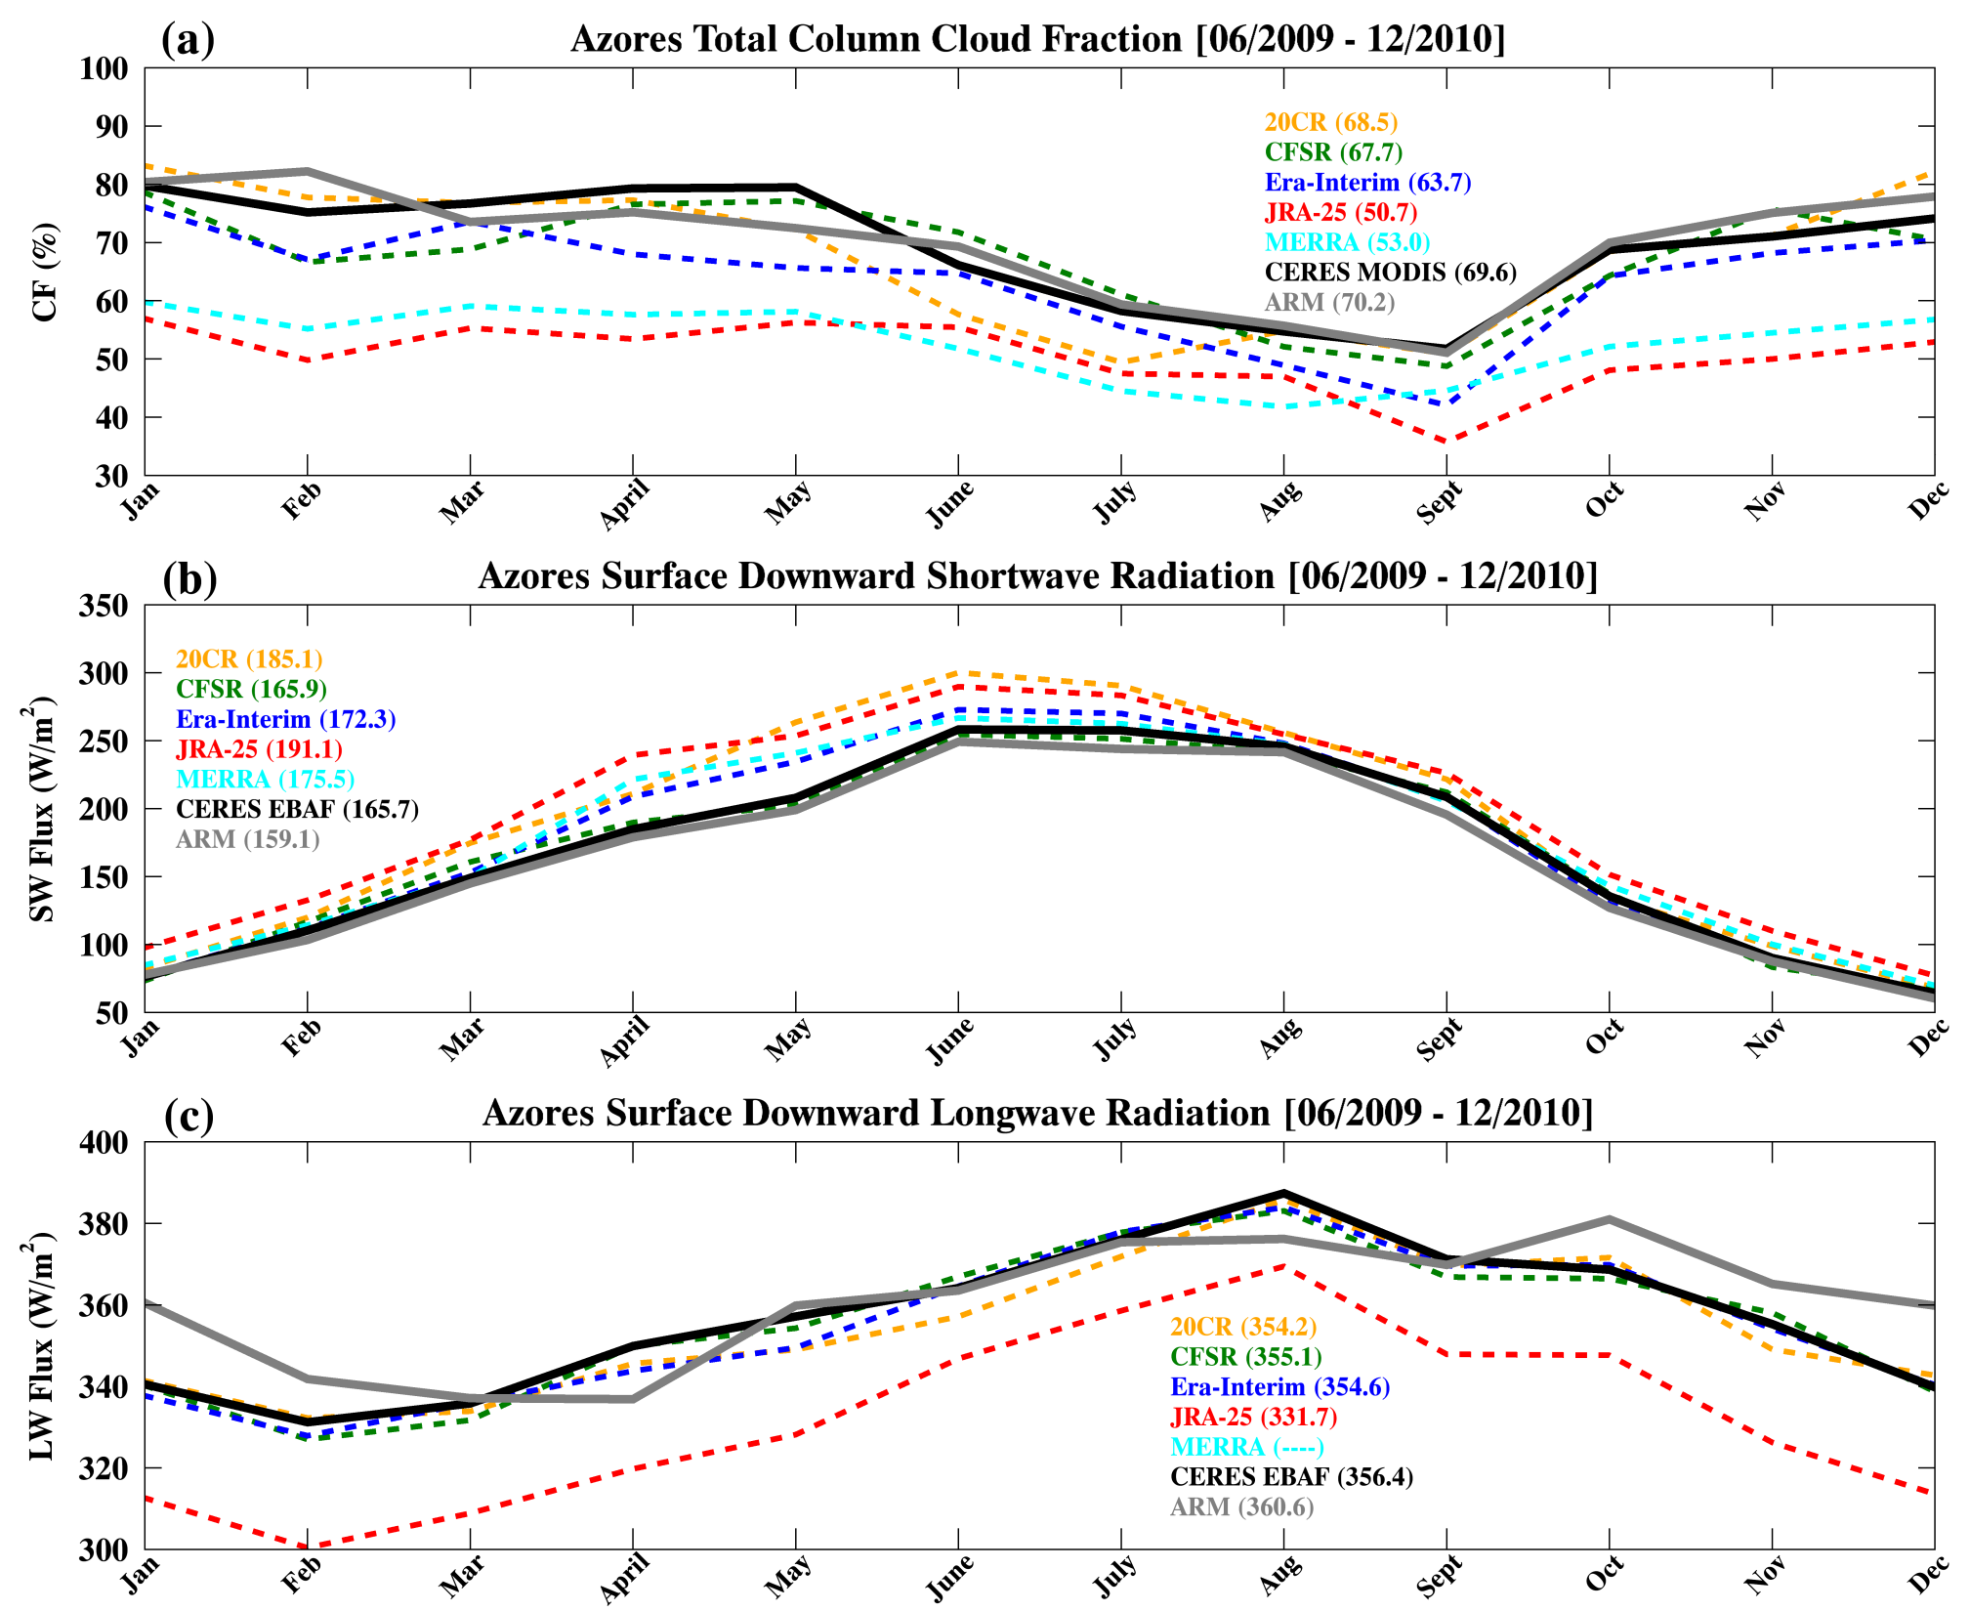
Compared to ARM (70.2%) and CERES MODIS (69.6%) CFs, all reanalyzed CFs are under predicted, which resulted in higher SW and lower LW fluxes at the surface than observations (lower CF➔higher SW_{dn} and lower LW_{dn} at the surface)

Slide 20
Azores Summary
Reanalysis | CF |  | Correlation | SWdn |  | Correlation | LWdn |  | Correlation
 | Mean | σ | CM | ARM | Mean | σ | CE | ARM | Mean | σ | CE | ARM
20CR | 68.5 | 12.2 | 0.92 | 0.92 | 185.1 | 83.1 | 0.99 | 0.99 | 354.2 | 17.0 | 0.98 | 0.84
CFSR | 67.7 | 9.7 | 0.90 | 0.84 | 165.9 | 69.6 | 0.99 | 0.99 | 355.1 | 18.0 | 0.99 | 0.80
Era-Interim | 63.7 | 10.0 | 0.92 | 0.93 | 172.3 | 77.1 | 0.99 | 0.99 | 354.6 | 18.2 | 0.99 | 0.83
JRA-25 | 50.7 | 5.9 | 0.82 | 0.75 | 191.1 | 75.8 | 0.99 | 0.98 | 331.7 | 21.9 | 0.99 | 0.81
MERRA | 53.0 | 6.2 | 0.97 | 0.90 | 175.5 | 73.2 | 0.99 | 0.99 | ---- | ---- | ----
CM/CE | 69.6 | 9.9 | 0.92 | 165.7 | 71.2 | 0.99 | 356.4 | 17.6 | 0.80
ARM | 70.2 | 9.8 |  | 159.1 | 68.3 |  | 360.6 | 15.0
Cloud Fraction (CF)
Reanalysis standard deviations are close to the observed ones
Reanalyses correlate more to CERES MODIS (CM)
Surface Downward SW Radiation (SWdn)
Reanalysis standard deviations are close to the observed ones
Extremely high correlations to both observing platforms
Surface Downward LW Radiation (LWdn)
Reanalysis standard deviations are close to the observed ones
Reanalyses correlate more to CERES EBAF (CE)

Slide 21
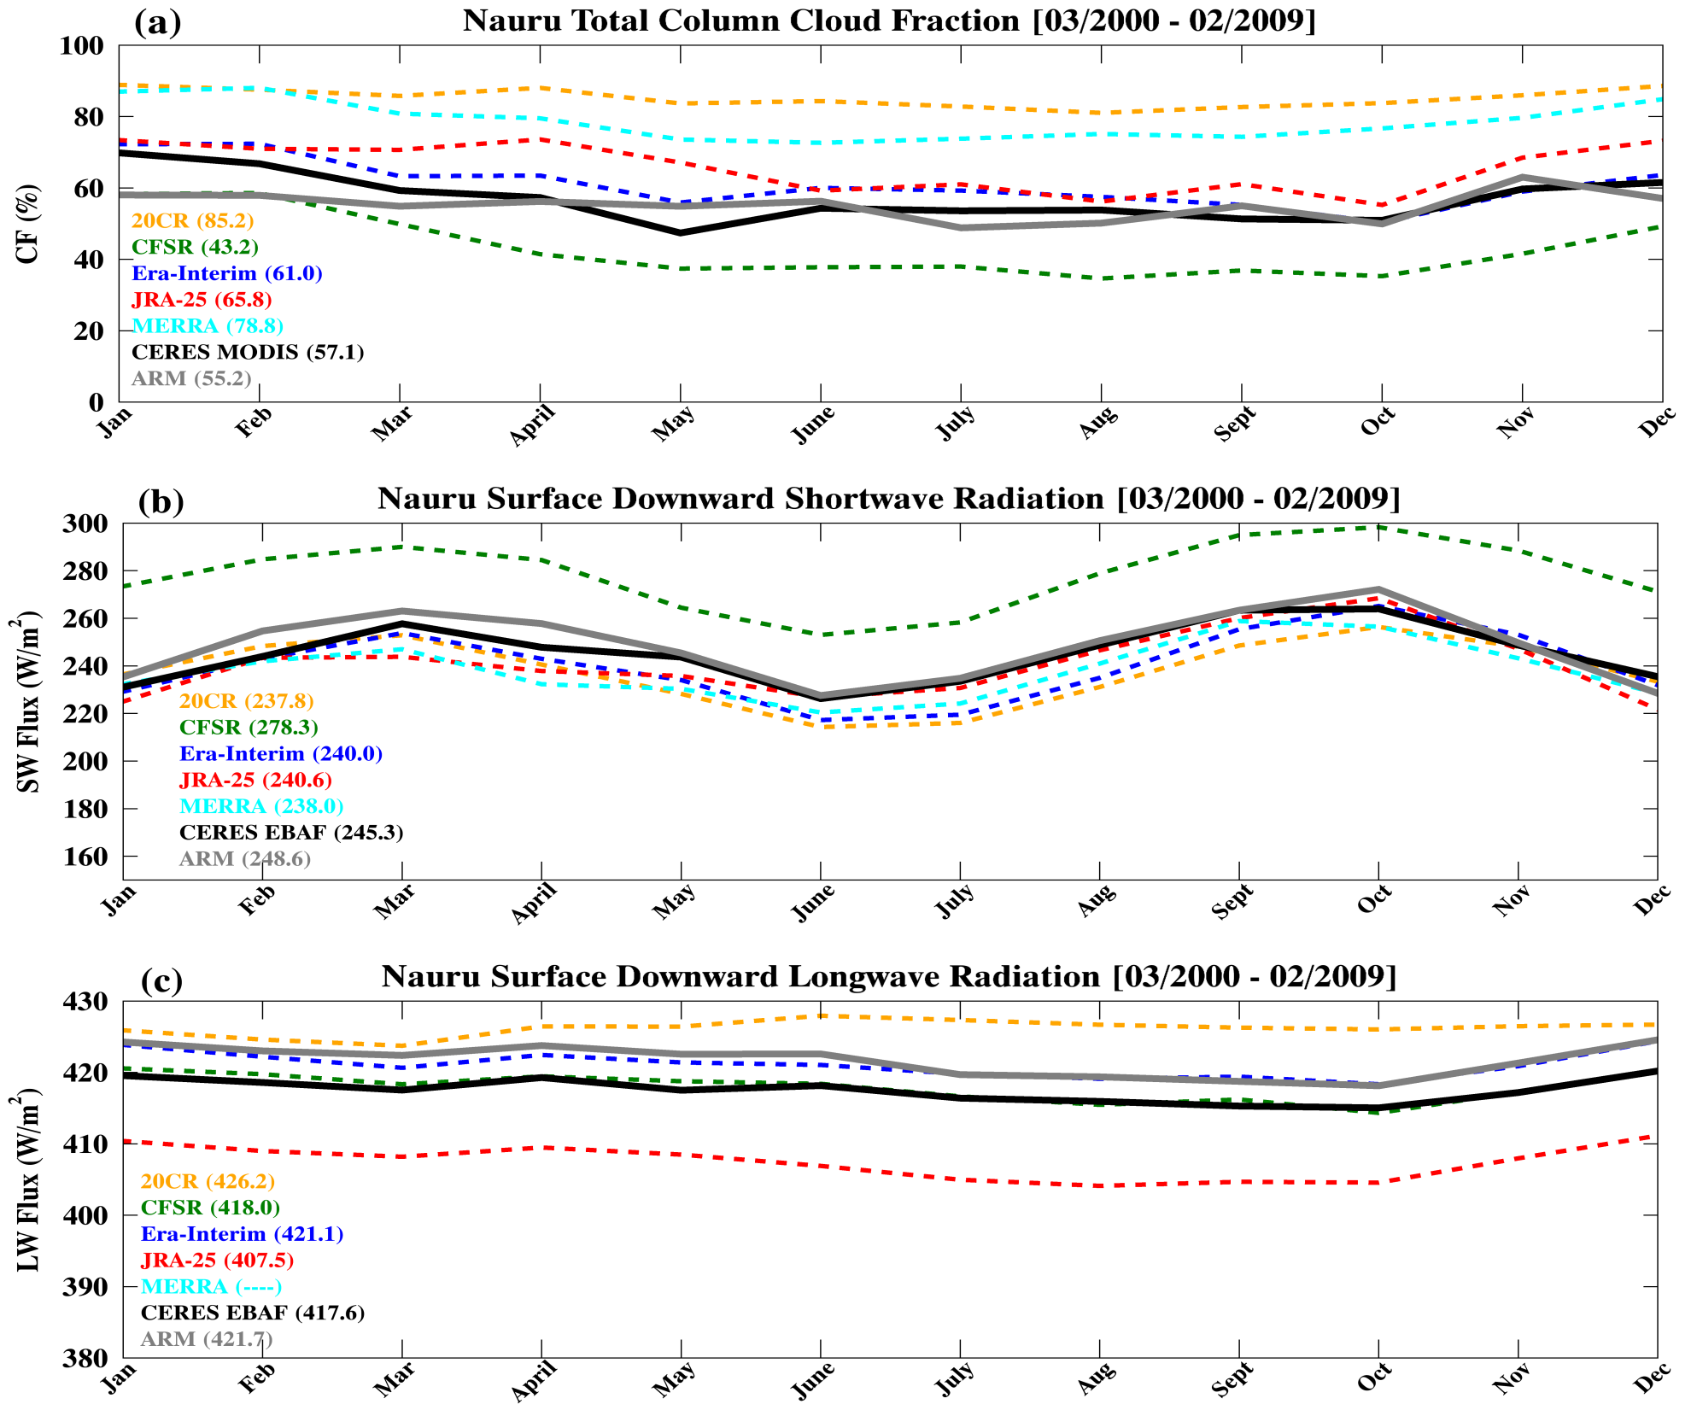
In contrast to the Azores comparison, all reanalyzed CFs (except CFSR) were higher than ARM (55.2%) and CERES MODIS (57.1%) CFs, which resulted in lower SW flux at the surface.
The reanalyzed surface LW fluxes are scattering around observations due to different cloud types.

Slide 22
Nauru Summary
Reanalysis | CF |  | Correlation | SDSR |  | Correlation | SDLR |  | Correlation
 | Mean | σ | CM | ARM | Mean | σ | CE | ARM | Mean | σ | CE | ARM
20CR | 85.2 | 2.6 | 0.80 | 0.66 | 237.8 | 13.8 | 0.81 | 0.83 | 426.2 | 1.1 | -0.06 | -0.15
CFSR | 43.2 | 8.6 | 0.92 | 0.51 | 278.3 | 14.5 | 0.89 | 0.89 | 418.0 | 2.0 | 0.96 | 0.97
Era-Interim | 61.0 | 6.5 | 0.91 | 0.49 | 240.0 | 14.9 | 0.93 | 0.91 | 421.1 | 1.9 | 0.97 | 0.95
JRA-25 | 65.8 | 6.9 | 0.67 | 0.67 | 240.6 | 14.0 | 0.91 | 0.90 | 407.5 | 2.4 | 0.94 | 0.96
MERRA | 78.8 | 5.4 | 0.92 | 0.52 | 238.0 | 12.1 | 0.93 | 0.88 | ---- | ---- | ----
CM/CE | 57.1 | 6.6 | 0.56 | 245.3 | 12.3 | 0.95 | 417.6 | 1.7 | 0.98
ARM | 55.2 | 4.0 |  | 248.6 | 14.6 |  | 422.1 | 2.2
Cloud Fraction (CF)
Reanalysis standard deviations are close to the observed ones
Reanalyses correlate more to CM
Surface Downward SW Radiation (SDSR)
Reanalysis standard deviations are close to the observed ones
On average, reanalyses correlate more to CE
Surface Downward LW Radiation (SDLR)
Reanalysis standard deviations are close to the observed ones
High correlations to both observing platforms (except 20CR)

Slide 23
Concluding Remarks
Upon analyzing the results from this study, convective-type cloud parameterizations (especially over the oceans) should be further considered
Resolving the horizontal, vertical, and temporal distributions of these types of clouds is essential for determining their effects on the TOA and surface radiation budgets
Understanding the cloud radiative heating rates of these types of clouds will facilitate this understanding
Next step; using CloudSat/CALIPSO vertical profiles

