Slide 1
The development of the NSST within the NCEP GFS/CFS
Xu Li
Acknowledgements:
DA, MODEL and More

Slide 2
Outline
Introduction
The current ocean (SST) in NWP
NSST (Near-Surface Sea temperature)
NSST within the NCEP GFS
NSST within the NCEP CFS (Future)

Slide 3
How SST is used in the current NWP system
Currently in NWP, since the only oceanic variable used is SST
SST = Oceanic Component
SST analysis is used as an input to NWP system
In fact, SST is evolving with time even if no prognostic model
SST climatology with seasonal variability plus the decayed initial anomaly
is the lower boundary condition of atmospheric forecast model
Critical to the energy exchange at air-sea interface
is the lower boundary condition of a radiative transfer model such CRTM
Critical to the satellite radiance simulation ➔ the evaluation of the cost function, bias correction and quality control

Slide 4
A Fact
The existence of a mixed layer simplifies the handling of ocean
SST = Bulk Temperature = Mixed Layer Temperature
Acceptable coarse vertical resolution of OGCM
All the observations can be used as SST
Air-sea coupling not important since the sea is slow-evolving in NWP
Others
T
Mixed Layer
Thermocline
Deeper
Ocean
z
4

Slide 5
What is NSST (Near-Surface Sea Temperature)?
NSST is a T-Profile just below the sea surface.
Here, only the vertical thermal structure due to diurnal thermocline layer warming
and thermal skin layer cooling is resolved
Diurnal Warming Profile
T
Mixed Layer
Thermocline
z
Deeper
Ocean
Skin Layer Cooling Profile
z
z
5
4

Slide 6
Scientific Basis for the improvement
The more realistic ocean
Inclusion of the NSST variability
The more effective use of observations
More observations
All observations available in GSI of NCEP GFS plus AVHRR, AMSRE and in situ sea temperature (buoys, ships…)
Direct assimilation
Exact the information from the indirect observation more effectively
Coupled (partially) data assimilation and prediction
Analysis
More consistent atmospheric and oceanic initial conditions
by minimizing a single cost function
Forecasting
Prognostic SST
by the coupling of atmosphere and ocean

Slide 7
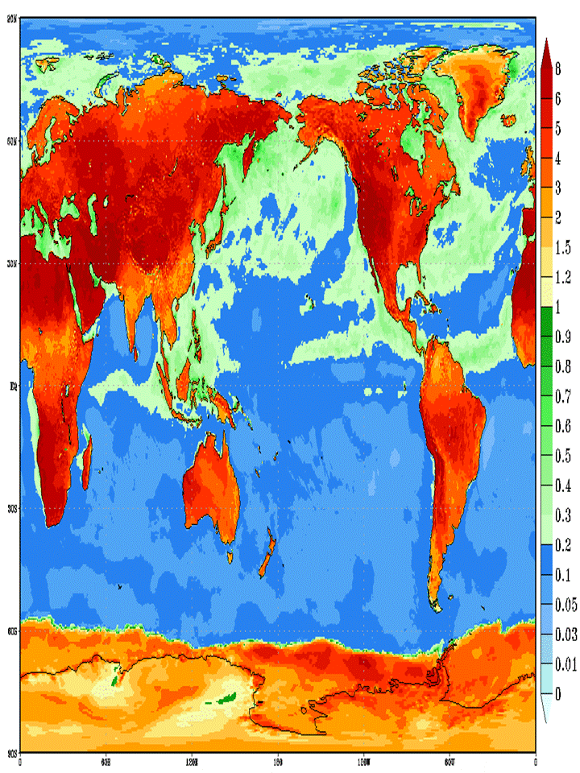
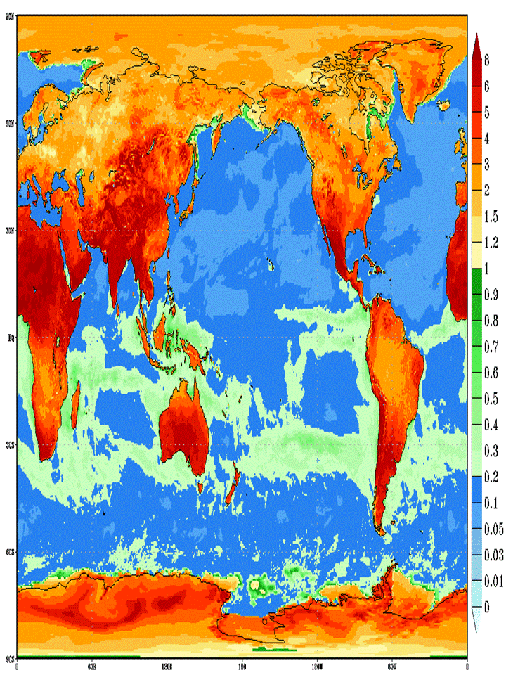
Monthly mean SST diurnal variability (SD) for EXP.
July, 2010
January, 2011

Slide 8
Features in different SST analysis
Features | Current GFS | GHRSST | NSST
Well-defined Analysis variable | No | Yes | Yes
Multi-Satellite | No | Yes | Yes
Direct Assimilation | No | No | Yes
Obs. with diurnal warming used | Yes | No | Yes
Diurnal variability resolved | No | Yes | Yes
Tf variability | N/A | No | Yes
NSST model used consistently | N/A | No | Yes
Coupled analysis | No | No | Yes (partially)

Slide 9
Current oceanic component (SST) in the NCEP GFS
FCST
ANAL
IC
Atmospheric
Forecasting Model
Atmospheric
Analysis
BG
SST Analysis:
Radiative
Transfer Model
(CRTM)
Simulated radiance
Jacobi’s

Slide 10
The NSST within the NCEP GFS
FCST
ANAL
IC
Atmospheric
Forecasting Model
(AFM)
Atmospheric
Analysis
(GSI)
BG
Analysis
(NSSTAN)
NSST Model
(NSSTM)
Radiative
Transfer Model
(CRTM)
Simulated radiance
Jacobi’s

Slide 11
SST or oceanic variable verification
O – B
Bias & RMS to the own analysis
RMS to the buoy observation

Slide 12
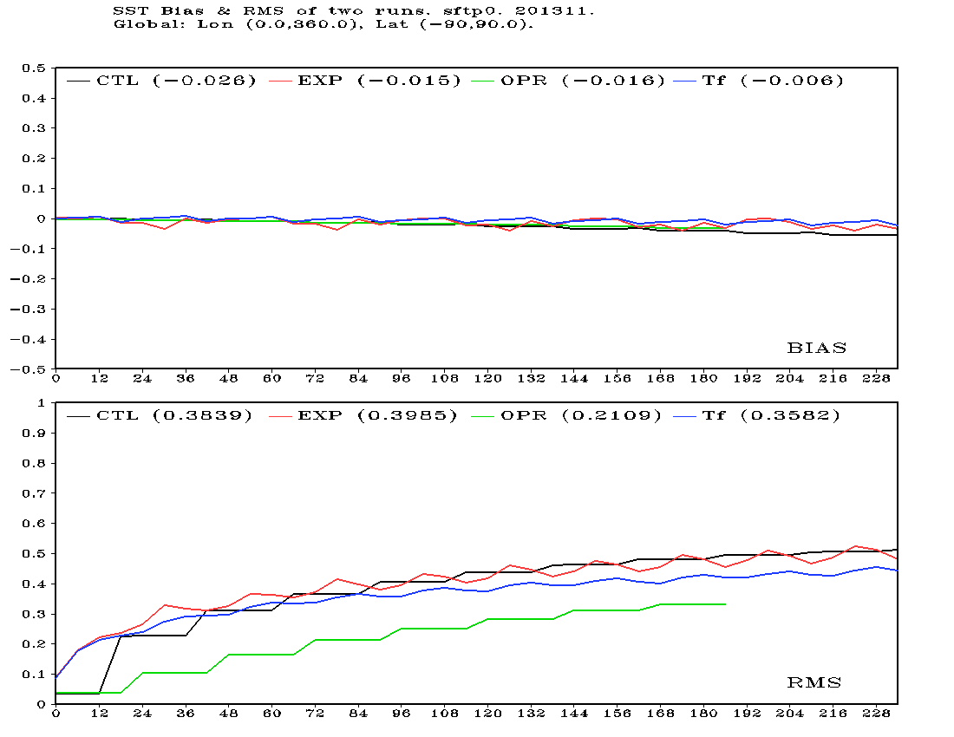
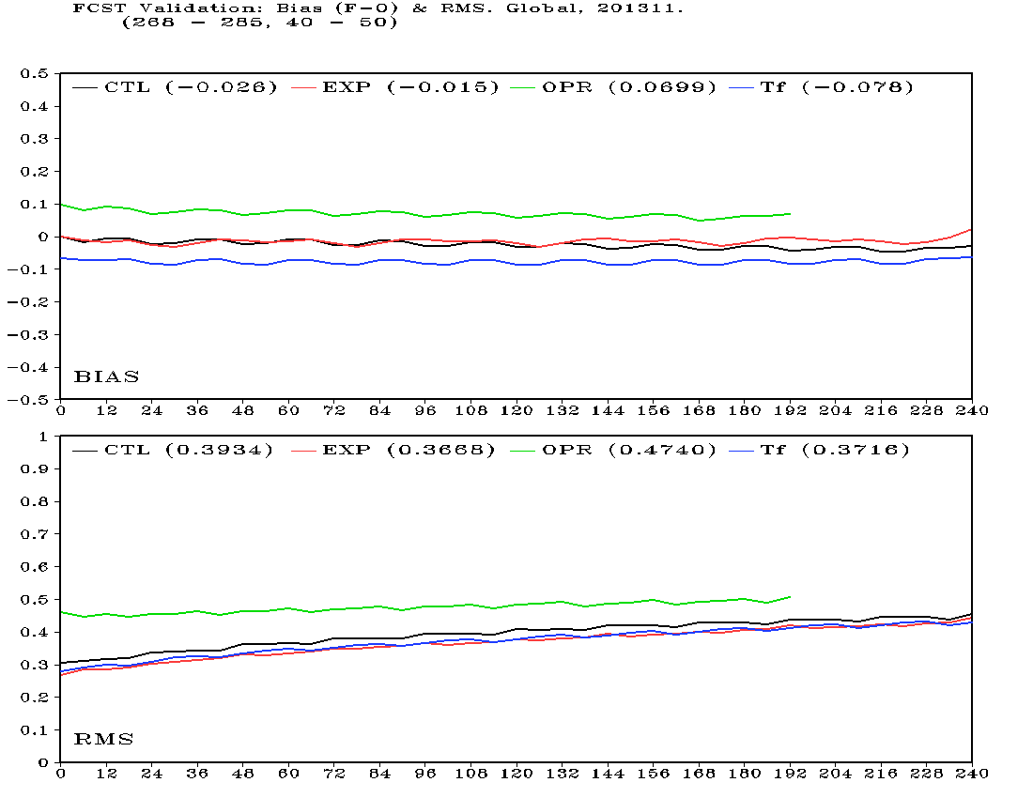
(a) Bias to own analysis
(c) Bias to buoy observation
(b) RMS to own analysis
(d) RMS to buoy observation
The verification of RTG SST (Black, used in the coming implementation), NSST SST (Red), Reynolds SST (Green, used in current operational) and Tf in NSST (Blue) for November 2013. The starting time is 00Z.

Slide 13
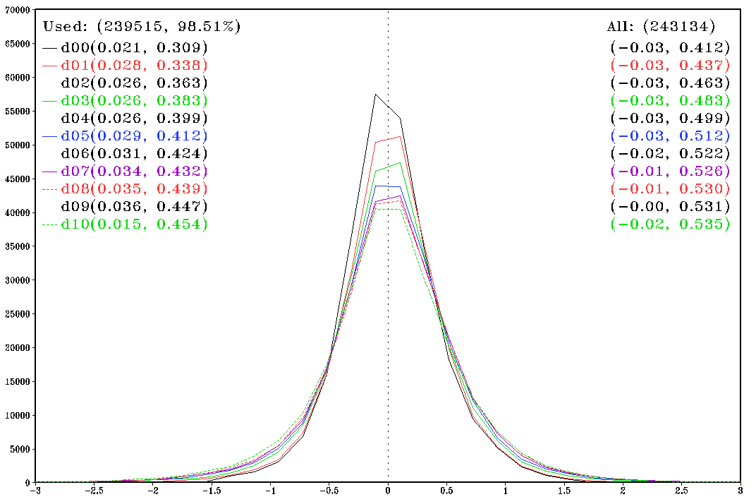
Histogram of (O – F) for predicted SST. 10/22/3013 – 11/27/2013.
Global, Control: [T_ob(z) – SST fcst]

Slide 14
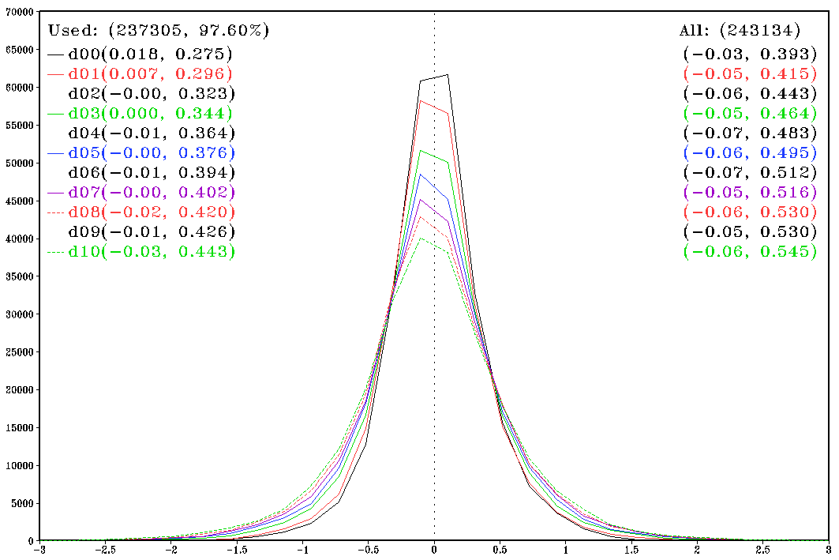
Histogram of (O – F) for predicted SST. 10/22/3013 – 11/27/2013.
Global, NSST/EXP: [T_ob(z) – T_fcst(z)]

Slide 15
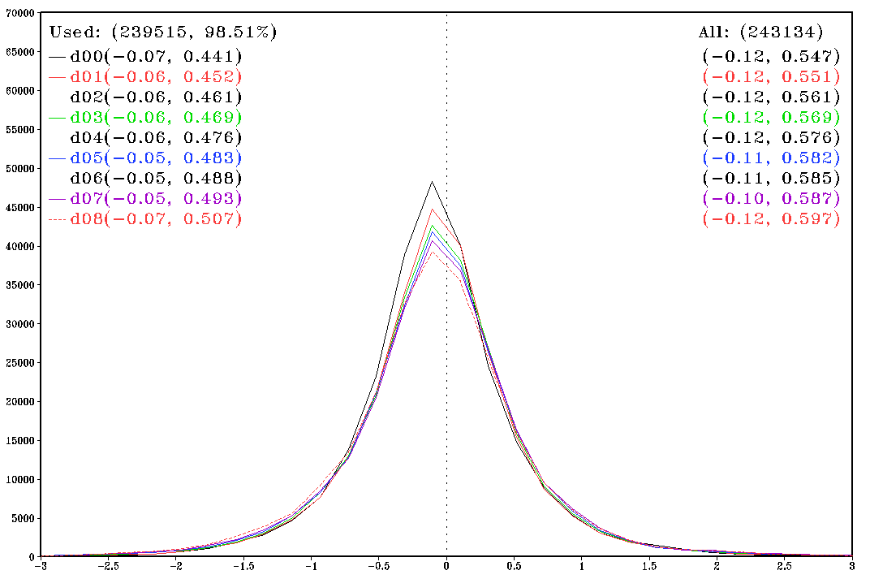
Histogram of (O – F) for predicted SST. 10/22/3013 – 11/27/2013.
Global, Operational: [T_ob(z) – SST fcst]

Slide 16
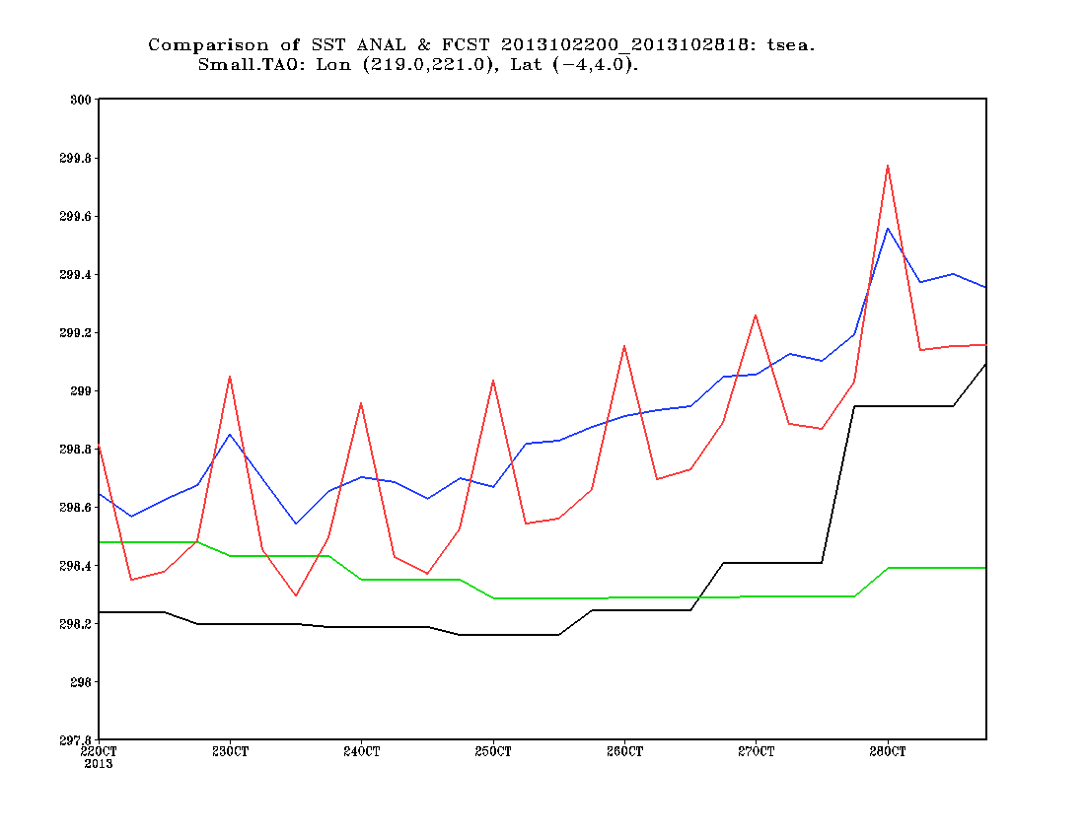
Time series of SST/Tf analysis. Area: (141 W – 139 W, 4S – 4N)
CTL SST ANAL
EXP SST ANAL
EXP Tf ANAL
OPR SST ANAL

Slide 17
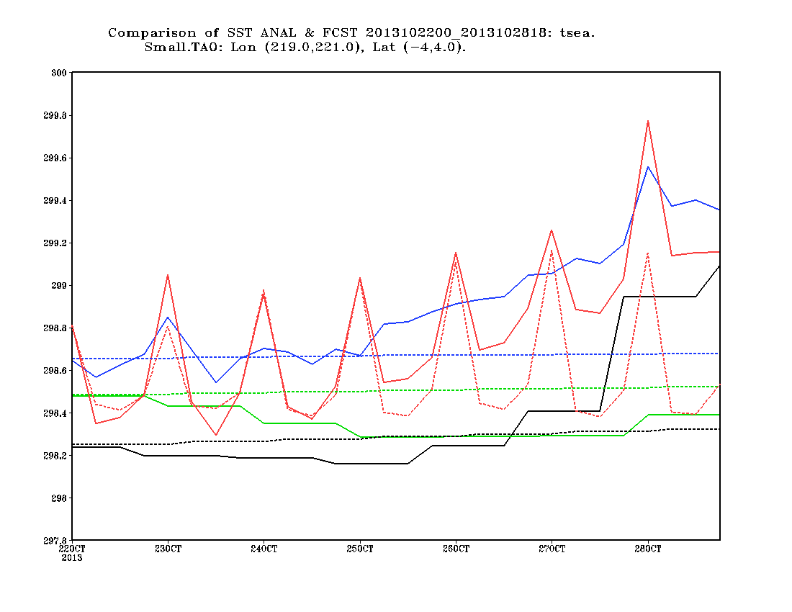
Time series of SST/Tf analysis and prediction. Area: (141 W – 139 W, 4S – 4N)
CTL SST ANAL
EXP SST ANAL
EXP Tf ANAL
CTL SST FCST
EXP SST FCST
EXP Tf FCST
OPR SST ANAL
OPR SST FCST

Slide 18
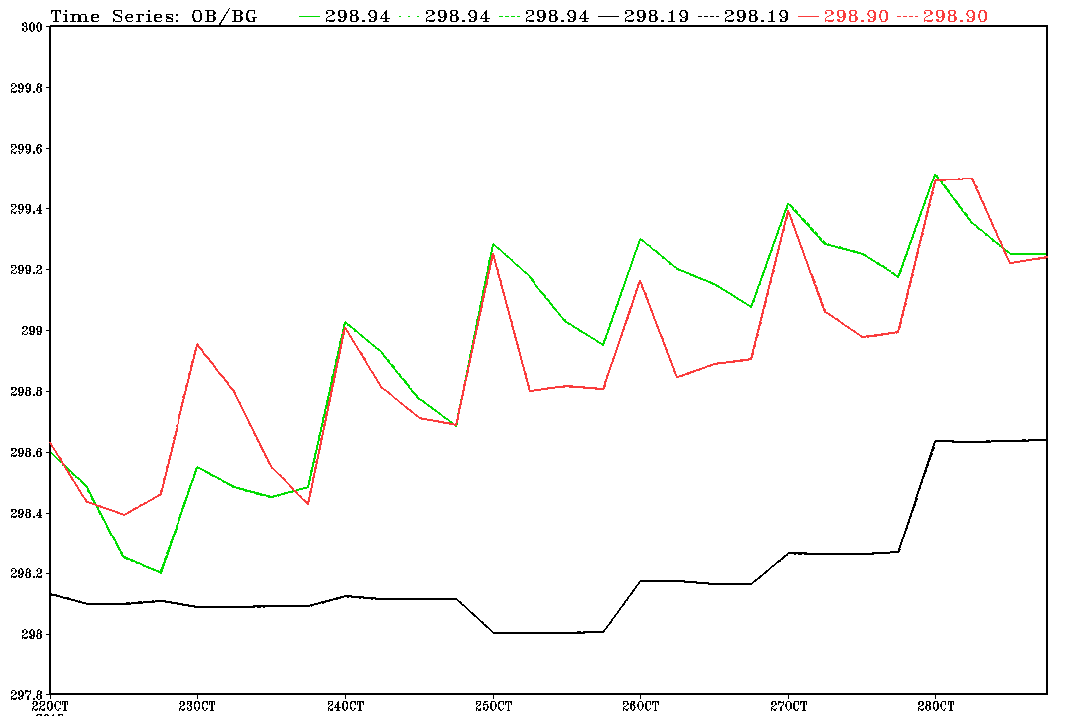
Time series of (O – B), 2013102200 - 2013102818. Area: (141 W – 139 W, 4S – 4N)
CTL
EXP
OBS (buoy)

Slide 19
Why SST, an oceanic variable, is analyzed in an atmospheric data assimilation system?
More consistent initial conditions
A single cost function and air-sea interaction
More effective use of satellite data
Assimilating satellite radiance directly to analyze the oceanic variable
Taking advantage of the atmospheric data assimilation
Advanced and updated frequently
A direction to coupled data assimilation
A single cost function for two media

Slide 20
Coupled Data Assimilation
Coupled data assimilation (definition)
Assimilation into a coupled model where observations in one medium are used to generate analysis increments in the other. This means a simultaneous minimization of a single cost function for atmosphere and ocean.
Loosely coupled data assimilation (NCEP CFS, NAVY, ECMWF)
The background for each medium is generated by a coupled integration but the analysis is done independently.
NSST
A single cost function
A coupled model
No Tf evolution
No error covariance between ocean and atmosphere

Slide 21
Coupled Prediction
The SST in coupled model may not be better than the persistent one as used in the operational NWP
Since the unconstrained models tend to develop their own climatological bias in 5 days for atmosphere and a few months for ocean respectively
The evolving SST due to the couple allows the system to progress more faithfully.
The negative feedback mechanism due to the couple can retard the growth of some errors.
Weather forecasting
The bias hasn’t developed yet
Climate prediction

Slide 22
Problems in NSST and Coupled Prediction System
A primary problem in NSST
Steady in forecasting
A primary problem in loosely coupled data assimilation such as NCEP CFS
An independent SST analysis is used as the first layer temperature ( ) of OGCM
Mismatch ➔quick adjustment in the initial forecasting period
Too weak SST diurnal variability
A primary problem in all coupled prediction
The first layer’s temperature, , is used as SST

Slide 23
One solution
The relationship among
The following conversion can be derived by integrating the above equation from z=0 to z=z1

Slide 24
A scheme to combine NSST and NCEP CFS
Coupled initialization
Consistent with the other oceanic variables
Coupled prediction
Evolving
Real SST instead of used at the interface

Slide 25
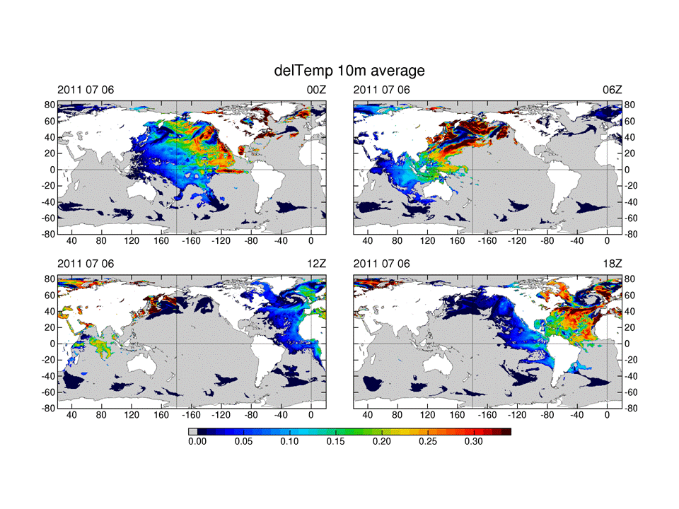

Slide 26
Combination of NSST and NCEP CFS
FCST
ANAL
Atmospheric
Forecasting Model
Atmospheric
Analysis
IC
Analysis
+
NSSTM
BG
+
OGCM
Analysis
Radiative
Transfer Model
(CRTM)
62

Slide 27
Incorporation of the NSST into an air-sea coupled
data assimilation and prediction system
ANALYSIS
FORECAST
Hybrid ENKF GSI
with Tf analysis built in
Atmospheric FCST Model
with NSST Model built in
IC
: Atmospheric state
vector
Get skin-depth dependent T(z) with and NSST T-Profile
Get and then for
the coupling with NSST T-Profile
and Oceanic model
T-Profile
Observation
innovation
in Tf analysis
T(z) = T_{f} (z_{w} ) + T’(z)
SST(z) = SST_{fnd} + T_{w}’(z) - T_{c}’(z)
Hybrid GODAS
Oceanic FCST Model
BG
: Oceanic state vector
NSST algorithm is part of both the analysis and forecast system. In the analysis, the NSST provides an analysis of the the interfacial temperature (“SST”) in the hybrid ENKF GSI using satellite radiances. In the forecast, the NSST provides the interfacial temperature (SST) in the free, coupled forecast instead of the temperature at 5-meter depth that is predicted by the ocean model.
Xu Li, EMC
Notes:
NSST algorithm is part of both the analysis and forecast system. In the analysis, the NSST provides an analysis of the the interfacial temperature (“SST”) in the hybrid ENKF GSI using satellite radiances. In the forecast, the NSST provides the interfacial temperature (SST) in the free, coupled forecast instead of the temperature at 5-meter depth that is predicted by the ocean model.

Slide 28
Discussions
NSST and Reanalysis
SST analysis
SST diurnal variability
Ocean
Weather prediction
Climate predition

