Slide 1

CFSR air-sea fluxes in the context of global energy and freshwater budgets
Lisan Yu (Lead PI) Woods Hole Oceanographic Institution
Yan Xue (Co-I) NCEP Climate Prediction Center
Collaborators:
Xianzge Jin WHOI
Arun Kumar, Caihong Wen NCEP CPC
MAPP Climate Reanalysis Task Force (CRTF)
Webnar, November 26th, 2013
Notes:
C:\Users\Lisan\Documents\DATA\OAFlux\BuoyLocation

Slide 2
Objective and Deliverables
Objective:
assessing CFSR in representing air-sea heat, freshwater, and momentum fluxes in the context of the global energy and water budgets
Deliverables:
(i) Buoy evaluation of uncertainty in the CFSR air-sea fluxes;
(ii) Understanding the effects of spatial resolution versus the SST initialization on the CFSR air-sea fluxes.
(iii) Practical recommendations for future improvement of air-sea flux estimation in reanalyses.

Slide 3
Perspectives of NCEP/CPC
Develop metrics to evaluate the strength and weakness of reanalysis flux products, particularly for CFSR, including web results display
  Validate against 120 buoy data
  Validate all flux components (SW, LW, LH, SH, E, P, taux, tauy)
  Estimate errors in mean, annual cycle, interannual variability
Design benchmarks to be used for development and evaluation of the next generation NCEP reanalysis flux products

Slide 4
Air-Sea Flux buoys: Locations & measurements

Slide 5
Main research questions:
What can we learn from buoy evaluation?
Buoy locations are sparse, clustered mostly in the tropics.
How can OAFlux be used to support the buoy evaluation?
OAFlux 1987-onward is satellite based, global, on 0.25-degree grids.
What values and benefits can be added if including other reanalyses in the research?
There are differences in spatial resolutions, SST initialization, etc.
Three specific research topics are pursued:
(1) Buoy evaluation and indication on the global energy budget,
(2) Frontal-scale air-sea interaction,
(3) Regional budget analysis using ocean observations.

Slide 6
(1) Current estimates of the global ocean energy and water budgets

Slide 7
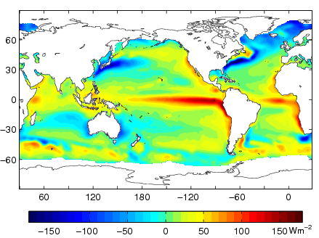
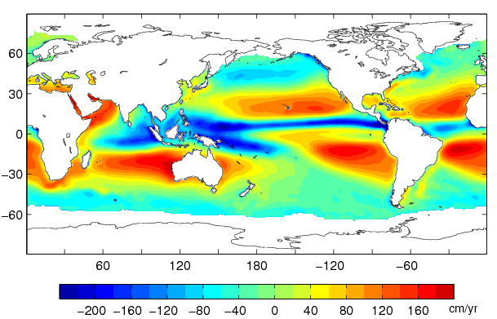
A tandem challenge:
- the energy and water cycle are coupled
Mean Qnet from 12 products
Mean E – P from 10 products
Notes:
What number should the global heat budget balance at?

Slide 8
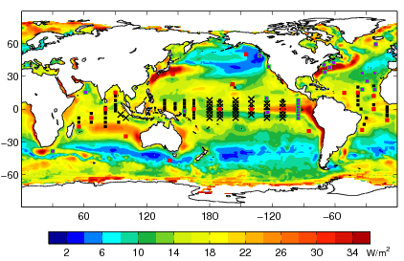
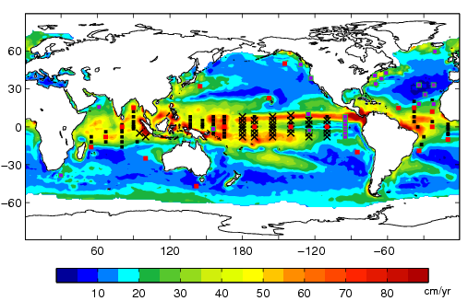
Differences between products are largest in the tropical oceans
Air-sea buoys are located mostly in the tropical oceans:
They are useful for identifying bias in surface fluxes
Qnet STD (12 products)
E – P STD (10 products)

Slide 9
Example: Buoy evaluation of the bias in SW
One buoy location
81 buoy locations
(1991-2007)

Slide 10
(2) Frontal-scale air-sea interaction: spatial resolution vs SST initialization

Slide 11
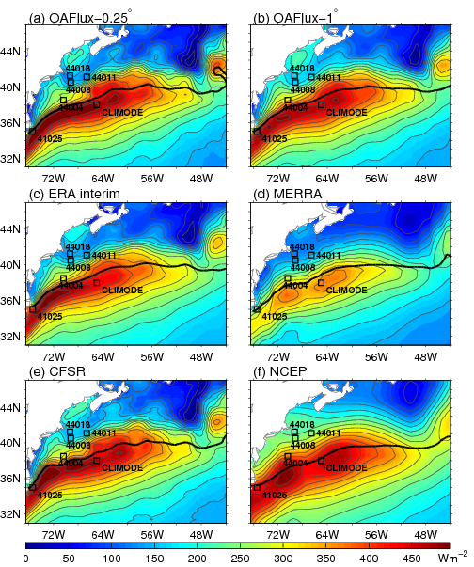
Frontal-scale air-sea fluxes in the Gulf Stream region:
(Jin and Yu, 2013)
Winter-mean Latent and Sensible Heat Fluxes
Spatial resolution
- CFSR (0.3°).
- MERRA (2/3°x1/3°),
- ERAinterim (0.7°),
- By comparison, NCEP/NCAR (1.875°)
Questions:
Does the spatial resolution matter in depicting the air-sea fluxes associated with ocean fronts?
Does the semi-coupled CFSR model configuration improve the CFSR air-sea fluxes in the frontal regions?

Slide 12
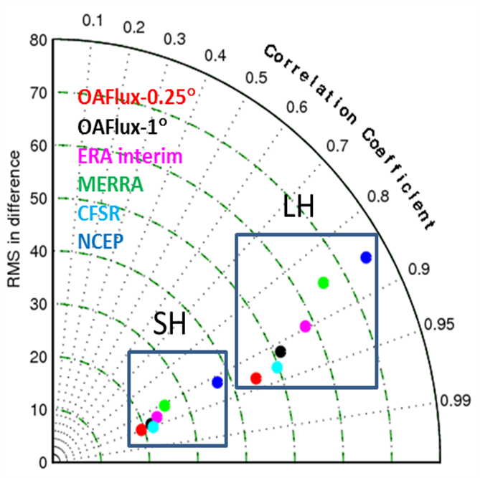
Buoy Evaluation in the Gulf Stream region: CLIMODE + 5 NDBC buoys
(Jin and Yu, 2013)
Latent heat flux
Mean DIFF (Product – Buoy)
Sensible heat flux
Mean DIFF (Product – Buoy)
N = 4288 collocations from 6 buoys

Slide 13
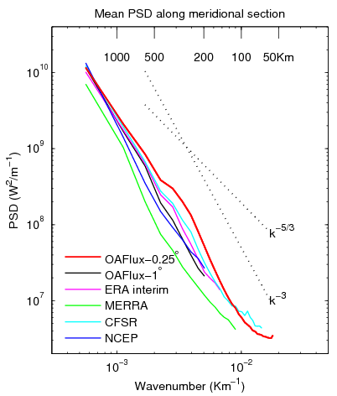
Power Spectral Density Analysis

Slide 14
SST modulation on surface heat and momentum fluxes
Monthly mean, 1988-2010
Thick black line: Mean position of the 18°C isotherm of SST from the respective product
Corr <SST, LH+SH>
Corr <SST, Wind Stress>
Is the better correlation between CFSR and SST due to the finer spatial resolution or the better SST coupling in the model?

Slide 15
Assessment of CFSR Surface Heat Fluxes at KEO
Caihong Wen , Meghan Cronin , Yan Xue and Arun Kumar
KEO: hourly data 2004-2010
CFSR : hourly data with T382 Gaussian
R1 : 6-hourly data with T62 Gaussian
R2: 6-hourly data with T62 Gaussian
Latent heat flux and wind speed on Dec 26, 2008
High spatial and temporal resolution enable CFSR to capture fine scales of ocean eddies and fronts.
Both the mean bias and root mean square errors (RMS) with KEO are substantially reduced in CFSR compared to R1 and R2.

Slide 16
Assessment of CFSR Surface Heat Fluxes at KEO
Caihong Wen , Meghan Cronin , Yan Xue and Arun Kumar
CFSR
Surface specific humidity (Q_{2m}) and wind speed
R2
R1
Q_{2m} and surface wind speed in CFSR agree
well with KEO much better than R1 and R2.
LHF derived with COARE 3.0 bulk algorithm
using reanalysis Q_{2m} and WS agrees with KEO
better than the reanalysis LHF.
● LHF from reanalysis
● LHF using COARE 3.0 bulk algorithm

Slide 17
(3) Regional heat budget analysis using ocean temperature observations
Can the ocean temperature observations be used to diagnose the surface heat flux products?
Energy budget equation:
Example: the seasonal change of the tropical warm pool heat content from ocean temperature observations, surface heat fluxes, and in situ buoy measurements.
(Song and Yu, 2013)
Three TAO/TRITON buoys were used to aid the diagnosis.

Slide 18
Summary
The project has three specific research topics:
(1) Buoy evaluation and indication on the global energy budget,
(2) Frontal-scale air-sea interaction,
(3) Regional budget analysis using ocean temperatures.
The preliminary results are promising.
We are moving forward on the right track.
We are developing understanding and skills to address the perspectives from the NCEP/CPC:
(1) Develop metrics to evaluate the strength and weakness of reanalysis flux products, particularly for CFSR
(2) Design benchmarks to be used for development and evaluation of the next generation NCEP reanalysis flux products

