Slide 1
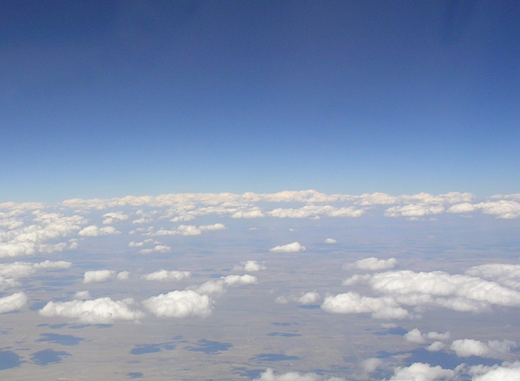
Improving the Land-Surface Components of the Climate Forecast System Reanalysis (CFSR)
Michael Ek, Jesse Meng, Jiarui Dong, Youlong Xia, Rongqian Yang (NCEP/EMC)
Kingtse Mo (NCEP/CPC)
Dennis Lettenmaier, Bart Nijssen (Univ. Washington)
Eric Wood, Justin Sheffield (Princeton Univ.)
NOAA Climate Program Office
Modeling, Analysis, Predictions, and Projections (MAPP) program
Reanalysis Task Force telecon, 26 November 2013
1

Slide 2
Improving the Land-Surface Components of the Climate Forecast System Reanalysis (CFSR)
GOAL: Improve Global Land Data Assimilation System (GLDAS) via:
Upgraded Noah land model (separate MAPP project).
Higher-resolution land data sets, i.e. vegetation, soils, vegetation phenology (near-realtime), etc.
Improved forcing, especially precipitation.
Land data assimilation (e.g. snow, soil moisture).
Thorough land model spin-up and enhanced downscaling procedures.
Include river routing to complete water cycle.
Extends land-atmosphere coupling to include ocean.
Test improved GLDAS in Climate Forecast System.

Slide 3
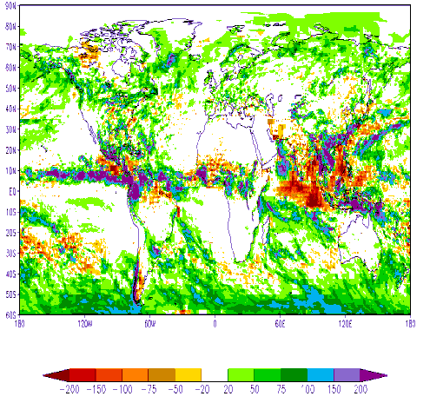
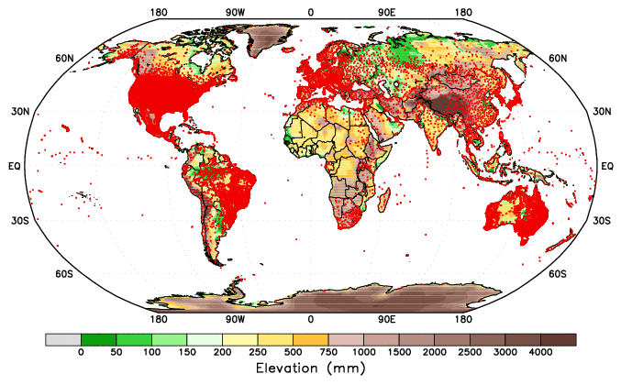
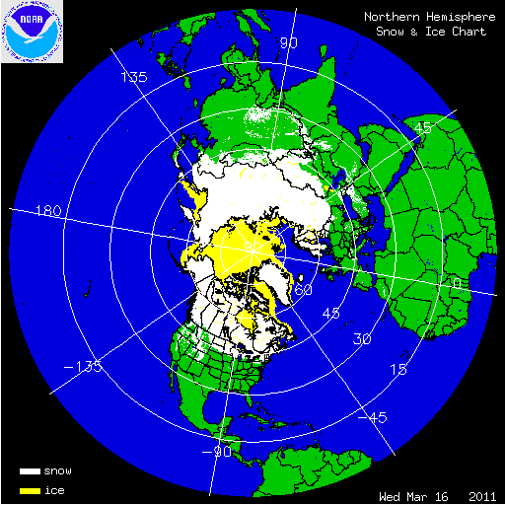
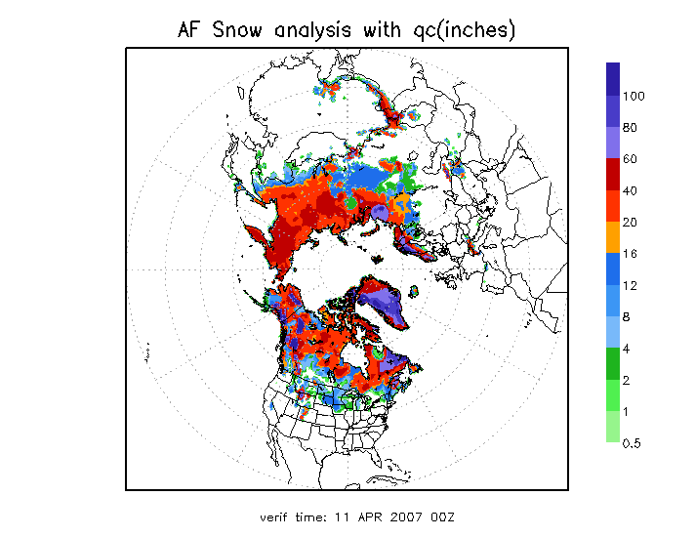
Global Land Data Assimilation System (GLDAS)
• GLDAS (runs Noah land surface model (LSM) under NASA/Land Information System (LIS) forced with CFSv2/GDAS atmospheric data assimilation output & “blended” precipitation in a semi-coupled mode.
• Blended precipitation via satellite (CPC/CMAP; heaviest weight in tropics--satellite observations more accurate & surface gauges sparse), gauge (heaviest in mid-latitudes where gauge density highest) & GDAS (modeled; high latitude--gauges sparse, satellite obs lack accuracy).
• Snow cycled in CFSv2/GLDAS if model within 0.5x to 2.0x observed value (IMS snow cover & AFWA snow depth products), else adjusted to 0.5 or 2.0 of observed value.
GDAS-CMAP precip
Gauge locations
IMS snow cover
AFWA snow depth

Slide 4
NCEP Realtime Operational GLDAS/LIS
Land Surface
Characteristics
Topography
Land Cover
Soil
Noah LSM
CFS/GFS
land analysis
Soil Moisture
Soil Temperature
Snow
Precipitation
Forcing
Non-precip
Meteorological
Forcing
CFS/GFS
land initial
conditions
gdas1.t00z.sfcanl
Land Variables
Soil Moisture
Soil Temperature
Snow
Land Information System
Christa Peters-Lidard et al., NASA/GSFC/HSB

Slide 5
NCEP Realtime Operational GLDAS
GDAS
Atmospheric analysis
Day 1
Day 2
Day 3
Day 4
Day 5
Day 6
Day 7
Day 8
GLDAS
Land analysis
GLDAS
Land analysis
Precip observation
Precip observation

Slide 6
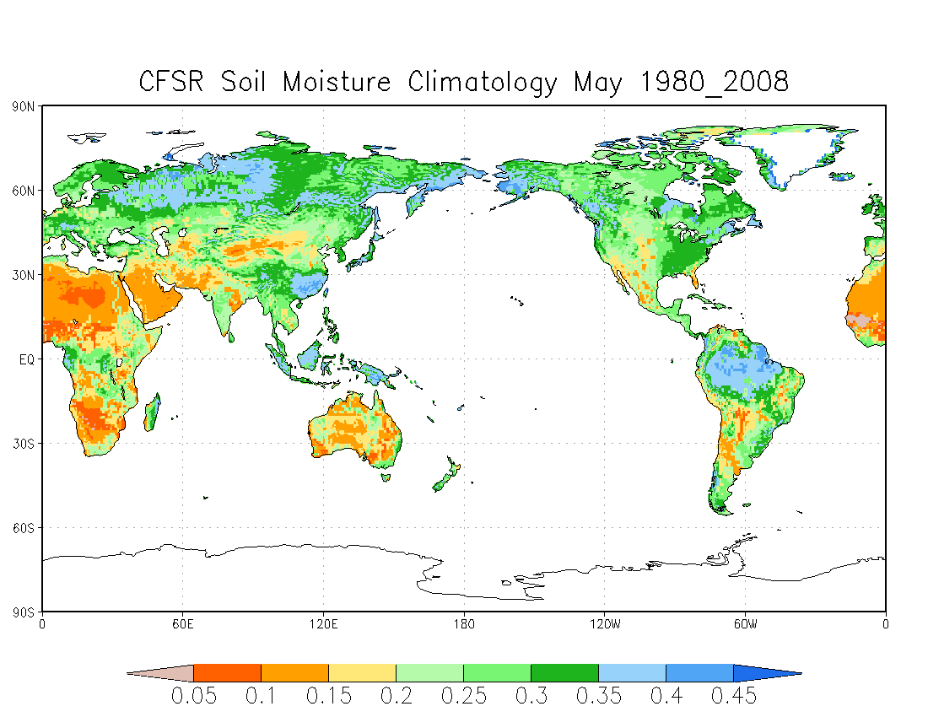
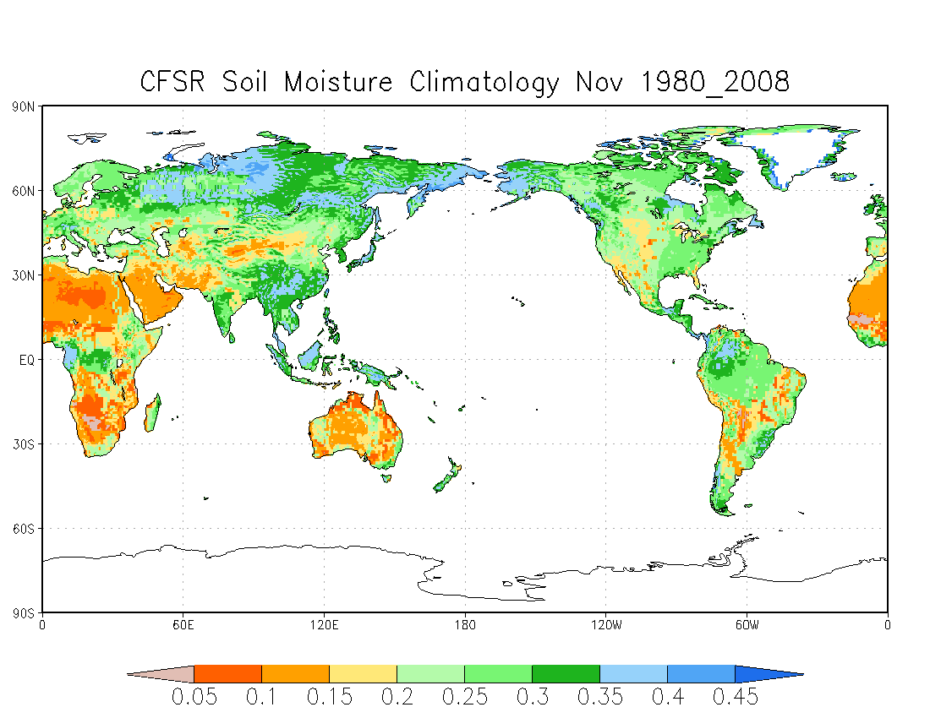
GLDAS soil moisture climatology

Slide 7
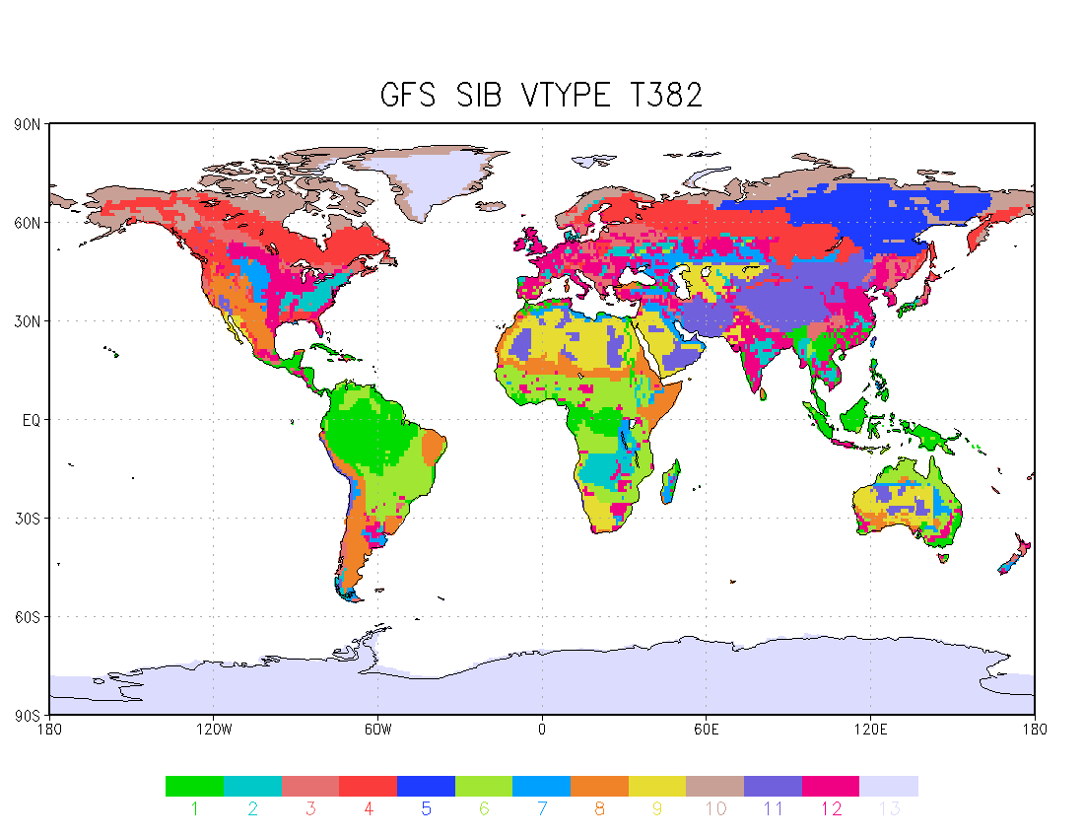
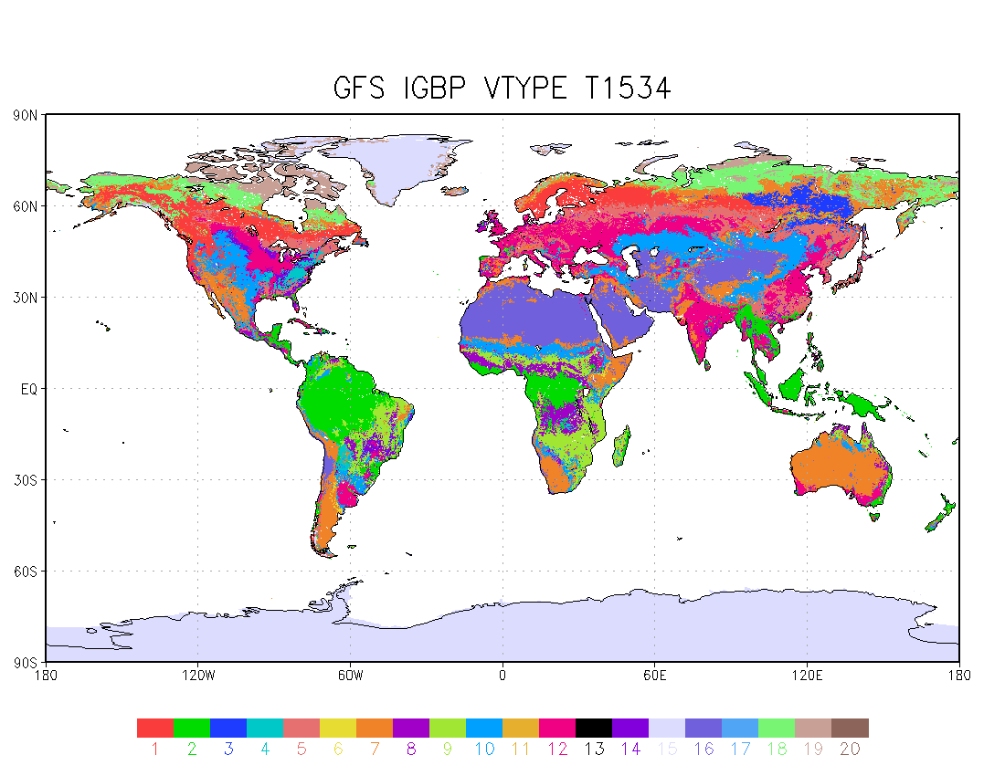
Vegetation Types: SIB vs IGBP
1: broadleaf-evergreen trees!
2: broadleaf-deciduous trees 3: broadleaf and needleleaf trees!
4: needleleaf-evergreen trees
5: needleleaf-deciduous trees (larch)
6: broadleaf trees with groundcover
7: groundcover only (perennial) 8: broadleaf shrubs with perennial groundcover
9: broadleaf shrubs with bare soil 10: dwarf trees and shrubs with groundcover (tundra)
11: bare soil 12: cultivations (the same parameters as for type 7)
13: glacial ice
1:Evergreen Needleleaf Forest
2:Evergreen Broadleaf Forest
3:Deciduous Needleleaf Forest
4:Deciduous Broadleaf Forest
5:Mixed Forests
6:Closed Shrublands
7:Open Shrublands
8:Woody Savannas
9:Savannas
10:Grasslands
11:Permanent wetlands
12:Croplands
13:Urban and Built-Up
14:Cropland/natural vegetation mosaic
15:Snow and Ice
16:Barren or Sparsely Vegetated
17:Water
18:Wooded Tundra
19:Mixed Tundra
20:Bare Ground Tundra

Slide 8
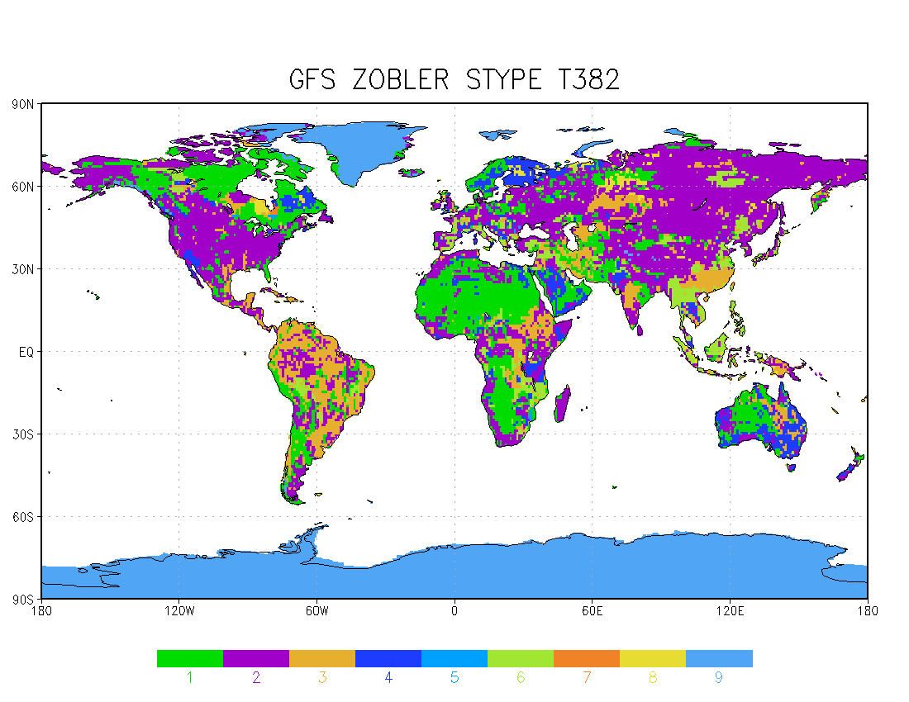
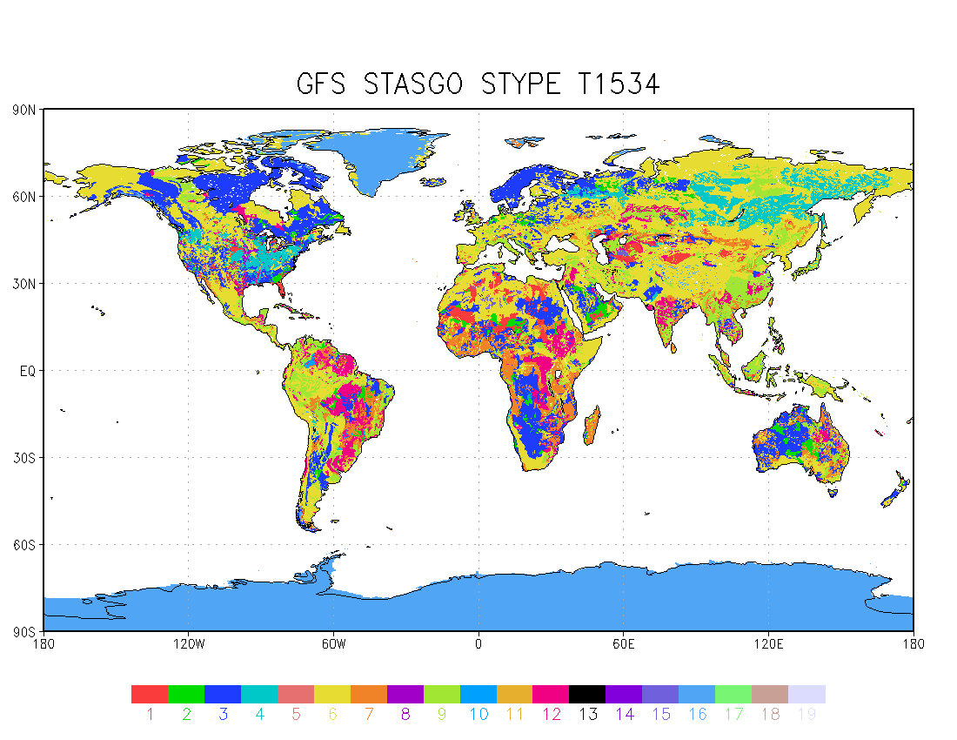
Soil Types: ZOBLER vs STASGO
loamy sand
silty clay loam
light clay
sandy loam
sandy clay
clay loam
sandy clay loam
loam
loamy sand
1: sand
2: loamy sand
3: sandy loam
4: silt loam
5: silt
6:loam
7:sandy clay loam
8:silty clay loam
9:clay loam
10:sandy clay
11: silty clay
12: clay
13: organic material
14: water
15: bedrock
16: other (land-ice)
17: playa
18: lava
19: white sand

Slide 9
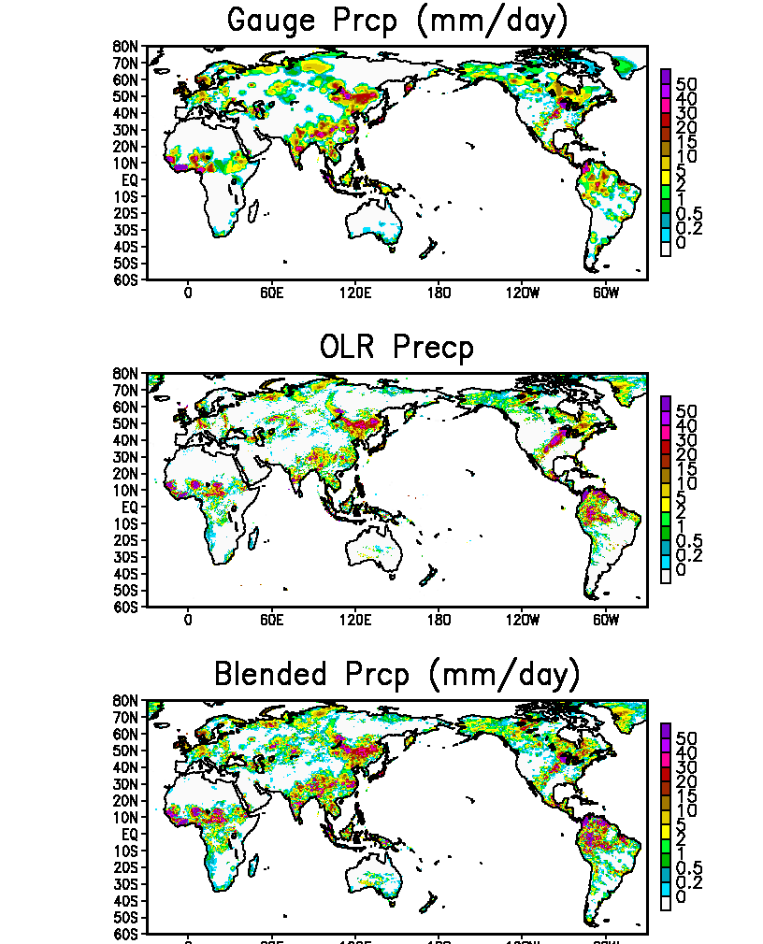
A Gauge-Satellite Blended Analysis of Daily Precipitation for Hydrometeorological Applications
0.25ºlat/lon over the global land
Daily analysis from 1979
Blending information from different sources to overcome shortcomings
CPC daily gauge analysis adjusted to GPCC monthly gauge data to correct the under-estimation in daily reports
OLR-based precipitation estimates derived through calibration against CMORPH
Daily gauge data and OLR precip combined to produce a precipitation analysis with long-term homogeneity and quantitative accuracy
Right figure: sample for Jul. 15,2010

Slide 10
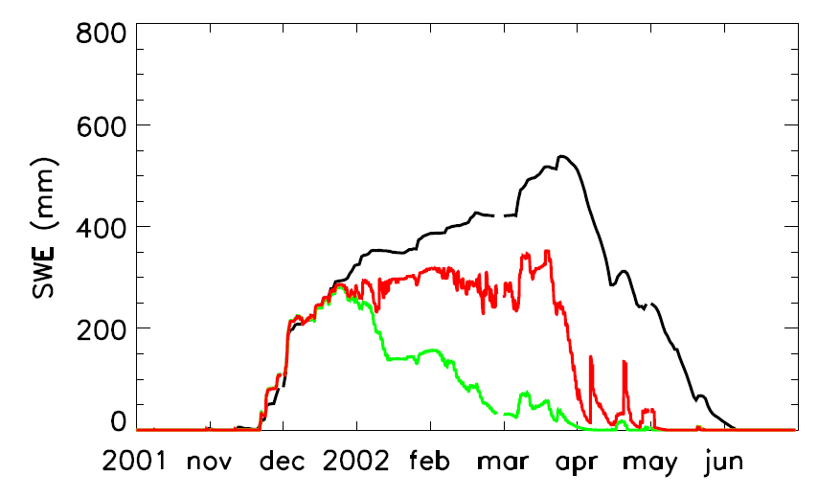
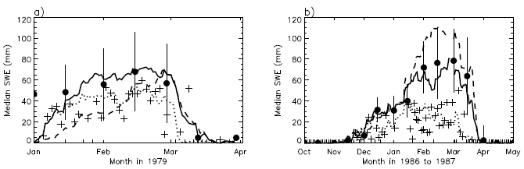
DATA ASSIMILATION: SNOW
An improved land-data assimilation component in GLDAS will decrease errors and improve the quality of the reanalysis. This would be a first effort that targets incorporating extensive satellite observations of land data sets into a NOAA/NCEP operational global reanalysis.
MODIS Snow Cover DA
SMMR SWE DA
Comparison of snow water equivalent between the open loop simulation (green), the assimilation simulation (red) and the in-situ measurement (black) averaged over all SNOTEL sites in the study region.
Comparison of the median SWE for pixels including 5 or more stations; ground observations (black dots), SMMR observations (plus), model forecast (dash lines), model forecast with assimilation run-I (dotted lines) and run-II (solid lines) from (a) January to March in 1979 and (b) from July 1986 to June 1987 (zoomed to the winter months from October 1986 to April 1987).

Slide 11
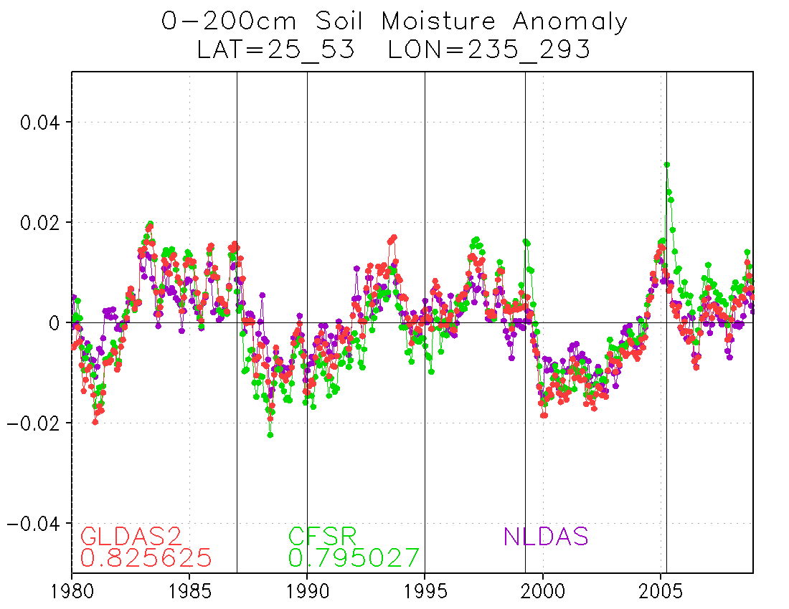
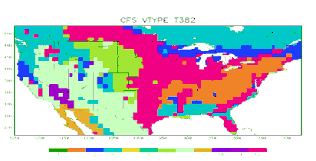
One-Stream retrospective GLDAS
Motivation: CFSR was executed in 6 streams, discontinuity at stream boundaries.
Solution: One-stream GLDAS (1979-realtime).
Configuration: Same as CFSR (LIS T382).
Forcing: CFSR surface forcing and blended (obs+model) precip forcing.
Initial condition: Spin up land states for 1 January, 1979.
Spin up: 15 years (5 repeating year of 2003; followed by 10 repeating year of 1979)

Slide 12
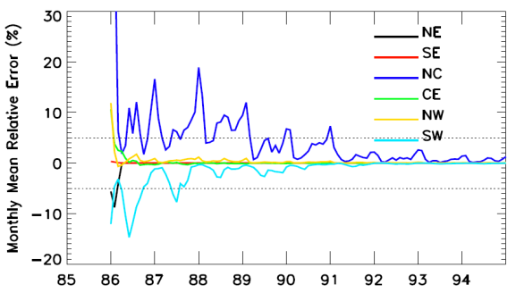
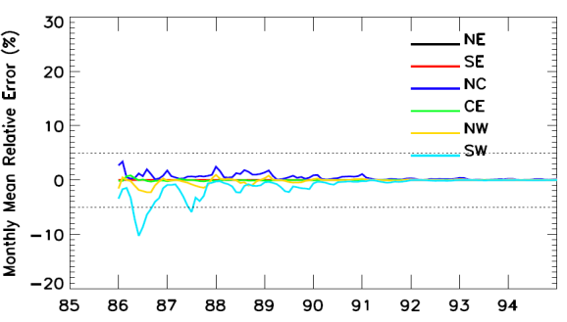
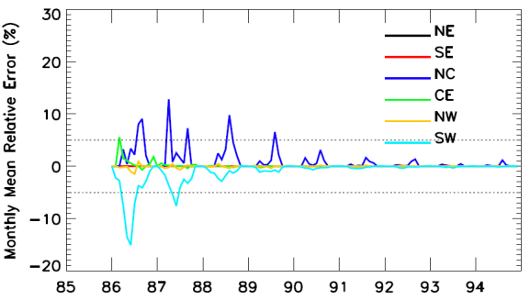
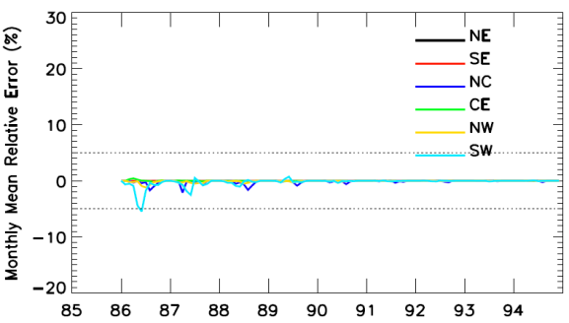
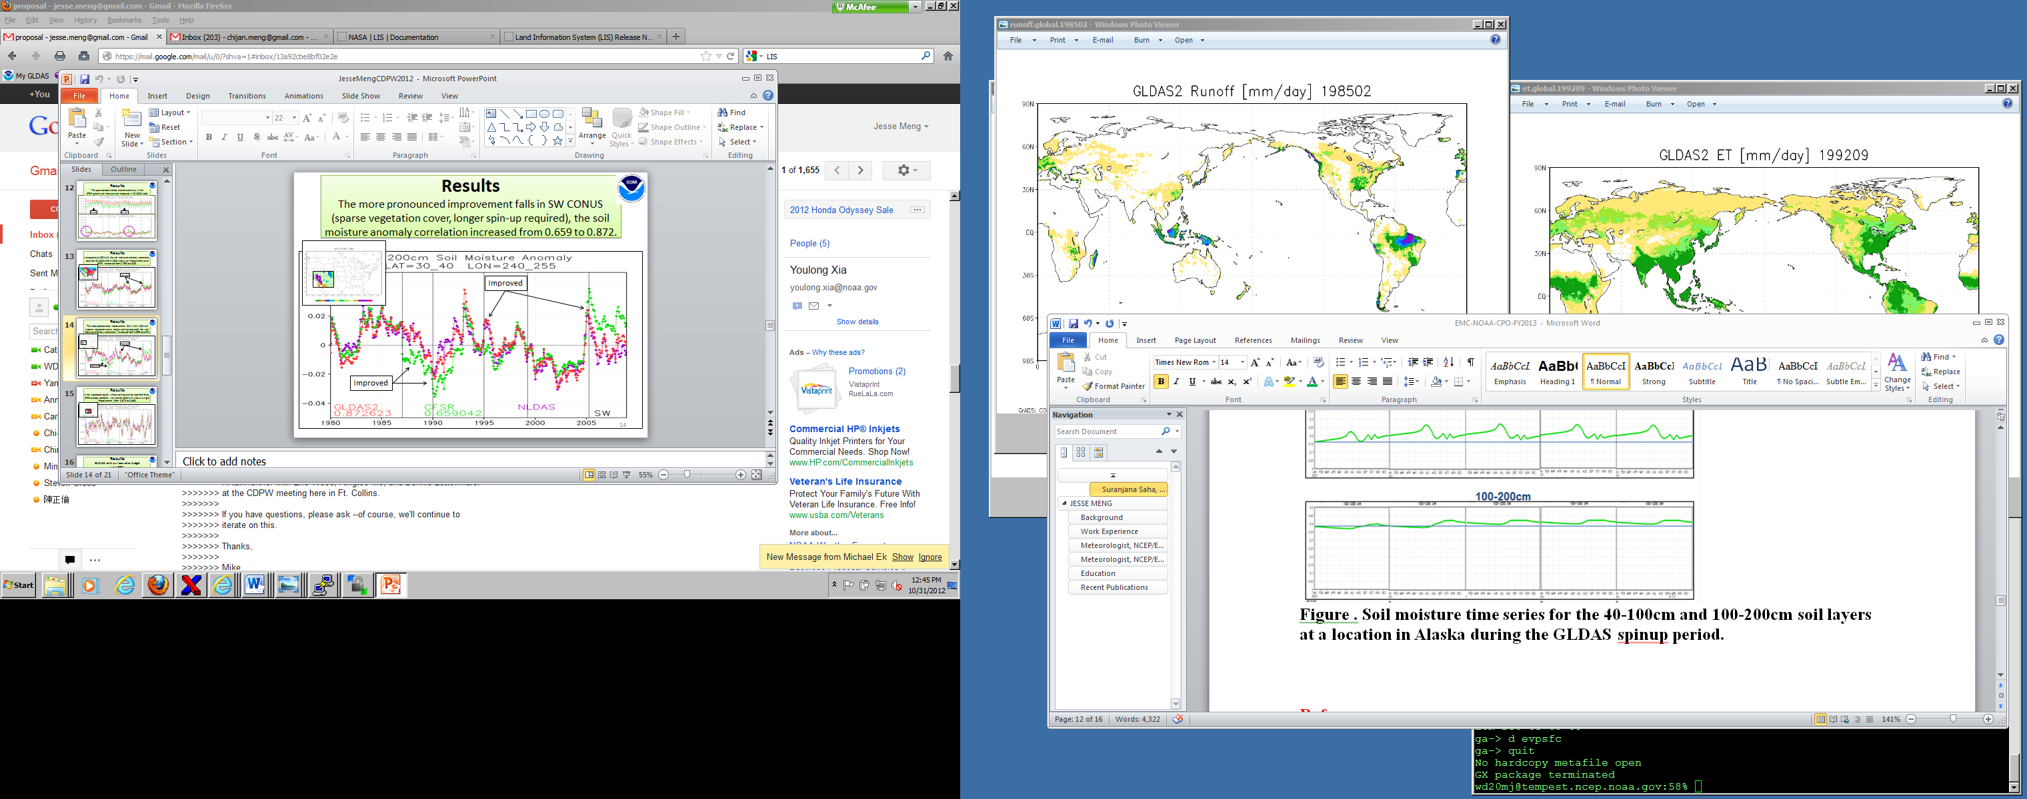
SPINUP STRATEGY
Precipitation is a major factor affecting spinup time.
Regions with annual precipitation over 1000m (NE and SE) requires spinup time less than 1 year.
Regions with annual precipitation between 500mm and 1000mm (CE and NW) require the 4-5 years spin-up time.
Regions with annual precipitation less than 500mm (NC and SW) requires nearly 10-year spinup time.
Temperature affects model spinup time in dry regions.
SPINUP: 1986
SPINUP: 1985
SPINUP: 1985&1986
SPINUP: 1984&1985
CFSR ran with six simultaneous “streams” (separate runs) over the 32-year period (1979-2010) with the issue of discontinuity of evolving land states.
A sufficient spin-up process for each single stream is required to maintain the continuity of land states.

Slide 13
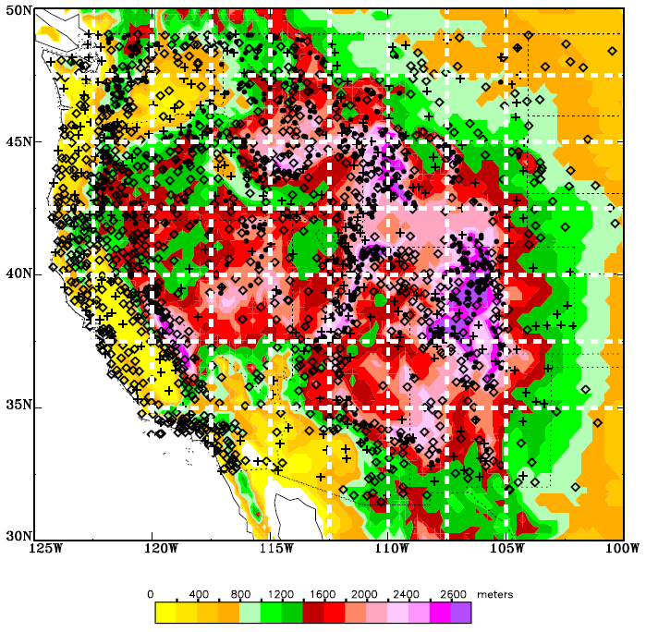
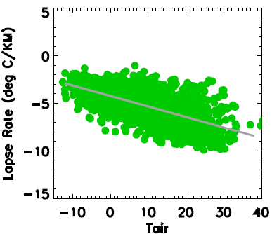
DOWNSCALING: TEMPERATURE
The statistical linear regression equation is spatially and temporally independent, with air temperature as the only input variable.
The approach is thus well-suited for producing time- and space-varying lapse rates, and would require minimal resources to implement in the downscaling software which typically support land surface and hydrologic modeling activities
LR=a+b*Tair
a=-4.24
b=-0.13
R=-0.672
RMS=1.37
Spatial distribution of in-situ stations consisting of 670 SNOTEL (dots), 319 USHCN (plus) and 992 RAWS (diamonds) stations in the western US.
The relationship between the lapse rate and air temperature derived from 60 grid boxes with 5 or above in-situ stations available for each month averaged over 1991-2012.

Slide 14

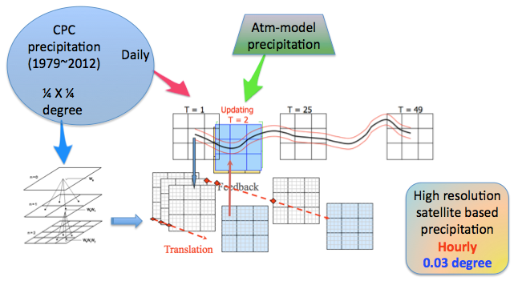
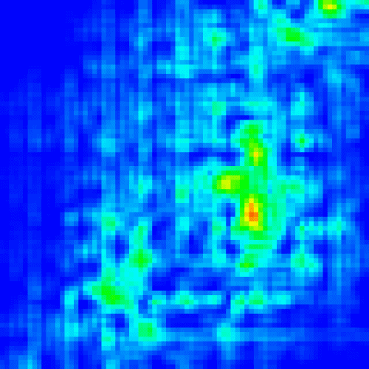
GLDAS High-Res Precip Input
CPC is preparing satellite based long-term precipitation data of ¼ X ¼ degree by calibrating daily CMORPH and OLR through pdf-matching tool.
We intend to downscale the product from ¼ degree to approx 3-km spatial resolution and daily to hourly temporal resolution.
We will use a space-time downscaling model based on improved random cascade method for spatial downscaling, and translation model assimilated with atmospheric model output for temporal downscaling.
Coarse resolution precipitation
Downscaled precipitation
The downscaled precipitation will be tested for future high resolution Global Land Data Assimilation System.

Slide 15
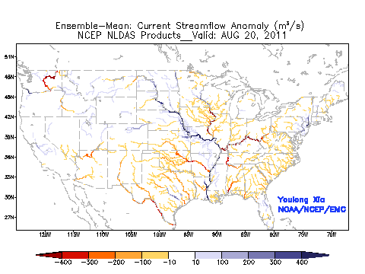
Streamflow from NLDAS routing scheme
Ensemble mean daily streamflow anomaly (m³/s)
Hurricane Irene and Tropical Storm Lee
20 August – 17 September 2011

Slide 16
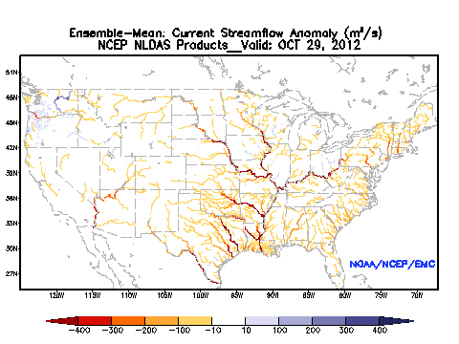
Streamflow from NLDAS routing scheme
Ensemble mean daily streamflow anomaly (m³/s)
Superstorm Sandy
29 October – 04 November 2012

Slide 17
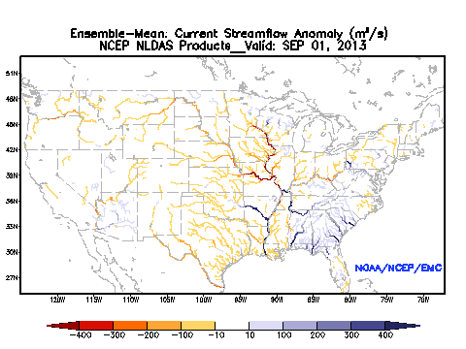
Streamflow from NLDAS routing scheme
Ensemble mean daily streamflow anomaly (m³/s)
September 2013

Slide 18
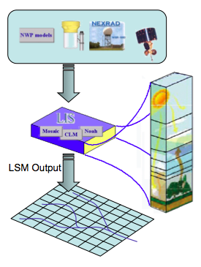
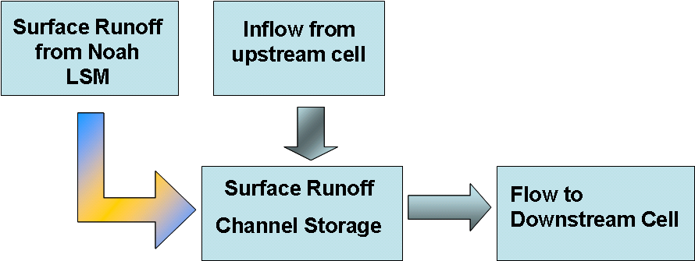
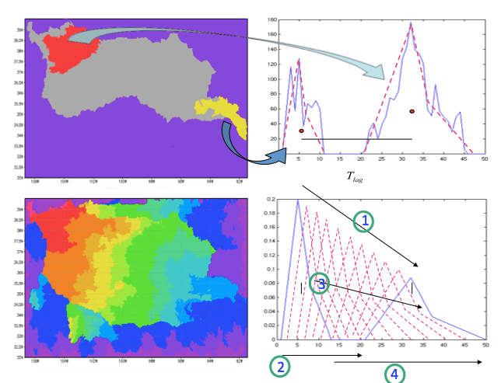
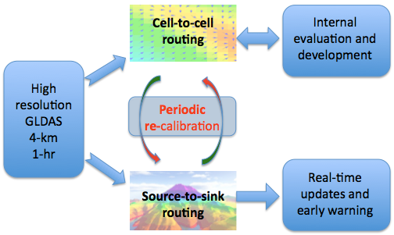
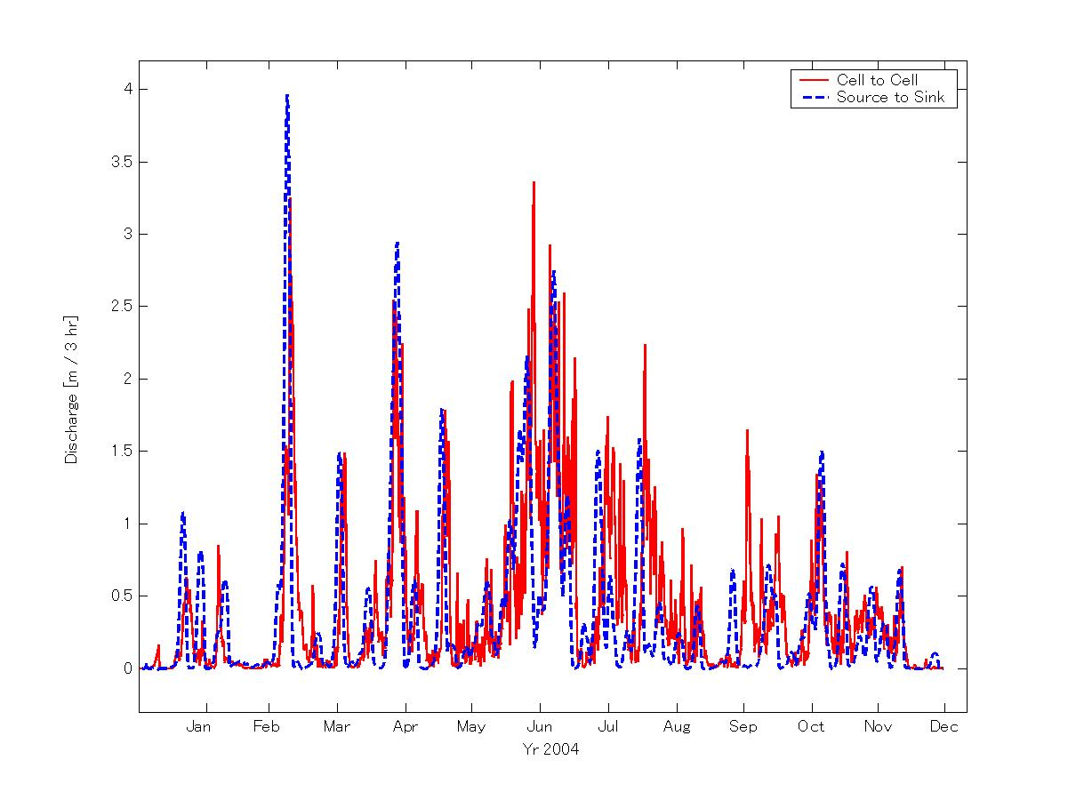
GLDAS - Flow routing
Atmospheric Forcing
Cell-to-cell routing
  computationally intensive
  parameter calibration is challenging
  Hard to implement for ensemble simulation and real-time operation
Source-to-sink routing
  Computationally efficient
  Accuracy is close to Cell-to-cell routing
  Useful for providing real-time updates and ensemble simulation

Slide 19
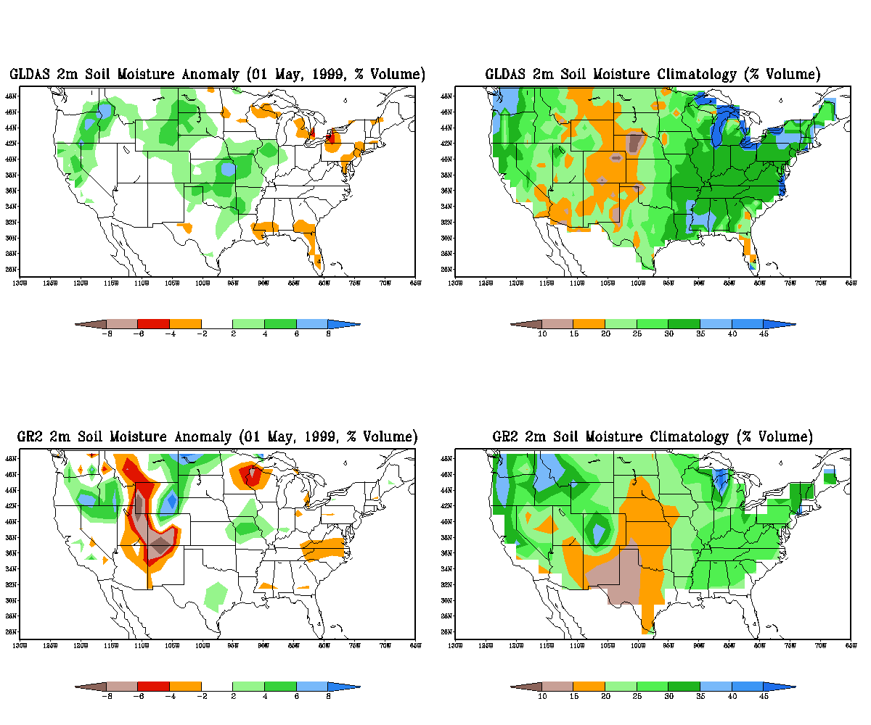
GLDAS and GR2: Soil Moisture Anomaly & Climatology (1 May 1999)
wet
high
GLDAS
Anomaly
Climatology
GR2

Slide 20
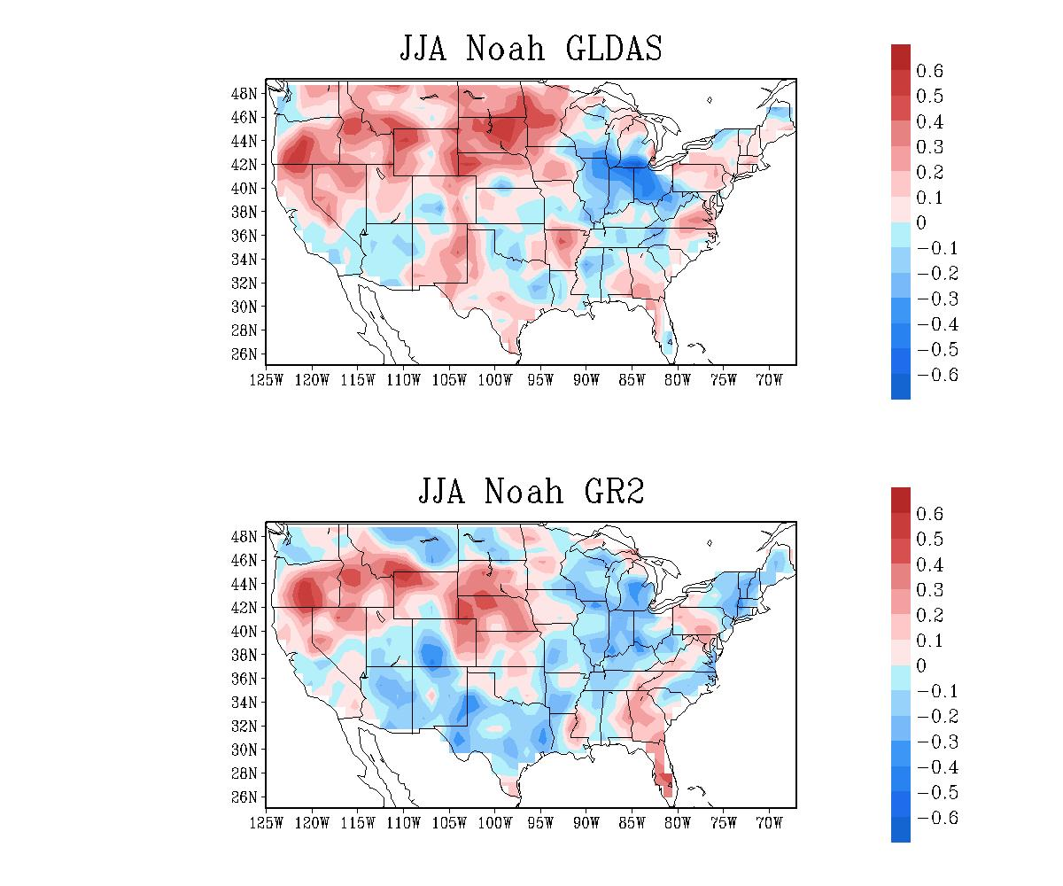
CFS Precipitation: Averaged Anomaly Correlation Skill (1980-2004, early May ICs)
GLDAS IC
AC Skill
GR2 IC

Slide 21
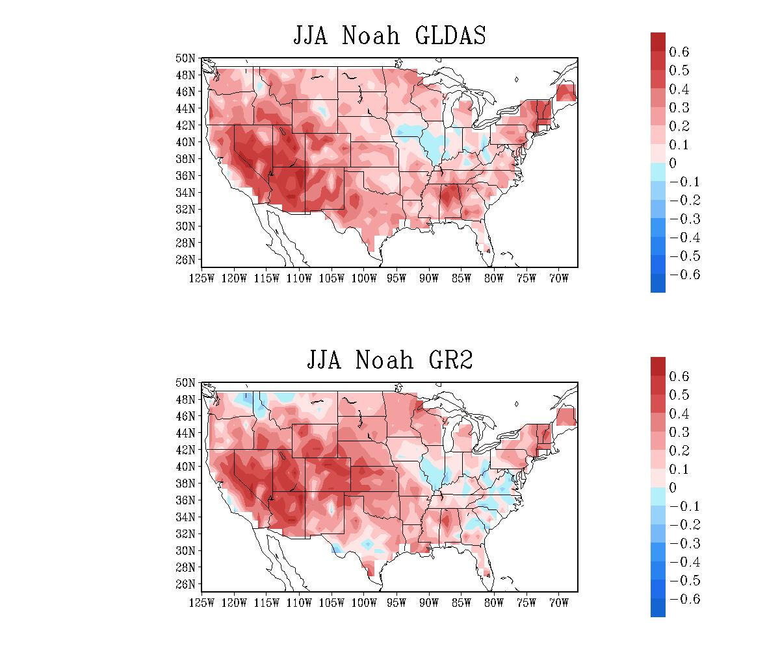
CFS T2m: Averaged Anomaly Correlation Skill
(1980-2004, early May ICs)
GLDAS IC
AC Skill
GR2 IC

Slide 22
Improving the Land-Surface Components of the Climate Forecast System Reanalysis (CFSR)
An improved Global Land Data Assimilation System (GLDAS; this project), with upgraded Noah land model (separate MAPP project), will Improve Connection between Reanalysis System Components: land with atmosphere & ocean, with extension to an upgraded Climate Forecast System.

