Slide 1
ERA-20C results and plans
Paul Poli
from the ERA section:
Dick Dee, Hans Hersbach, Paul Berrisford, Adrian Simmons, Rossana Dragani, Shoji Hirahara, Patrick Laloyaux, Carole Peubey, David Tan

Slide 2
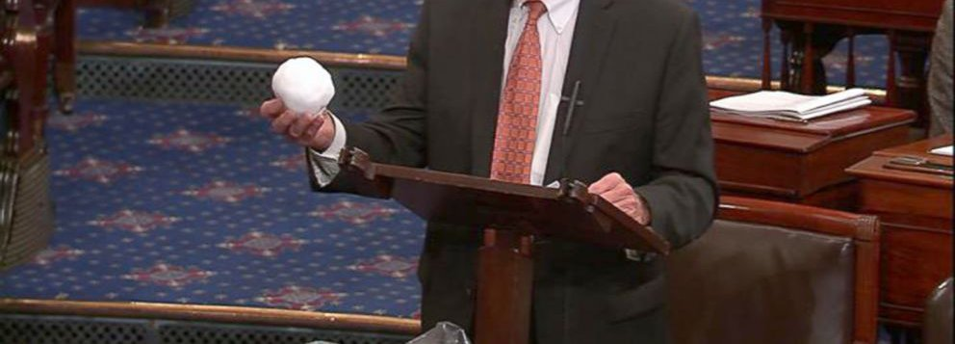
How can we quickly assess the current climate evolutions?
http://www.ecmwf.int/en/about/media-centre/news/2015/warm-conditions-continue-2015

Slide 3
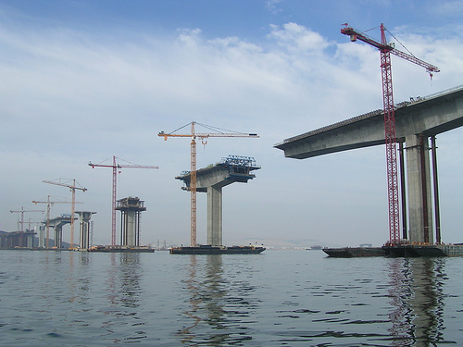
Why ERA-20C? Another step… towards a comprehensive Earth system reanalysis, to be continued in near-real-time
(Future/ Real-time)
(Past)
Upcoming satellites:
Copernicus Sentinels,
EPS-Second Generation, … to be exploited in NRT for climate monitoring
ERA-15, ERA-40
ERA-20C
ERA-Interim
ERA-20C is an outcome of the EU FP7-funded ERA-CLIM project, a 3-year project which has now ended.
It is the first ECMWF reanalysis of the 20th century, assimilating only surface observations.
It serves as a stepping stone towards:
- reanalyzing the other components of the Earth system, such as ocean
- reanalyzing also the observations collected so far, including upper-air and satellites
It uses an approach very much similar to 20CR (Compo et al., 2011), but using incremental 4DVAR, of course!

Slide 4
Outline of this talk
ERA-20C results
Methodology employed
Products generated
Performance observed
Climate value of the products
Uncertainties in the products
Known issues in the products
Unknowns in the products
Plans for next-generation ERA-20C version x
Coupling with the ocean
Assimilating more observations throughout the century (upper-air and satellites)

Slide 5
ERA-20C system configuration
Resolution:
Horizontal resolution: T159 (approx. 125 km), as in ERA-40, increments at T95 (approx. 210 km)
Vertical resolution: 91 levels, top at 0.01 hPa
Temporal resolution: 3-hourly output
Model version IFS CY38R1, with added time-varying forcings:
HadISST2.1.0.0 (sea-surface temperature and ice fraction), greenhouse gases (O₃, CO₂, CH₄, N₂O, CFC-11, CFC-12, CFC-22, CCL₄), solar cycle, and tropospheric and stratospheric aerosols
Observations sources:
ISPD v3.2.6: using all SP/MSLP observations, except from ICOADS collection
ICOADS v2.5.1: using all observations of SP/MSLP and U10
Two productions so far:
a 10-member ensemble: produced in ~200 days in 2013
a deterministic re-run: produced in ~50 days end 2013-beginning 2014
Data assimilation method different from ECMWF NWP operations in 2013/14:
4DVAR with 24-hour window
Ensemble updated its own background error correlations and global variances every 10 days
Deterministic production used constant (current) background error correlations, but global variance was rescaled to the ensemble background error global variance every 100 days
Daily modulation of the background error maps of vorticity by the ensemble spread in vorticity
Digital filtering of increments in vorticity and temperature, to reduce linear model instabilities
Variational bias correction of Ps, with faster convergence in the case of suspected observation time-series breaks (determined based on SNHT homogeneity test applied to 20CR departures)

Slide 6
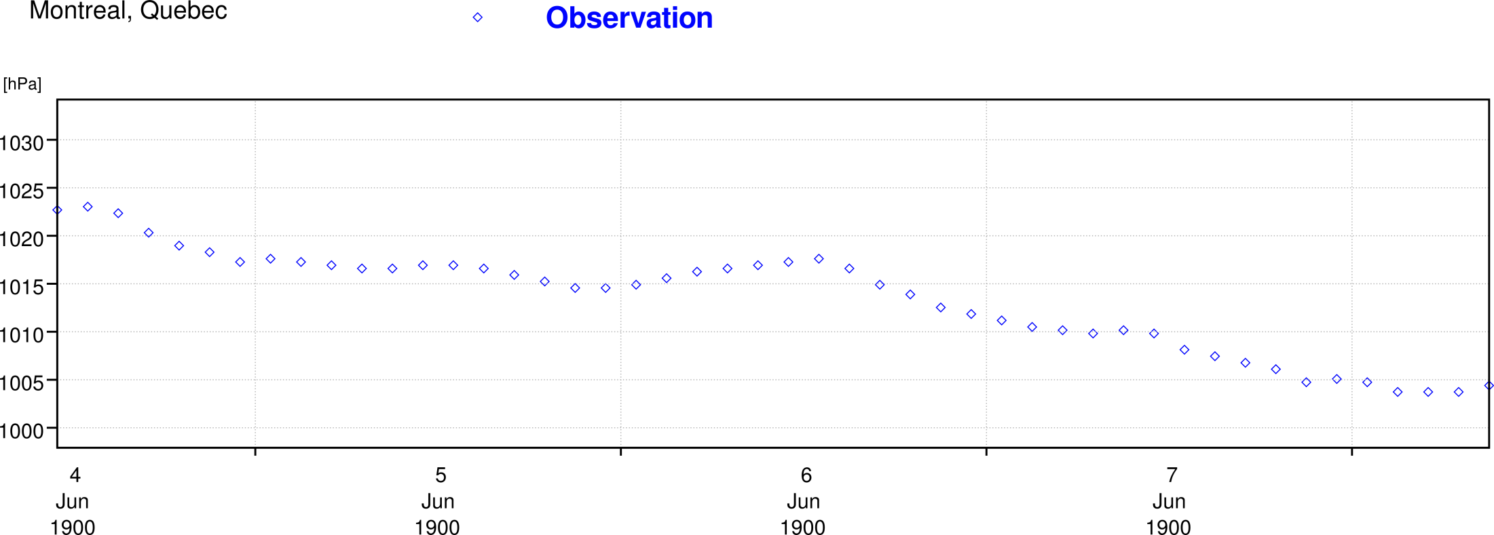
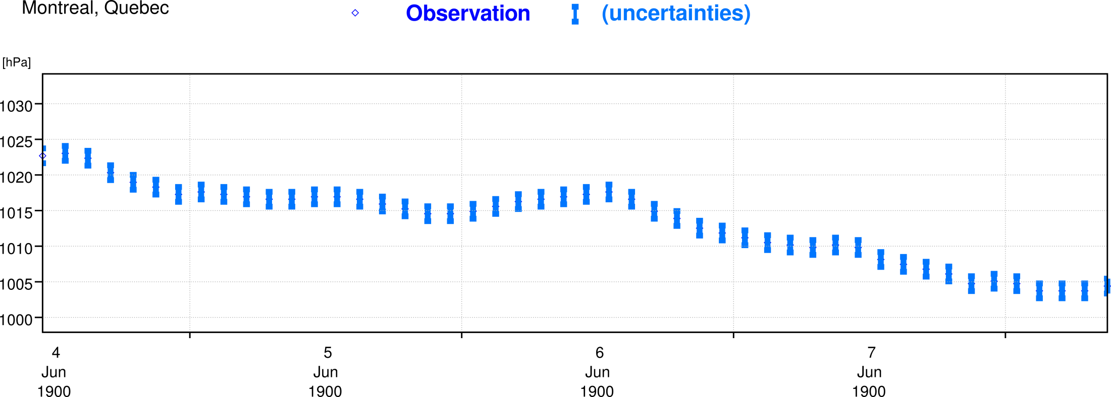
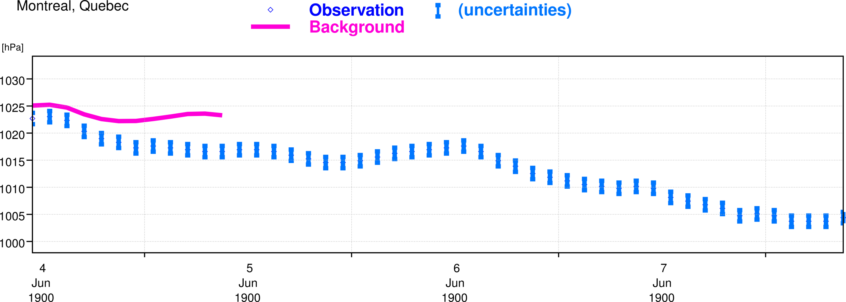
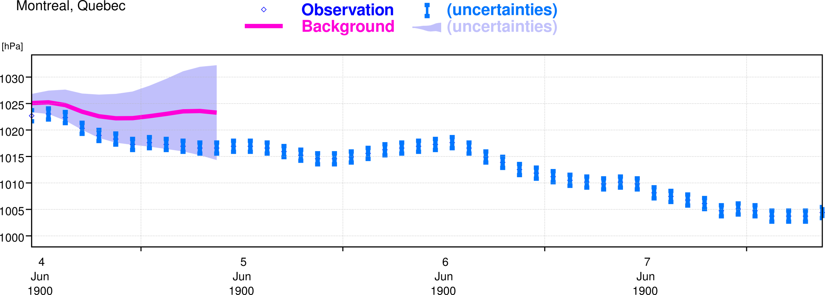
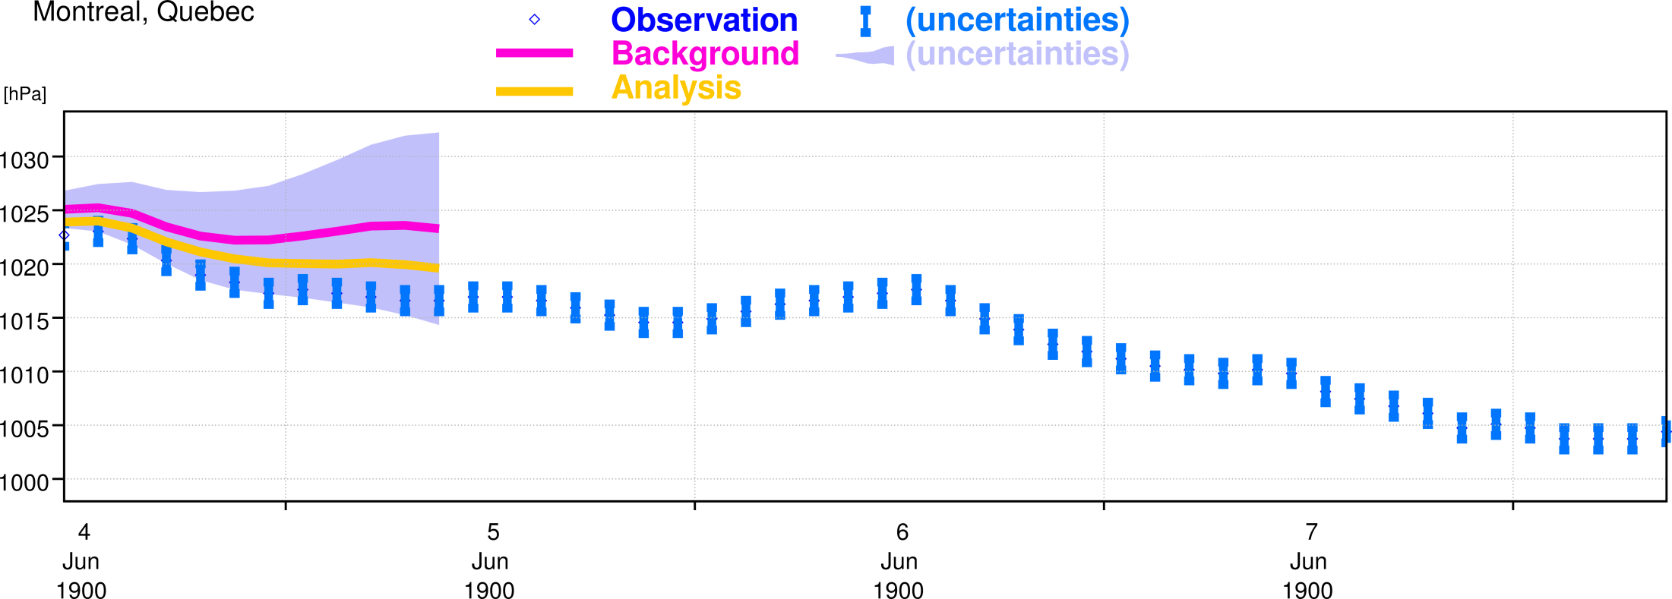
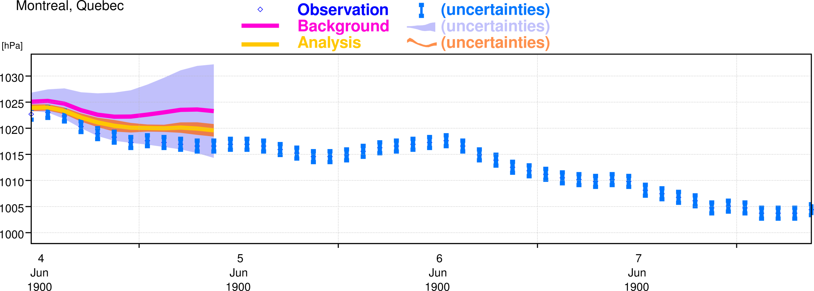
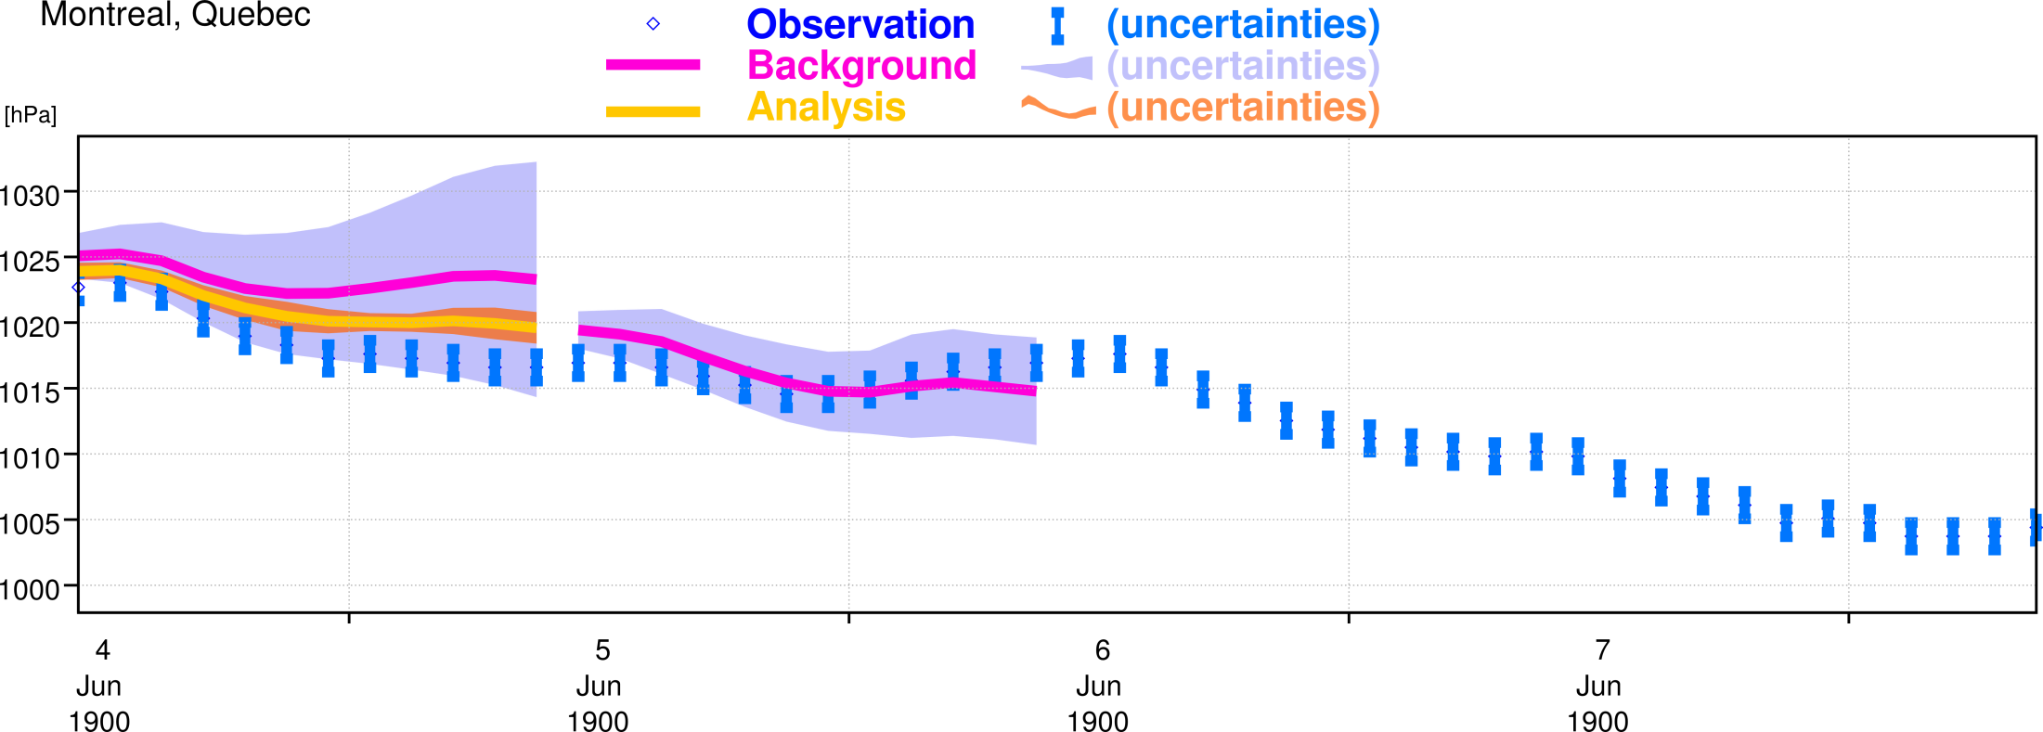
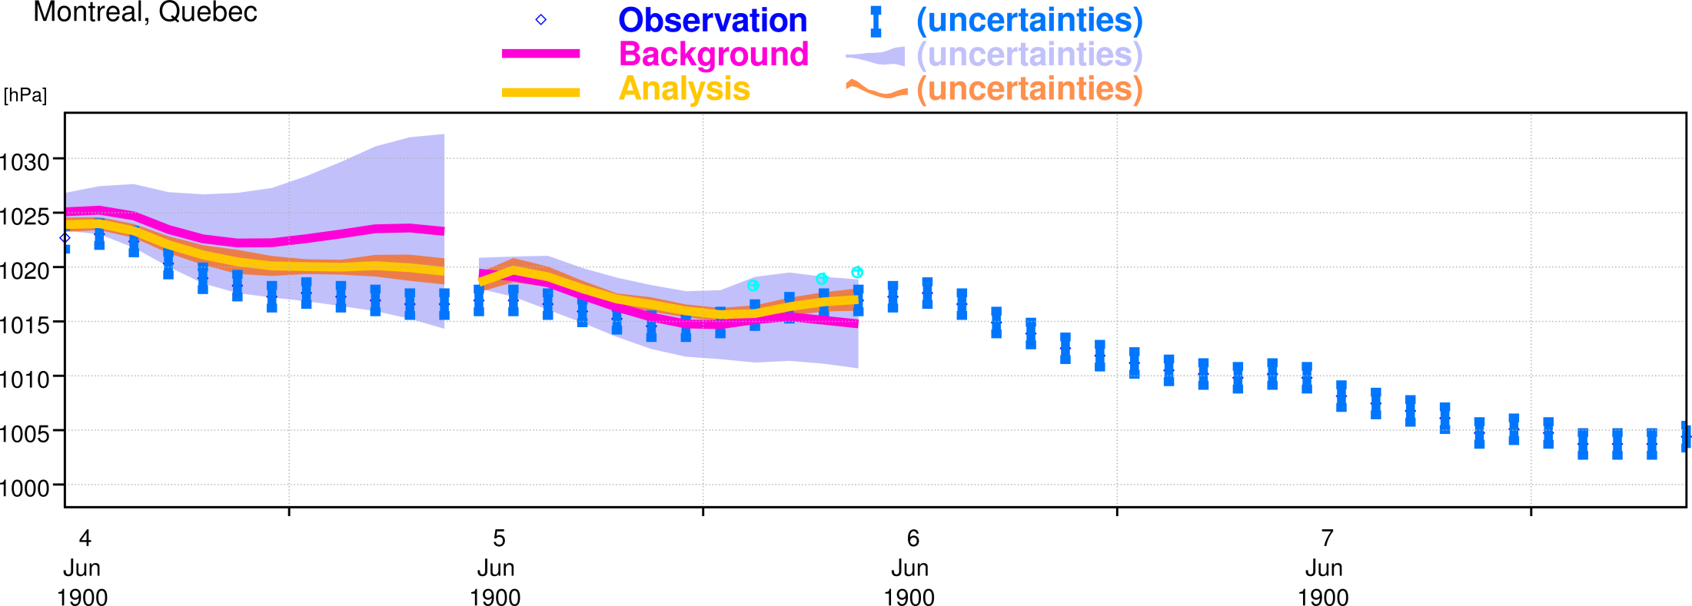
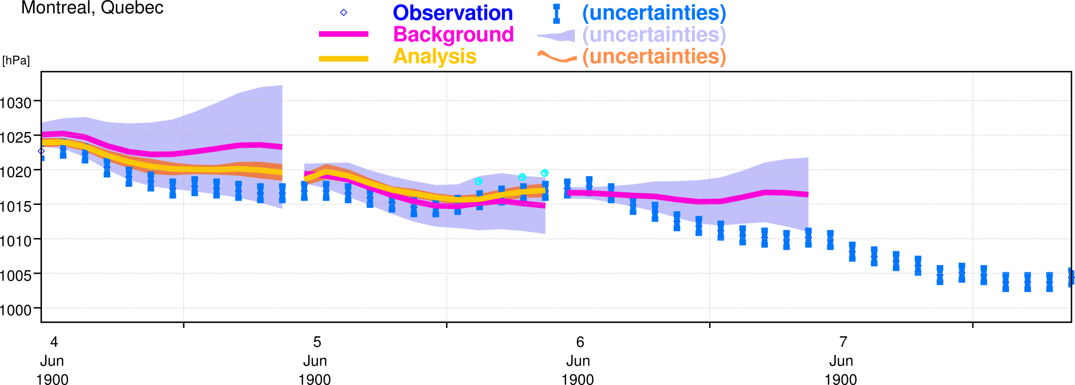
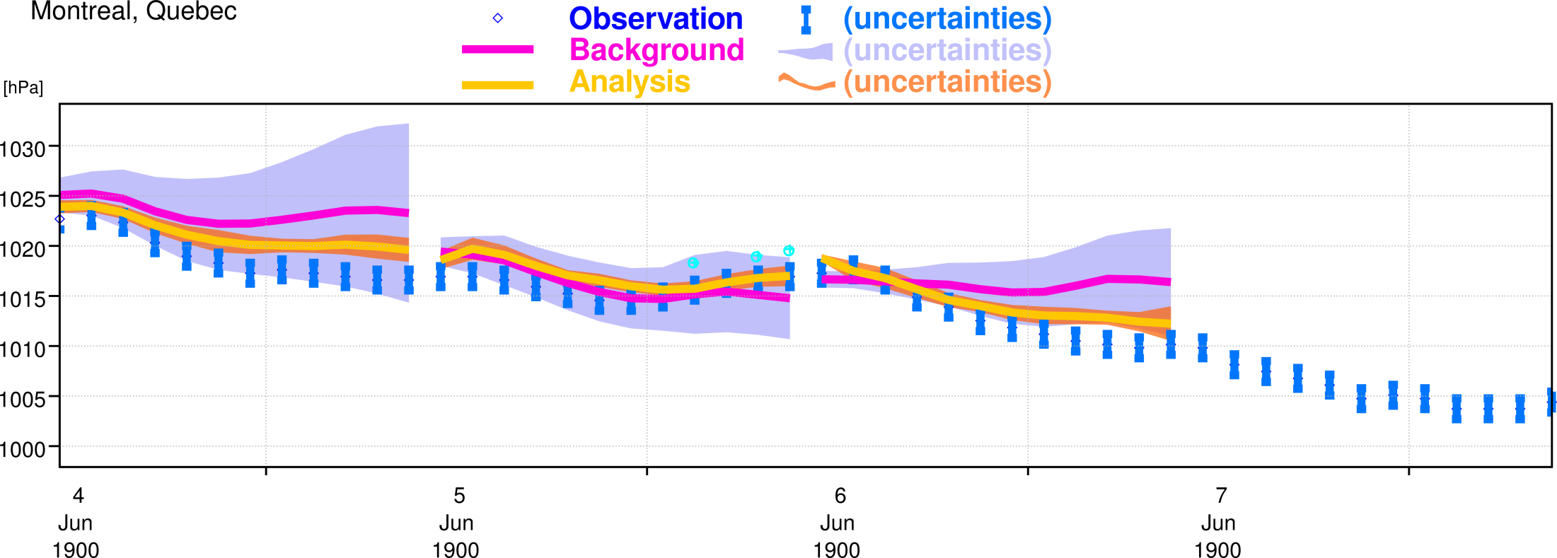
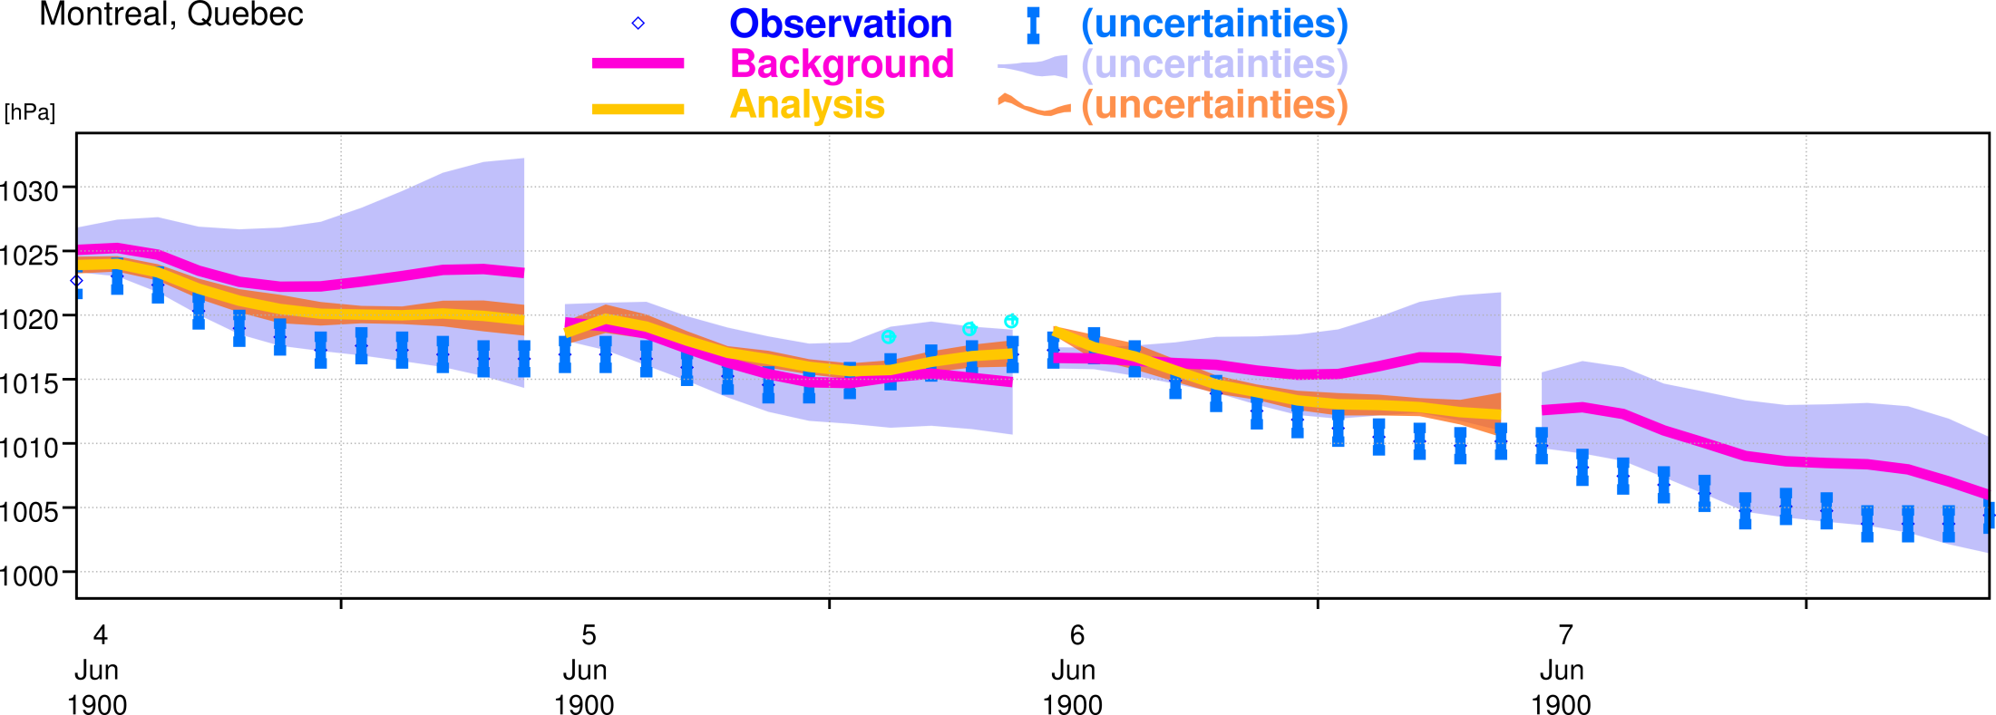
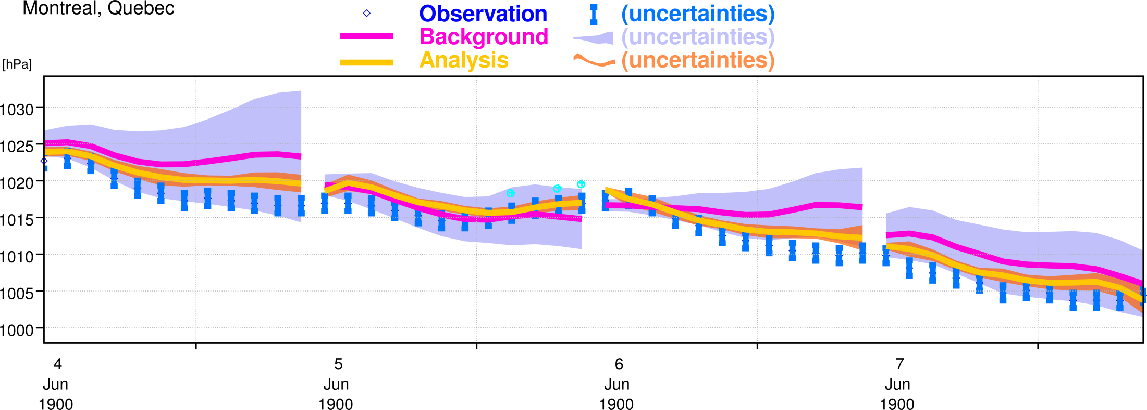
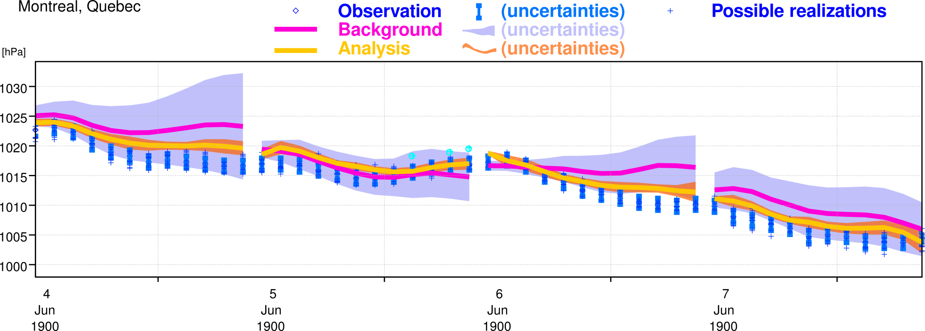
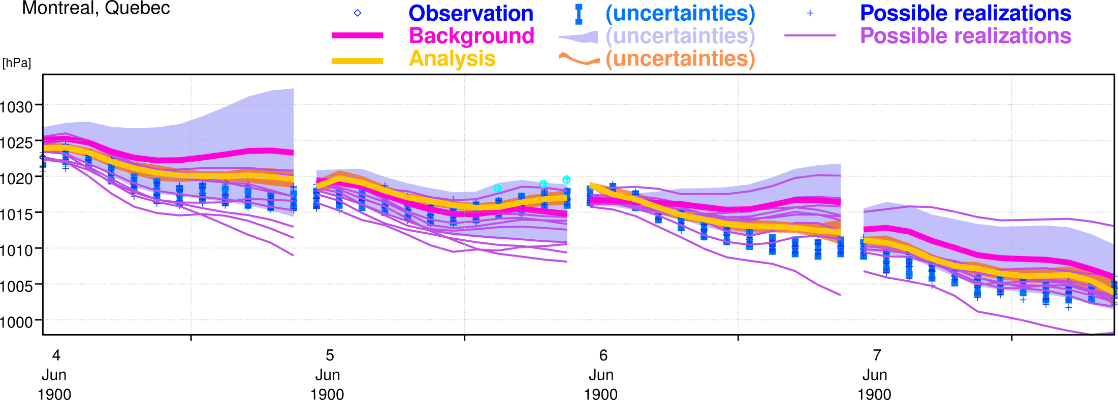
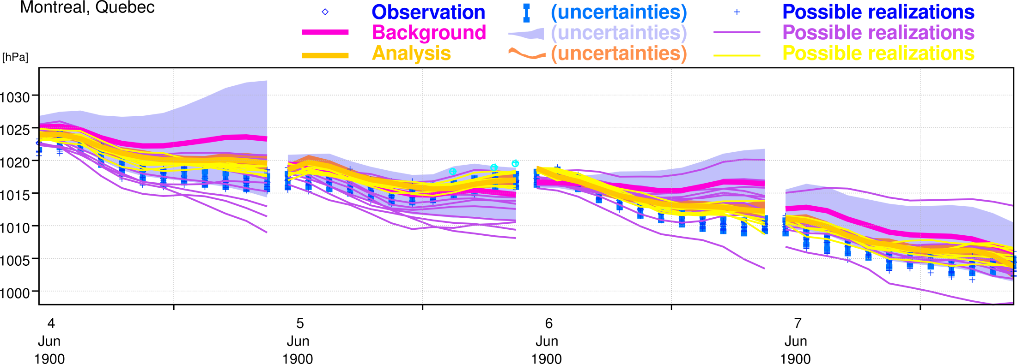
Specifying and estimating uncertainties with a 10-member ensemble of 24-hour 4DVAR data assimilations
Observation errors (sigma_O)
SST errors (10-member ensemble)
Model errors (stochastic physics)
10 members
“Monte-Carlo” equivalent to the estimation problem:
Ensemble supposed to contain all sources of uncertainties (nay, it doesn’t…) so that product spread is a measure of product uncertainty

Slide 7
Temperature analysis increments 1979-2010
ERA-Interim
[K]
ERA-20C ensemble
Fluctuating increments add spurious low-frequency signal to analyses
ERA-20C deterministic
This is the production that we decided to release

Slide 8
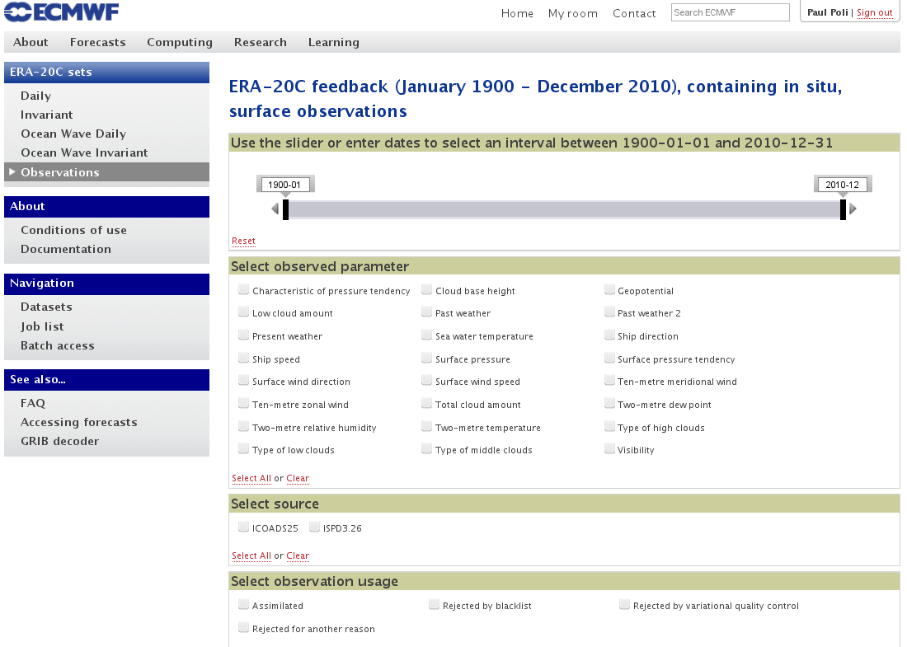
ERA-20C Products at http://apps.ecmwf.int/datasets/
3-hourly and invariant fields
(Monthly means available on MARS, soon on the web)
Observation feedback (available on MARS, soon on the web), allowing discovery before retrieval
(Facility will be further developed in near-future)

Slide 9
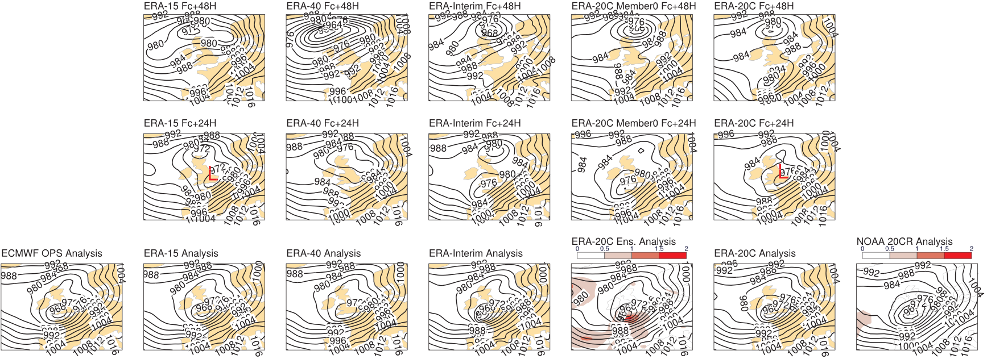
Looking first at a single case: European Storm of 16 Oct 1987
Best 24-hour forecast is from ERA-20C ensemble ERA-20C deterministic gives a degraded view (though still better than ERA-40)

Slide 10
Climate value for the water cycle (I)
In spite of a systematic bias (~2 mm too dry), ERA-20C is closer to RSS and HOAPS in terms of inter-annual-variability than ERA-Interim and JRA-55

Slide 11
Climate value for the water cycle (II)
A. Simmons

Slide 12
Uncertainties generated by the ERA-20C ensemble: Ensemble spreads. Example here with 2-metre temperature
ERA-20CM: model integration driven by forcings, without any assimilation (Hersbach et al., 2015 doi: 10.1002/qj.2528)
Reduction in ensemble spread in ERA-20C is stronger than in ERA-20CM
Increase in intra-month variability in ERA-20C is NOT observed in ERA-20CM
The factor 50x over the century in number of obs surely explains this. But why does the reduction in spread match the increase in variability?
-Is this an unwanted feature of the ensemble method that we used?

Slide 13
Comparison to independent observations to assess uncertainties (I): infrared spectra Nimbus-4 IRIS Apr 1970-Jan 1971
667 cm⁻¹ 15 μm CO₂
1110 & 1043 cm⁻¹ 9.6 μm O₃
1306 cm⁻¹ 7.6 μm CH₄
Mean obs. in cloud-clear areas
Channel number
Stdev. for tropospheric (stratospheric) temperature soundings channels below 2K (3K)
Find out more about ongoing efforts on satellite data rescue:
http://www.ecmwf.int/en/about/media-centre/news/2015/climate-reanalysis-data-challenge

Slide 14
Comparison to independent observations to assess uncertainties (II): water vapor
Stdev (Obs - ERA-20C) is about 7K
Stdev (Obs) is about 21K
Explained variance = (21*21-7*7) out of (21*21)
ERA-20C explains about 90% of the variance in SSMI channel 3 (22GHz), whereas ERA-Interim explains 98%
Comparison with SSM/I FCDR of brightness temperatures from CM SAF, by running RTTOV v11 at the time and location of the SSM/I observations, considering only clear-sky scenes over ice-free ocean

Slide 15
Comparison to SSM/I highlights missing variability in ERA-20C
ERA-20C is probably missing tropical instability waves, owing to monthly SST forcing (missing intra-month variability)
Computation from ERA-20C
Computation from ERA-Interim, at the same times and locations as the observations
Average SSM/I channel 2 (sees SST) brightness temperature from the FCDR for F10, F11, and F13, at 0.25 degree longitude resolution (horizontal axis) and per day of the year 1996 (vertical axis, from 1 January at the bottom to 31 December at the top) in the Eastern Tropical Pacific for latitudes 1.5 to 2.5 degree North, for clear-sky scenes after retaining longitudinal anomalies (12 deg window) and 20-50 days signal

Slide 16
Winds from buoys: we should have treated separately moored vs. drifting
Note also the suspicion of some winds with 180 degree shift in direction u → -u v → -v

Slide 17
ERA-20C rejected most of the (bogus) observations of tropical cyclone (TC) central pressure
20CR assimilated most TC bogus observations
20CR
Here we rejected most data b/c of background check or VarQC
ERA-20C ensemble
Here we rejected most data b/c of an innovative QC that rejected constant time-series of observations… and central pressures can be constant for several days in IBTrACS!
ERA-20C deterministic

Slide 18
What is really happening in the Southern high latitudes?
Problem first pointed out, to my knowledge, by Dave Bromwich and Julien Nicolas
~10 hPa drop in ERA-20C and 20CR: is it real?
Note, it is not seen in an AMIP run (ERA-20CM)

Slide 19
Computing maps of departures with respect to ERA-20C, the AMIP (ERA-20CM), and 20CR
…suggests that observations of pressure reported at the highest latitudes do not agree with the free model integration. Yet all such observations are consistent between one another (all collections have the same behavior). Who’s right then? The pressure observations, or the (sea-ice-driven) model? Is the forcing ‘suboptimal’?
See animation for several years, and other videos, at
https://www.youtube.com/playlist?list=PLNgQfkVXCl8gQKXkXEUBEygfSreSwNY1Z

Slide 20
ECMWF Reanalyses (not including chemistry and composition)
ERA5
ERA-Interim
+ land-surface
+ ERA-Interim/Land
ERA-40
+Satellites
ERA-15
+Upper-air
ERA-PRESAT
CERA-20C
ERA-20C
+Surface
+ ERA-20CL
ERA-20CM
Forcings (SST, sea-ice…)
ORA-S4
Observation Diversity
CERA-20CM
ORA-20CM
ORA-S5
CERA-20C
+Sub-surface
ORA-20C
1900
1950
2000
2020

Slide 21
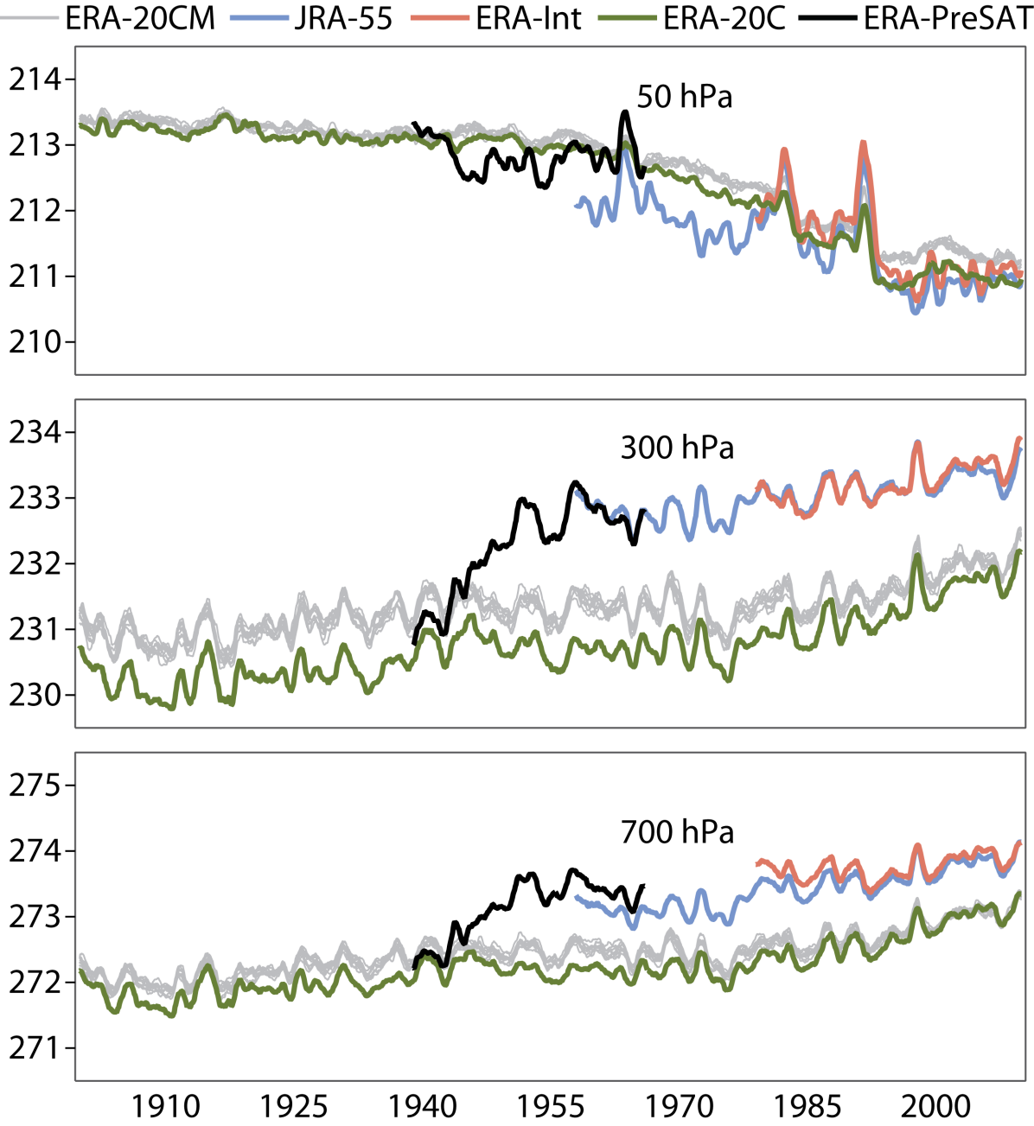
Adding observations to ERA-20C: trial for 1940-1964
Note how adding upper-air observations takes the mean state from ERA-20C (biased cold in troposphere) to a state-of-the-art product like JRA-55
Unanswered question of how to treat this optimally in a 20th century reanalysis starting without upper-air observations…
A. Simmons

Slide 22
Conclusions

Slide 23
Conclusions
ERA-CLIM initiated a new class of reanalyses: ERA-20C family
All results can be analyzed w.r.t to a model integration baseline, ERA-20CM
ERA-20C iterated once, with a second production that applied lessons from the first production. Products available online since 1 Oct 2014 at http://apps.ecmwf.int/datasets/
Observation feedback published online in a user-friendly interface (last-minute update: deployment now scheduled for Wednesday 6 May 2015)
Not our last and final product, we will hopefully make new versions!
ERA-CLIM2 funds R&D for next-generation reanalyses
To couple with ocean
To increase observation diversity in century-long reanalyses
More ERA-20C products to be released soon
Monthly means, and possibly ensemble spreads
ERA-20CL: land-surface model driven by meteorological forcing from ERA-20C

Slide 24
Extra slides

Slide 25
ERA-20C productions
Ensemble run had pushed the envelope of what ECMWF infrastructure can deliver in terms of reanalyses:
6 streams of 10 members each. Completed in 200 days
Deterministic run employed 22 streams. Peak production yield was 15 Tb in 1 day
Planned from the onset as a “blitz run”, under 100 days
Actually took around 50 days (not removing downtimes, would have been faster otherwise)
Started around Christmas time when fewer people were around to mess with overall machine load, then adjusted for timing and scheduling for next 10 days
Once stable (evening of 31 December 2013), each stream produced 50days/day
“Production hangover”: after this we were left with about 1 Petabyte of data to organize for release. We are finally getting there now.

Slide 26
Why 2 productions of ERA-20C?
The 10-member ensemble production was required:
To compute background error covariances: ‘B matrix’ of Variational assimilation
Ensemble used its own, self-generated background errors
Brand new idea in 2013, only made it to ECMWF NWP operations recently.
What happened in this ERA-20C ensemble:
In the upper troposphere and above, the background error variances (derived from the ensemble spread) were sometimes large (>several K).
The background errors contained remote vertical correlations.
The combination of the two lead the 4DVAR to spread information from the surface all the way up.
Slowly-varying systematic analysis increments made an imprint in the stratosphere, destroying forcing-led low-frequency (good) information.
Trying out vertical localizations in the 4DVAR ruined its synoptic quality.
Only option was to re-do a production without using the ensemble-generated background error correlations
Advantage: this could be done without an ensemble: deterministic production.
Resulted in much better upper-air climate, but slightly worse meteorology

Slide 27
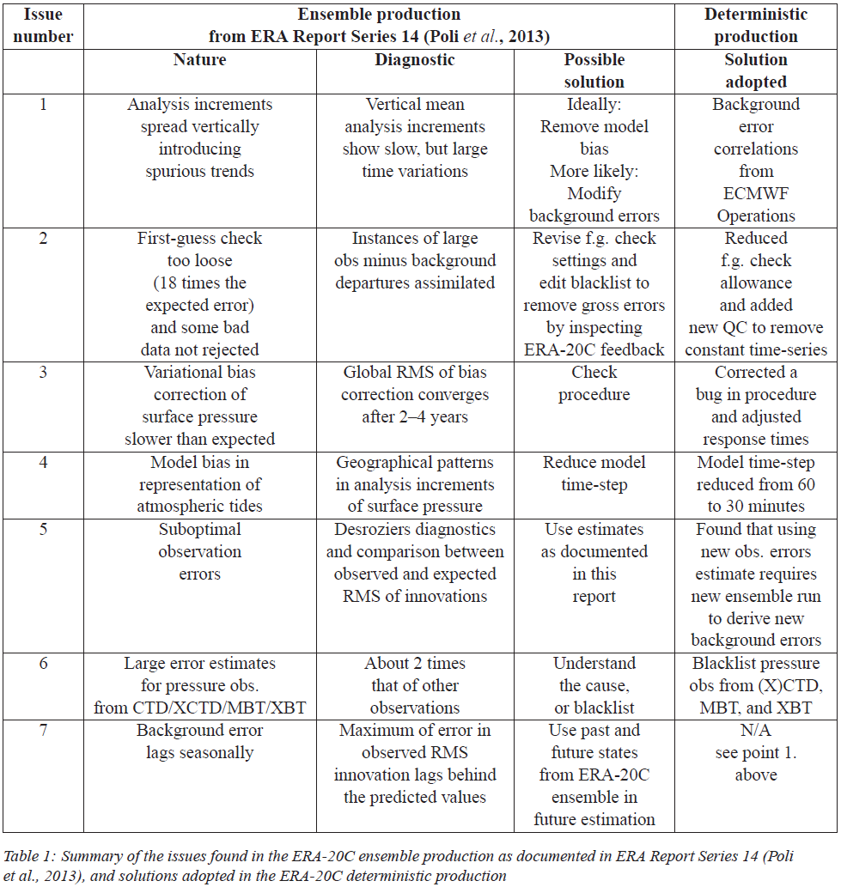
ERA-20C deterministic re-run also fixed other problems: Issues in ERA-20C ensemble Solutions adopted

Slide 28
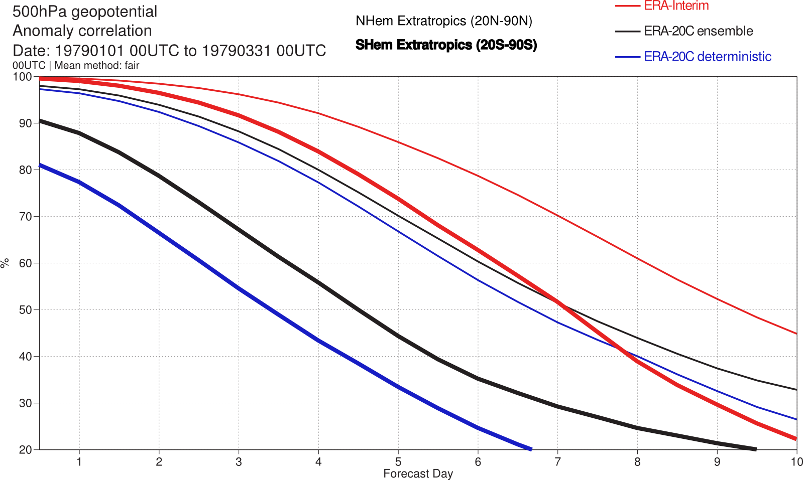
ERA-20C forecast scores
This is confirmed by the forecast scores

Slide 29
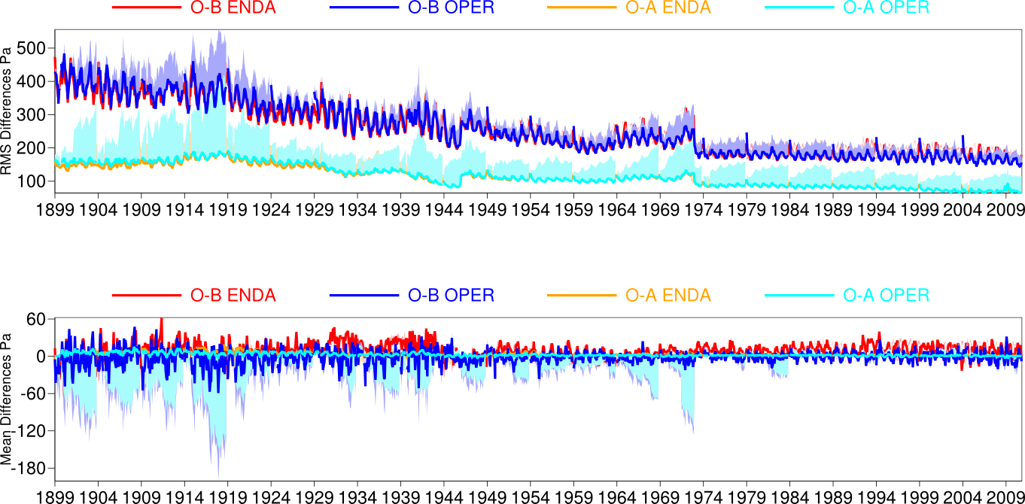
Observation feedback metrics (both ERA-20C runs)
Mean sea level pressure
Before bias correction
After bias correction
Shading shows work done by observation bias correction instead of the work done by the meteorological analysis to adjust the whole atmospheric state to fit the data

Slide 30
Climate value for temperature
Model level 30 (about 50 hPa)
ERA-20C ensemble
ERA-20C deterministic
Model level 71 (about 700 hPa)
ERA-20C ensemble
ERA-20C deterministic
Model level 89 (near-surface)
ERA-20C ensemble
ERA-20C deterministic
2-meter
1st ERA-20CM run
ERA-20C deterministic
CRUTEM4 data (Jones et al., 2012)
ERA-20CM
A. Simmons

