Slide 1
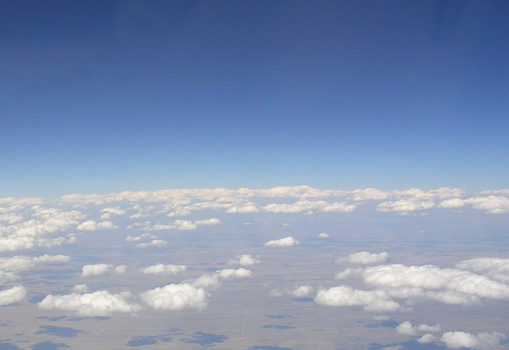
Improving the Land Surface Component of the CFS Reanalysis
Michael Ek¹, Kingtse Mo², Jesse Meng³, Jiarui Dong³, Roshan Shresha³, Rongqian Yang³, Youlong Xia³
¹NOAA/NWS National Centers for Environmental Prediction (NCEP)
Environmental Modelling Center (EMC)
College Park, Maryland, USA
²NOAA/NWS National Centers for Environmental Prediction (NCEP)
Climate Prediction Center (CMC)
College Park, Maryland, USA
³NCEP/EMC and I.M. Systems Group (IMSG)
College Park, Maryland, USA
…and a large number of collaborators!

Slide 2
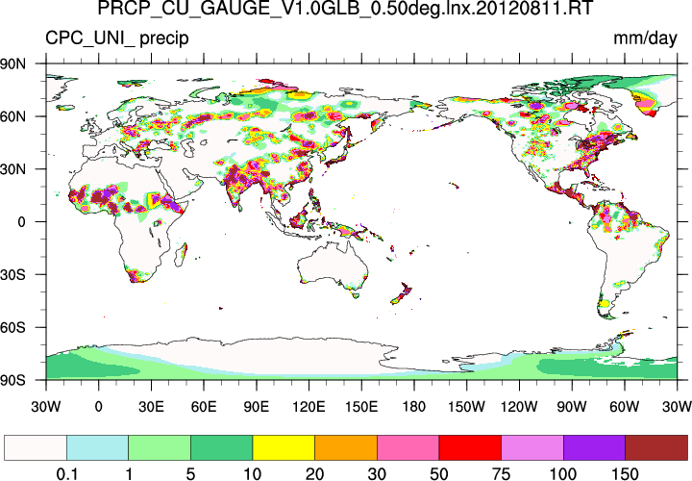
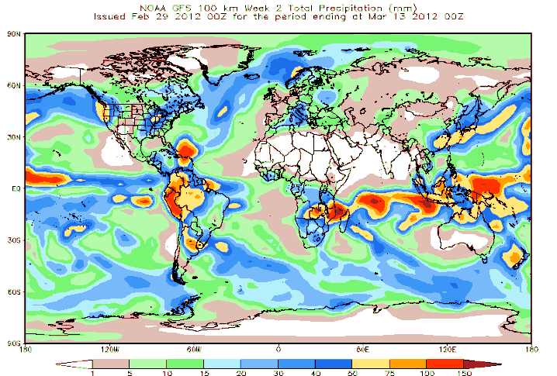
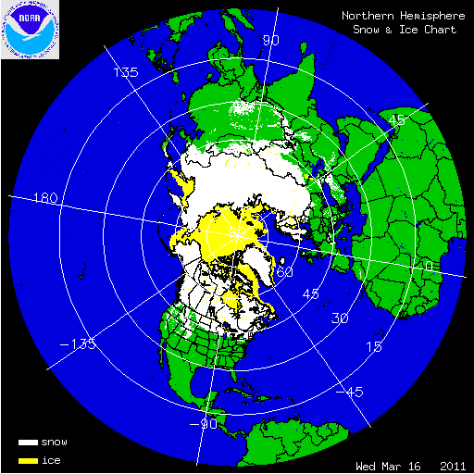
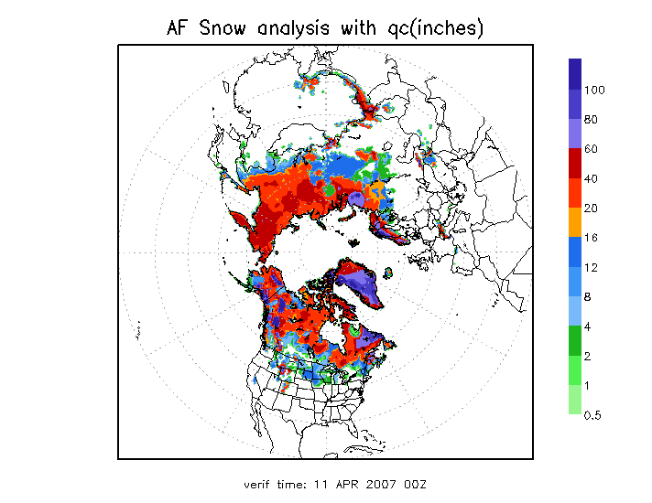
Current Global Land Data Assimilation System (GLDAS) at NCEP Operational in CFSv2 at NCEP 01 April 2011
Noah surface model runs in semi-coupled mode with Climate Data Assimilation System version (CDASv2); daily update provides initial land states to operational Climate Forecast System version 2 (CFSv2).
Forcing: CDASv2 atmospheric output, & “blended” precipitation, snow.
Blended Precipitation: CPC satellite (heaviest weight in tropics); CPC gauge (heaviest mid-latitudes); model CDASv2 (high latitude).
Snow: IMS cover & AFWA depth, cycled if within 0.5-2.0x “envelope”.
30+ year global land-surface climatology.
Research/partners supported by the NOAA Climate Program Office, Modeling, Analysis, Predictions, and Projections (MAPP) program.
Precipitation
Snow
CMAP
Surface gauge
GDAS
IMS cover
AFWA depth
Jesse Meng, NCEP/EMC

Slide 3
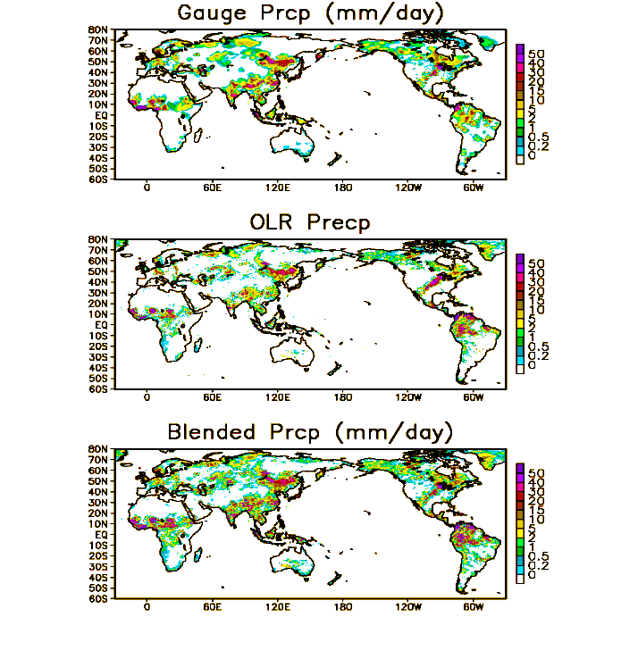
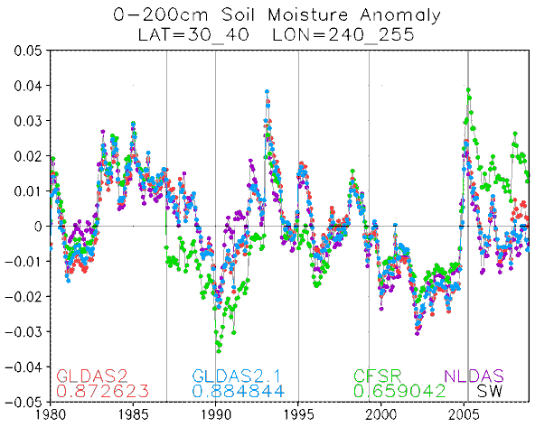
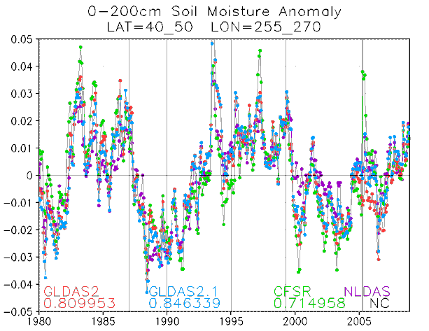
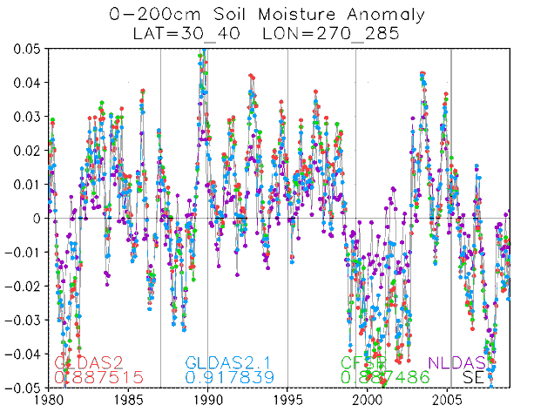
LDAS Upgrade: GLDASv2 with New Precipitation Forcing
Precipitation Data in current operation:
CMAP, 5-day data latency.
Unified global gauge analysis, 1-day data latency.
New Precipitation Data:
CPC Gauge-satellite blended analysis of daily global precipitation.
0.25º lat/lon over the global land.
1979-present.
Blending information from different sources:
CPC daily gauge analysis.
GPCC monthly gauge data.
OLR-based precipitation estimates.
CMORPH-based precipitation estimates.
1-day data latency.
Preliminary Results:
Improved soil moisture spin-up & anomalies.
Courtesy of Pingping Xie, NCEP/CPC
Southwest US
Northern Plains
Southeast US
Jesse Meng, NCEP/EMC

Slide 4
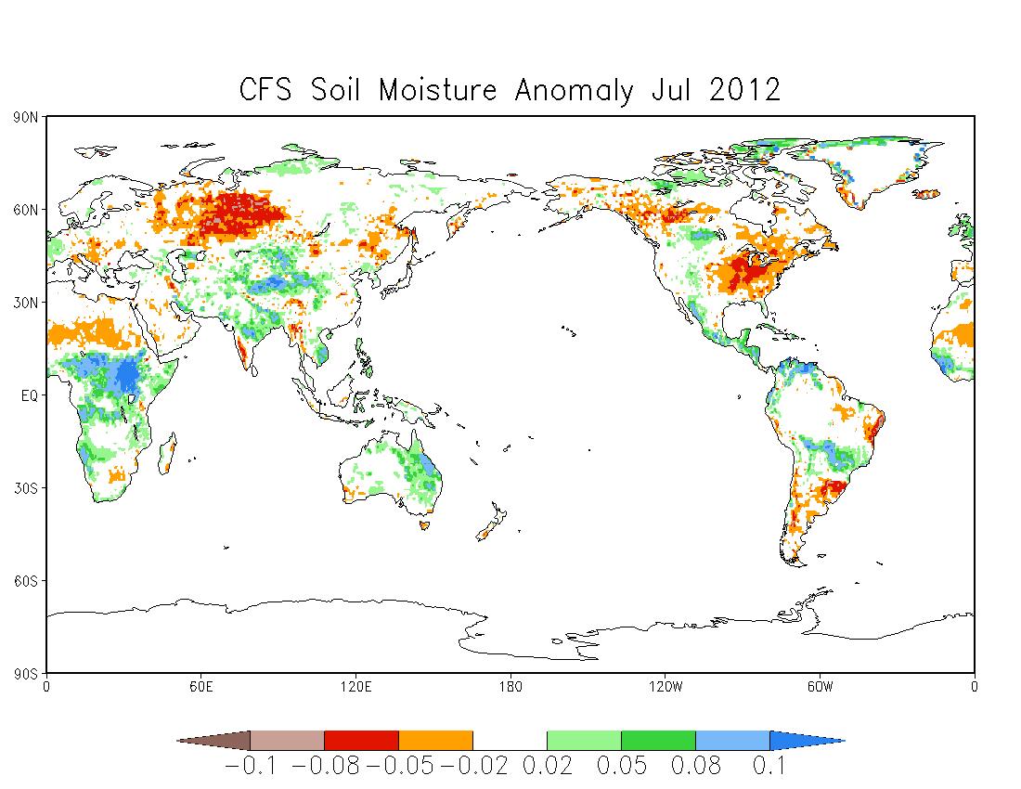
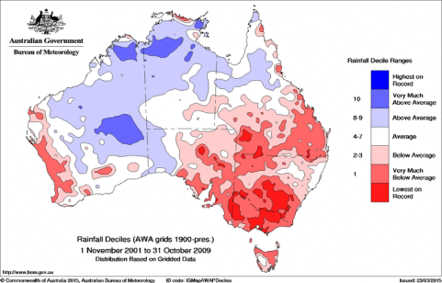
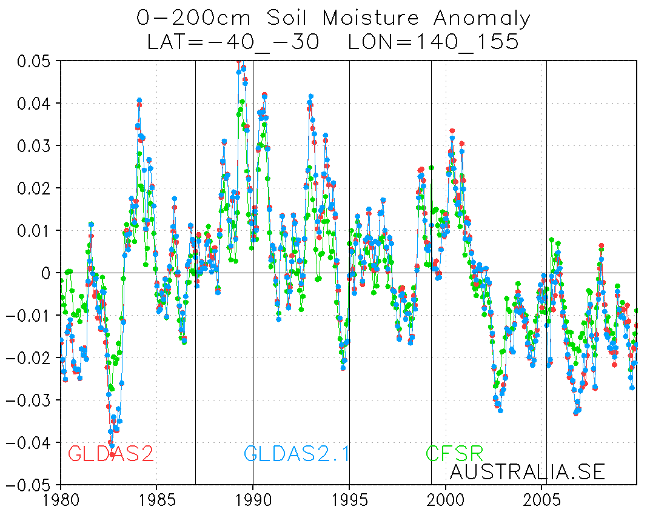
GLDAS Global Drought Monitor
Russian drought
US drought
July 2012 Soil Moisture Anomaly from NCEP GLDASv2
Uganda flooding
2002-2007, The Australian Millennium Drought
from NCEP GLDASv2
Jesse Meng, NCEP/EMC

Slide 5
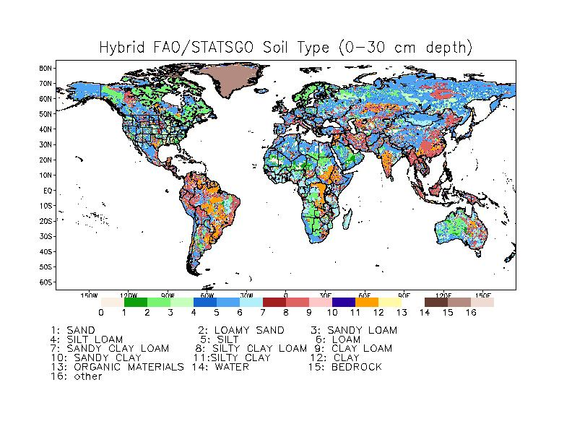
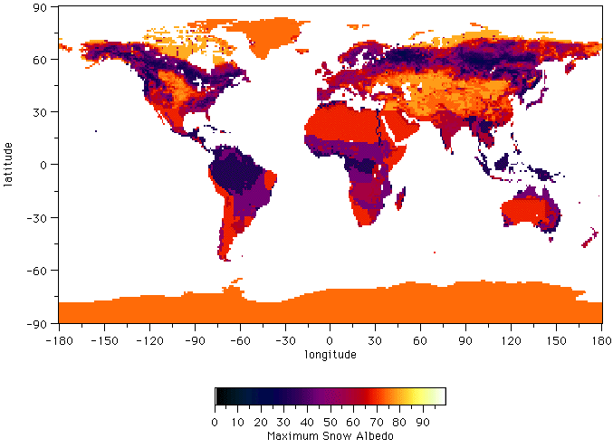
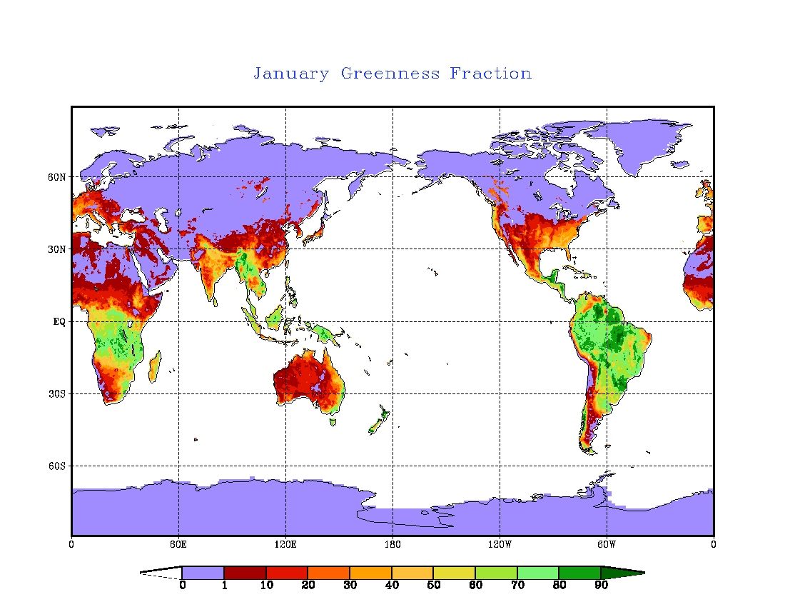
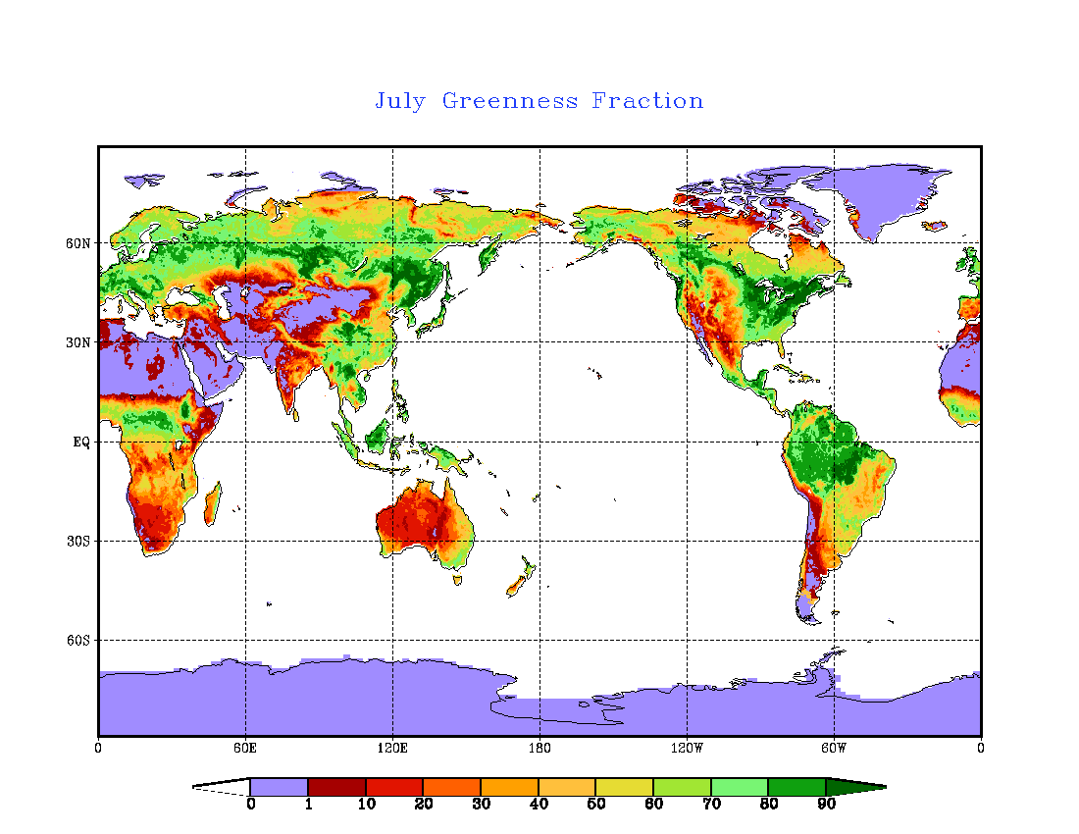
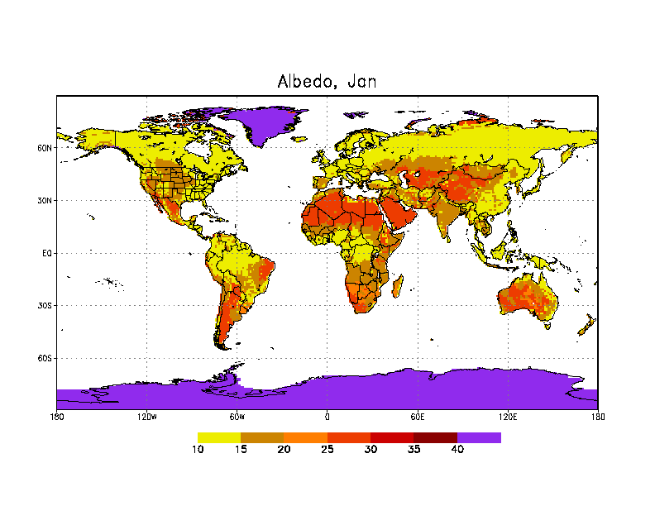
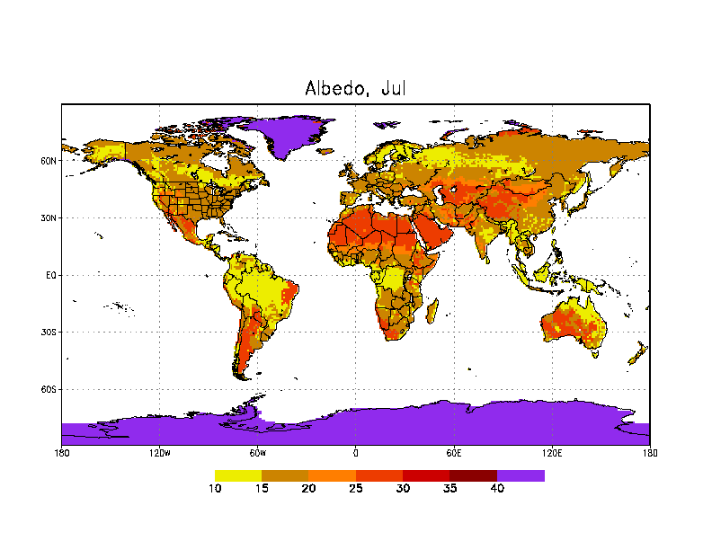
Land Data Sets Used in NCEP Modeling Systems
Vegetation Type
(1-km, IGBP-MODIS)
Soil Type
(1-km, STATSGO-FAO)
Max.-Snow Albedo
(5-km MODIS)
Jan
July
winter
summer
Green Vegetation Fraction (GVF) (monthly, 1/8-deg, NESDIS/AVHRR)
Snow-Free Albedo
(5-km MODIS)
Climatologies: fixed/annual, monthly, weekly.
Near real-time observations, e.g. GVF “becoming” a land state.

Slide 6
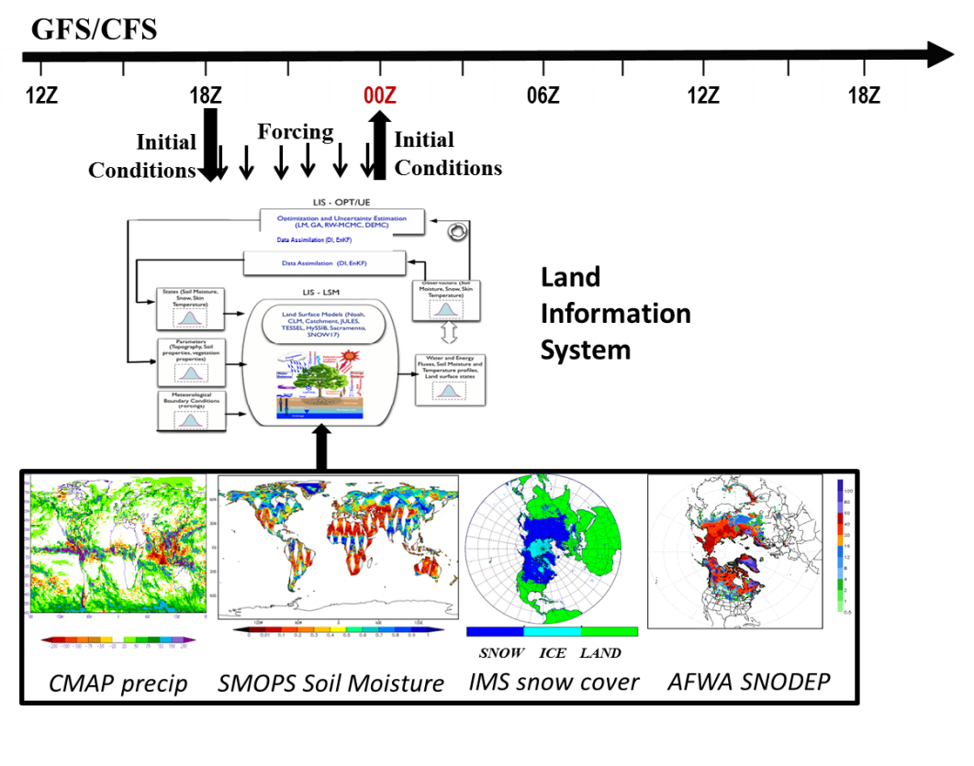
Satellite-based Land Data Assimilation in NCEP Modeling Systems
Use NASA Land Information System (LIS) to serve as a unified Land Data Assimilation System (LDAS) for testing both GLDAS and NLDAS.
LIS EnKF-based Land Data Assimilation tool used to assimilate:
Snow cover area (SCA) from operational NESDIS Interactive Multisensor Snow and Ice Mapping System (IMS), and AFWA snow depth (SNODEP) products.
CFSR GLDAS
Michael Ek, Jesse Meng, Jiarui Dong (NCEP/EMC)
Christa Peters-Lidard, Sujay Kumar (NASA/GSFC)
NASA
Build NCEP’s CFS-GLDAS by incorporating the NASA Land Information System (LIS) into NCEP’s GFS/CFS (left figure)
Offline tests of the existing EnKF-based land data assimilation capabilities in LIS driven by the operational CFS.
Coupled land data assimilation tests and evaluation against the operational system.
(LIS)
Jiarui Dong, NCEP/EMC

Slide 7
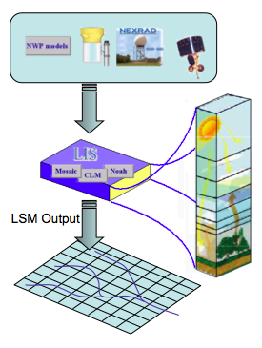
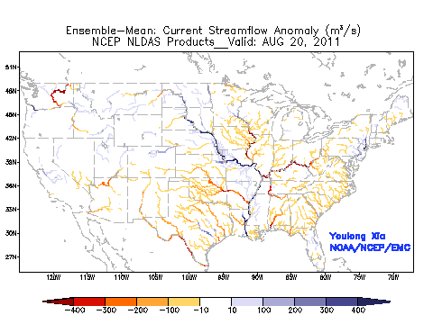
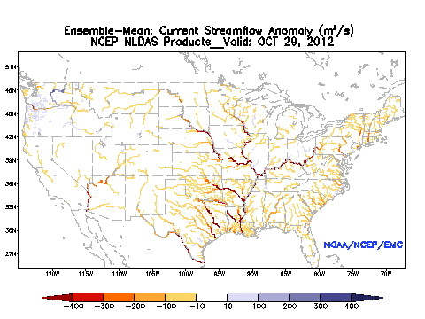
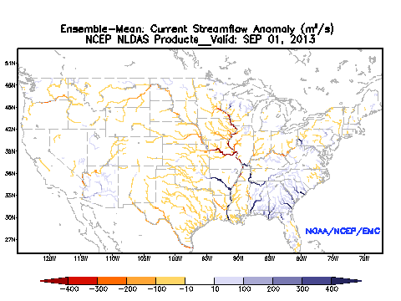
Model Improvement: Hydrology, River-Routing
Atmospheric
Forcing
Ensemble mean daily streamflow anomaly (NLDAS)
Hurricane Irene and Tropical Storm Lee, 20 August – 17 September 2011
Surface flow
Superstorm Sandy, 29 October – 04 November 2012
Saturated
subsurface flow
Colorado Front Range Flooding, September 2013
Close Coordination with National Water Center
Groundwater
Youlong Xia and Roshan Shresha, NCEP/EMC

