Slide 1


Update on Stratosphere Improvements in Reanalysis
Craig S. Long¹
Hai-Tien Lee¹, Jack Woollen²
Fabrizio Sassi³, Judith Perlwitz⁴
1 - NOAA/NWS/NCEPClimate Prediction Center
2 - NOAA/NWS/NCEPEnvironmental Prediction Center
3 – Navel Research Lab
4 – NOAA/OAR/ESRL/PSD
Climate Reanalysis Task Force – November 18, 2015

Slide 2
Last Report: October 30, 2013
Presented issues with the stratosphere in the CFSR compared to other reanalyses
  Resolution: T382/L64, changed to T574/L64 in 2010
  6 Streams
  Bias corrected SSU Channel 3 (other reanalyses did not)
  Model version used had a warm bias in the upper stratosphere
    As a result: each stream started out with cold anomalies and ended with warm anomalies
  AMSU Channel 14 was not assimilated
  Amplitude of summer-max / winter-min temperature is smaller than other reanalyses
    Especially in ATOVS period
  QBO winds lag observations
    CFSR resorted to using ERA40 tropical winds from 1987-1998.
  SAO is under represented
  Ozone mixing ratios follow climatology above 5 hPa – no inter-annual variability
Climate Reanalysis Task Force – November 18, 2015

Slide 3
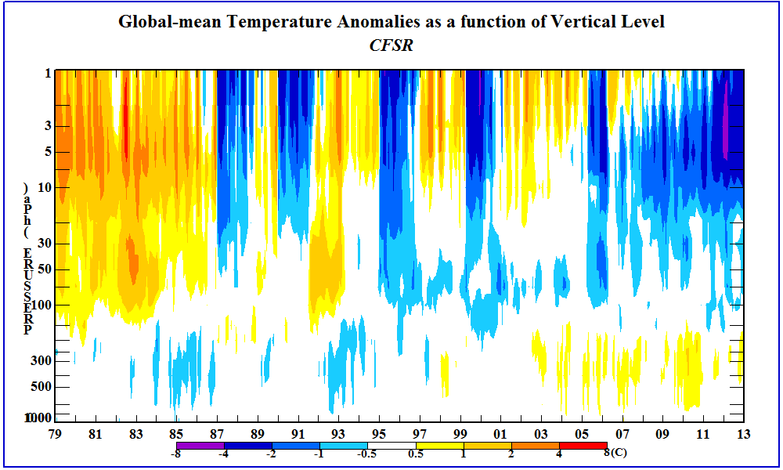
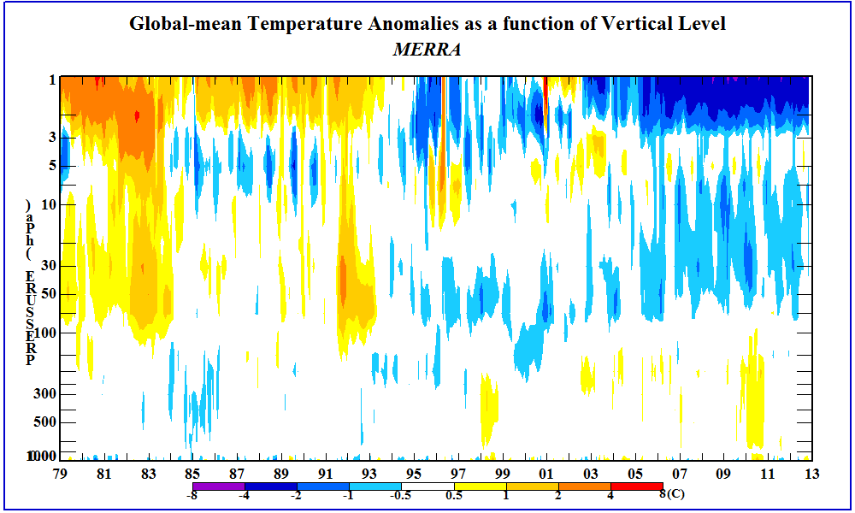
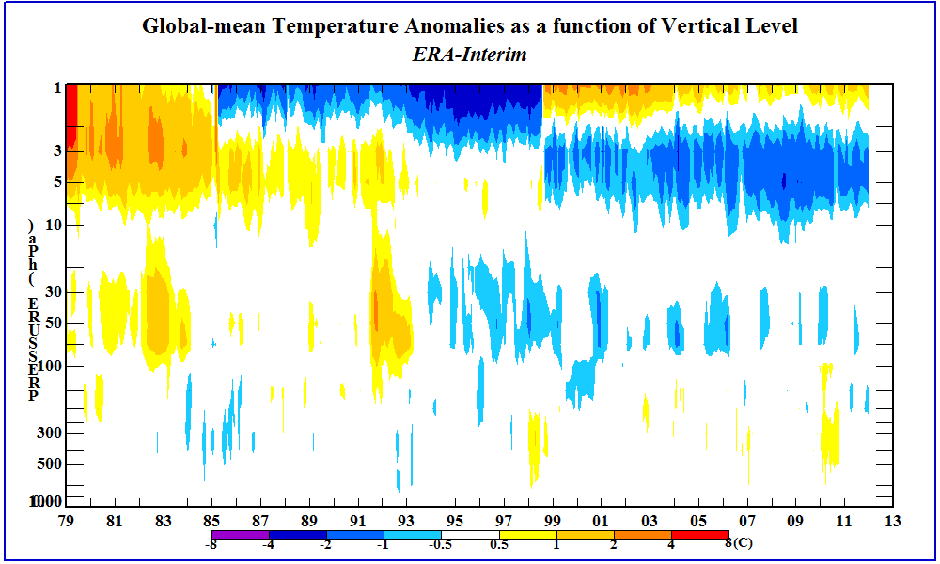
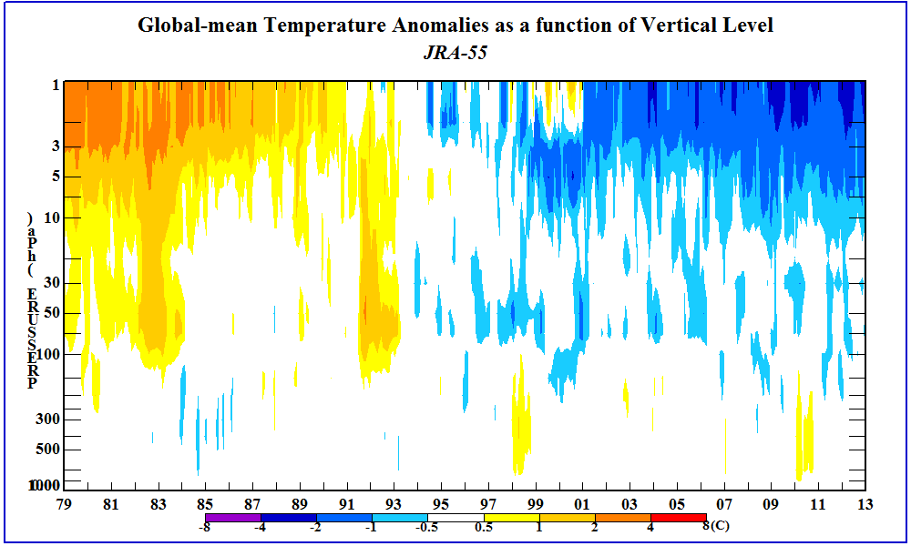
Global Temperature Anomalies
El Chicon
Pinatubo
Streams
El Nino
TOVS / ATOVS
Climate Reanalysis Task Force – November 18, 2015

Slide 4
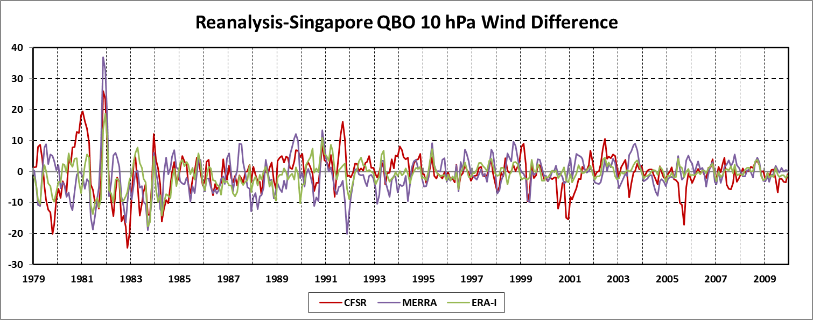
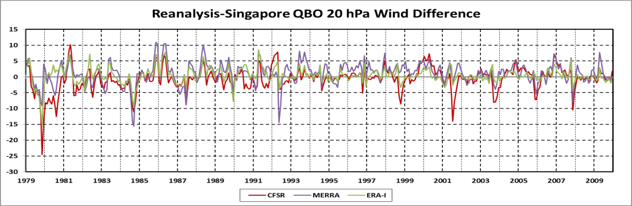
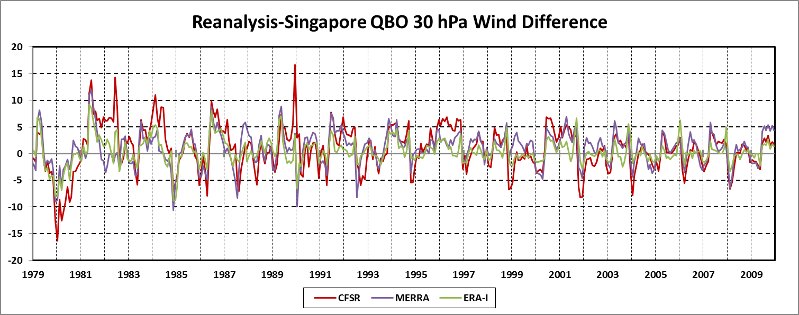
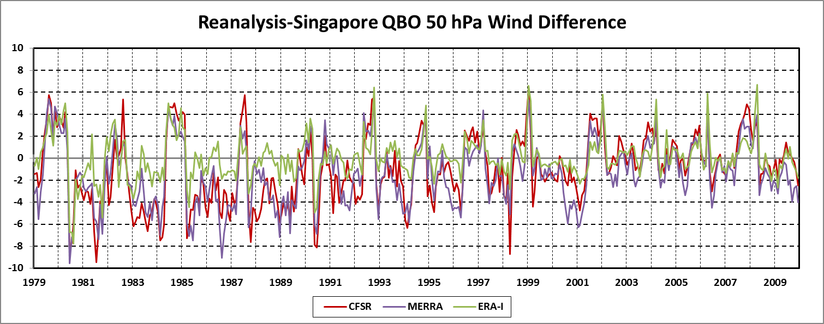
QBO Winds at Singapore
Westerlies
Easterlies
Wind Reversal
Climate Reanalysis Task Force – November 18, 2015

Slide 5
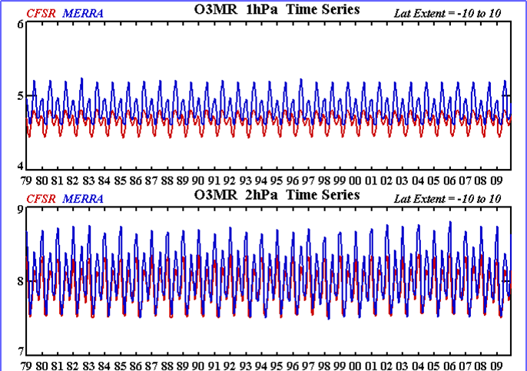
Repeating ozone annual cycle
Time series of ozone mixing ratios (ppm) at 1 and 2 hPa between 10N and 10S from the CFSR and MERRA reanalyses. The observation errors were 60x too large in both GSI assimilation systems preventing any SBUV(/2) ozone observations from being assimilated. The repeating cycles are the models climatology.
Climate Reanalysis Task Force – November 18, 2015

Slide 6
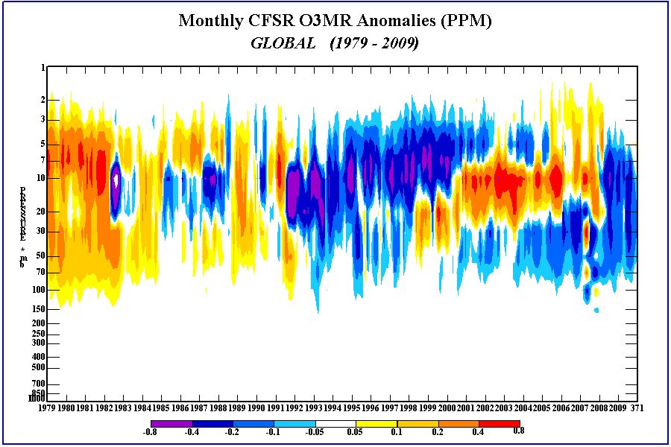
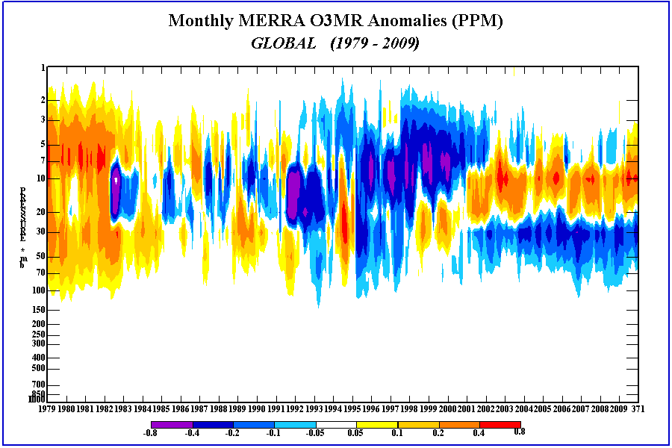
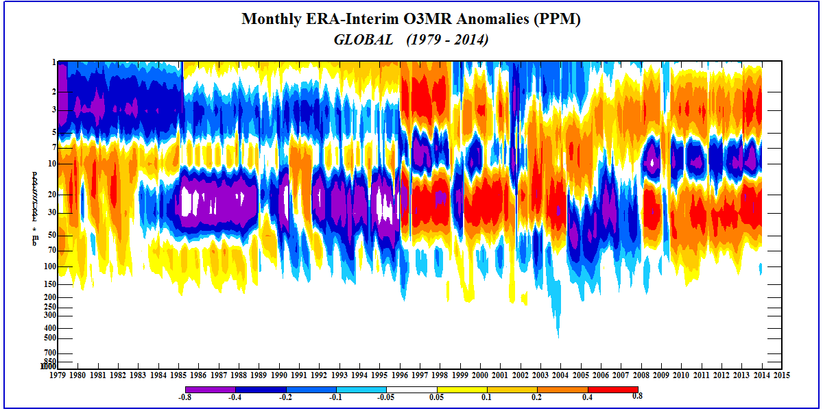
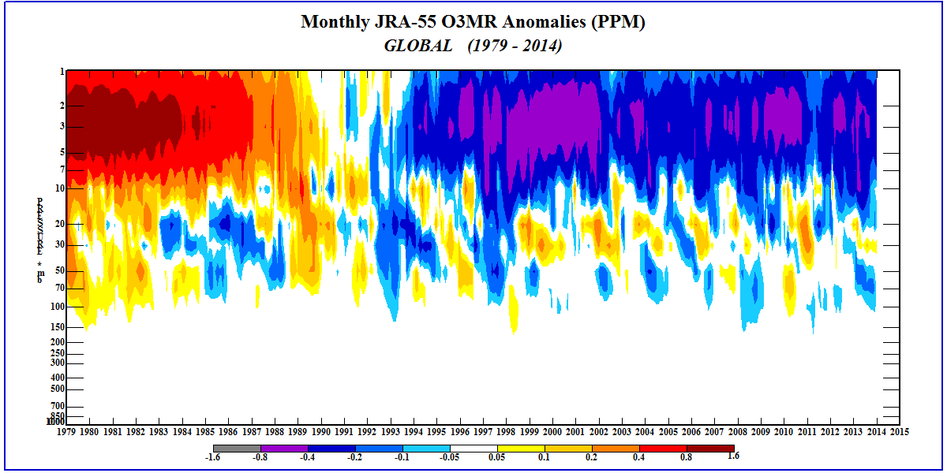
Global Ozone Anomalies
No Variability
Climate Reanalysis Task Force – November 18, 2015

Slide 7
Experiments and Purpose
Pr1998o – started Jan 1, 1998
  3DVar, T254/L64
  assimilates AMSU ch 14,
  does not bias correct SSU ch 3 and AMSU ch 14
  Fast job to see how not bias correcting top channels impacts analysis
  Lower res than CFSR but newer GSI
Pr1997b – started Jan 1, 1997
  Hybrid EnKF – 80 members – T126/L64, Assim: T254/L64
  assimilates AMSU ch 14,
  does not bias correct SSU ch 3 and AMSU ch 14
  Slower job to see how EnKF produced background errors improves analysis
Pr1997c – started Oct 26, 1998
  Hybrid EnKF – 80 members
  assimilates AMSU ch 14,
  does not bias correct SSU ch 3, AMSU ch 13 and 14
  Similar to pr1997b but to see if/how not bias correcting AMSU ch 13 affects analysis in upper stratosphere
Climate Reanalysis Task Force – November 18, 2015

Slide 8
3DVar vs EnKF
3DVar
  Static background errors
    Obs used everywhere
EnKF
  80 members provide information of where there is agreement
    obs not needed as much
  And where there is disagreement
    obs really needed
  Possible point of failure
    if 80 members agree incorrectly
    Not enough obs to modify analysis
Climate Reanalysis Task Force – November 18, 2015

Slide 9
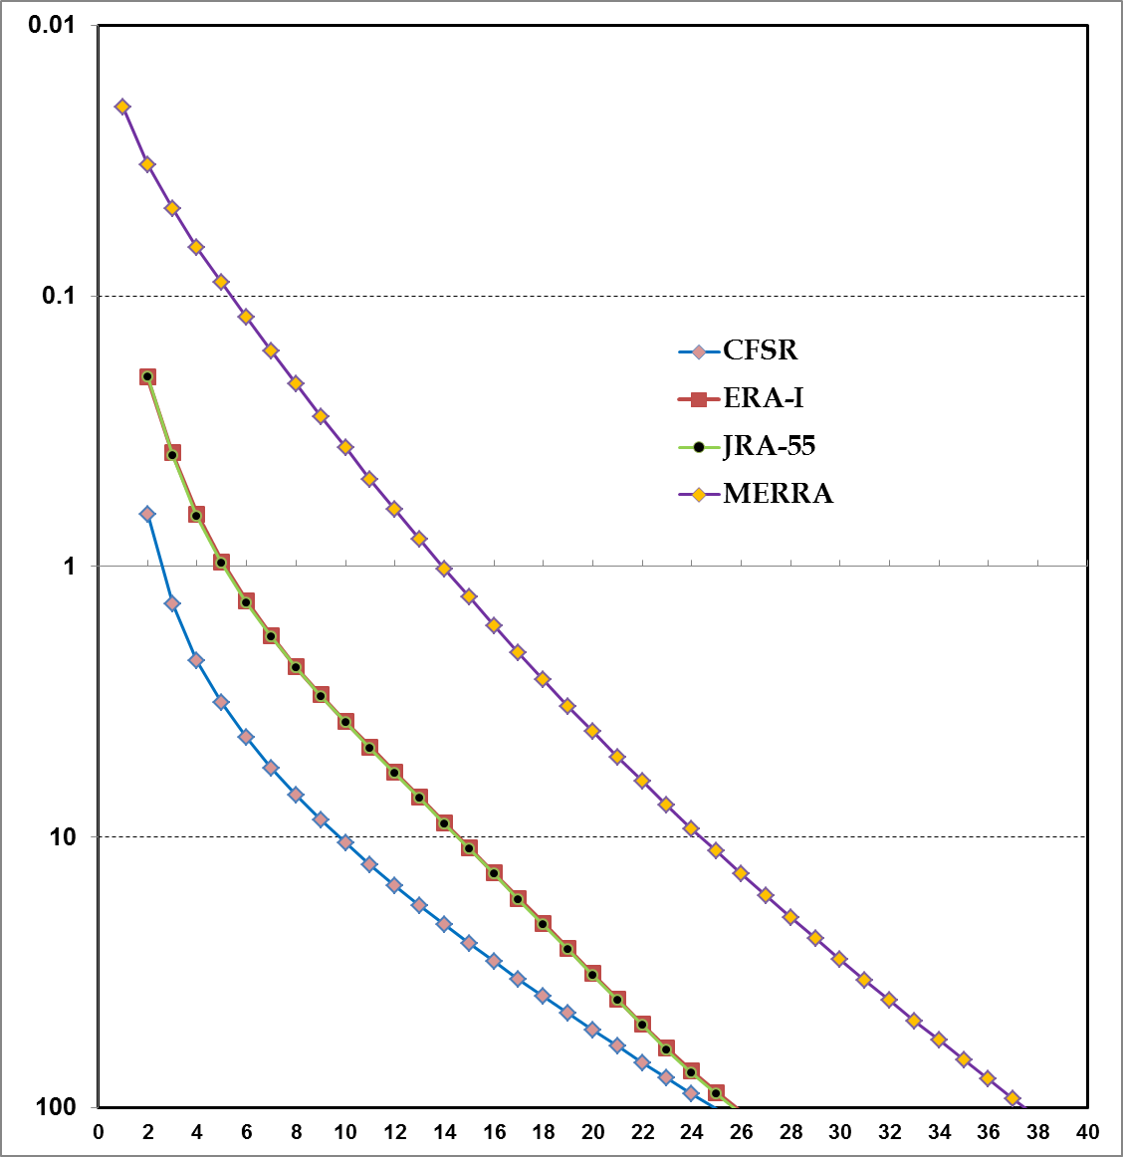
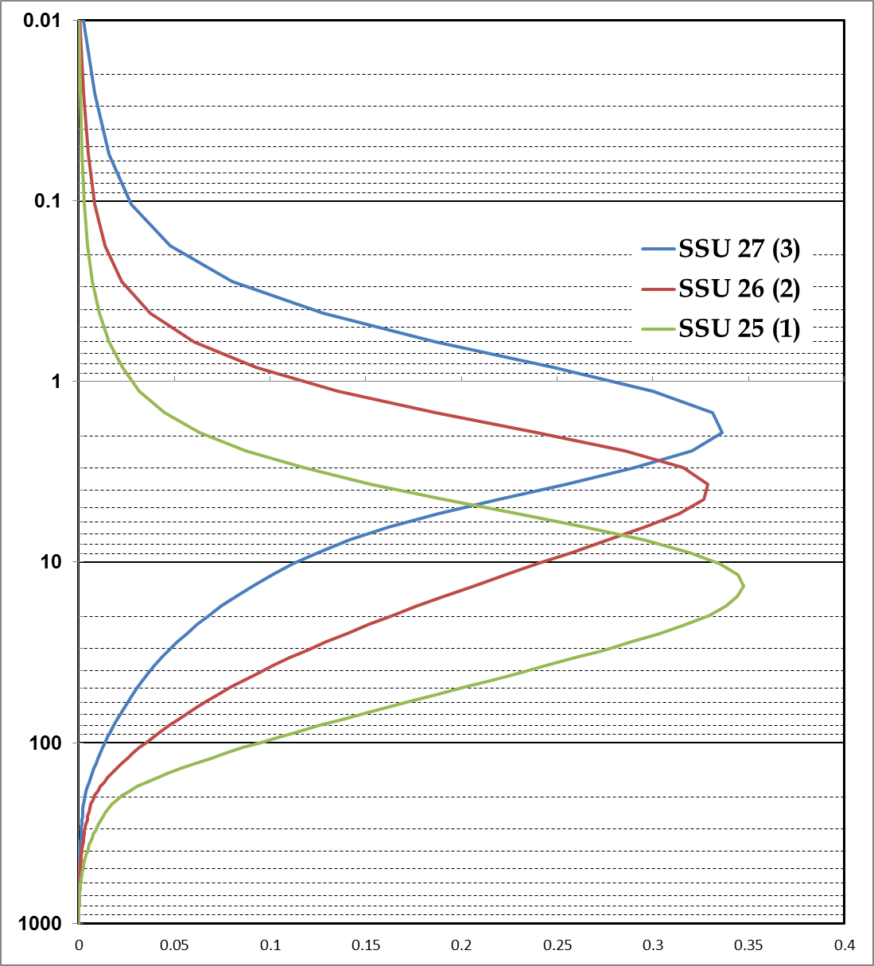
Reanalyses Model Levels
Climate Reanalysis Task Force – November 18, 2015

Slide 10
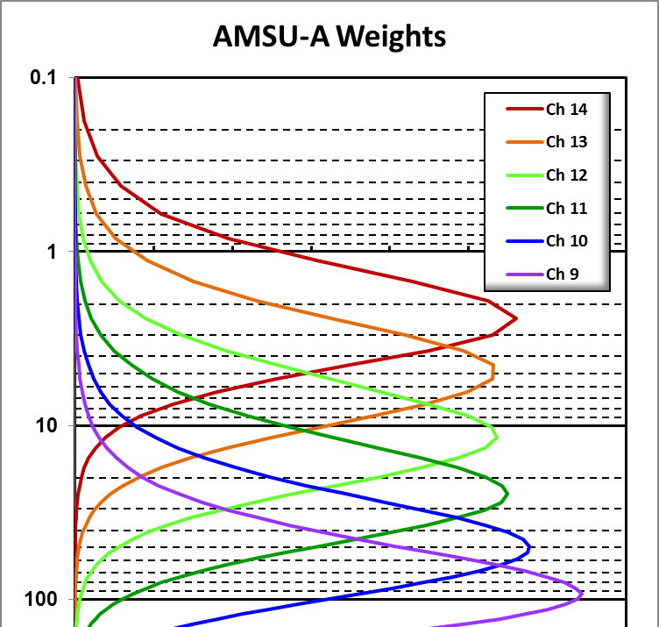
Reanalyses Model Levels
Climate Reanalysis Task Force – November 18, 2015

Slide 11
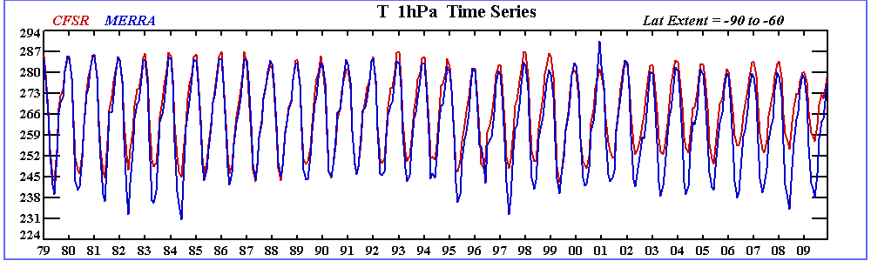
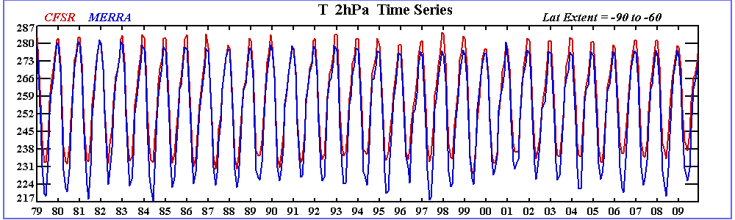
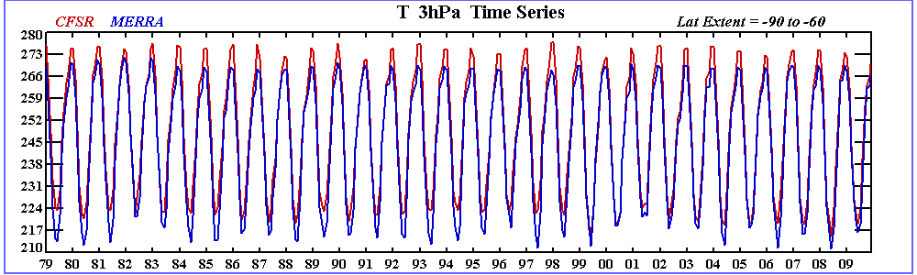
Warm Bias and Small Temp Amp
1 hPa
CFSR has
Small Amp
AMSU ch 14 not assim
Reasonable agreement
2 hPa
CFSR is
warm biased
3 hPa
Climate Reanalysis Task Force – November 18, 2015

Slide 12
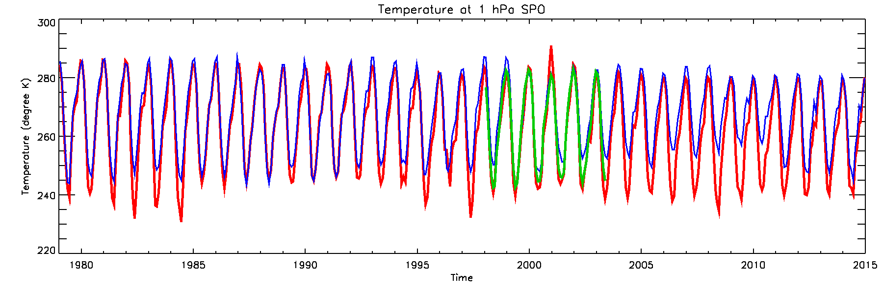
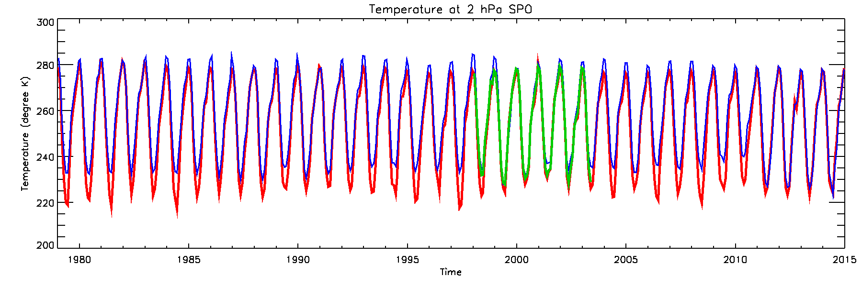
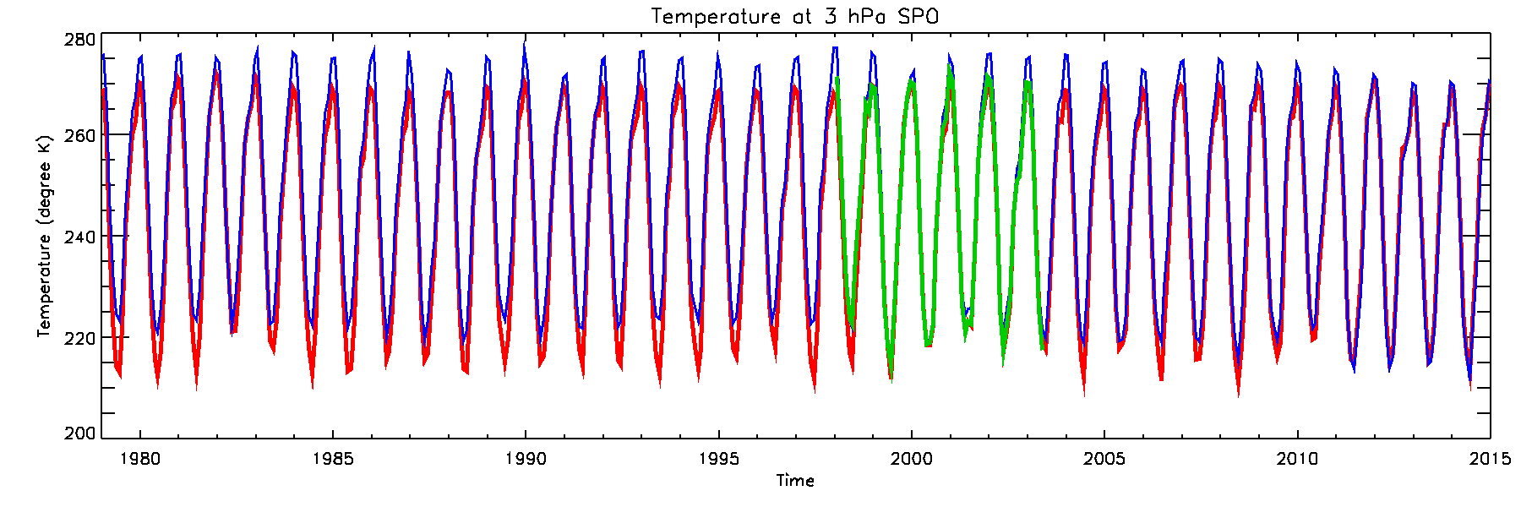
Pr1998o shows improved upper strat temp amplitude
Colors switched
MERRA (red)
CFSR (blue)
1 hPa
pr1998o has
similar amp
as MERRA
2 hPa
pr1998o is
not biased
wrt MERRA
3 hPa

Slide 13
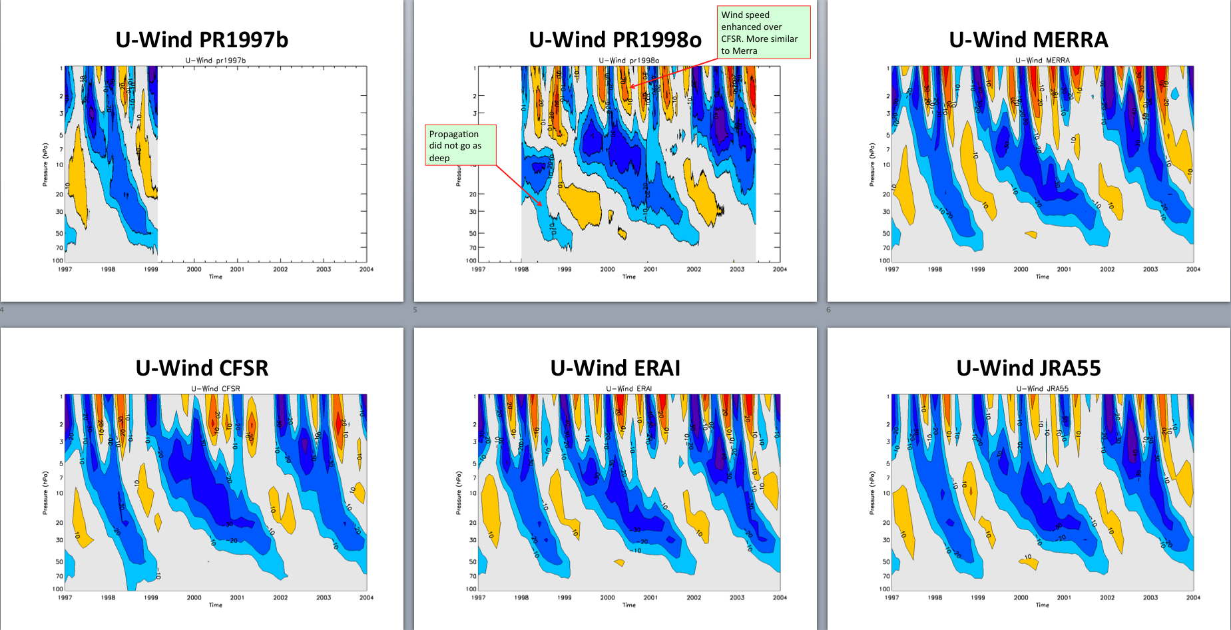
QBO winds
Descending easterlies more like other reanalyses
ERA40 winds
Climate Reanalysis Task Force – November 18, 2015

Slide 14
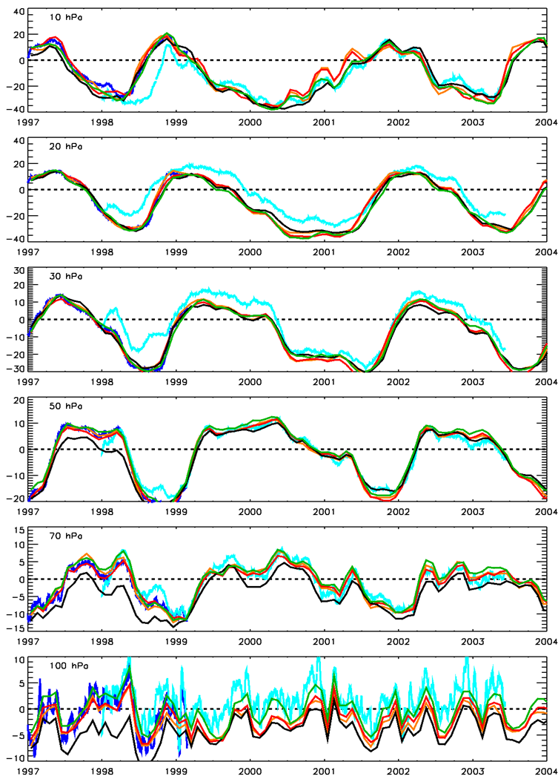
QBO Winds
10 hPa
Legend:
  blue – pr1997b
  cyan – pr1998o
  black - CFSR
  red – ERA-I
  orange– MERRA
  green – JRA-55
20 hPa
Pr1998o
Departs from
Other Reanalyses
30 hPa
50 hPa
Pr1997b
Follows
Other Reanalyses
70 hPa
100 hPa
Climate Reanalysis Task Force – November 18, 2015

Slide 15
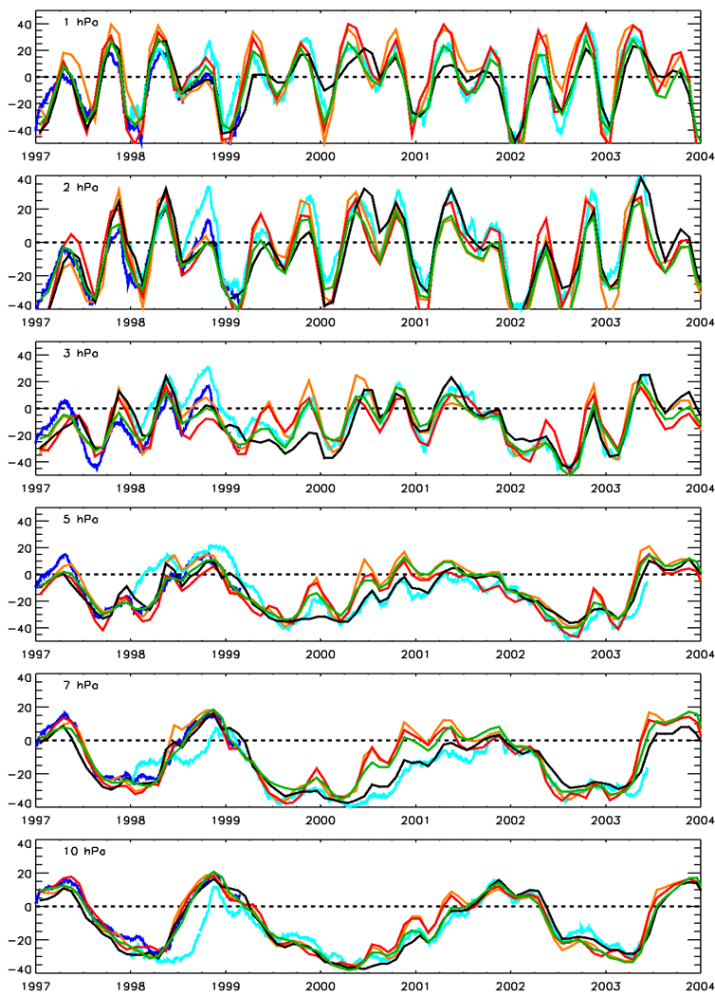
SAO Winds
1 hPa
Legend:
  blue – pr1997b
  cyan – pr1998o
  black - CFSR
  red – ERA-I
  orange– MERRA
  green – JRA-55
2 hPa
Pr1997b
Follows
Other Reanalyses
3 hPa
Pr1998o
Follows
CFSR
Post 1999
5 hPa
7 hPa
CFSR
Uses ERA40 through 1998
10 hPa
Climate Reanalysis Task Force – November 18, 2015

Slide 16
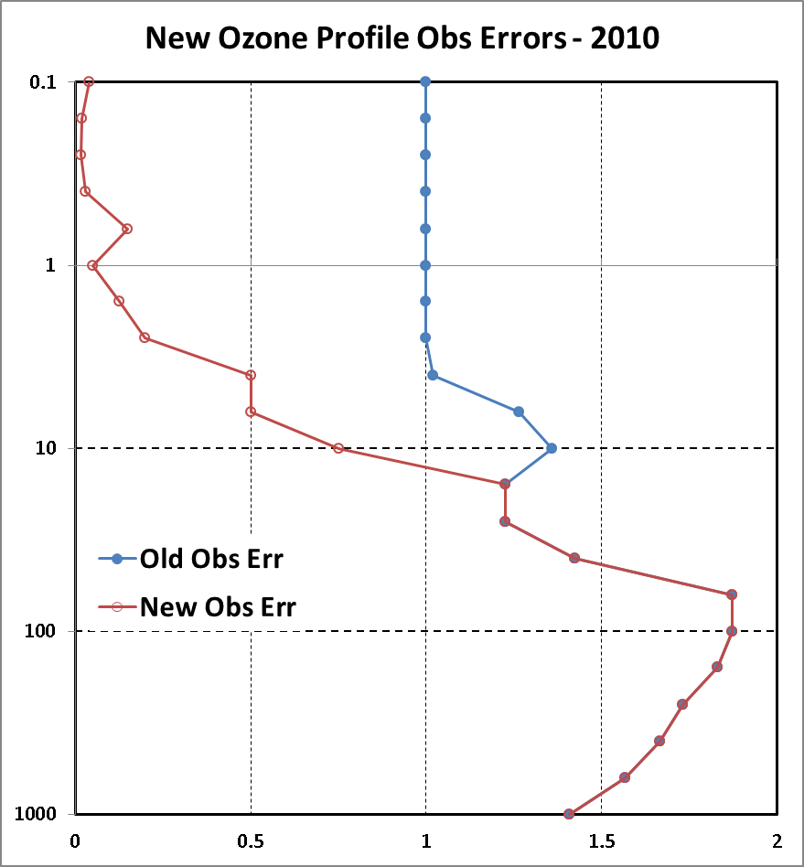
O3mr Seasonal Cycle In Upper Stratosphere
Observation errors were incorrect for most of CFSR
used in CFSR
Climate Reanalysis Task Force – November 18, 2015

Slide 17
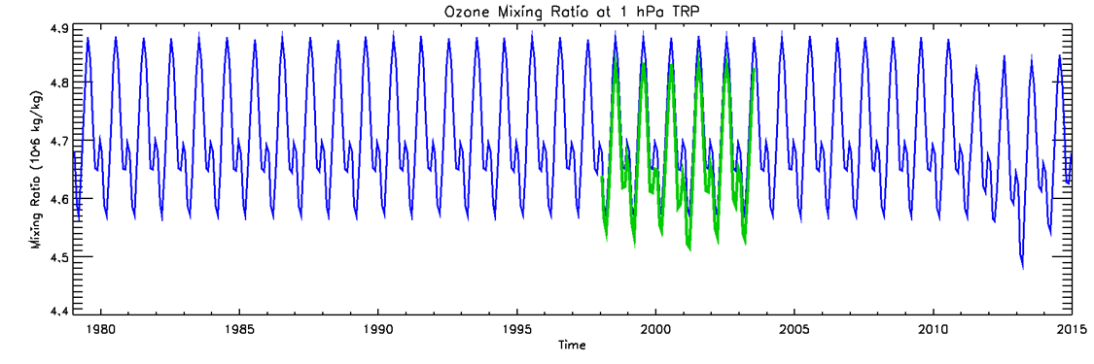
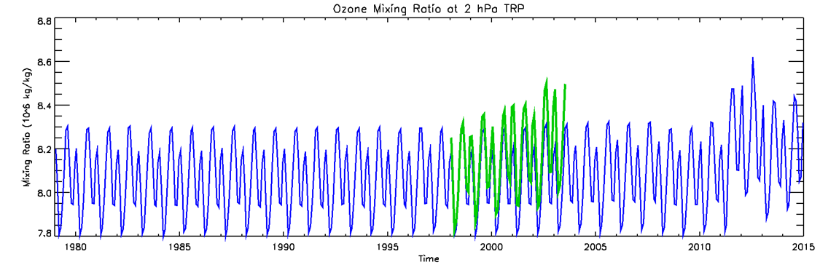
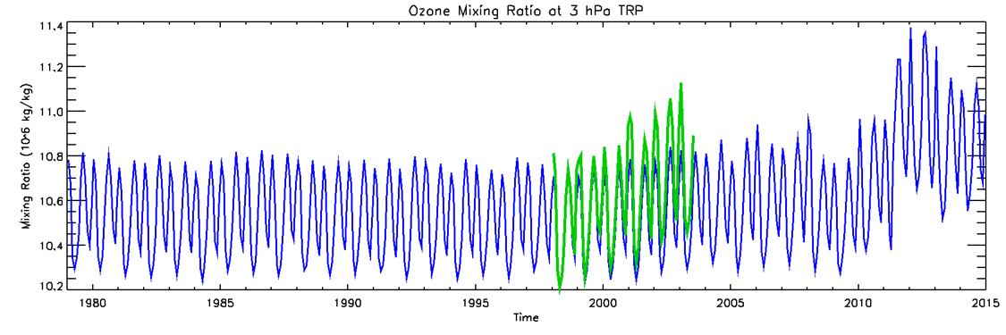
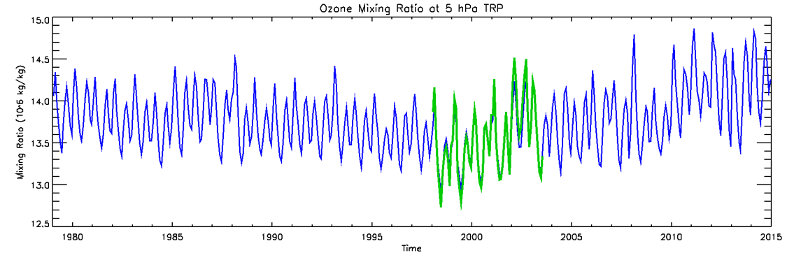
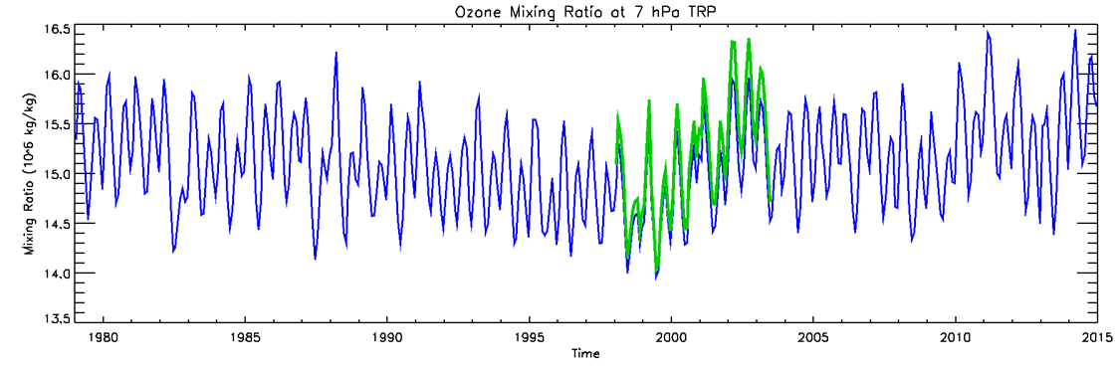
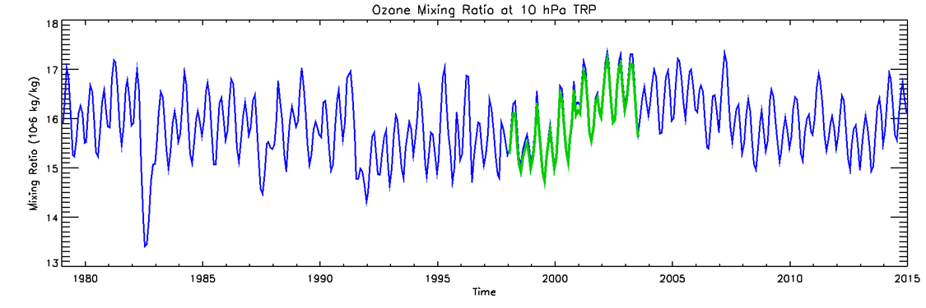
O3mr Seasonal Cycle In Upper Stratosphere
10S-10N
1 hPa of pr1998o remains unchanged
No inter-annual variability
In CFSR
2 and 3 hPa of pr1998o show similar trend as in 5, 7, and 10 hPa.
Inter-annual variability
In both CFSR
And pr1998o
Obs Errors changed in 2010
Blue is CFSR
Green is pr1998o
CFSR and test run only assimilate SBUV/2 o3mr.
Climate Reanalysis Task Force – November 18, 2015

Slide 18
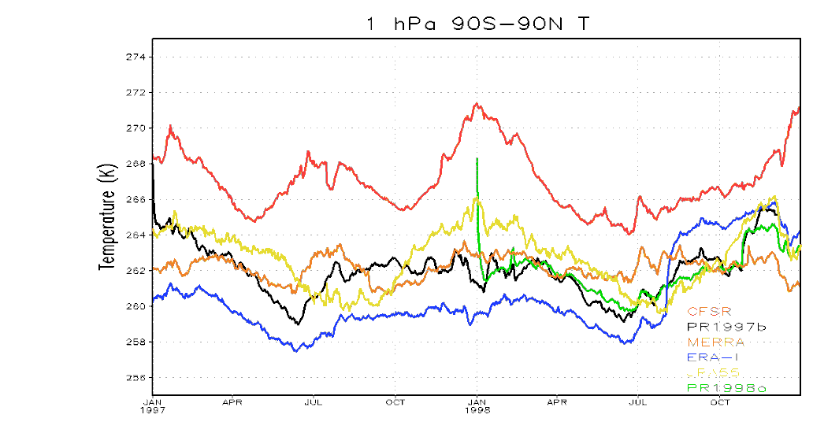
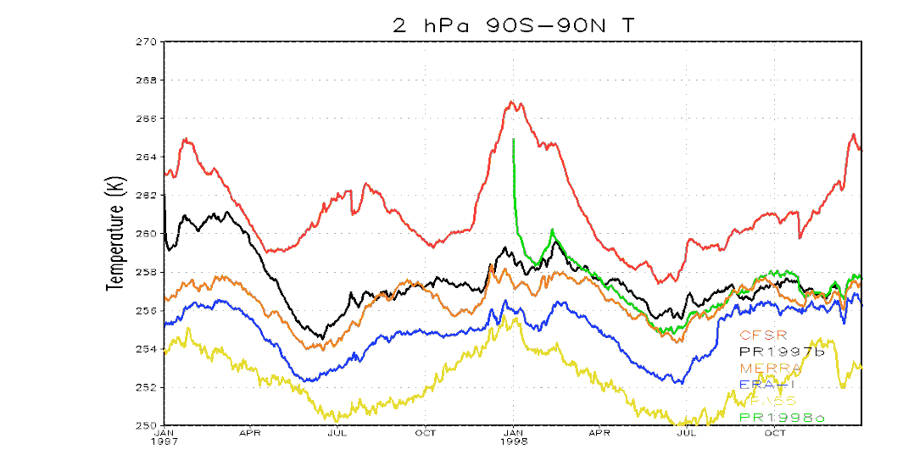
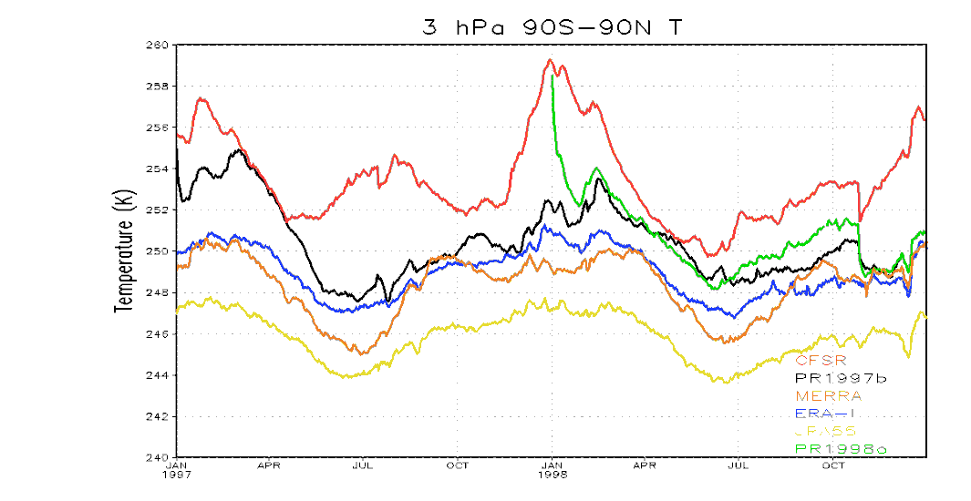
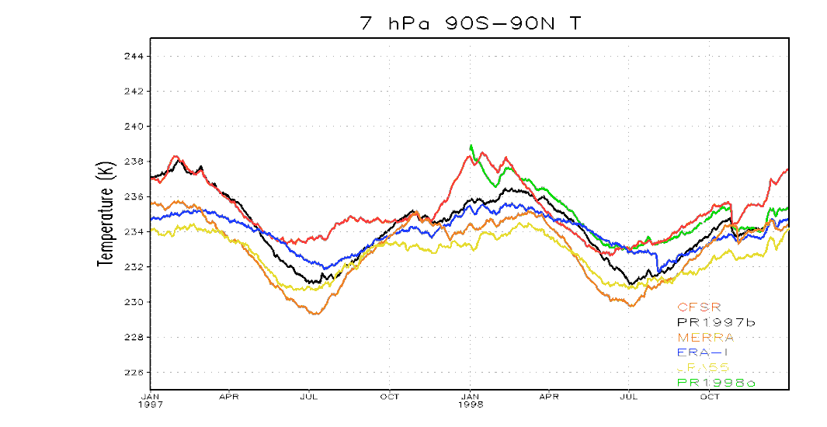
Global Mean Temperatures – Transition from SSU to AMSU
ERA-I
Switch
CFSR Warm
CFSR Warm
ERA-I cool
JRA-55 cool
CFSR Warm
JRA-55 cool

Slide 19
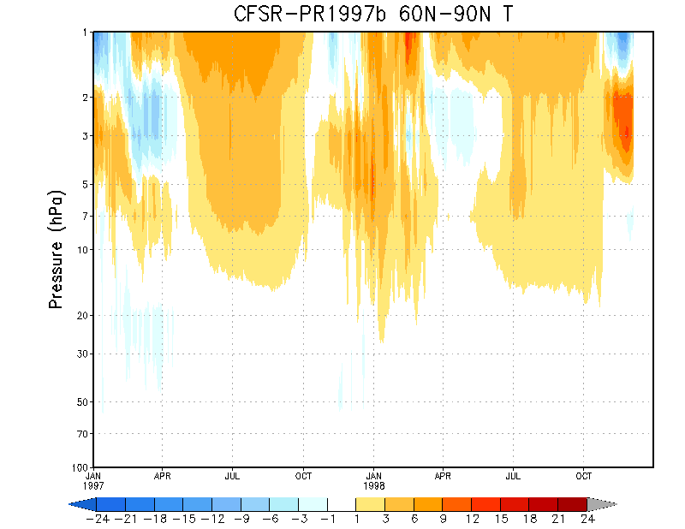
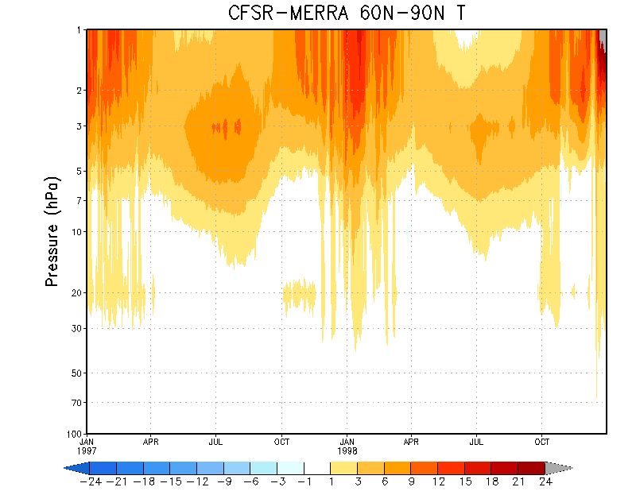
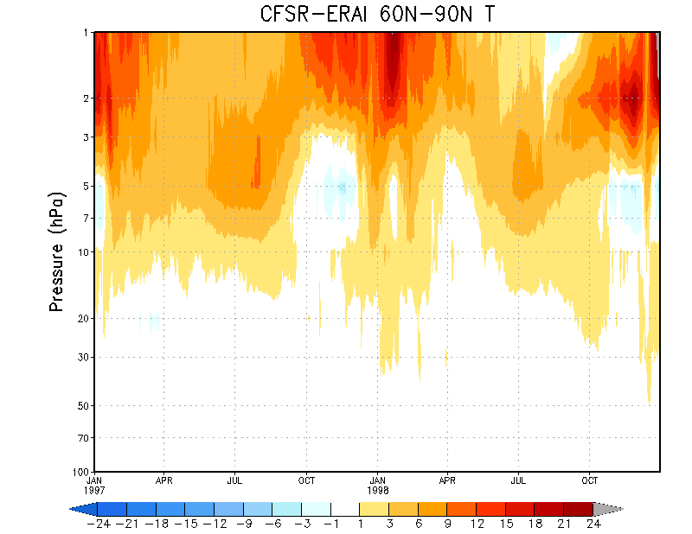
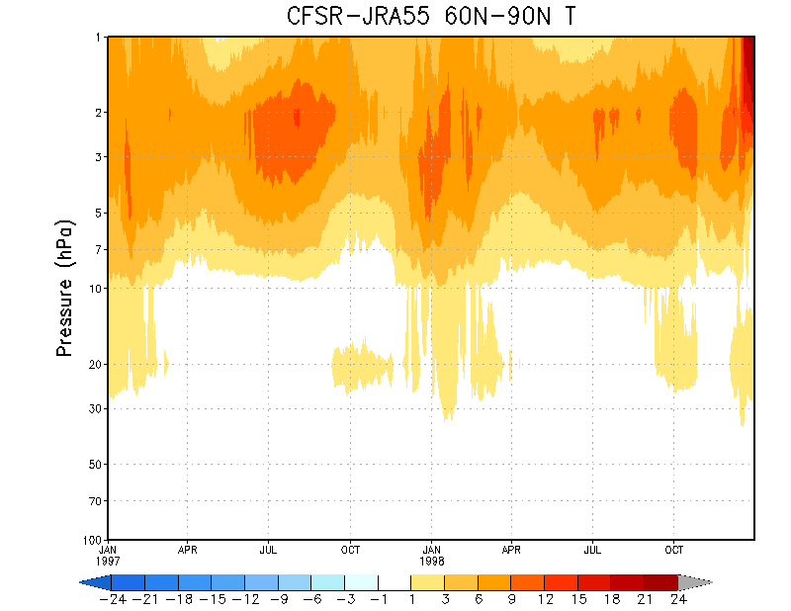
N Polar Mean Temperatures : CFSR - Reanalyses
1997
1998
1999
Climate Reanalysis Task Force – November 18, 2015

Slide 20
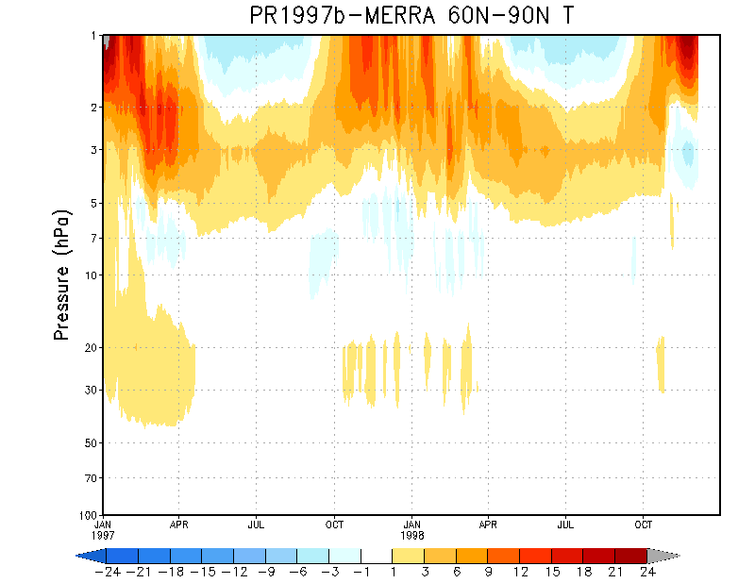
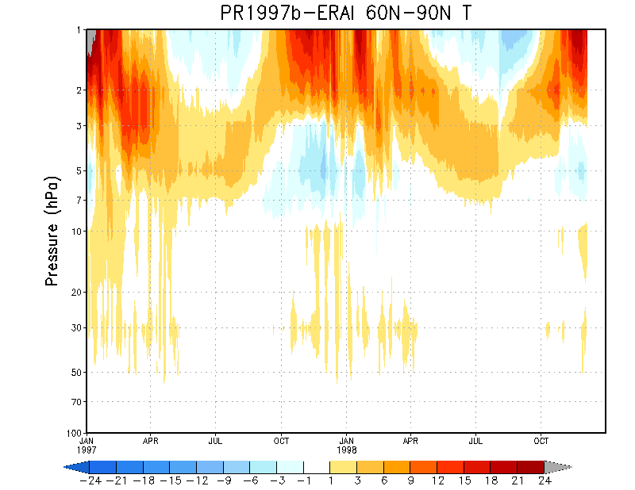
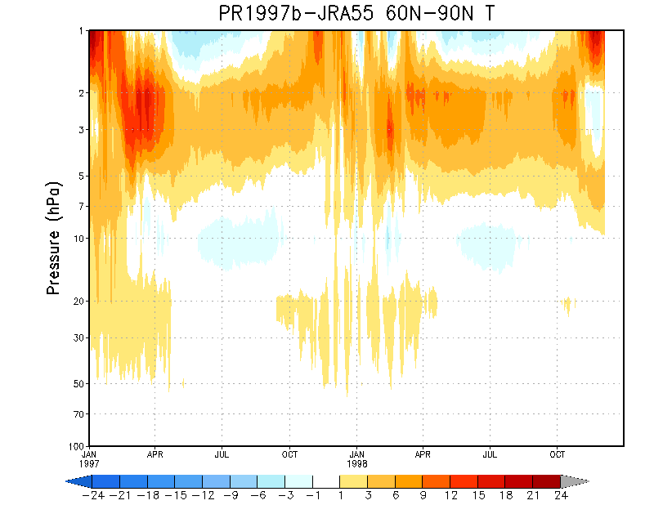
N Polar Mean Temperatures : pr1997b - Reanalyses
1997
1998
1999
Climate Reanalysis Task Force – November 18, 2015

Slide 21
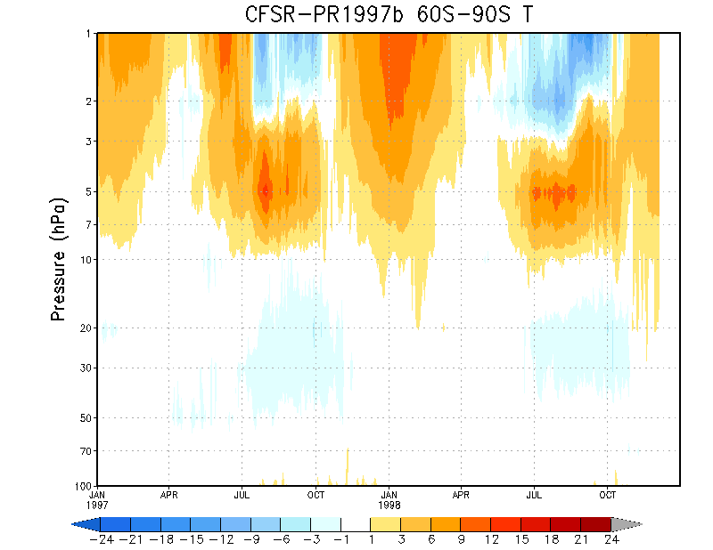
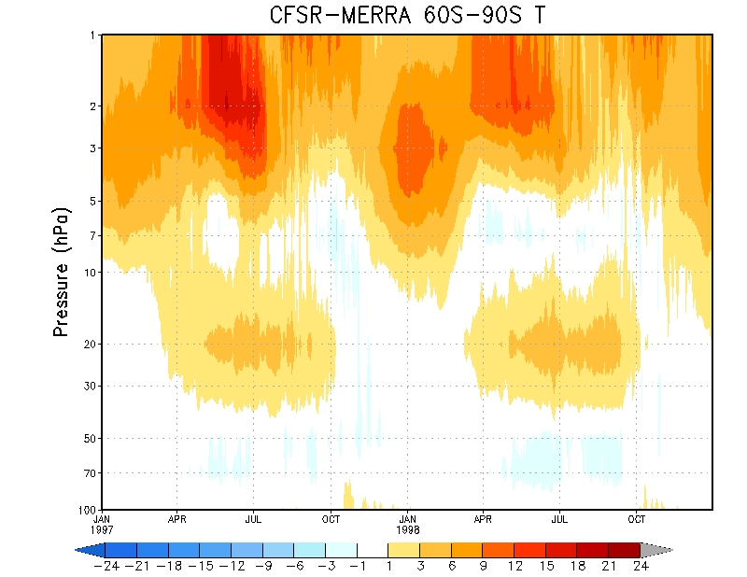
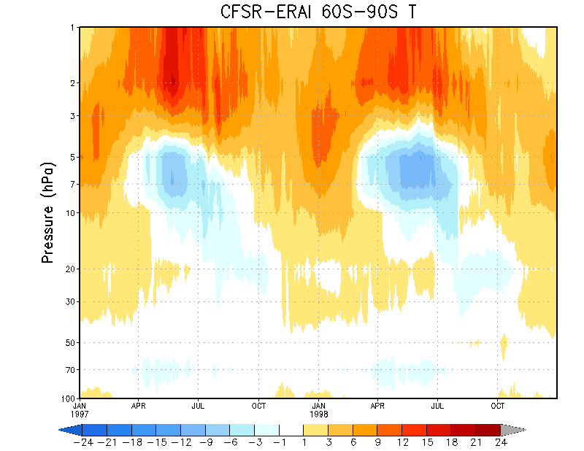
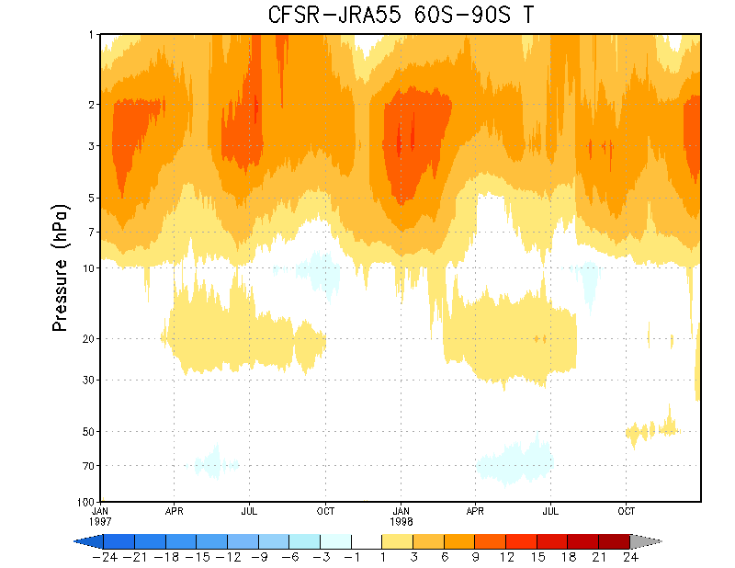
S Polar Mean Temperatures : CFSR - Reanalyses
1997
1998
1999
Climate Reanalysis Task Force – November 18, 2015

Slide 22
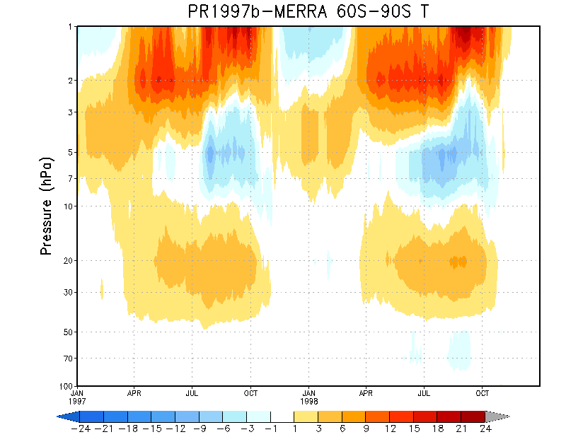
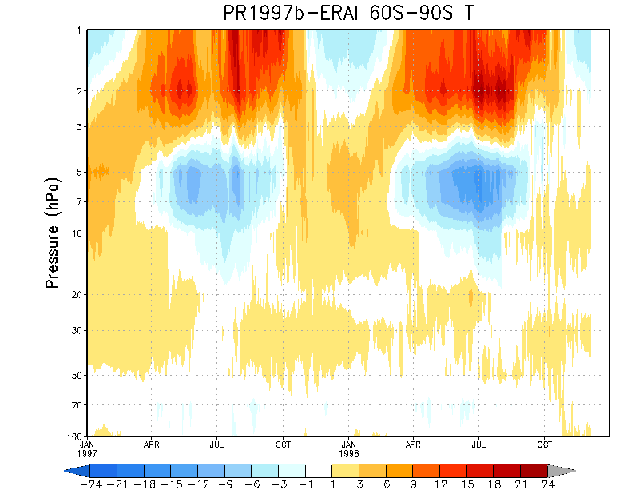
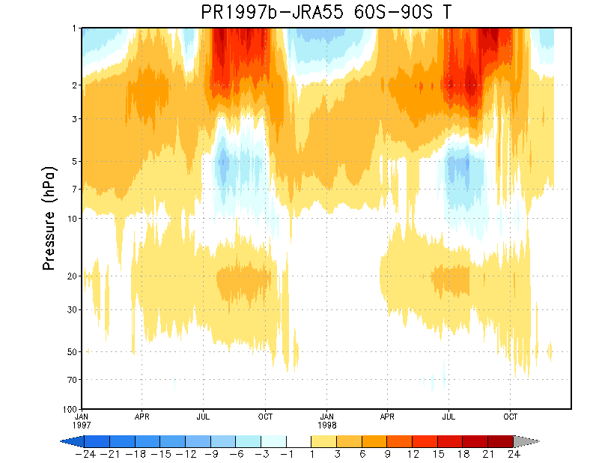
S Polar Mean Temperatures : pr1997b - Reanalyses
1997
1998
1999
Climate Reanalysis Task Force – November 18, 2015

Slide 23

Temperature Comparison : pr1997b and pr1998o
EnKF 3DVar
Pr1998o warmer than pr1997b
Difference is smaller in ATOVS period
Climate Reanalysis Task Force – November 18, 2015

Slide 24

Temperature Comparison : pr1997b and pr1998o
EnKF 3DVar
Difference is smaller in ATOVS period, except at top.
Note: Scale Change from Tropics
Climate Reanalysis Task Force – November 18, 2015

Slide 25

Temperature Comparison : pr1997b and pr1998o
EnKF 3DVar
Ch 3
Differences occur where SSU Channels Peak
Difference is smaller in ATOVS period
Ch 2
Ch 1
Note: Scale Change from Tropics
Climate Reanalysis Task Force – November 18, 2015

Slide 26
Which is better: a look at O-A and O-G
pr1998o (3DVar) vs pr1997b (EnKF)
EnKF hybrid is overall better.
  Improvement occurred greatly in SSU Ch3 (global and tropical); slightly in Ch2; insignificantly in Ch1.
SSU ch3 O-A, although much improved by EnKF hybrid, the residual increments are still sizable.
  little was changed from O-G
N. Polar inconclusive:
Climate Reanalysis Task Force – November 18, 2015

Slide 27


Brightness Temperature Increment
N14
SSU Ch3
O-A (pr1997b) - thick blue
O-G (pr1997b) - thick red
O-A (pr1998o) - thin blue
O-G (pr1998o) - thin red
Global Mean
Global RMS
Climate Reanalysis Task Force – November 18, 2015

Slide 28






Global Mean Increments
N11
N14
SSU Ch3
SSU Ch2
SSU Ch1
Climate Reanalysis Task Force – November 18, 2015

Slide 29
What We’ve Learned
Not bias correcting SSU Ch 3 and AMSU Ch 14 gives better results.
Assimilating AMSU ch 14 improves temp amplitude and removes warm bias.
New ozone obs errors provides better inter-annual variability
  Not true at 1 hPa
  More work to be done – GFS ozone fcst project
EnKF produces better QBO winds than 3DVar
  SAO amplitude is smaller though.
Both 3DVar and EnKF have warm bias during winter months at high latitudes
EnKF has smaller temp increments than 3DVar for SSU ch 3.
Differences between EnKF and 3DVar reduced when use AMSU
Still have jump during transition from SSU to AMSU
Model limitations may prevent any improvements in upper strat.
Climate Reanalysis Task Force – November 18, 2015

Slide 30
What Still Needs to be Done
1980’s where multiple SSU’s impact analysis
QBO in 1980’s
Mitigate SSU to AMSU transition by continuing to assimilate some SSU channels.
Import GFS ozone fcst scheme, check for impacts.
Model improvements that need to happen to improve the stratosphere:
  Raise model top / increase number of model layers above 10 mb
  Install non-orographic gravity wave scheme for fcst model to produce a QBO
  Reduce any model bias in upper strat /lower meso
Climate Reanalysis Task Force – November 18, 2015

