Slide 1
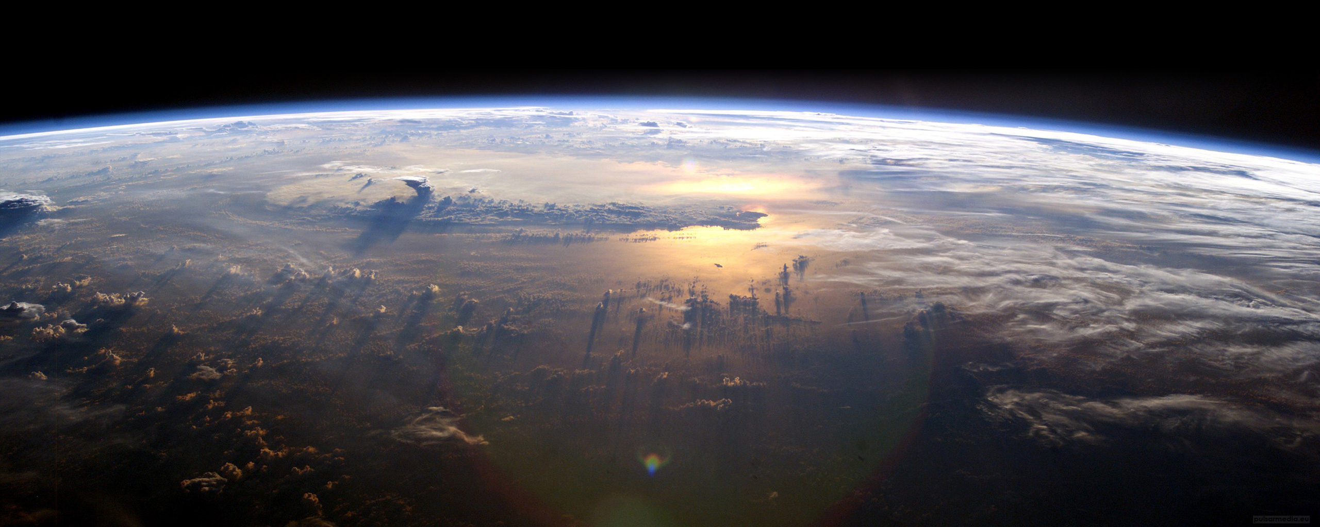


Collaborative REAnalysis Technology Environment – Intercomparison Project (CREATE-IP)
Jerry Potter
Laura Carriere
http://cds.nccs.nasa.gov
Climate Reanalysis Task Force Telecon
April 29, 2015
NASA Goddard Space Flight Center
Sciences and Exploration Directorate
Computational and Information Sciences and Technology Office

Slide 2

Outline
Rationale for putting reanalysis into the Earth System Grid Federation (ESGF)
  Oriented toward CMIP5
Need for an expanded reanalysis site
  Oriented to wider user base

Slide 3
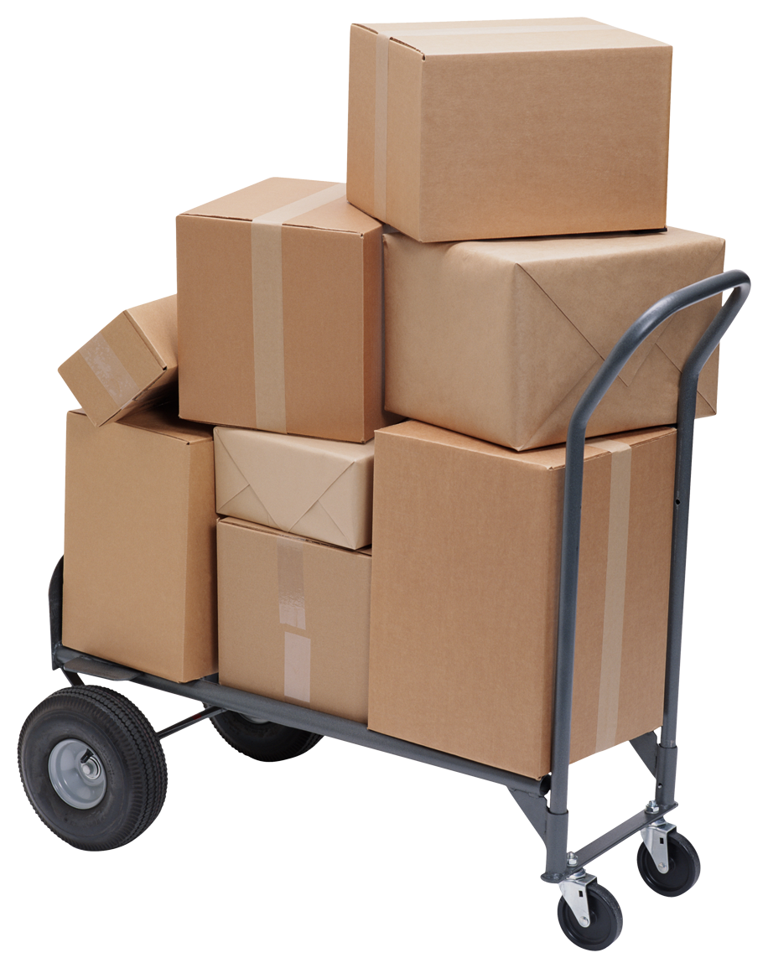
Reanalysis for model intercomparison projects (Ana4mips)
Collection of variables from the global reanalysis efforts that are underway today
Follow-on effort to obs4MIPs, supporting the CMIP model intercomparison and validation exercise.
Each dataset is reformatted similarly to facilitate comparison with each other, observations and with the CMIP models
  Standardization of meta-data in netCDF, global attributes, units, bounds, variable naming etc. i.e. CMOR (CMIP5 standards) processing
Selected variables included directly in obs4MIPs

Slide 4
Currently transitioning to an expanded project
The scope of ana4MIPs is limited
  Variables
  Levels
  Monthly
In order to provide data for a reanalysis intercomparison – new project was envisioned

Slide 5
CREATE-IP
Collaborative REAnalysis Technical Environment – Intercomparison Project
  Designed to serve as a launch point for reanalysis intercomparison
  High frequency data (6h, 3h, 1h) in addition to monthly
  O-A, O-F to address model and observation biases
    Gridded observations used in assimilation
  Enablement of a computational environment
    Working to make storage and computing available for reanalysis intercomparison
    Vetted users will have internal access to their own analytics
    Researching options for providing server side analytics to public users
  Tools for interdisciplinary scientists and ArcGIS
  COG https://www.earthsystemcog.org/projects/create-ip/

Slide 6
Current reanalysis sources converted to the CMIP5 standard format
Name | Source | Time Range | Assimilation | Resolution Available
MERRA | NASA | 1979-present | 3D-VAR, with incremental update | 2/3 lon x1/2 lat deg 3d Analysis and 2d variables; 1.25 deg 3d Diagnostics
ERA-Interim | ECMWF | 1979-present | 4D-VAR | 0.75x0.75
CFSR | NCEP | 1979-present | 3D-VAR | .5x.5 and 2.5x2.5
JRA25 | JMA | 1979-present | 3D-VAR | T106
JRA55 | JMA | 1958-2012 | 4D-VAR | 1.25x1.25
20CR | NOAA/ESRL | 1871-2012 | Ensemble Kalman Filter | 2x2
ERA20C and 20CRv2C – next

Slide 7
Current CREATE-IP monthly averaged data available (CMIP5 list)
Air Temperature | Specific Humidity
Condensed Water Path | Surface Air Pressure
Convective Precipitation | Surface Downward Eastward Wind Stress
Eastward Near-Surface Wind | Surface Downward Northward Wind Stress
Eastward Wind | Surface Downwelling Longwave Radiation
Evaporation | Surface Downwelling Shortwave Radiation
Geopotential Height | Surface Temperature
Ice Water Path | Surface Upward Latent Heat Flux
Near-Surface Air Temperature | Surface Upward Sensible Heat Flux
Near-Surface Wind Speed | Surface Upwelling Longwave Radiation
Northward Near-Surface Wind | Surface Upwelling Shortwave Radiation
Northward Wind | TOA Incident Shortwave Radiation
Precipitation | TOA Outgoing Clear-Sky Longwave Radiation
Relative Humidity | TOA Outgoing Longwave Radiation
Sea Level Pressure | Total Cloud Fraction
Snowfall Flux | Water Vapor Path
 | omega (=dp/dt)

Slide 8
High frequency data will include 1h, 3h, or 6h
3D winds
3D temperature
3D humidity
Surface pressure
Precipitable water
Possibly more to assist in making CFMIP restart files
Saved at all the vertical levels available

Slide 9
Reanalysis intercomparison
Courtesy: Coordinating Earth observation data validation for RE-analysis for CLIMATe ServiceS – (Core Climax) – Procedure for comparing reanalyses and comparing reanalyses to assimilated observations and CDRs. 17 July 2014

Slide 10
Examples of reanalysis differences
2010 Russian Heat wave – how well do the reanalyses capture the intense surface drying over Western Russia?
Surface drying/heating in 2 reanalyses
Global precipitation anomaly in 2 reanalyses
AMSU had a significant impact on MERRA but the ECMWF choose not to assimilate that data – because of the impact on precipitation

Slide 11
S-RIP requested reanalysis ozone in ppmv
Notes:
the tropospheric ozone in the chemistry model
that was used to produce the ozone boundary
condition for the JRA-55 has a known bias;
this model bias affected the stratospheric part of
the ozone profile when satellite total ozone
data are used to modify the a priori ozone profile.

Slide 12

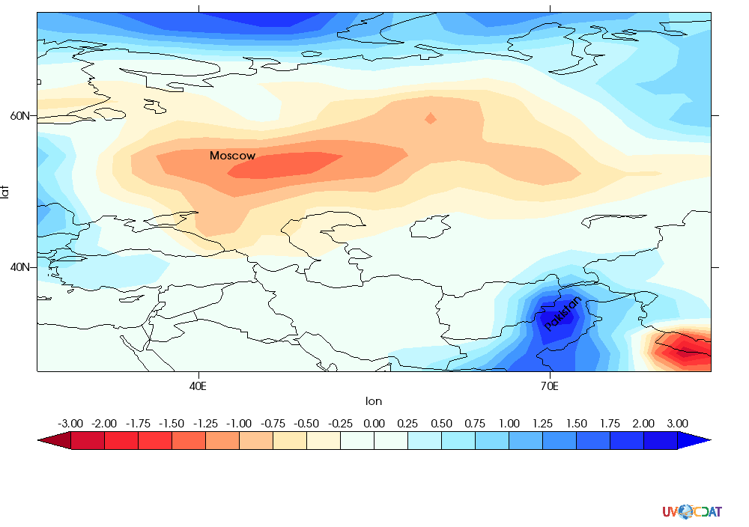
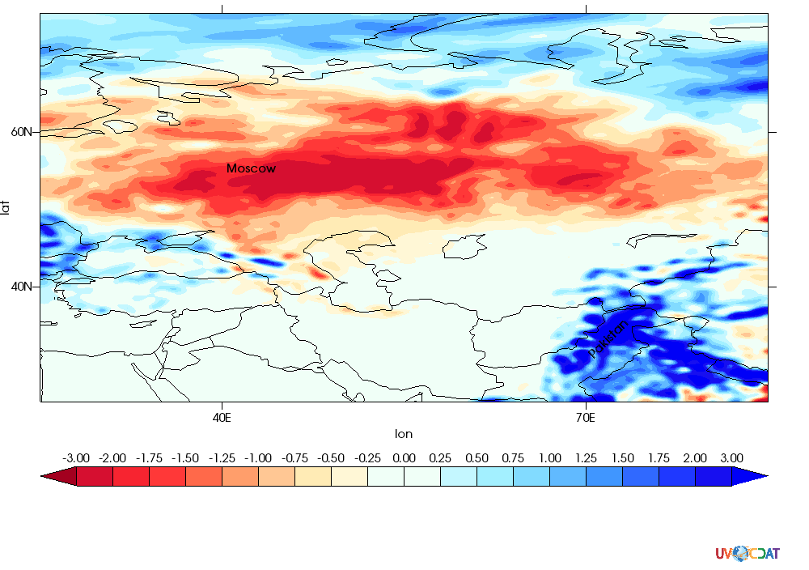
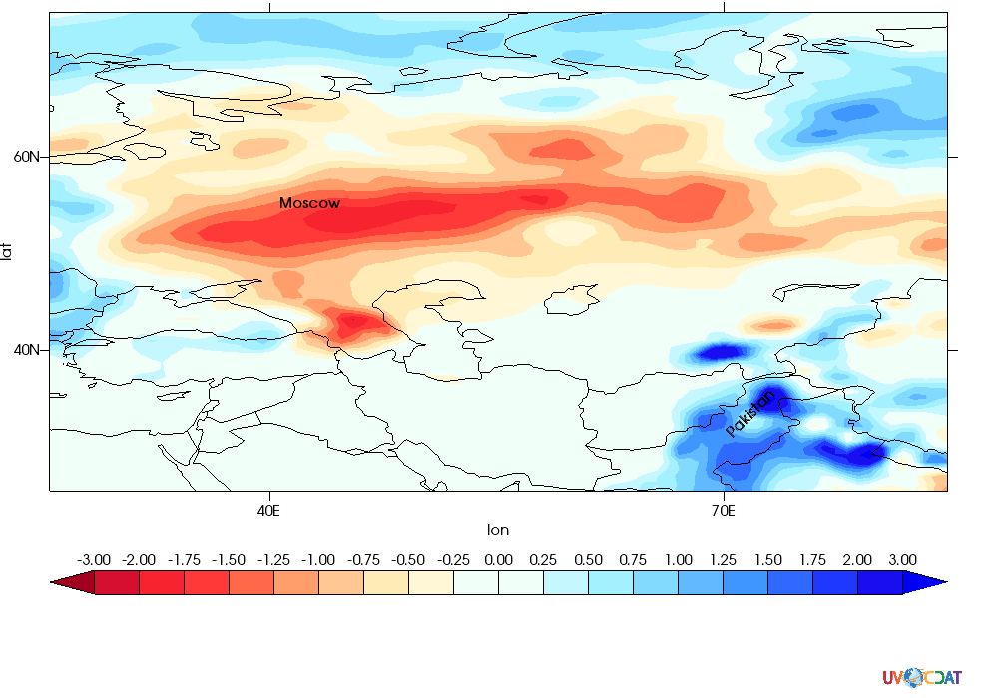
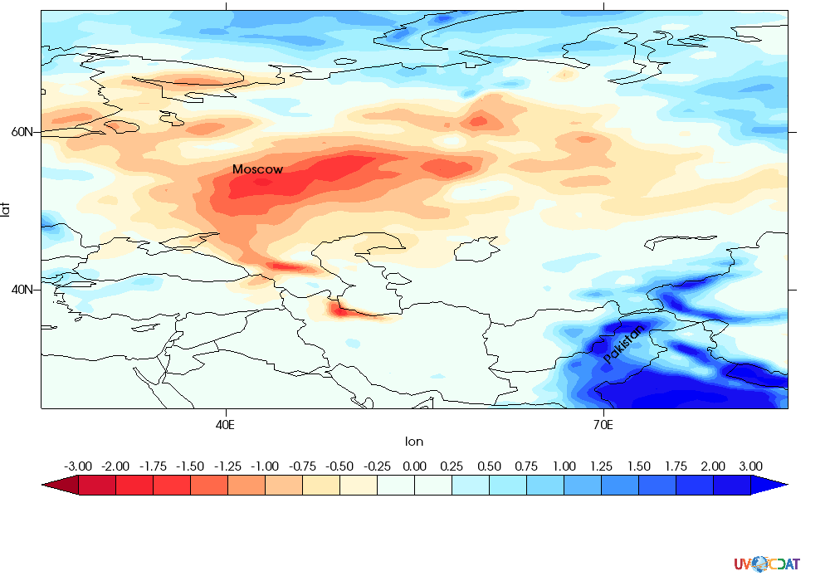
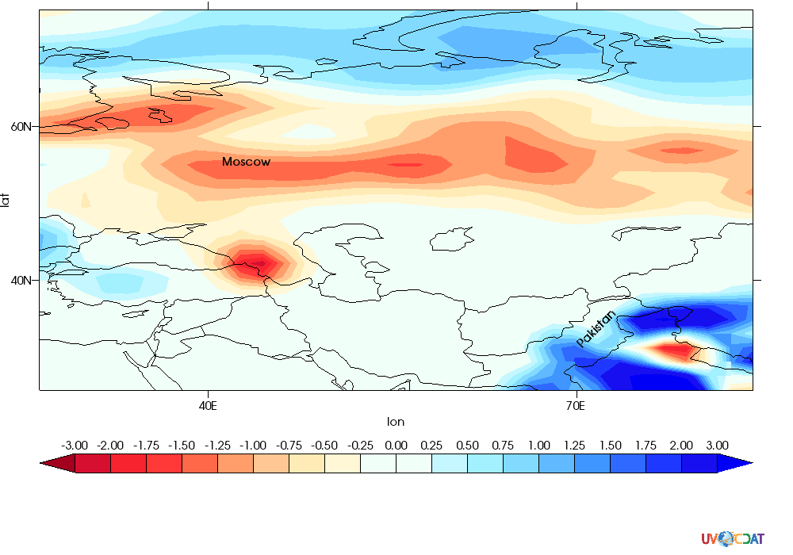
June-July-August Precipitation Anomaly for 2010
GPCP)
CFSR
ECMWF
MERRA
20CR
Notes:
Format differences, data download time 60-80% of scientist’s time

Slide 13
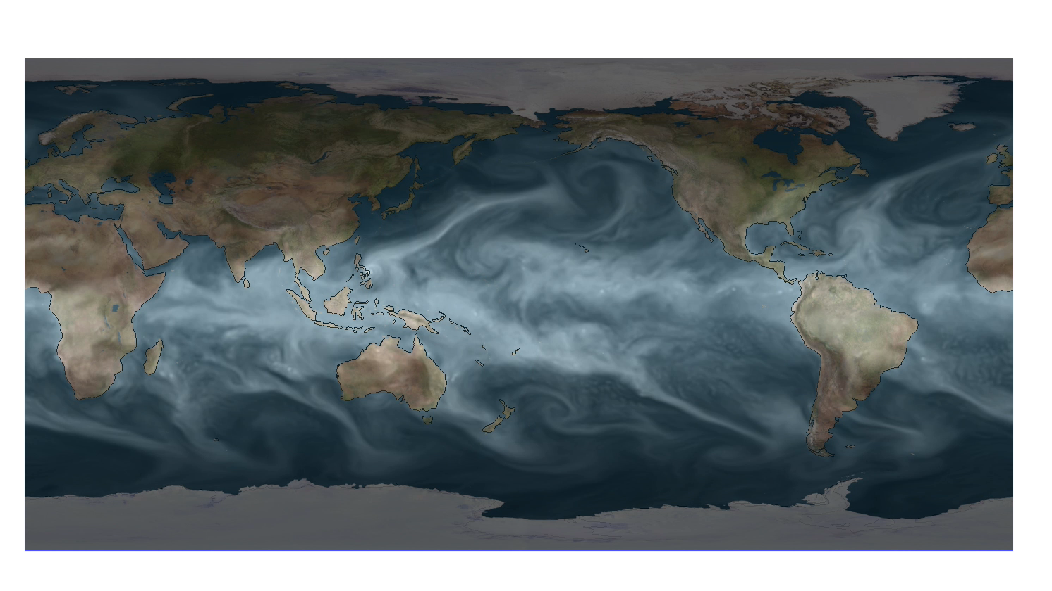
Visualizations available in CREATE-IP
CFSR precipitable water December 8-11, 2014

Slide 14
Conclusions
IPCC has been aided significantly by climate model intercomparison served through ESGF
  CMIP3, CMIP5, CFMIP
  Ensembles
  Successful partly because of data standardization
Adding observations in a similar format in ESGF
  to help with model validation is an import next step – increases usefulness of satellite data
  Ana4mips also includes documentation
Reanalysis in ESGF in similar format
Used by modeling and diagnostic community – ana4MIPs
    Variables not directly observable – winds etc.
New more comprehensive reanalysis intercomparison- CREATE-IP
    Help evaluate observations, perform process studies, help with model biases, identify causes of climate change in the past, help understand uncertainty

