Slide 1
MAPP-CTB 2014 Project
Improving Cloud Microphysics and Their Interactions with Aerosols in the NCEP Global Models
SUNYA: Sarah Lu, Qilong Min, Sheng-Po Chen
NCEP: Yu-Tai Hou, Shrinivas Moorthi, Fanglin Yang, Jun Wang, Partha Bhattacharjee
GSFC: Arlindo da Silva, Donifan Barahona, Anton Darmenov

Slide 2
Presentation outline
Background
CTB Aer-Cld project overview
Ongoing activities and future plan
Concluding remarks

Slide 3
Why include aerosols in the predictive systems?
Improve weather forecasts and climate predictions by taking into account of aerosol effects on radiation and clouds
Improve assimilation of satellite observations by properly accounting for aerosol effects
Provide aerosol (lateral and upper) boundary conditions for regional air quality predictions
Produce quality aerosol information that address societal needs and stakeholder requirements, e.g., UV index, air quality, ocean productivity, visibility, and sea surface temperature retrievals.

Slide 4
Global aerosol prediction at NWP centers
Aerosol modeling, traditionally serving regional air quality and climate communities, has seen rapid development at several operational NWP centers over the last few years
Operational aerosol forecasts are now available from several operational and research NWP centers, including NRL, ECMWF, GMAO, JMA, UKMO, and NCEP.
Aerosol prediction systems are built upon modeling/assimilation methodologies already in place for the meteorological systems.
NRL: NAAPS, driven by NOGAPS
ECMWF: MACC, IFS coupled with LMD
NCEP: NGAC, NEMS GSM coupled with GOCART
UKMO: MetUM with the Hadley Centre dust scheme

Slide 5
Chemical Reanalysis
Monitoring Atmospheric Composition and Climate (MACC) reanalysis at ECMWF
Covering the period 2003-2010
Reanalysis of atmospheric composition (O₃, CO, NO₂, CH₄, aerosol optical depth)
Modern Era Retrospective Analysis (MERRA) Aerosol Reanalysis at GMAO
Feature Description
Model GEOS-5 Earth Modeling System (w/ GOCART)
Driven by QFED daily Biomass Emissions
Aerosol Data Assimilation Local Displacement Ensembles (LDE)
MODIS reflectances
AERONET Calibrated AOD’s (Neural Net)
Stringent cloud screening
Period mid 2002-present (Aqua + Terra)
2000-mid 2002 (Terra only)
Resolution Horizontal: nominally 50 km
Vertical: 72 layers, top ~85 km
Aerosol Species Dust, sea-salt, sulfates, organic & black carbon

Slide 6
Aerosol Direct effect
Solar Radiation Scattered to Space
Solar Radiation Scattered to Space
Mostly
Scattering Aerosol
Mostly
Absorbing Aerosol
Solar Radiation Absorbed
by Aerosol Layer
Atmospheric Radiative Warming
Less Solar Radiation Reaches Surface
Less Solar Radiation Reaches Surface
Surface Radiative Cooling
Surface Radiative Cooling
(e.g. sulfate, sea salt aerosols)
(e.g. black carbon, dust aerosols)
C. A. Randles (GSFC)
Notes:
So as you are all aware, aerosols directly effect climate because they scatter and absorb (mostly) solar radiation (though dust also has longwave absorption). Some aerosols like sulfate and sea salt aerosols mostly scatter, and they have a radiative cooling impact at the top of the atmosphere and at the surface. Absorbing aerosols like black carbon from fossil fuel and biomass burning sources cools the surface, warms the atmosphere, and can have a warming or cooling top-of-the atmosphere effect depending on the brightness of the surface beneath.

Slide 7
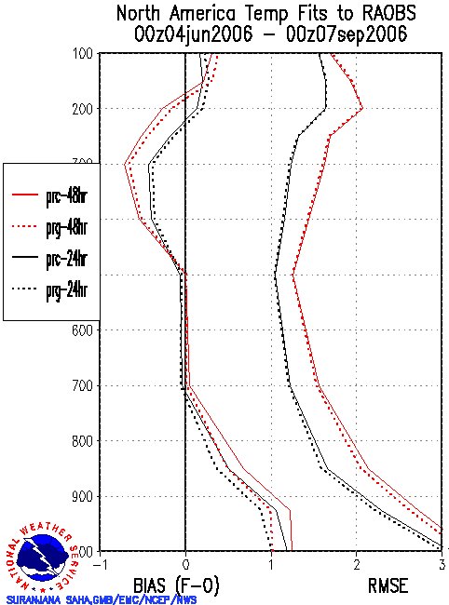
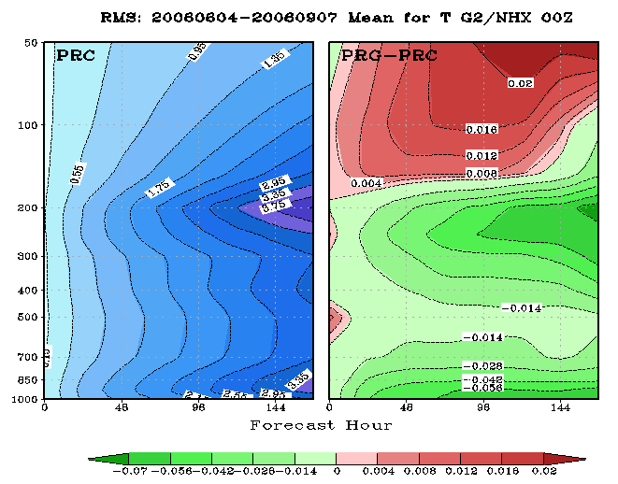
Aerosol-Radiation Feedback: Impact of Aerosols on Weather Forecasts
Verification against analyses and observations indicates a positive impact in temperature forecasts due to realistic time-varying treatment of aerosols.
T126 L64 GFS/GSI# experiments for the 2006 summer period
PRC uses the OPAC climatology (as in the operational applications)
PRG uses the in-line GEOS4-GOCART% dataset (updated every 6 hr)
#: 2008 GFS package
%: In-line GEOS4-GOCART

Slide 8
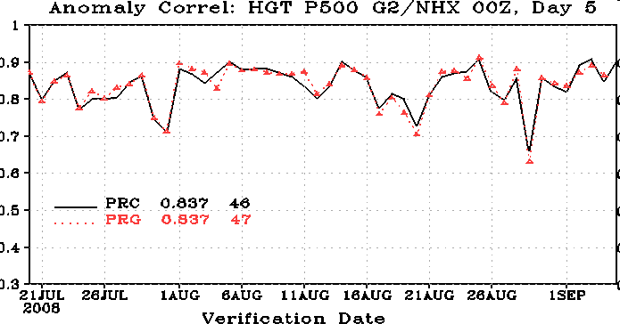
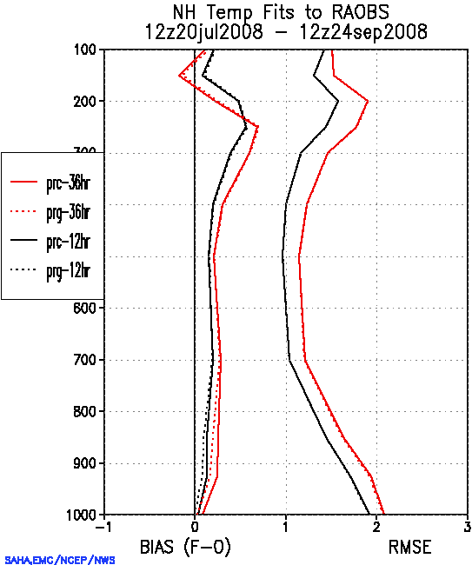
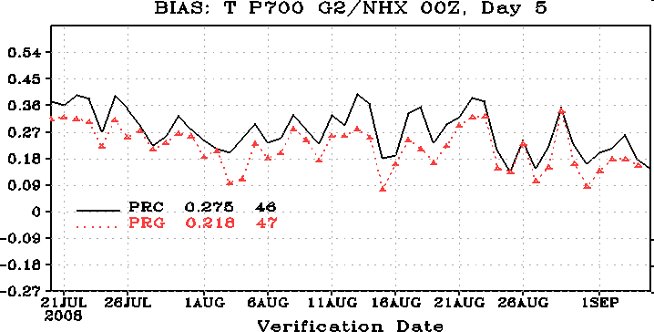
Aerosol-Radiation Feedback: Impact of Aerosols on Weather Forecasts
T382 L64 GFS/GSI# experiments for the 2008 summer period
PRC uses the OPAC climatology (as in the operational applications);
PRG uses the off-line GEOS4-GOCART% monthly dataset
#: 2010 GFS package
%: off-line GEOS4-GOCART

Slide 9
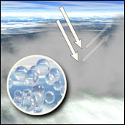
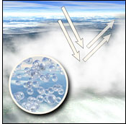
Aerosol INDirect effect
graphic courtesy NASA Earth Observatory
graphic courtesy NASA Earth Observatory
Larger cloud droplets,
less reflective cloud.
Smaller cloud droplets,
more reflective cloud.
Twomey Effect
Less Aerosols
Increased Cooling by Clouds
More Aerosols
Larger cloud droplets,
droplets rain out easier,
clouds dissipate quicker.
Smaller cloud droplets,
droplets rain out less,
longer-lived clouds.
Albrecht Effect
C. A. Randles (GSFC)
Notes:
Aerosols indirectly impact climate through microphysical interactions with clouds -

Slide 10
Global aerosol prediction at NCEP
NEMS GFS Aerosol Component (NGAC)
NCEP’s global in-line aerosol forecast system
Build upon NOAA Environmental Modeling System (NEMS) -- a common modeling framework using Earth System Modeling Framework (ESMF)
Model Configuration:
Resolution: T126 (~ 1°x1°) L64
AGCM: NCEP’s NEMS GFS
Aerosol: GSFC’s GOCART
Provide 5-day dust forecast (at T126) since 2012
Multi-species forecast (Dust, sea-salt, sulfates, organic & black carbon) using satellite-based smoke emissions planned for Q4FY15
In-line chemistry advantage
Consistency: no spatial-temporal interpolation, same physics parameterization
Efficiency: lower overall CPU costs and easier data management
Interaction: Allows for feedback to meteorology

Slide 11
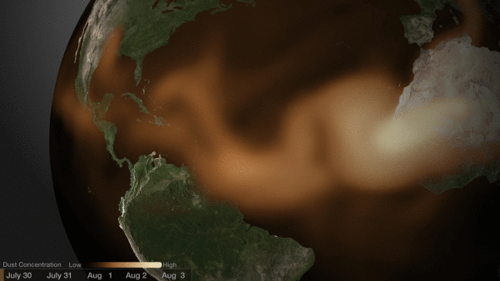
ATM and AER in NOAA Environmental Modeling System
Atmospheric Components
Introduces a prognostic aerosol capability
Provides chemical weather forecasting capability
Provides a first step toward aerosol data assimilation and reanalysis capabilities
Atm Dyncore
GSM
Atm Physics
GFS
Aerosols
GOCART
ESMF Coupler linking GFS physics and GOCART
Massive dust storm sweeps over Atlantic, reported by NBC on July 31, 2013.
.

Slide 12
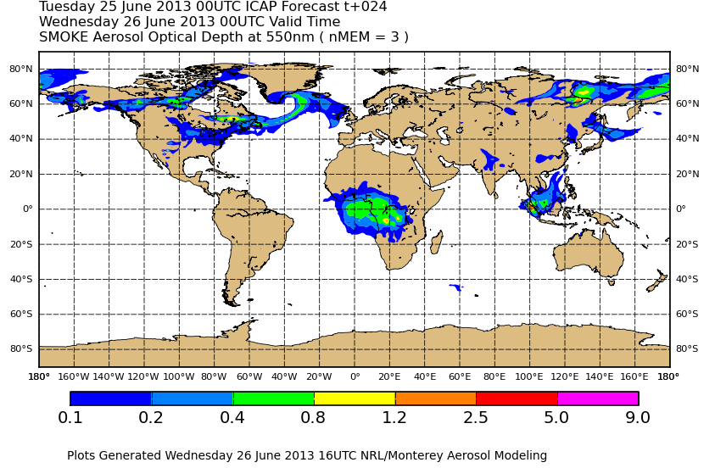
NGAC simulations using NRT smoke emissions
ICAP global ensemble from NRL, ECMWF, GSFC, and JMA
NGAC, using NRT smoke emissions blended from polar orbiting and geostationary satellites

Slide 13
Proposed upgrades in physics suites
Implement a multimodal and double-moment Modal Aerosol Module (MAM-7, Liu et al. 2012) as a potential upgrade to replace the operational GOCART scheme
Implement a double-moment cloud microphysics scheme (Morrison and Gettleman 2008, Barahona et al. 2013) as an option that would replace the operational Zhao-Carr cloud microphysics scheme
Build an interface to link cloud properties and aerosol physicochemical properties. The new cloud microphysics scheme can be driven by aerosol size and composition diagnosed from the operational bulk scheme, and provided by the new modal aerosol scheme.
Consistent coupling of cloud micro and macro physics. Work will be done to ensure the linkage is consistent between new cloud microphysics and the PDF of cloud properties (i.e., cloud fraction and liquid water content for the existing scheme, and sub grid distribution of condensate amount for the experiment schemes developed by the CPT projects).
Extend the unified and flexible model infrastructure used in RRTM radiation package to support the new cloud-aerosol package

Slide 14
The Modal Aerosol Module (MAM)
A modal aerosol module (MAM, Liu et al., 2012) has been developed for the Community Atmosphere Model version 5 (CAM5), the atmospheric component of the Community Earth System Model version 1 (CESM1).
MAM is capable of simulating the aerosol size distribution and both internal and external mixing between aerosol components, treating numerous complicated aerosol processes and aerosol physical, chemical and optical properties in a physically-based manner.
Aerosol components
Sulfate
Ammonium
Black carbon
Dust
Sea salt
Primary organic
Secondary organic
Aerosol modes
Aitken
Accumulation
Primary carbon
Fine sea-salt
Fine dust
Coarse sea salt
Coarse dust
Aerosol microphysics
Nucleation (H2SO4-NH3-H2O and BL nucleation)
Coagulation (intra- and intermodal of AIT, ACC, PCM)
Condensation(H2SO4, NH3 and SOA(g))
Gas-aerosol exchange
A. Darmenov (GSFC)

Slide 15
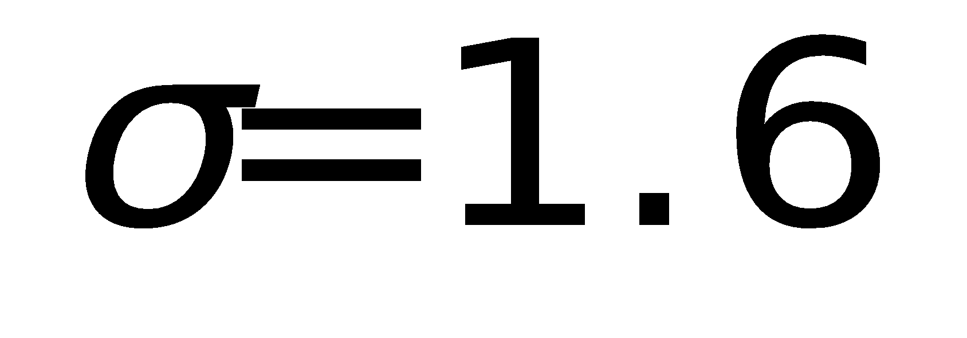
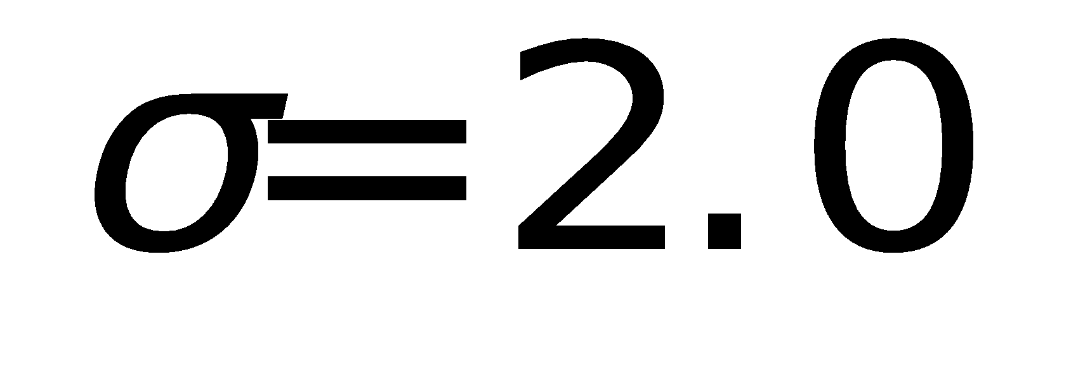
Configuration of MAM7
Aitken
number
water
sulfate
ammonium
secondary OM
sea salt
Accumulation
number
water
sulfate
ammonium
secondary OM
hydrophobic OM
black carbon
sea salt
Fine Dust
number
water
dust
sulfate
ammonium
Fine Sea Salt
number
water
sea salt
sulfate
ammonium
coagulation and
condensation
Two attachment states:
a) interstitial - suspended in (clear or cloudy) air
b) cloud-borne - attached to / contained within stratiform cloud droplets (AP in convective cloud droplet are not treated explicitly)
aged to the accumulation mode due to condensation of H2SO4, NH3 and SOA(gas)
Primary Carbon
number
water
hydrophobic OM
black carbon
Coarse Dust
number
water
dust
sulfate
ammonium
Coarse Sea Salt
number
water
sea salt
sulfate
ammonium
A. Darmenov (GSFC)

Slide 16
New Cloud Microphysics in GEOS-5
 | Current microphysics | New microphysics
Cloud Type | Large scale (stratus, anvils and cirrus) | Convective and Large Scale
Moments | One | Two
Species | Mass of ice and liquid | Mass and number of ice and liquid
Ice-liquid Partitioning | Prescribed as a function of Temperature | Determined by the microphysics
Droplet activation | Not available | Explicit, linked to the aerosol
Ice nucleation | Not available | Explicit, Linked to the aerosol
Subgrid scale variability | Only total water | Total water, liquid, and vertical velocity
Barahona, D., Molod, A., Bacmeister, J., Nenes, A., Gettelman, A., Morrison, H., Phillips, V., and Eichmann, A.: Development of two-moment cloud microphysics for liquid and ice within the NASA Goddard Earth Observing System Model (GEOS-5), Geosci. Model Dev., 7, 1733-1766, doi:10.5194/gmd-7-1733-2014, 2014.

Slide 17
Two-Moment Cloud Microphysics
Convection (Barahona et al., 2014)
Semi-prognostic microphysics: Aerosol affect
rain formation and phase partitioning but not cloud development (No invigoration effects)
Stratiform (Morrison and Gettleman, 2008)
Fully-prognostic microphysics: Generation of condesate linked to CCN and IN activation
Detrained condensate
Homogeneous freezing
Ice nucleation
Fully prognostic microphysics
Immersion Freezing
Precipitation
Droplet transport
CCN activation
Entrained aerosol
CCN activation
Fully prognostic microphysics
CCN activation
Allows coupling of the aerosol physicochemical properties to cloud formation through CCN and IN activation.
Comprises a new set of balance equations, tracking droplet and ice crystal number concentration besides mass mixing ratios.
D. Borahona (GSFC)

Slide 18
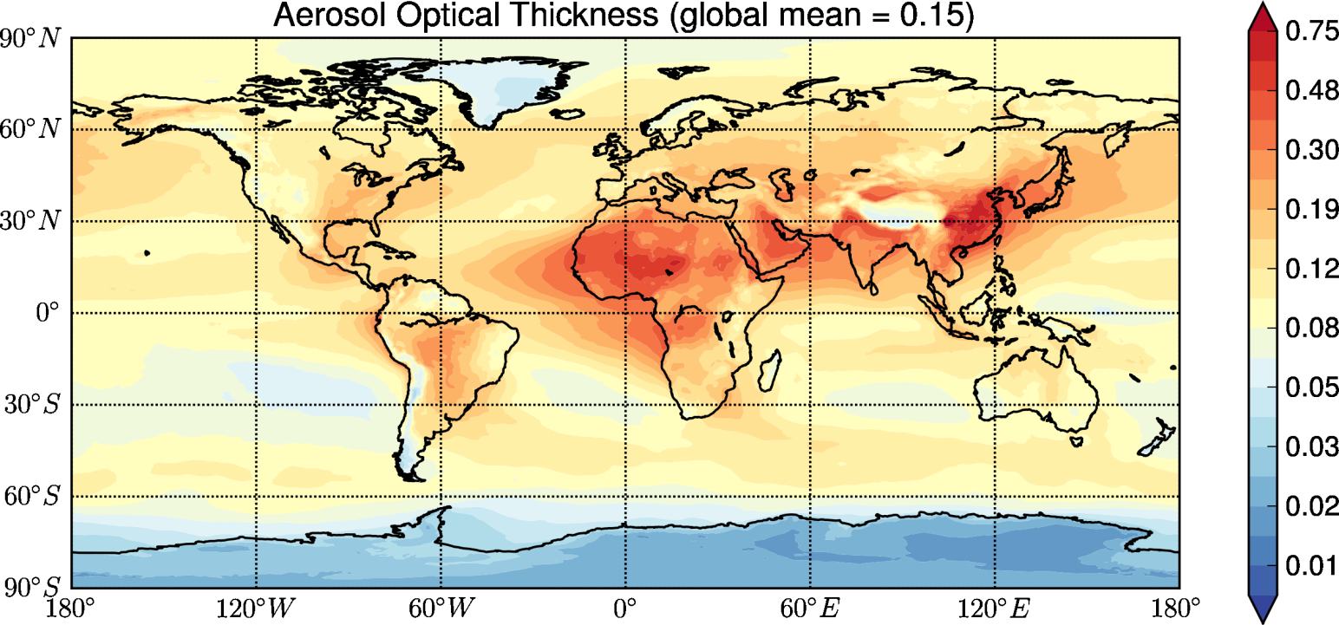
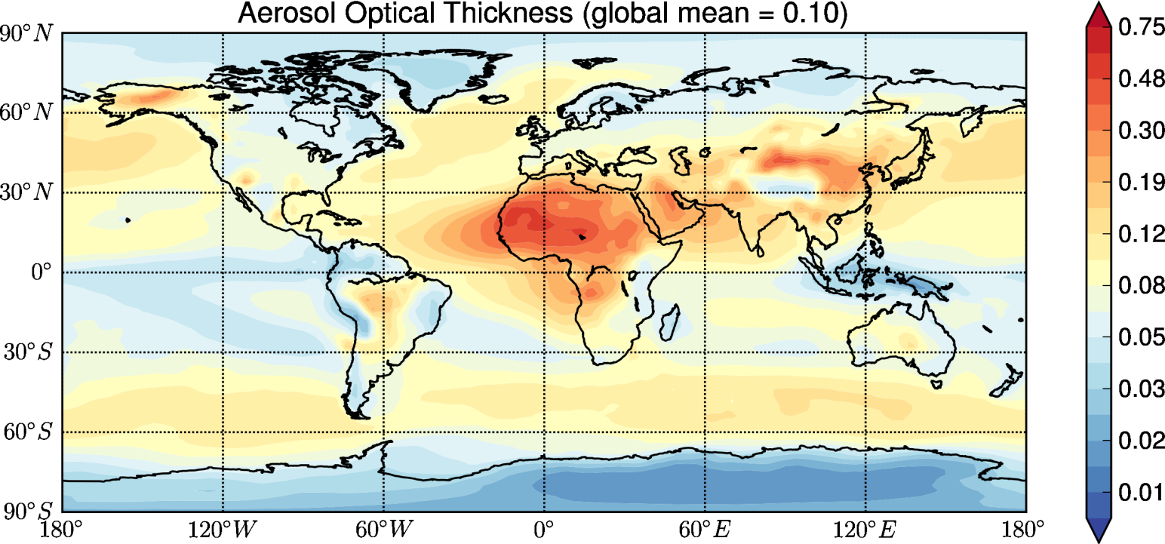
Aerosol Optical Thickness in GEOS-5
A. Darmenov (GSFC)
Annual mean AOT in 2005 from MERRAero (top/left) and MAM7(bottom/right).

Slide 19
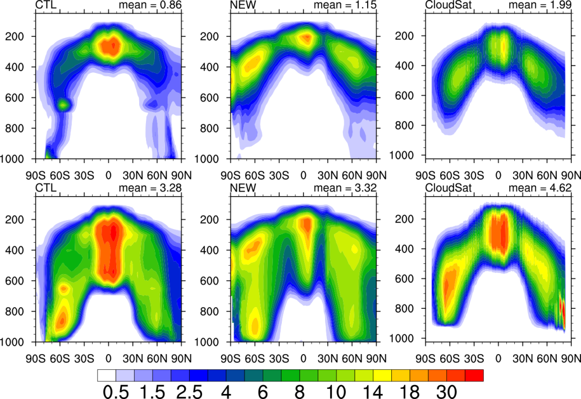
M-G scheme predicts the evolution of the mass and number of ice crystals and cloud droplets, considering several microphysical processes (e.g., hydrometeor collection, condensation/evaporation, freezing, melting, and sedimentation)
Zonal mean non-convective ice water mass mixing ratio
(mg kg−1) (upper panels) and total ice condensate (ice and snow, bottom panels) for non-convective clouds from the CTL and NEW runs and the CloudSat retrieval (Li et al., 2012).
Zonal mean non-convective liquid water mass mixing ratio
(mg kg−1) (upper panels) and total liquid condensate (water and rain, bottom panels) for non-convective clouds from the CTL and NEW runs and the CloudSat retrieval (Li et al., 2014).
D. Borahona (GSFC)

Slide 20
ATM and AER in NOAA Environmental Modeling System
Atmospheric Components
Atm Dyncore
GSM
Atm Physics
GFS
Aerosols
GOCART
Restructure NEMS GFS to couple with the GSFC GEOS5 chemistry package (aerosols, tropospheric chemistry and stratospheric chemistry)
ESMF Coupler linking GFS physics and GOCART
Proposed revision in the CTB Aer-Cld project
Atmospheric Components
Aero-Chem Component
Trop chem*
Atm Dyncore
GSM
Atm Physics
GFS
Bulk Scheme GOCART
Modal Scheme MAM-7
Strat chem*
ESMF Coupler linking GFS physics and Aero-Chem
*: compiled as stub lib on-the-fly since NCEP does not port the ozone chemistry code from GSFC

Slide 21
Adopting GEOS-5 aerosol-cloud package
GSM_Moist
Coupling of Macrophysics and Microphysics
Convective parameterization
Two-moment MG cloud microphysics
RAS V2
PDF-based cloud scheme (SHOC)
Large scale and convective condensation, precipitation, evaporation, and sublimation
Detrained mass fluxes,
Unsaturated downdrafts,
Very simple bulk microphysics
MGMICRO
Microphysical processes for Stratus and Anvil clouds
AER_CLOUD
Cloud droplet activation and Ice nucleation
Aerosol Activation
This project will adopt MAM, MG, and AER_Cloud from GSFC and coordinate with EMC/CPT teams on coupling cloud micro and macro physics
Aerosol Transport (GOCART, MAM-7)

Slide 22
Ongoing activities and future plan
From this CTB project
Improving the representations of cloud microphysics, aerosol processes and aerosol-cloud-radiation interaction in GFS/CFS by adopting GSFC’s physically-based cloud/aerosol package
Going Further
Resources versus complexity: How much complexity is needed to accurately represent the aerosol processes and effectively account for aerosol effects?
Observation-based diagnosis package is needed to examine whether the model with improved aerosol-cloud package better captures the aerosol/cloud properties and the processes relevant to aerosol-cloud-radiation interactions.
Efforts to develop an aerosol data assimilation capability in the hybrid EnKF-GSI system are now underway

Slide 23
Concluding Remarks
Operational global aerosol forecasts are now available at NCEP
Efforts are under way to upgrade aerosol model and improve the aerosol-cloud-radiation interaction (the CTB Aer-Cld project)
Enhanced diagnosis tools are needed to evaluate the physics upgrades
The prognostic aerosol capability provides a first step toward aerosol data assimilation and aerosol reanalysis

Slide 24
Thanks.
Questions and Comments?

